Slide 1


Statistically Significant Discriminative Pattern Search
Hoang-Son Pham¹, Gwendal Virlet²,
Dominique Lavenier², Alexandre Termier²
[1] ICTEAM-Université Catholique de Louvain, Belgium,
[2] Univ Rennes, Inria, CNRS, IRISA
21st International Conference on Big Data Analytics and Knowledge Discovery
August 27, 2019
Notes:
Good afternoon!
Today, I'm happy to introduce to you my PhD thesis.
The topic of the thesis is “Novel pattern mining techniques for genome-wide association studies”.
This research is done under the supervision of Dominique Lavenier and Alexandre Termier
So what is GWAS ?
How it is important in biology

Slide 2
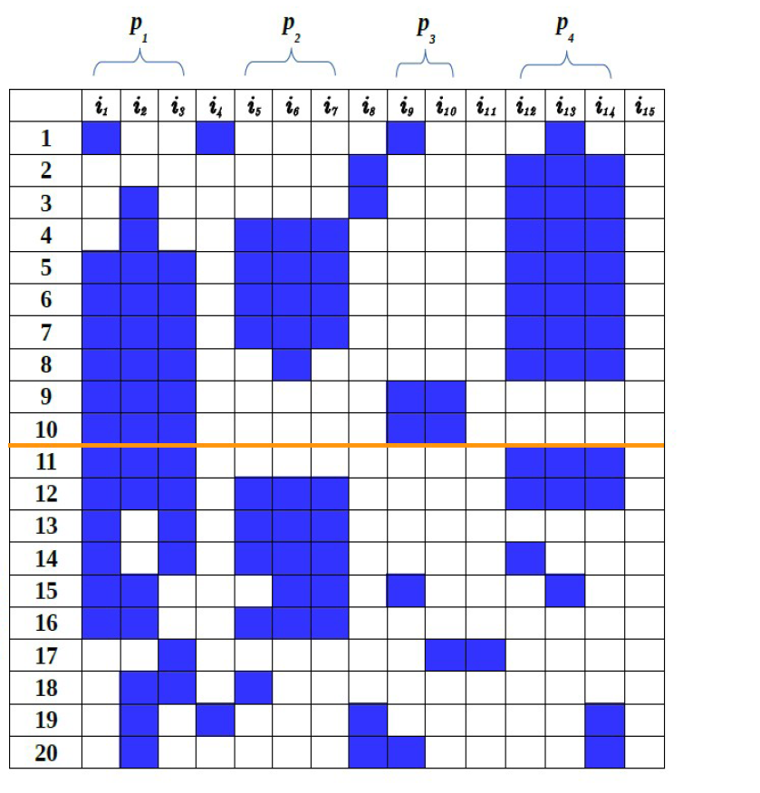

Introduction
Genetic variations
?
{i₁ , i₂ , i₃ } : 6 diseases / 2 normal
{i₅ , i₆ , i₇ } : 4 diseases / 4 normal
{i₁₂ , i₁₃ , i₁₄ } : 7 diseases / 2 normal
HOW ?
- search patterns : data mining
- evaluate quality : statistic
Disease
Normal
Notes:
In the real world, to study the association between SNP combination and diseases.
The SNP are collected from two large groups of individuals. Case group includes people affected by a disease and control group includes healthy people.
And the case/control dataset can be formulated as a matrix.
Where each line of the matrix is a individual and columns are SNPs.
A pattern is a group of SNPs.
How can we search patterns and how to evaluate the quality of the pattern.
The promising approach for searching patterns is data mining (pattern mining techniques). And quality evaluation is done by statistic.

Slide 3
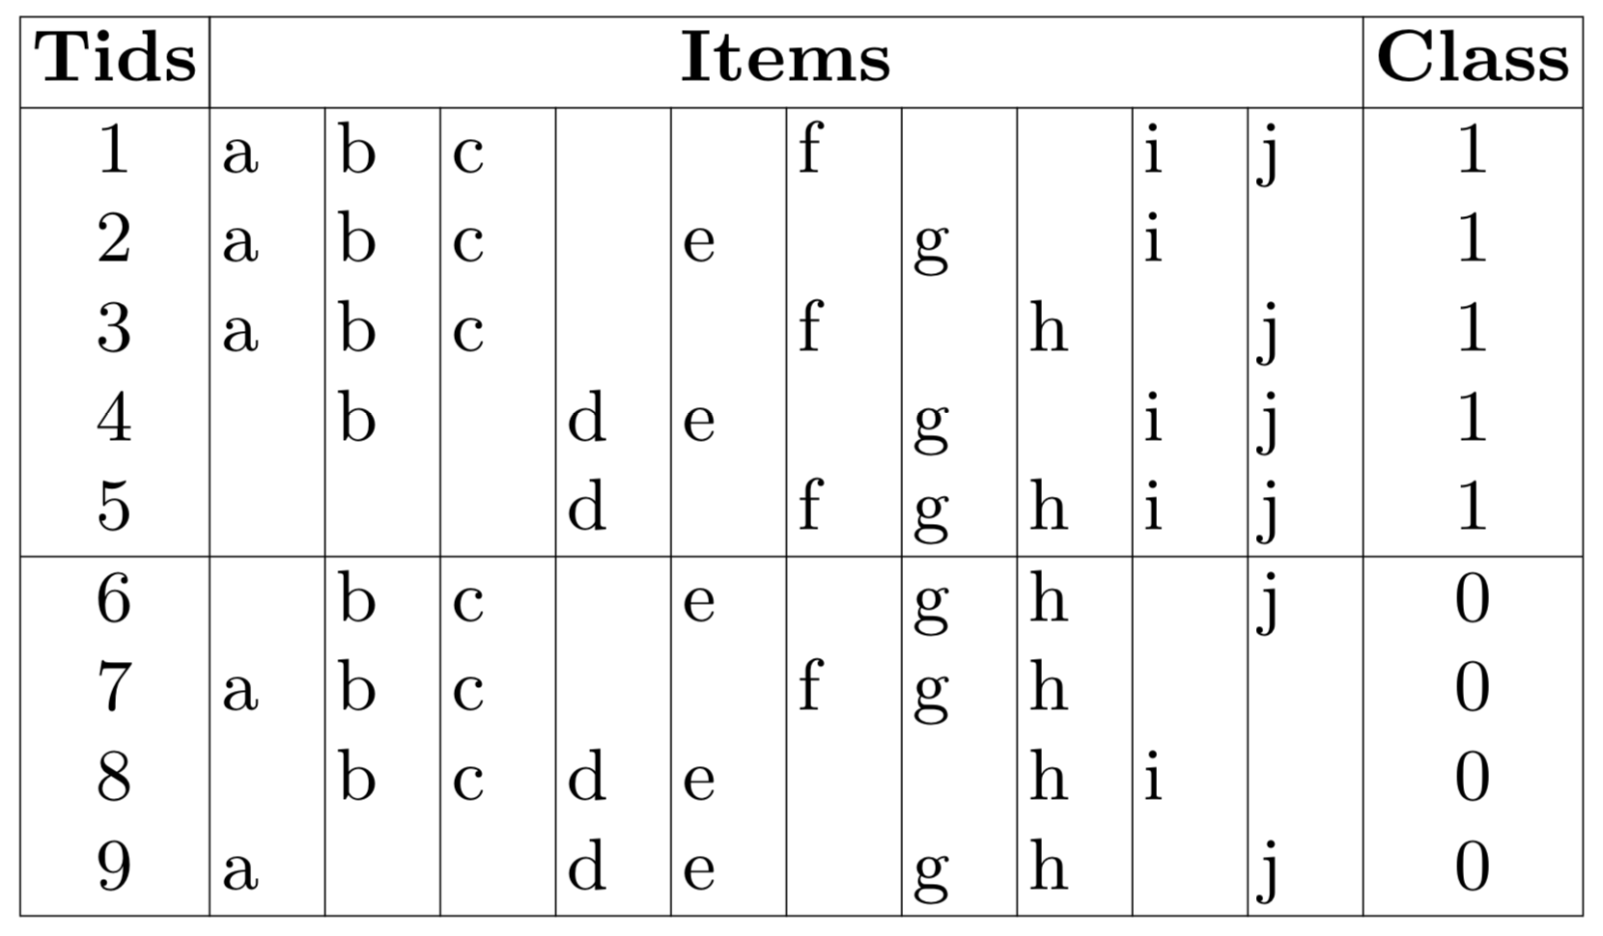
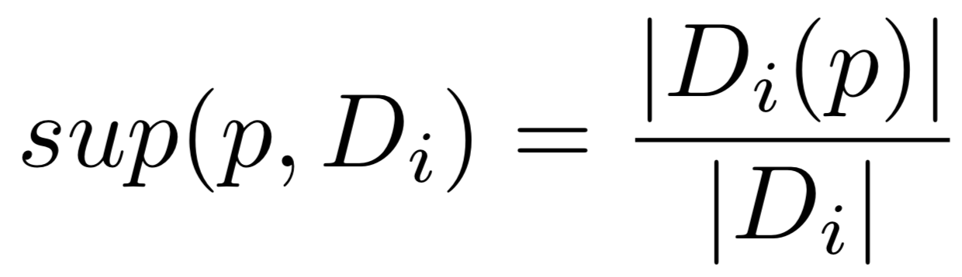
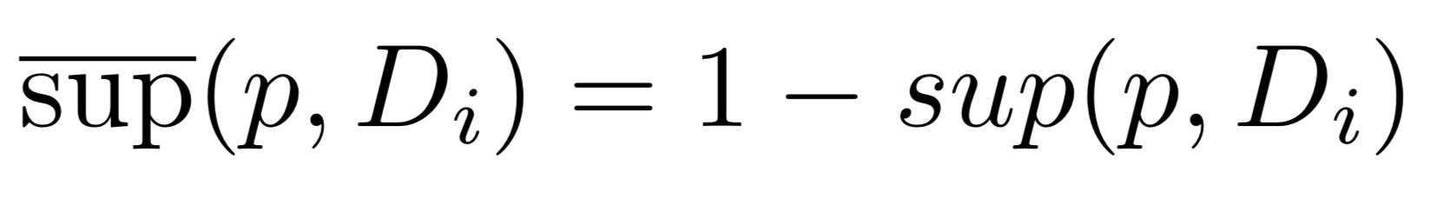
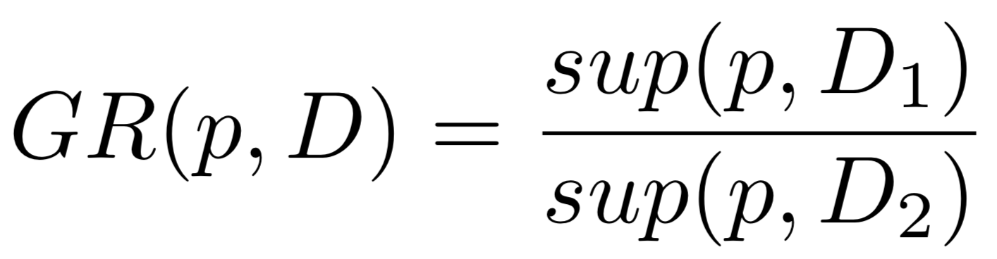
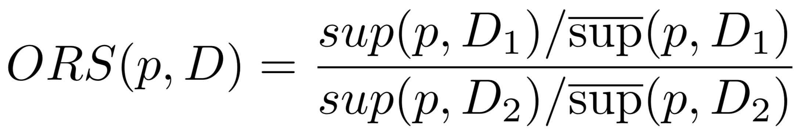
Problem definition
Support of the pattern p in class i:
Negative support:
Discriminative score measures:
Support difference:
Grow rate supports:
Odds ratio supports:
Notes:
Given a case-control dataset, for each pattern we can compute its presence and absence in the case and in the control group. These values can be tabulated in a contingency table.
To evaluate the association strength between variant combination and disease, we can use some risk measures such as : odds ratio, risk ratio and risk difference.
These are bio-statistics measurements that are widely used for testing association in case-control studies.
The GWAS aims to find patterns which have high risk score.
In addition, for each pattern we have to test the statistical significance by using p-value or confidence interval.
A pattern is evaluated as importance if it satisfies both conditions: risk score is better than a threshold and satisfies statistical significance.
Our objective is to find such these patterns.

Slide 4
Problem definition
Confidence interval:
  a range of values (Lower confidence interval – Upper confidence interval)
  used to evaluate the statistical significance of a result
Statistically significant discriminative pattern
a pattern satisfies both discriminative threshold (alpha) and confidence interval (beta)

Slide 5
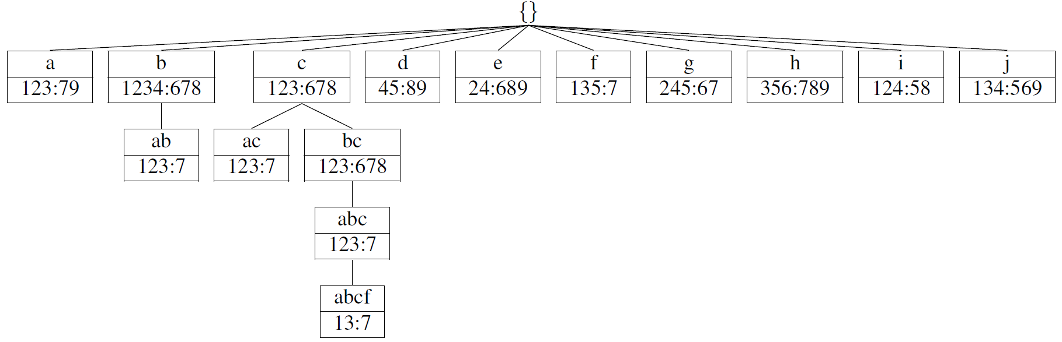
Classical enumeration strategy
Exponential
Pruning strategies ?
Itemset Frequency Discriminative score
c 6 OR = 0.5
bc 6 OR = 0.5
abc 4 OR = 4.5
abcf 3 OR = 2.0
Anti-monotonic ? YES NO!

Slide 6
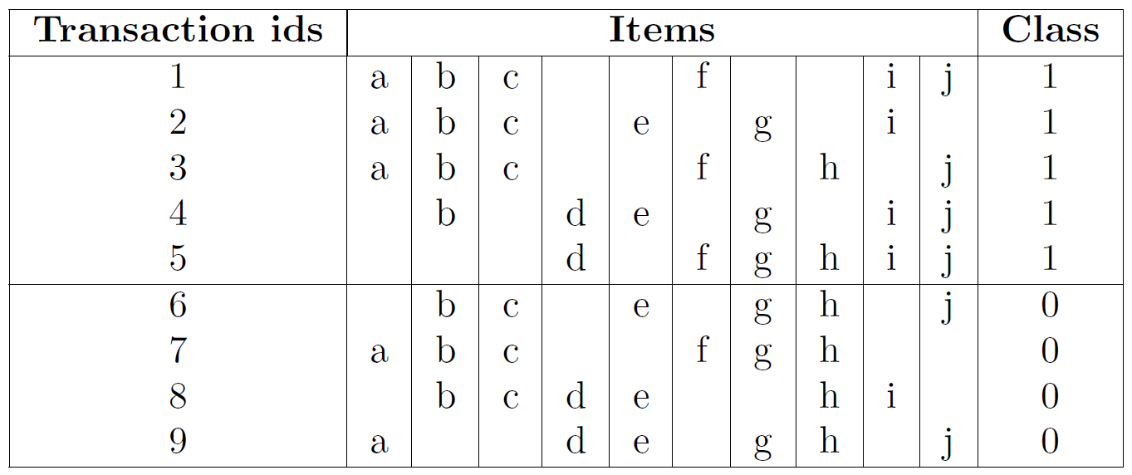
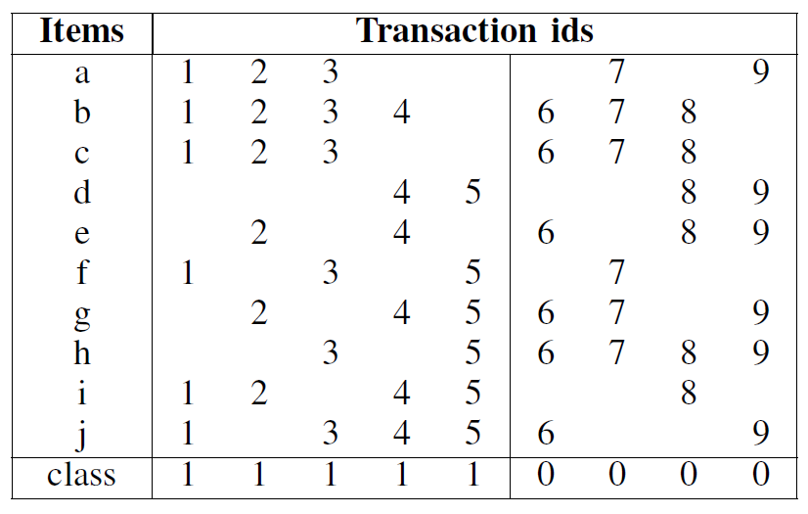
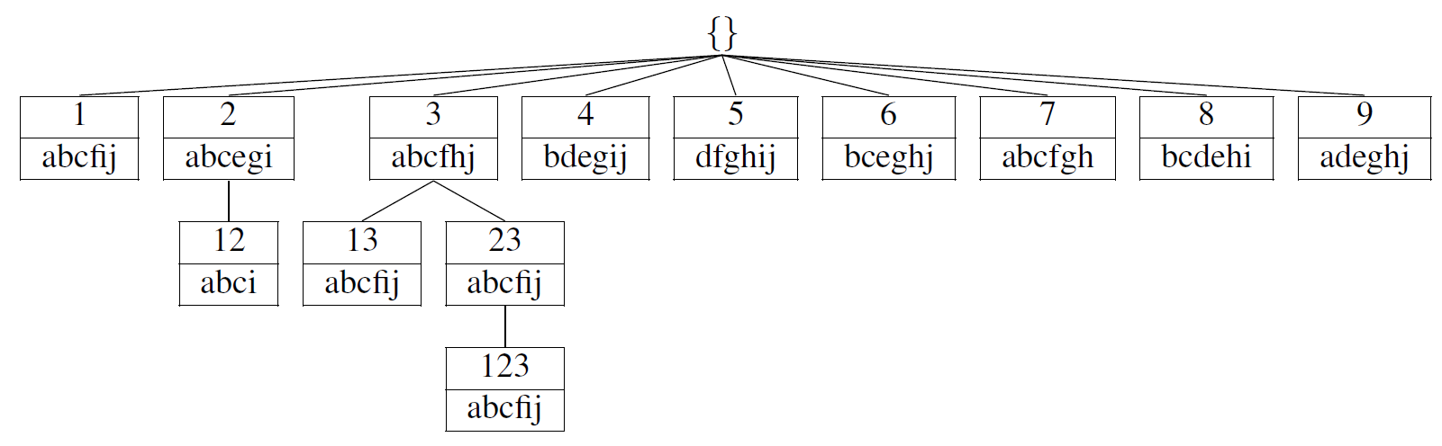
Better enumeration strategy
Transposition
Reduce: 2^{|items|} → 2^{|transaction ids|}

Slide 7
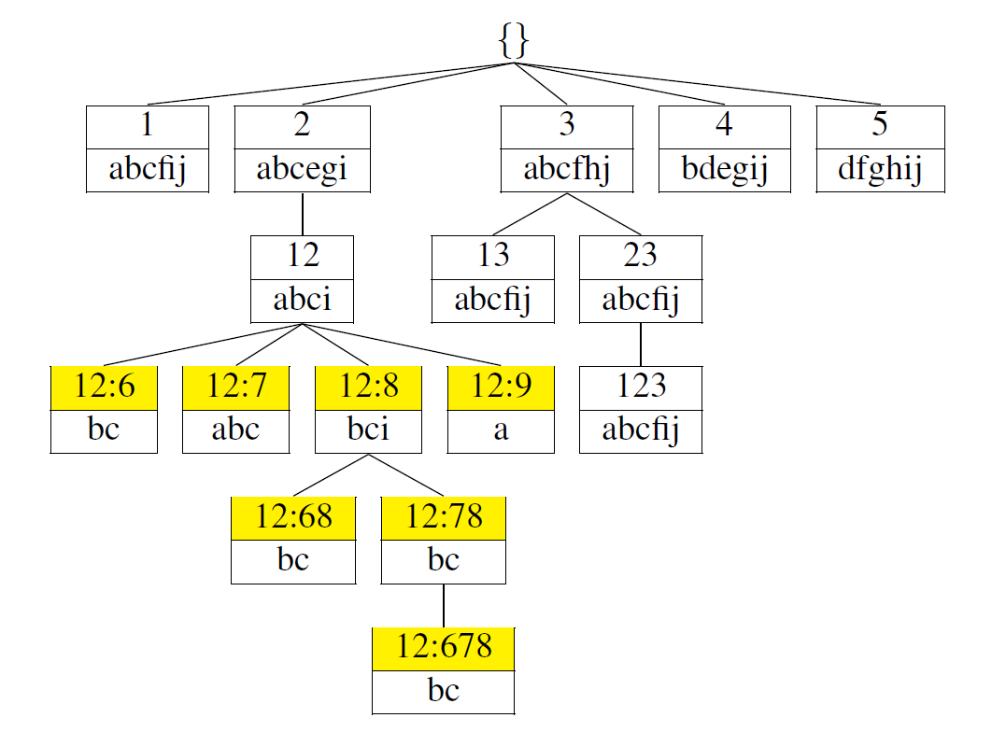
Better enumeration strategy + pruning
Important contribution:
discriminative score measures and confidence interval are anti-monotonic on a branch
→ search discriminative patterns more effectively (with pruning)

Slide 8
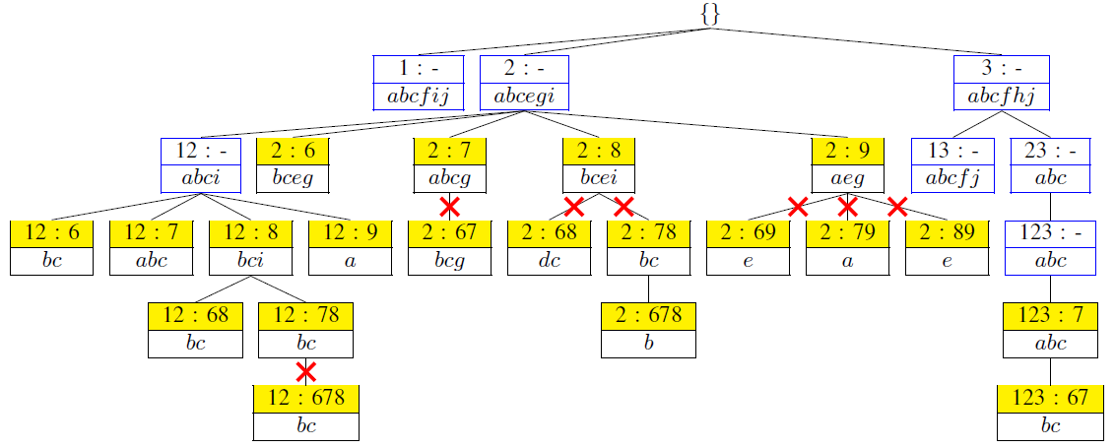
Enumeration strategy
Anti-monotonic example
Threshold = 1 Tidset Itemset Discriminative score
- 12 : - abci OR = +∞
YES 12 : 8 bci OR = 2*3 / 3*1 = 2
NO 12 : 78 bc OR = 2*2 / 3*2 = 0.66
Pruned 12 : 678 bc OR = 2*1 / 3*3 = 0.22
Anti-monotonicity formally proved in document

Slide 9
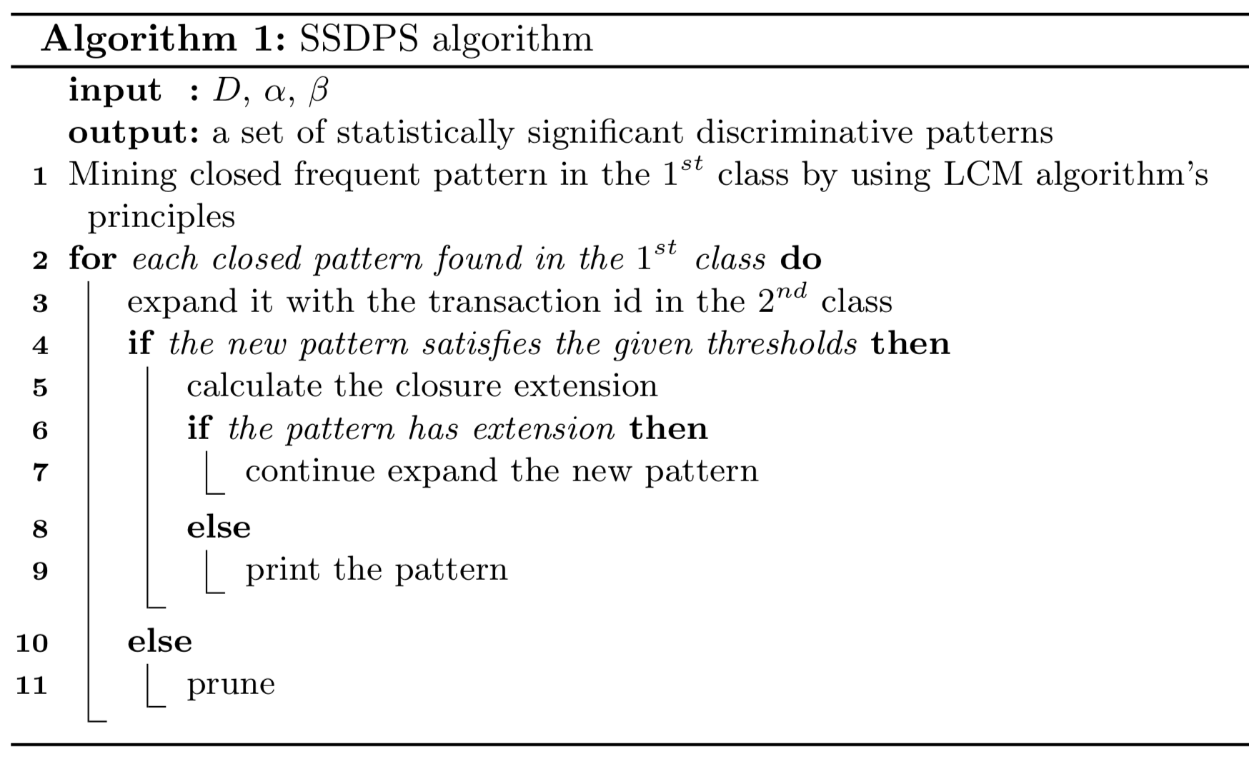
SSDPS algorithm

Slide 10
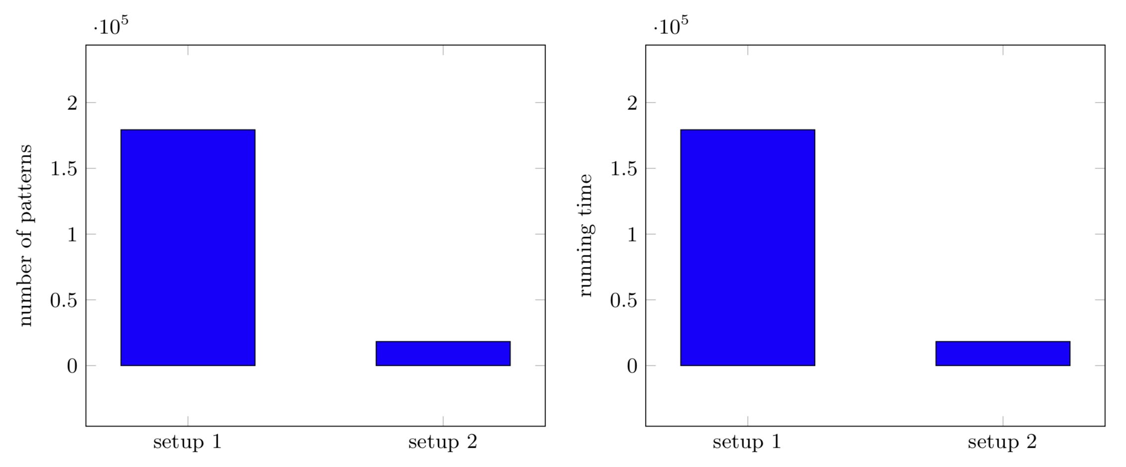
Experimental results
Simulated data: 100 transactions (50 cases, 50 controls), 260 items
Pruning evaluation
Setup 1: OR = 2; Setup 2: OR = 2, LCI_OR = 2
Notes:
In genetic variant datasets, the amount of SNP is very large, using all SNP to find combinations is infeasible. In addition, many individual SNP are no really meaningful
Therefore we propose a two-step framework to search SNP combination associated with disease:
1) we first select candidate genotypes by using p value and support of genotype in the control group. The reason is that the p value guaranties that the selected candidates are significant, while the control support is used to eliminate very common genotypes.
2) we then use the SSDPS algorithm to search SNP combinations.
The experimental results on simulated datasets show that the two-step framework is efficiently discover statistically significant discriminative patterns.
….

Slide 11
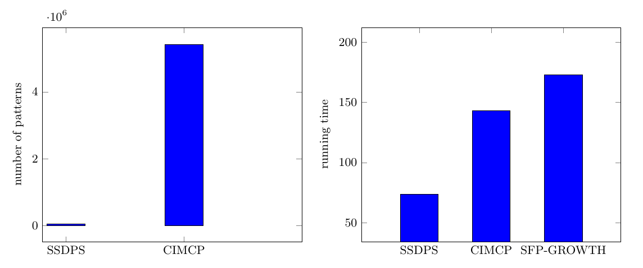
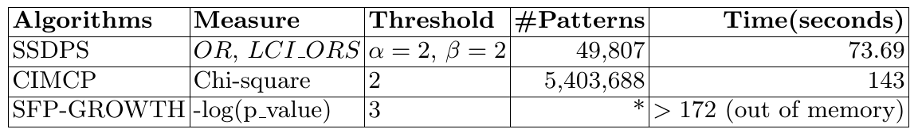
Experimental results
Compare to other algorithms
Notes:
In genetic variant datasets, the amount of SNP is very large, using all SNP to find combinations is infeasible. In addition, many individual SNP are no really meaningful
Therefore we propose a two-step framework to search SNP combination associated with disease:
1) we first select candidate genotypes by using p value and support of genotype in the control group. The reason is that the p value guaranties that the selected candidates are significant, while the control support is used to eliminate very common genotypes.
2) we then use the SSDPS algorithm to search SNP combinations.
The experimental results on simulated datasets show that the two-step framework is efficiently discover statistically significant discriminative patterns.
….

Slide 12
Conclusion
Proposed a novel enumeration strategy in which discriminative measures and confidence interval are used as anti-monotonic property.
Perspectives:
  Heuristic search
  Integrate domain knowledge in data mining
  Apply other techniques to further remove uninteresting patterns
Notes:
In general, the pattern mining techniques proposed in this thesis efficiently discover SNP combinations associated with diseases. However, to more efficiently tackle GWAS, several directions should be explored in future work.
First, skypattern is a promising approach for association strength evaluation. However, applying this technique to identify interesting genetic variant combinations association with diseases remains challenging. Thus directly discover skypatterns in one stage is the first perspective.
Second, integrate domain knowledge in data mining to search specific kind of patterns. For example search SNP combination according to their real locations, or we can search SNP combinations based on other information such as gene, QTL.
Last but not least, the available algorithms often generate a large number of patterns which contain many redundant ones. Represent these patterns as a small set of non-redundant patterns is a challenge. Thus, to provide better data visualization of patterns, collaborate with researchers in data visualization and biologists is an appropriate approach

Slide 13
Reviewers’ comments
Technical details:
  Why do we use Galois connection ?
  What are the different discriminative measures for ?
  Parameters used in the algorithm, i.e., alpha and beta ?
Experimental results:
  Difficult to see the influence of the choice of measures
Related work: lack of exposition

Slide 14
THANK YOU VERY MUCH
FOR YOUR LISTENING

