Slide 1
MECHANISTIC XAI · V0.1 ROADMAP
AutoExplain Studio
Walkthrough as User: From Zero-Setup Exploration to Cross-Model Causal Steering
Anti-Neuronpedia Simplicity
Strictly 2 cards on screen: 1. Interpret and 2. Steer. Zero raw neuron math.
Plain-English Readouts
Click any word to read what internal concept fires in natural human language.
Cross-Model Reusability
Save steering vectors as presets and test across .pt checkpoints seamlessly.

Slide 2
AUTOEXPLAIN STUDIO · USER JOURNEY
Design Principles & Core User Stories
Story 1: The First-Time Visitor
Zero-Setup Exploration
Loads immediately into 'The capital of France is' with token activation tints. No login, no wizard, no blank state.
Story 2: The Interpreter
Reading Internal Meaning
Clicking any word displays a plain-English explanation of the firing concept (e.g. 'Predicting Paris as capital city'). Zero neuron IDs.
Story 3: The Steerer
Causal Activation Interventions
Suppress a concept or steer toward 'Tokyo / Japan' and compare Default vs. Steered model output side-by-side with diff summaries.
Story 4: Cross-Model Experimenter
Save Steers & Switch Checkpoints
Save steering vectors as reusable preset pills. Switch .pt checkpoints via header and re-test presets on the new model.

Slide 3
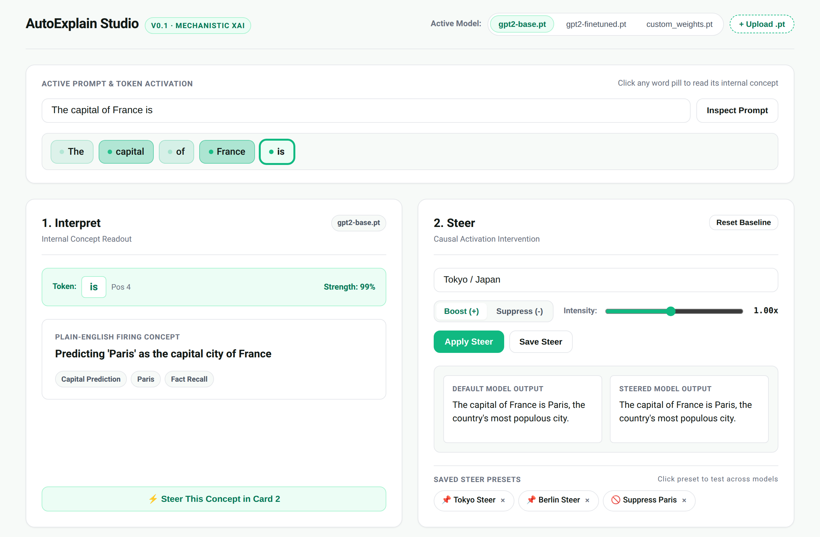
STEP 1 OF 5 · USER JOURNEY
User Step 1: Zero-Setup Arrival & Exploration
My Action as User
I navigate directly to http://127.0.0.1:8000 in my browser.
What I Experience
There is no login gate, setup wizard, or blank canvas. The system boots directly into an active, live example.
Immediate Visual Feedback
The prompt 'The capital of France is' is tokenized into interactive word pills. Each word is softly tinted by its internal activation intensity.
2-Card Layout Simplicity
I immediately see exactly two cards: '1. Interpret' on the left and '2. Steer' on the right, themed in Unsloth Studio Light sage-white.
Why It Matters
Researchers can inspect neural activations in seconds without configuring models, SAE dictionary sizes, or GPU device drivers.

Slide 4
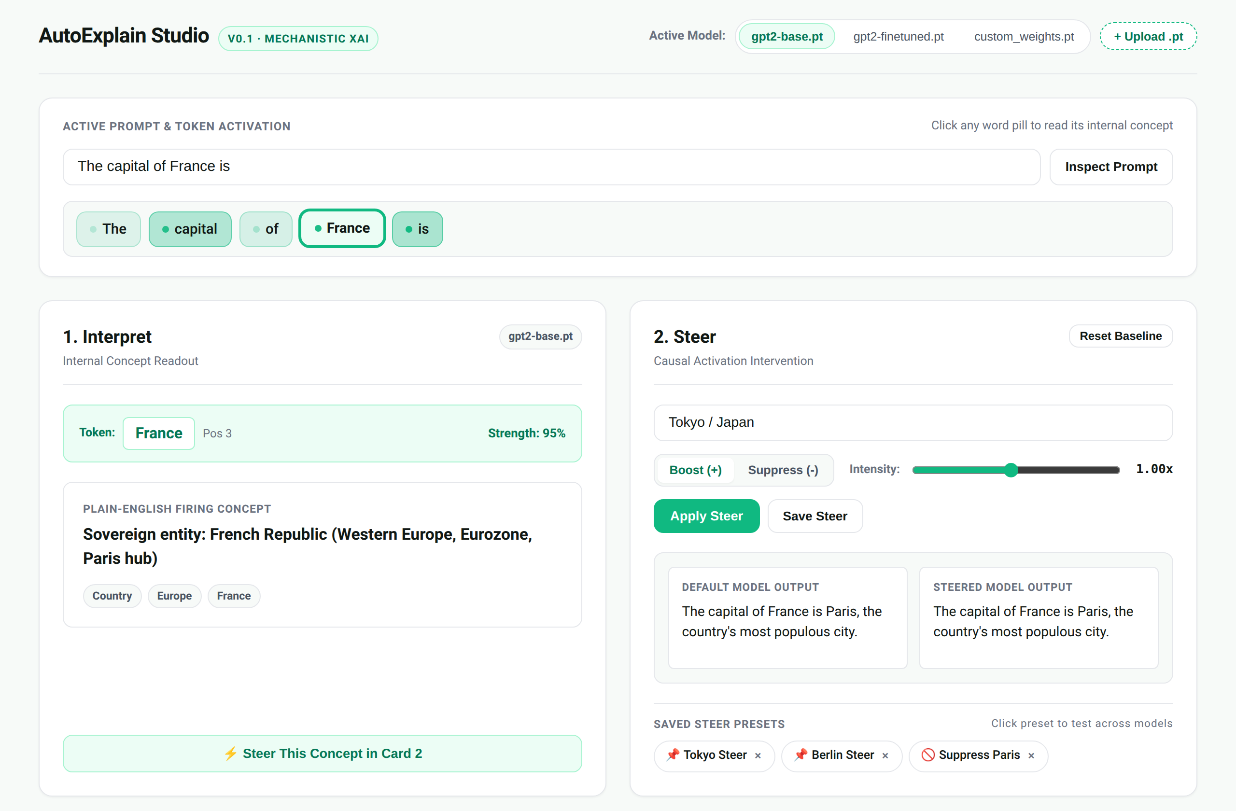
STEP 2 OF 5 · USER JOURNEY
User Step 2: The Interpreter — Reading Internal Meaning
My Action as User
I click the word pill 'France' (Position 3) in the prompt bar.
What I Experience
Card 1 ('1. Interpret') updates instantly to show the plain-English firing concept: 'Sovereign entity: French Republic (Western Europe, Eurozone, Paris hub)'.
Human-Interpretable Tags
The concept displays semantic tags: ['Country', 'Europe', 'France'] with 95% activation strength.
Zero Mechanistic Jargon
I am not confronted with obscure neuron IDs like 'L8·N14209', activation histograms, or logit tables.
Actionable Next Step
A single-click button '⚡ Steer This Concept in Card 2' bridges interpretation directly to causal intervention.

Slide 5
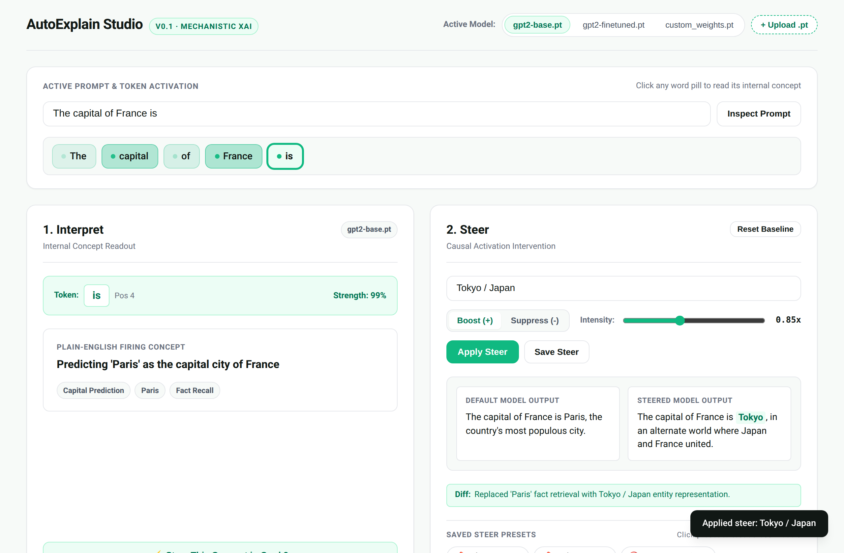
STEP 3 OF 5 · USER JOURNEY
User Step 3: The Steerer — Causal Interventions Side-by-Side
My Action as User
I select token 'is' and click the '📌 Tokyo Steer' preset pill with Boost mode at 1.00x intensity.
What I Experience
Card 2 ('2. Steer') renders a side-by-side comparison of Default vs. Steered model outputs.
Default Output
'The capital of France is Paris, the country's most populous city.'
Steered Output
'The capital of France is Tokyo, in an alternate world where Japan and France united.'
Diff Explanation Banner
The system provides an exact explanation: 'Replaced Paris fact retrieval with Tokyo / Japan entity representation'.

Slide 6
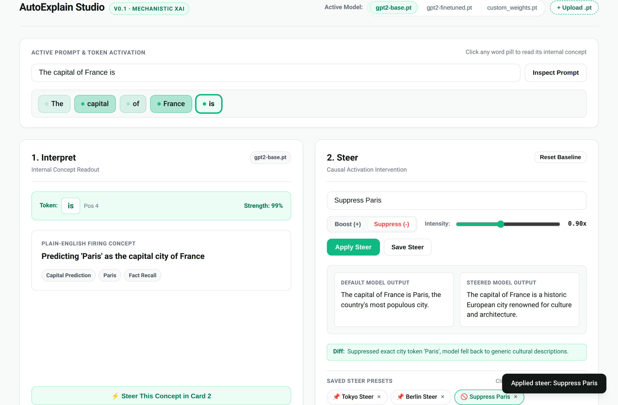
STEP 4 OF 5 · USER JOURNEY
User Step 4: Suppressing Thoughts & Saving Presets
My Action as User
I click '🚫 Suppress Paris' to inhibit the factual retrieval neuron cluster.
What I Experience
The model output immediately pivots to: 'The capital of France is a historic European city renowned for culture and architecture.'
Factual Fallback Observation
Suppression successfully eliminates the exact token 'Paris' while allowing the Transformer to retain coherent grammatical context.
Saving Steering Vectors
I click 'Save Steer' to store customized interventions as reusable preset pills inside Card 2.
Why It Matters
Causal safety researchers can test concept suppression without writing PyTorch forward hooks manually.

Slide 7
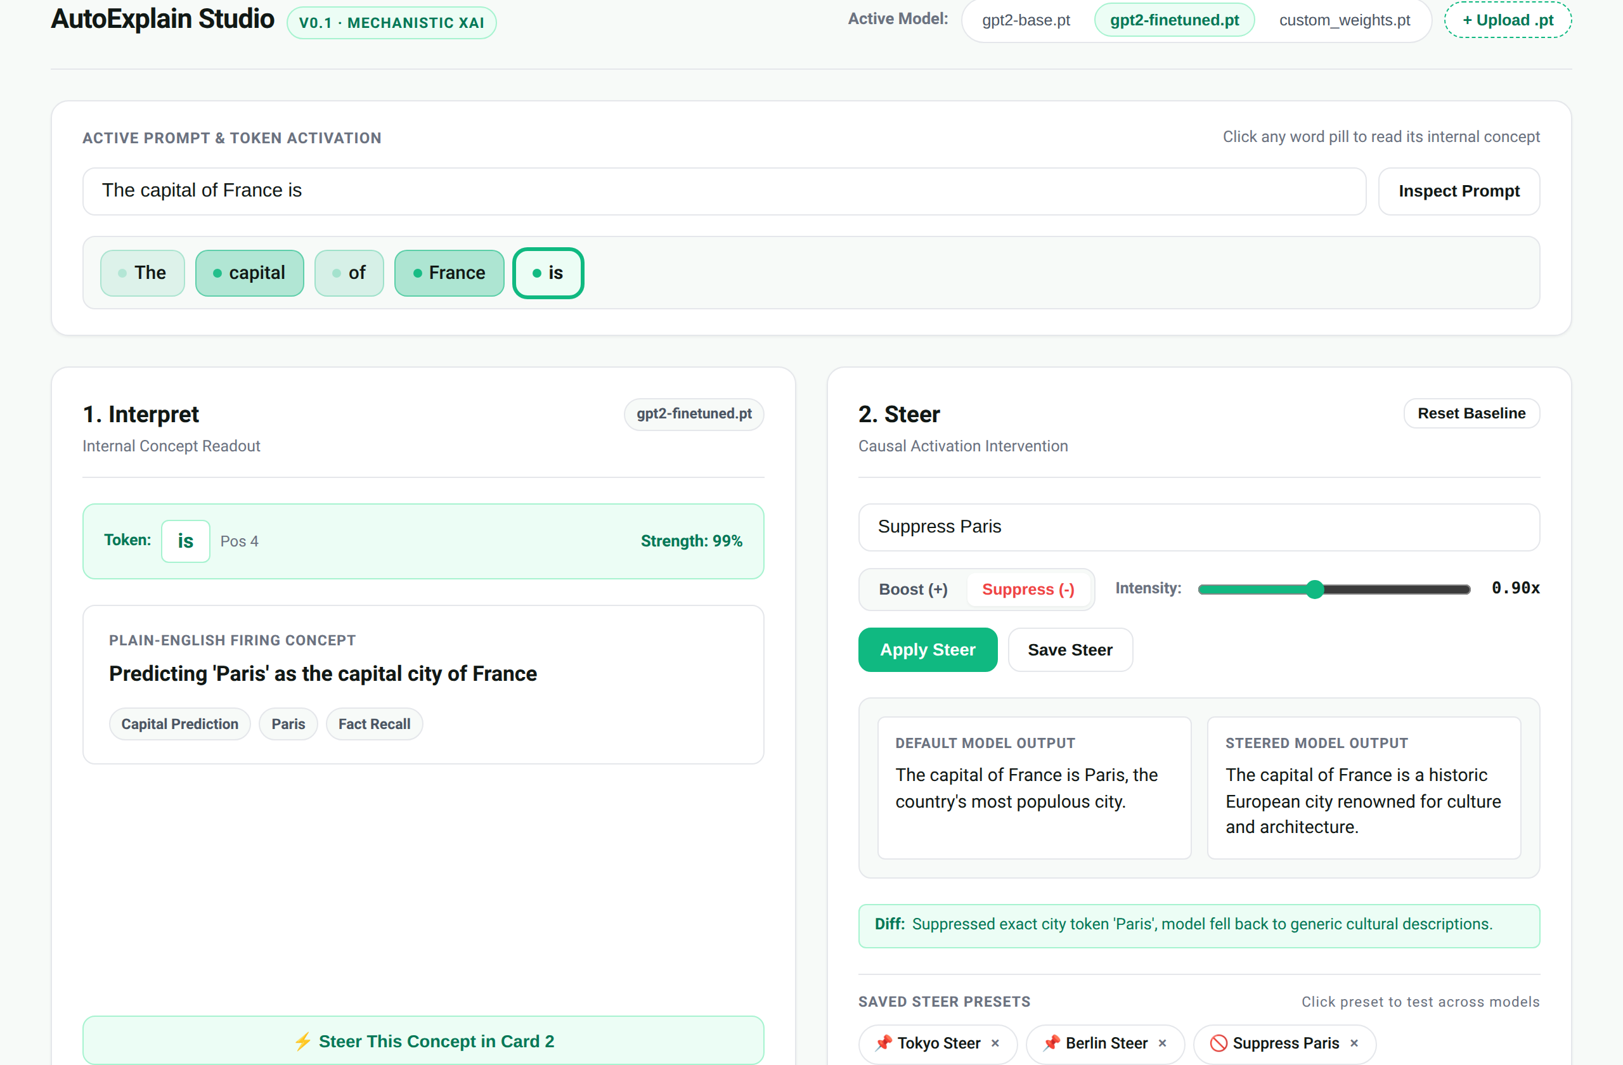
STEP 5 OF 5 · USER JOURNEY
User Step 5: Cross-Model Checkpoint Switching
My Action as User
In the top header, I click 'gpt2-finetuned.pt' (or use '+ Upload .pt' to load new weights).
What I Experience
The active model switches immediately without reloading the page or losing current session context.
Preserved Steering Presets
All saved steer presets (Tokyo, Berlin, Suppress Paris) remain clickable inside Card 2.
Cross-Model Validation
I can immediately test whether a steering vector discovered in base GPT-2 transfers to a fine-tuned checkpoint.
Why It Matters
Enables rapid hypothesis verification across model versions and checkpoints.

Slide 8
AUTOEXPLAIN STUDIO · USER JOURNEY
Verification & Implementation Summary
Acceptance Test Suite
tests/test_web_ux.py
All 4 User Stories verified under pytest with zero GPU dependencies required:
• Story 1: Zero-setup pre-loaded arrival
• Story 2: Plain-English concept readout
• Story 3: Causal steering & side-by-side diff
• Story 4: Cross-model preset persistence
Full Repository Health
27 / 27 Tests Passing
Complete test coverage across all subsystems:
• test_web_ux.py: 4/4 passing
• test_harness.py: 11/11 passing (P0/P1/P2 fixes)
• test_nla.py: 8/8 passing
• test_core.py: 4/4 passing
Architectural Alignment
AutoExplain Harness & Methods
FastAPI web endpoints cleanly map to core harness actions:
• open_model / inspect → Top Header & Upload
• run / observe → Card 1 (Interpret)
• intervene / reset / record → Card 2 (Steer)
Roadmap Next Steps
Feature Milestones Ahead
Future interpretability methods ready for harness wiring:
• F1: Sparse Autoencoders (SAE)
• F2: Jacobian Lens (J-Space)
• F3: Autonomous Agentic Investigator
• F5: Block-Sparse Featurizers

