Slide 1

Introduction to Object-Oriented Databases
3rd Country Conference, February 2007
by
Prof. Kazimierz Subieta
subieta@pjwstk.edu.pl
http://www.ipipan.waw.pl/~subieta

Slide 2
Topics
Why object-oriented databases?
Why relational and object-relational databases are not enough?
Current major activities concerning object-oriented databases.
Basic concepts of object-oriented databases.
PJIIT projects on object-oriented databases.

Slide 3
Why object-orientation in databases?
Object databases consist of objects
rather than relations, tables or other data structures.
What is object?
“Object” is a kind of idiom or metaphor that addresses the human psychology and the way humans perceive the real world and think.
Millions years of the evolution have created in our minds mechanisms enabling us to isolate objects in our environment, to name them, and to assign to them some properties and behaviour.
Object-orientedness in computer technologies
is founded on inborn mechanisms of our minds.

Slide 4
Why is object-orientation important?
The software manufacturing problems:
  Growing cost of software design, development and deployment,
  The problem with “legacy” (obsolete) software,
  Big risk of unsuccessful projects,
  Immature methods of software design and construction,
  Poor reliability, problems with security
  Integration of distributed, heterogeneous, redundant and fragmented data and service resources,
  Very high cost of software maintenance.
The main factor of the software problems: Complexity
Object-orientation in new hope in fight with complexity.

Slide 5
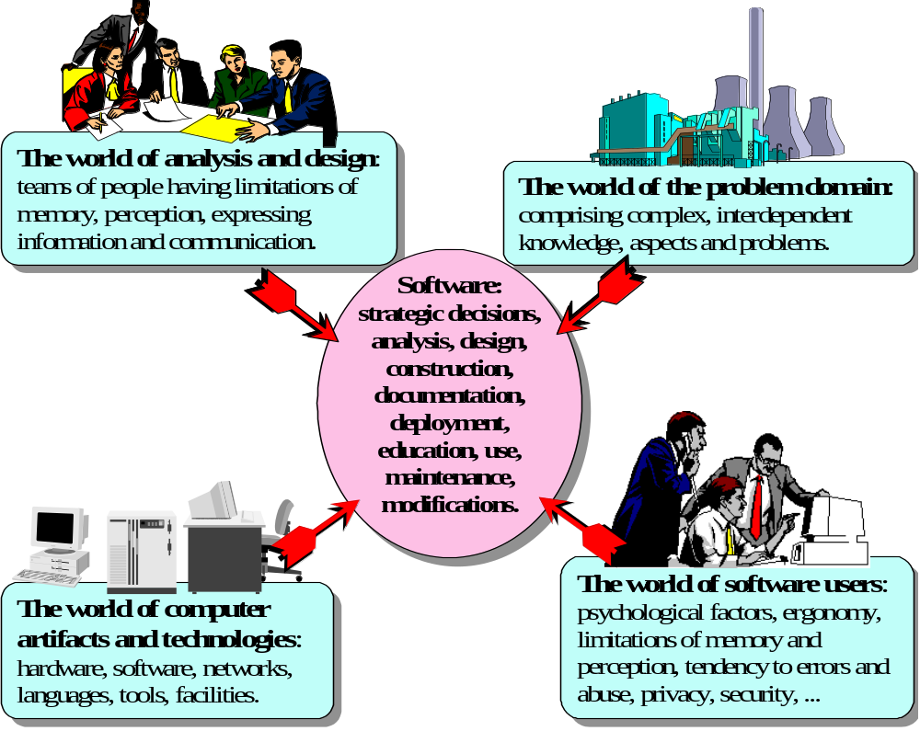
Factors of the software complexity

Slide 6


Conceptual modeling of software
Processes of the software constructions are performed in our minds.
People must clearly imagine the problem before solving it.
Software analysis and design tools are nowadays object-oriented as a rule, c.f. UML.
mapping
mapping
*
...
...
...
...
...
...
...
...
...
...
...
...
...
...
...
...
...
...
Human
perception of the problem domain
Abstract conceptual model of the problem domain
Programmer’s view of data structures and operations
Object-orientation reduces the complexity of the mappings:
- between the human perception of the problem domain and an abstract model
- between the abstract object-oriented model and databases → object databases

Slide 7
Why relational and object-relational databases are not enough?
Relational databases are currently the most popular
  It is unlikely that they will loose soon their dominant position
However, relational databases imply severe impedance mismatch between object-oriented design and relational data structures
  The mapping is difficult, software production cost is higher,
  Performance frequently compromised, maintenance cost too high.
The relational model and the object model are fundamentally different, and the integrating the two is not straightforward
Object-relational wave disappointed:
  Almost nobody uses object-oriented extensions of relational systems (see the famous interview with David Maier)
  They are not supported by standards, tools and API-s
  New SQL standards aiming the object-relational model are unsuccessful.

Slide 8
Major activities concerning object-oriented databases
Commercial OO DBMS (ca. 5% of the database market)
  Limited functionalities in comparison to RDBMS
  Objectivity/DB, GemStone, Object Store, Versant, Ontos, db4o,…
Object Data Management Group (ODMG) standard
  Low technical quality, inconsistent, incomplete, no full implementation
  However, showing the direction.
New standards SQL-99 and SQL 2003
  Extremely huge and eclectic, too many redundant options, extremely difficult to implement,
  Loose recommendation rather than strong technical specification.
OMG MDA / OCL / QVT /Action Semantics
  Actually, proposed as a support for UML specification, not databases
  Suggestions that can be used as query/programming languages are to be checked.
Java and .NET persistence layers, Hibernate, LINQ, native queries
XML repositories and query languages.
New (pending) OMG standard on object-oriented databases.
A lot of academic projects, in particular, our ODRA project.

Slide 9
General capabilities of object databases
Traditional capabilities (from relational systems):
Secondary storage management
Schema management
Concurrency control
Transaction management, recovery
Query processing
Access authorization and control, safety, security
New features:
Complex objects
Object identities
User-defined types
Encapsulation
Type/class hierarchy with inheritance
Overloading, overriding, late binding, polymorphism
Computational and pragmatic completeness of programmers’ interfaces

Slide 10
Object database concepts (1)
Complex objects, object identity. Objects have arbitrary complexity. Each object has identity, i.e. a unique internal identitifier (OID) (with no meaning in the problem domain), and Each object has one or more external names.
Relationships, associations, links. Objects are connected by conceptual links. For instance, the Employee and Department objects can be connected by a link worksFor.
Encapsulation and information hiding. The internal properties of an object are subdivided into two parts: public and private (invisible from the outside).
Classes, types, interfaces. Each object is an instance of one or more classes. Objects are instantiated according to information presented in the class. The class contains the properties that are common for some collection of objects (objects’ invariants). Each object has a type. Objects are accessible via their interfaces.

Slide 11
Object database concepts (2)
Abstract data types (ADTs): a kind of a class, which assumes that any access to an object is limited to the predefined collection of operations.
Operations, methods and messages. An object is associated with a set of operations (methods). The object performs the operation after receiving a message with the name of operation to be performed (and its parameters).
Inheritance. Classes are organized in a hierarchy reflecting the hierarchy of real world concepts. For instance, the class Person is a superclass of the classes Employee and Student.
Polymorphism, late binding, overriding. The operation to be executed on an object is chosen dynamically, after the object receives the message with the operation name.
Persistence. Database objects are persistent, i.e., they live as long as necessary. They can outlive programs, which created them.

Slide 12

Architecture of an Object-Oriented DBMS
Source program
in C++, Java, etc.
4GL/RAD environment
Processor
Facilities
of ad hoc
queries
Preprocessor
Source program
in 4GL/RAD
Compiler
Transaction
processing,
log management,
rollback,
recovery,
authorization,
security
Object code
modules
Query
optimization
and processing
Executable
Linker
program
Database resources
Class library, run-
time modules of
the prog. lang.
Class library, run-
time modules of
OODBMS
Data/Objects
Views
Rules
Indices
Catalogs

Slide 13
Traditional and object-oriented application
The traditional structure
of an application
The object-oriented structure
of an application
Possive data
(relations)
Linked objects
...
...
...
Database
schema
Database
schema
...
...
...
...
...
...
...
...
...
Classes and types
...
...
...
...
...
...
...
...
...
...
...
...
...
...
...
...
...
...
...
...
Procedure and
function libraries
Application
modules
...
...
Types
Procedure and
function libraries
Application
modules
Dictionaries,
catalogs
Database procedures,
views, rules
Dictionaries,
catalogs
Database procedures,
views, rules

Slide 14
Object Data Management Group (ODMG)
A group of startup companies who thought that traditional standard-making processes were slow and cumbersome.
The idea of this activity is taken from the group OMG developing the standard CORBA.
ODMG developed four versions of the standard (last ODMG 3.0, 2000).
The standard has a lot of drawbacks. It is probably too early and immature.
The standard already plays an important role of integrating research and development efforts devoted to object bases.
Many projects both in industry and academia are going along the lines that were determined by the standard.

Slide 15
ODMG Standard: the content
Object Model. It determines the meaning of basic concepts of object-oriented data structures, such as: objects, attributes, relationships, collections, interfaces, operations, inheritance, and others.
Object Definition Language (ODL). It is an extension of CORBA IDL. ODL is used to determine the structure of a database, i.e., a database schema.
Object Interchange Format. It determines the representation of objects for exchanging them between different OODBMS.
Object Query Language (OQL). OQL retains some syntax of SQL. Semantically, OQL is very different from SQL. OQL is intended to retrieve data from an object base.
Bindings to programming languages C++, Smaltalk and Java. They determine principles of including ODL and OQL statements into the mentioned languages. The bindings define many classes, allowing to access and process an object base directly from one of these languages.

Slide 16
Pure Object-Oriented DBMS (OODBMS)
They provide traditional database functionality (e.g. persistence, distribution, integrity, concurrency and recovery), but are based on the object model. They totally abandon the relational model.
They are (somehow) related to the ODMG standard.
They are well suited for handling complex, highly interrelated data, particularly in cross-platform and distributed environment.
Some benchmarks show that performance of pure OODBMS is much better than RDBMS.
So far, however, pure OODBMS have marketing disadvantages, which reduce their wide acceptance:
maturity of technology
stability of vendors
size of companies
...

Slide 17
Object-Relational DBMS (ORDBMS)
ORDBMS are based on the idea that the relational model and SQL implemented in the majority of RDBMS should be extended.
A database still consists of a set of tables.
A number of object features are provided as an extension to this core relational model (multi-row tables, references between rows, inheritance between tables, etc.).
No standards: they exclude portability and even a common conceptual and didactic basis.
Informix Dynamic Server (formerly Illustra, Informix Universal Server),
IBM’s DB2 Universal Database,
Oracle-10,
UniSQL/X,
OSMOS,
Ingres II,
Sybase Adaptive Server,
...

Slide 18
SQL-99 (aka SQL-3)
A new SQL standard developed by ANSI and ISO.
SQL-99 is assumed to be a programming language with full computational and pragmatic power.
The main data structure is the table, equipped with a lot of options.
SQL-99 supports user-defined abstract data types (ADTs), including methods, object identifiers, subtypes, inheritance and polymorphism.
Some enhancements are introduced to statements defining tables, in particular, types of rows, row identifiers, and (specific) inheritance between rows.
Control statements, parameterized types, programming abstractions.
A lot of other features
SQL-99 is downward compatible with SQL-92
Little care about minimality, non-redundancy and clean separation between primary (built-in), secondary (add-on, library) and external features.
Extremely huge and eclectic (1100-1600 pages).
There are doubts if it will ever be entirely implemented.

Slide 19
Query languages
The commercial success of relational database systems to a big extent has been amplified by the idea of query languages.
SQL, the most representative language, has various applications.
“Impedance mismatch”: clumsy programmers’ options due to embedding of a query language into a programming language.
The advent of pure OO DBMS caused a lot of confusion concerning query languages for this sort of systems: e.g. “impossible to define”, “impossible to create a consistent theory”.
Query languages can be defined for OO DBMS.
New powerful idea: the Stack-Based Approach (SBA)
Stack-Based Query Language (SBQL) – a powerful query and programming language for OO databases - is proposed as a new OMG standard.
  Looking for supporters and a lot of good luck.

Slide 20
What is SBA and SBQL?
SBA is a conceptual frame for developing O-O database query/programming languages
SBQL is a model query language according to SBA.
  It has the same role and meaning as object algebras, but it is formally sound and much more universal.
SBA/SBQL deal with various data models and all imaginable and reasonable query constructs.
Abstract implementation is the basic paradigm of formal specification of semantics.

Slide 21
ODRA: Object-oriented database core functionality
The prototype is operating
  Client-server database system,
  Each installation can work as a client and as a server
  Hierarchical client-server architecture possible
  Main memory database, with memory mapping files.
Distributed protocols - implemented
Integrated Development Environment (IDE) - implemented
Administration module - advanced
Still a lot of programming is required to introduce advanced features related e.g. to classes, transactions (including distributed ones) and optimizations.

Slide 22
ODRA (Object Database for Rapid Applications development)
ODRA applications (distributed)
Java client
application
Web Service
application
Web Service
application
SBQL client application 1
SBQL client application 2
JDBC
gateway
Web Service
gateway
Web Service
gateway
Client
view 1
Client
view 2
Client
view 3
Client
view 4
Client
view 4
ODRA
database (server)
Integration view
Communication Bus
Contributory
view 1
Contributory
view 2
Contributory
view 3
Contributory
view 4
Contributory
view
ODRA
database
ODRA
database
ODRA
database
ODRA
database
ODRA
database
O-R
wrapper 1
O-R
wrapper 2
O-XML
wrapper
O-WS
wrapper
….
wrapper
Relational
database 1
Relational
database 2
XML
file
Web Service
application
….
application
Existing non-ODRA applications (distributed)

Slide 23
SBQL for ODRA
The prototype is operating, ready for testing
Probably the most advanced implemented query language for object-oriented models.
  Incomparably more powerful than OQL, OCL and XQuery
  Comparable to last versions of the SQL standard.
  Imperative (programming) statements, functions and procedures (with parameters being queries, recursive)
  Strong typing (advanced, but not finished yet)
  Updateable views - ready
  Optimized by rewriting - ready
  Optimization by indices almost ready.
Considered as a new OMG standard for object-oriented databases

Slide 24
Current PJIIT European projects
European Project eGov Bus
  A dynamically adaptable information system supporting life events experienced by the citizen or business serviced by European government organizations.
  Integration of distributed, heterogeneous, redundant and fragmented resources for eGov applications.
  8 European partners, Jan 2006 - Dec 2007, budget 3 M Euro
European Project VIDE
  The UML-compliant action language VIDE to be researched, developed, evaluated and disseminated during the project will enable fully visual prototyping, programming, debugging and documenting of future applications.
  Implementation of OMG MDA, visual programming.
  10 European partners, July 2006 – Dec 2008, budget 4 M Euro

Slide 25
SBQL in the eGov Bus project
SBQL as embedded QL for application programming in Java.
SBQL as a self-contained DBPL for application programming.
SBQL updateable views will play the following roles:
  As mediators that virtually convert a local data and service resource to the shape that is required by the canonical model.
  As integrators that virtually fuse fragmented collections residing on different servers, resolve heterogeneities, remove redundancies, join fragmented remote services into the form of a procedure (c.f. life events) and (if necessary) equip some remote objects into new classes and methods.
  As customizers that adapt the data that are seen through the canonical model to the need of particular end user applications and/or to particular users.

Slide 26
VIDE project
SBQL implementation engine will be used to implement and extend OCL.
OCL queries will be depicted visually in the visual version of the language code.
OCL queries will address directly UML-like class diagrams.
OCL queries will be components of visual programming graphical metaphors.
The VIDE language will have both visual and textual syntax with no losses in the automated conversion between the two.
The programmer will have the freedom of choice to edit either the visual or the textual code.
There is a political game: OCL is an OMG standard, while SBQL is more powerful, simpler, consistent, with well-specified semantics.

Slide 27
Conclusion
Object databases have a growing position on the market.
  Although currently relational systems dominate
Despite a lot of commercial confusion and despite object-relational rivals, object databases are successfully applied in practical areas.
Object-relational models, adopting object-oriented concepts on top of relational systems, are not accepted by database programmers.
The relational model has already lost its position as a scientific and technical authority in the database domain.
XML technologies are not true object-oriented.
Java persistence is limited as a database technology.
The pure object database model, an intellectual winner, has big chances to be an eventual commercial winner.

