Slide 1
Portlets
Notes:
1

Slide 2
Table of Content
Concepts
MVC Phases
Portlet versus Gadget
Architecture
JSP Code Snippets
Portlet Preferences
Simplest Hello World
Portlet Bridges
Notes:
2

Slide 3
Concepts
3
Notes:
3
3

Slide 4

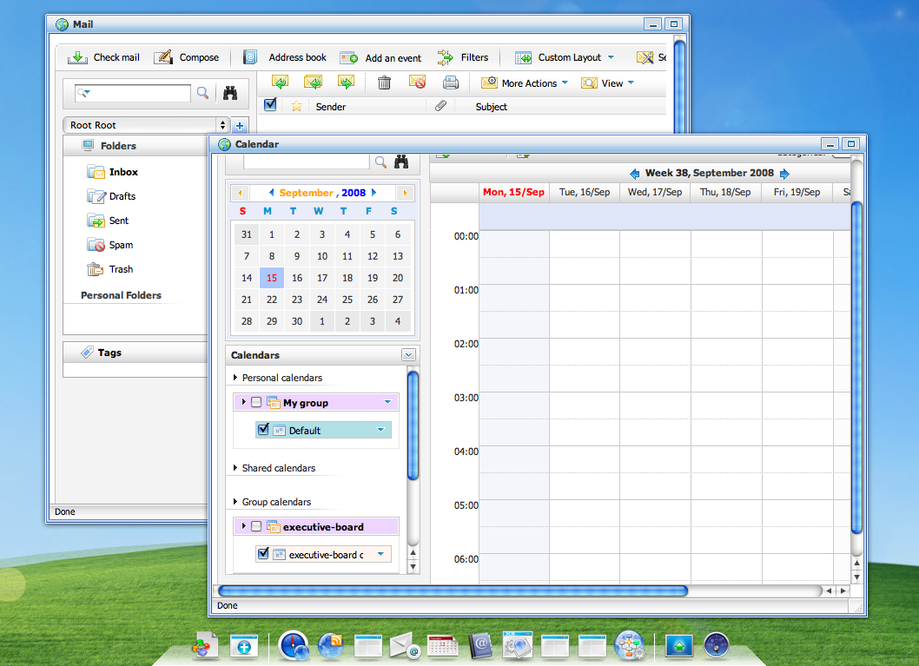



Portlets
Enterprise portals aggregate your applications, contents and services
Calendar
Portlet
Portal
Sales
Gadget
Java EE

Slide 5
Definitions
Portlet : A portlet is an application that provides a specific piece of content (information or service) to be included as part of a portal page.
Portlet Container : A portlet container contains portlets and manages their lifecycle.
JSR-286

Slide 6

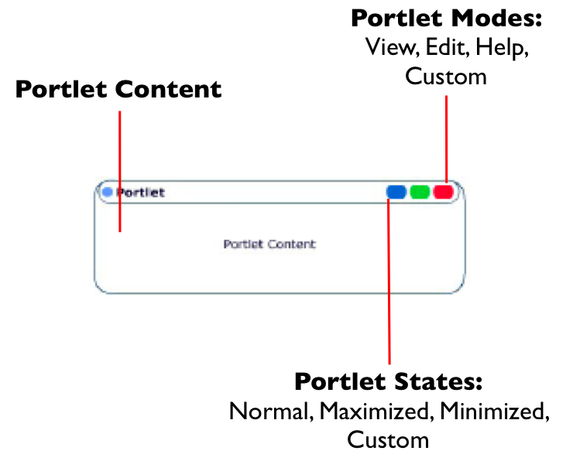
Concepts

Slide 7
Portlets
Portlets are server components
Similar to servlets
Designed for aggregation and personalization
Portlet 2.0 standard
Designed to integrate with the Java EE ecosystem but not part of it

Slide 8

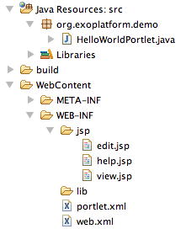
Portlet
JSR 168 et JSR 286
Based on a Web Container (Servlets/JSP)
Extends the class javax.portlet.GenericPortlet
Configuration:
./WEB-INF/portlet.xml
Notes:
- le warfile contient un des portlets. Une portlet s’occupe de la gestion

Slide 9
MVC Phases
9
Notes:
9
9

Slide 10
The MVC paradigm
Portlets interactions are divided into three phases:
action phase updates state and acts as controller
event (Portlet 2.0+) phase coordinates portlets, it is an extension of the action phase to other portlets on the same page
render phase retrieves markup to update the view

Slide 11
Portlets lifecycle
init()
Initialization of the portlet
processAction()
Valid the form and commit changes in the database
processEvent()
Event management
render()
Render the content of the portlet and read in the database
destroy()
Destroy the portlet

Slide 12
Portal http GET
Renders a portal page
The render phase reads the state and create markup

Slide 13
Portal http POST
Triggered by a portlet to trigger the execution of its action phase
The action updates the state
Database
Session
Preferences
Parameter
The optional event phase signals other portlet that something happened
Finally page rendering occurs again

Slide 14
Phase sequence
Portal
Portlet
Portlet
Portlet
Action
Event
Render

Slide 15
Portlet vs Gadget vs Servlet
15
Notes:
15
15

Slide 16
Gadgets
Gadgets are browser components
An embeddable chunk of Javascript using web standards
Many implementations, many names: widgets, badge, module, webjit, capsule, snippet, …
eXo uses the de facto standard “Google Gadget”

Slide 17
Portlets vs Gadgets
Portlet | Gadget
Portlets use the javax.portlet interfaces and classes | Google Gadget API
Requires a build (compile/package/deploy) | No development process required
Supports Browser Back Button (BBB) | No support for BBB
Supports bookmarkability | No support for bookmarkability

Slide 18
Portlets vs Gadgets
Portlet | Gadget
Request/response server interactions | Live user interface
State is shared between the portal and the portlet container | State is shared between the browser DOM and the portal No development process required
Use container services (Database, EJB, ESB) | Use Programmable Web, usually REST Web Services
Standardized coordination | De facto standard by Google

Slide 19
Portlet vs Servlet
Portlet Extras
Decorations
Portlet mode: view, edit, help, admin
Window state: minimized, normal, maximized
Personalization
Specified support for internationalization
Categorization

Slide 20
Portlet / Servlet similarities
PortletRequest | ServletRequest
PortletResponse | ServletResponse
PortletSession | ServletSession
PortletContext | ServletContext
PortletFilter | ServletFilter
PortletRequestDispatcher | RequestDispatcher

Slide 21
Architecture
21
Notes:
21
21

Slide 22
Request / Response Objects
Each phase defines his own objects
Similar to the Servlet API
PortletRequest
PortletResponse
ActionRequest
RenderRequest
ActionResponse
RenderResponse
EventRequest
ResourceRequest
EventResponse
ResourceResponse

Slide 23

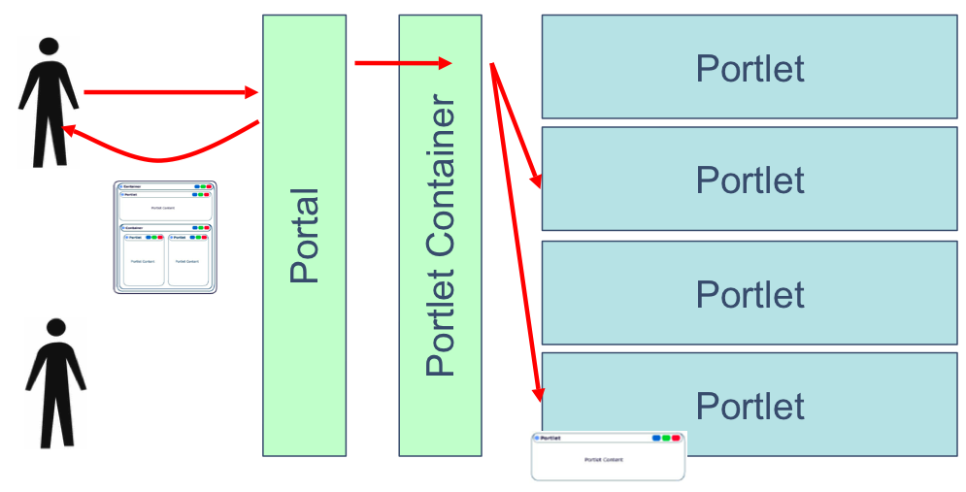
Architecture

Slide 24
Portlet application packaging
Portlets are packaged in a war file and the portlet container discovers them
The portlet.xml deployment descriptor configures and describes the portlets

Slide 25
Configuration
<?xml version="1.0" encoding="UTF-8"?>
<portlet-app
xmlns="..." version="2.0"xmlns:xsi="..." xsi:schemaLocation="http://java.sun.com/xml/ns/portlet/portlet-app_2_0.xsd">
<portlet>
<description xml:lang="EN">HelloWorld Portlet</description>
<portlet-name>HelloWorld</portlet-name>
<display-name xml:lang="EN">Hello World Portlet</display-name>
<portlet-class>org.exoplatform.demo.HelloWorldPortlet</portlet-class>
<expiration-cache>0</expiration-cache>
<supports>
<mime-type>text/html</mime-type>
<portlet-mode>help</portlet-mode>
<portlet-mode>edit</portlet-mode>
</supports>
<supported-locale>en</supported-locale>
<supported-locale>fr</supported-locale>
<portlet-info>
<title>HelloWorld</title>
<short-title>Hello</short-title>
</portlet-info>
</portlet>
</portlet-app>
25

Slide 26
JSP Code Snippets
26
Notes:
26
26

Slide 27
PortletRequestDispatcher
Delegate rendering to a jsp page
private static final String VIEW_PAGE = "/WEB-INF/jsp/view.jsp";
public void doView(RenderRequest pRequest, RenderResponse pResponse)
throws PortletException, IOException {
pResponse.setContentType("text/html");
PortletContext context = getPortletContext();
portletRequestDispatcher rd = context.getRequestDispatcher(VIEW_PAGE);
rd.include(pRequest, pResponse);
}

Slide 28
Portlets URL
Portlets URL are managed by the portal
The PortletURL object is available during rendering phase and allows to create an URL to the action phase or rendering phase of the portlet
...
PortletURL renderURL = response.createRenderURL();
renderURL.setParameter(“a”, “b”);
renderURL.setPortletMode(PortletMode.EDIT”);
renderURL.setWindowState(WindowState.MAXIMIZED);
String url = portletURL.toString();
PortletURL actionURL = response.createActionURL();
...

Slide 29
Portlet Taglib for JSP
...
<%@taglib uri="http://java.sun.com/portlet_2_0" prefix="portlet"%>
<!-- Mandatory !!! -->
<portlet:defineObjects /> <br/>
...
<!-- une autre manière de créer des URLs -->
<portlet:renderURL var="renderURL"/> <br/>
Render Link: <a href="<%=renderURL %>"
...
WindowState and PortletMode <br/>
<%= renderRequest.getWindowState().toString()%> <br/>
<%= renderRequest.getPortletMode().toString()%> <br/>

Slide 30
Portlet Preferences
30
Notes:
30
30

Slide 31
PortletPreferences
Classes and methods to manage personalization of portlets
Generally used in the «edit» mode
Preferences can be editable (action) or read only (render)

Slide 32
PortletPreferences
...
<portlet-preferences>
<preference>
<name>message</name>
<value>Message par defaut</value>
<read-only>false</read-only>
</preference>
</portlet-preferences>
...
...
PortletPreferences prefs = actionRequest.getPreferences();
prefs.setValue("message", "Nouveau Message");
prefs.store();
...
...
String message = prefs.getValue("message", “");
...

Slide 33
Save Preferences
Input form ... <portlet:actionURL var="action"/> <form action="<%=action %>" method="post"> <label for="messageinput">Message:</label> <input type="text" name="message" id="messageinput" value="<%= message %>"/> <input type="submit" label="Save" /> </form> ...
ProcessAction() call ... if (request.getPortletMode().equals(PortletMode.EDIT) ) { String message = request.getParameter("message"); PortletPreferences prefs = request.getPreferences(); prefs.setValue("message", message); prefs.store(); response.setPortletMode(PortletMode.VIEW); } ...

Slide 34
Simple Portlet Example
34
Notes:
34
34

Slide 35
Portlet Example
Simple Hello World: package
|-- SimplestHelloWorld-0.0.1.war
| `-- WEB-INF
| |-- classes
| | `-- org
| | `-- gatein
| | `-- portal
| | `-- examples
| | `-- portlets
| | `-- SimplestHelloWorldPortlet.class
| |-- portlet.xml
| `-- web.xml
Notes:
35
35

Slide 36
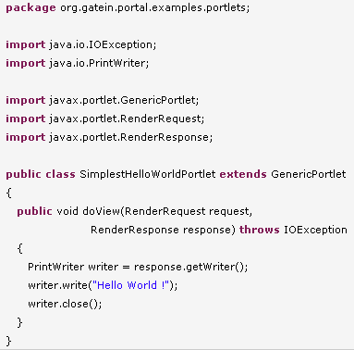
Portlet Example – Portlet Class
Notes:
36
36

Slide 37
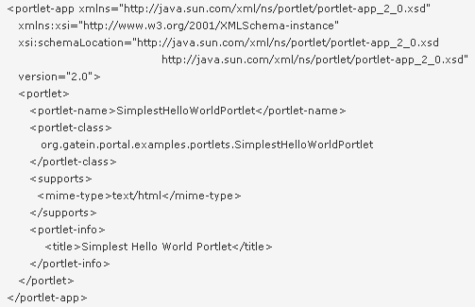
Portlet Example – portlet.xml
Notes:
37
37

Slide 38
Exercises – Simple Portlets
Simple Portlets
There are four examples of portlet bridges
Analyse, build and test these examples
Simple hello world (java only) (Add doEdit() method and “edit” in the portlet.xml file)
JSP: hello user (all phases)
Extra: Take the JSP example, modify it depending on your experience: modify the rendering jsp files, access to eXo services, add a form and react to different parameters
Notes:
38
38

Slide 39
Extra Exercise – Portlet 2.0
Push by RenderReponse:
In Portlet 2.0 you can modify any element of the response from any portlet.
Therefore you use the RenderResponse object.
An example of a RenderResponse is in a portlet’s form code that adds a javascript to header of the page:
RenderResponse response = context.getResponse();
Element elementS = response.createElement("script");
elementS.setAttribute("type", "text/javascript");
elementS.setAttribute("src", "/eXoWCMResources/javascript/eXo/wcm/backoffice/public/Components.js");
response.addProperty(MimeResponse.MARKUP_HEAD_ELEMENT,elementS);
Exercise: Create a portlet that adds a favicon to the current page, access the favicon by a rest service. Or alternatively add Google Analytics. Favicon hint: <link rel="shortcut icon" href=“/portal-rest-path/name_of_icon.ico"> or add a meta data (for search engines)
Notes:
39
39

Slide 40
Portlet Bridges
40
Notes:
40
40

Slide 41
Portlet Bridges
Bridges are portlet implementations which adapt web framework to the portlet world and allows you to execute native applications
JSF Portlet Bridge / JSR 301
Struts 1 bridge deprecrated
Struts 2 portlet
SpringMVC portlet
Grails portlet
Tapestry portlet

Slide 42
The web framework reality check
Gives you productivity
You should not develop an application with the Portlet API
low level
not productive

Slide 43
Web framework for portals
The Portlet Bridge
An adapter for a web framework to the portlet container runtime
Works ideally with framework that does not expose the servlet container
Limited support for the full portlet API
The Portlet Framework
The web framework approach to the portlet world
Leverage your knowledge of a framework
The full portlet API can be leveraged

Slide 44
Portlet Bridges
Modern web frameworks have an abstraction (SPI) over the servlet API
The bridge implements the SPI by delegating to portlet container
Legacy web frameworks relies on the servlet API
The bridge executes the target framework in its servlet container context
Notes:
SPI : System Programmer Interface

Slide 45
JSF Bridge Specification
Portlet Bridge Specification for JavaServer Faces (JSR 301)
The main goal is to define how a JSF application executes in a portlet environment
Additionally it specifies how advanced portlet features can be used
Split into two specifications
Portlet 1.0 Bridge Specification for JavaServer Faces 1.2
Portlet 2.0 Bridge Specification for JavaServer Faces 1.2
At least three open source implementations
Apache MyFaces Portlet (RI)
JBoss PortletBridge
OpenPortal JSF PortletBridge

Slide 46
JSF Bridge Lifecycle
Restore
View
Apply
Request
Values
Process
Validations
Action
Save Context
Invoke
Application
Update
Model
Values
Render
Load
Context
Restore
View
Render

Slide 47
JSF Bridge Features
Clean room specification
Maintain action request attributes
Handle identifier namespacing
Handle redirects during the render phase
Supports portlet mode changes
Manage a view per mode
Navigation between modes
/edit.jspx?javax.portlet.faces.PortletMode=edit
#{sessionScope['javax.portlet.faces.viewIdHistory.view']}

Slide 48
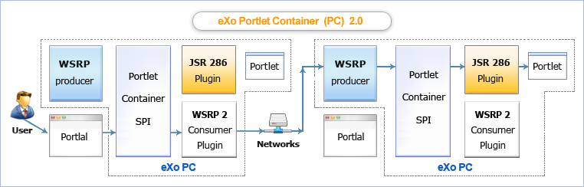
WSRP: Remote Portlets

Slide 49
JBoss Portlet Bridges
JBoss Portlet Bridge
Implementation of the JSR-329 specification which supports the JSF 1.2 runtime within a JSR 286 portlet
Supports JSF, Seam and RichFaces
The developer no longer needs to worry about the underlying portlet development, portlet concepts, or the API.
Notes:
49
49

Slide 50
JBoss Portlet Bridges
Understanding how JSF works with Portal
The portlet bridge isn't a portlet. It's the mediator between the two environments and allows JSF and Portal to be completely unaware of each other.
The bridge is used to execute Faces requests on behalf of the portlet.
During each request, the Faces environment is setup and handled by the bridge.
Part of this implementation acts as a Faces controller much as the FacesServlet does in the direct client request world.
Notes:
50
50

Slide 51
Exercises – JBoss Portlet Bridges
Portlet Bridges
There are two examples of portlet bridges
Analyse, build and test these examples
JSF: hello user
Extra: Struts: jpetstore
Extra: Customize the JSF example
Notes:
51
51

Slide 52
Portlets
Notes:
52

