Slide 1
GIT Introduction
Vu Viet Phuong - PortalTeam

Slide 2
Objective
Understand the advantage of GIT and determine if we should use GIT or not.
Know how to use the common used GIT commands

Slide 3
Subject
Characteristic of GIT
  The most powerful features of GIT
  Explain the differences between GIT and SVN
GIT basic usages
  - Day to day GIT used commands
Tips and Tricks

Slide 4
Characteristic of GIT

Slide 5
History
Invented by Linus Torvalds to
    support the development of the Linux Kernel
Incredibly fast, very eﬃcient with large projects,
  has an incredible branching system for non-linear development
Projects using Git : Linux Kernel, Perl, Eclipse, Android ...

Slide 6
Compare to SVN
There are many version control tools in the market
    But GIT is a completely difference tool
    GIT own many distinct, powerful features
Interface is fairly similar to SVN
Git stores and thinks about data differently than SVN

Slide 7
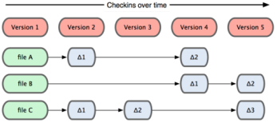
SVN Data Model
SVN store history as a list of ﬁle-based changes

Slide 8
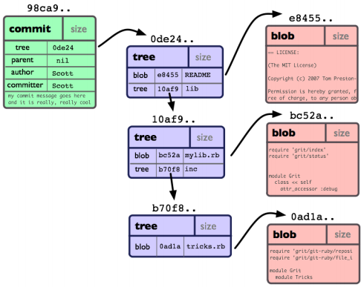
GIT Data Model
Database addressable by the hash value of its contents

Slide 9
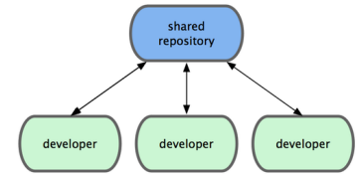
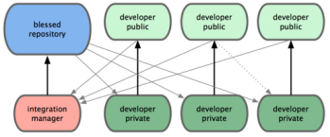
Repository
GIT - Local and multi Remote Repositories
    SVN – only 1 repository on server
SVN may loose history in some case, Git doesn't

Slide 10
Why's GIT fast ?
The internal database structure
Nearly every operation is Local
Entire history is on local disk
This database is compressed effectively
  transfer over network, use SSH or GIT protocol

Slide 11
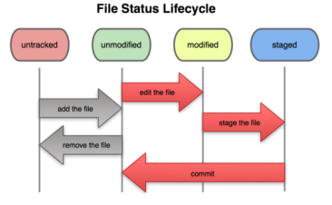
State
States : untracked, modiﬁed, and staged, committed

Slide 12
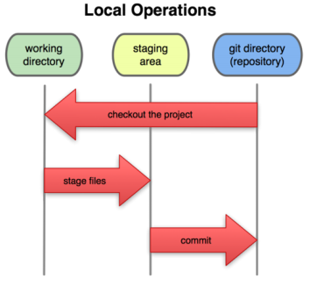
Working Area
The Git directory, the working directory, and the staging area.

Slide 13
Branch Management
Killer feature – Managing branches
    Make Git apart in the VCS community
Branching operations nearly instantaneous
    Switching back and forth between branches just as fast
We can create branches, and merge often
    even multiple times in a day

Slide 14
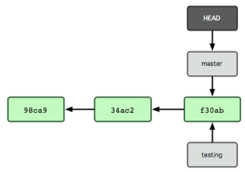
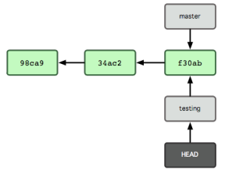
Switch Branch
Point to current Branch
Switch branch

Slide 15
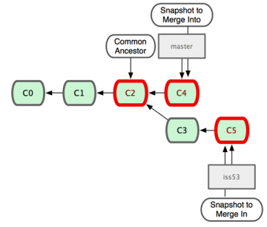
Basic Merge

Slide 16
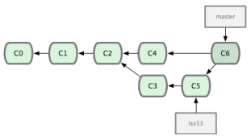
Basic Merge
Include changes
from C3, C5

Slide 17
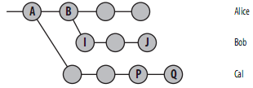
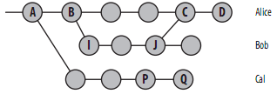
Advance Merge
Histories have diverged
Merge Bob to Alice

Slide 18
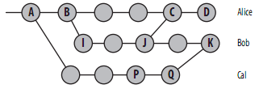
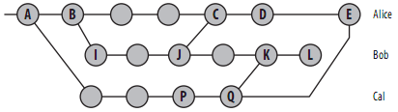
Advance Merge
Merge Cal to Bob
Merge Cal to Alice

Slide 19
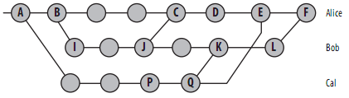
Advance Merge
Merge Bob to Alice

Slide 20
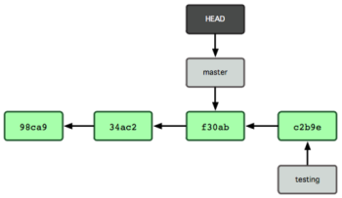
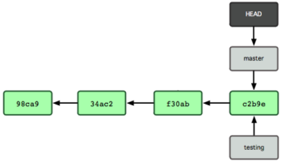
FastForward Merge
Merge testing to master
Move pointer forward

Slide 21
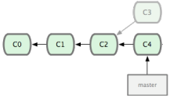
FastForward Push
GIT “push” comand equals to svn commit
    By default, GIT only allow “FastForward” push
    To override this, use --force option
before push
public repository's master
after force push

Slide 22
Modify History
Return to one point in History
    $ git reset --hard <commitID>
Replace last commit
    $ git commit –amend -m <msg>
Rebase history
    $ git rebase -i <commitID>

Slide 23
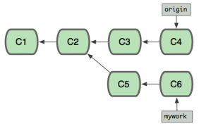
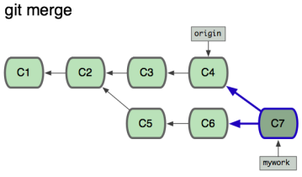
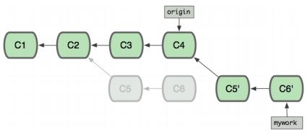
Rebase History
Can be used to merge branches, or modify history
rebase

Slide 24
Working with Patch
Support binary patch
  Resize a “jpeg” file → support create patch
    $ git diff --binary > patchToFile
Create – apply mutiple patches
Cherry picking

Slide 25
Git Basics

Slide 26
Installing GIT
http://git-scm.com/download
Window, Mac – Download Installation file
Linux - The primary Git package :
  git-core, git-doc – document
  git-cvs, git-svn – work with CVS, or SVN
  gitk – graphical application
$ sudo apt-get install git-core git-doc gitk git-svn

Slide 27
Configuration
3 Config files:
    /etc/gitconfig → all users, repositories (--system)
    ~/.gitconfig → one user, all repo (--global)
    [repo]/.git/config → specific to repository (default)
Your Identity – information in each commit
    $ git config --global user.name "phuong_vu"
    $ git config --global user.email phuong_vu@exoplatform.com
List all config values:
    $ git config --list

Slide 28
Ignoring Files
3 places to put ignore file names:
    .gitignore
        specific to folder, go with source code to public repo
    .git/info/exclude
        not share with others
    $ git config core.excludesfile <path>
        can use system, global, or default config file

Slide 29
Create .git
Initialized empty Git repository (.git folder)
    $ git init
Cloning an existing Repository
    $ git clone <url>
Create GIT repo from SVN repo
    $ git svn clone --username <name> <url>

Slide 30
Everyday works
$ git add [-A] [-i] <path>
  add changes to index
$ git rm [--cached] <path>
  remove changes
$ git commit [-a] -m “msg”
  commit changes

Slide 31
View Changes
Git store project snapshot on each commit
    SVN store a list of ﬁle-based changes
$ git show <commitID>
Uncommitted changes
        $ git diff [--cached]
Changes between branches
        $ git diff master..standalone

Slide 32
View History
$ git log [--pretty] [--graph] [--grep] [-S]
--pretty → display format
--graph → show history in diagram
--grep → search by commit msg
--S → search by diff
Search log by content
        $ git log --follow [PATH]

Slide 33
Revert Changes
Modify history
    Replace last commit
        $ git commit --amend -m “msg”
    Reset your history
        $ git reset --hard <commitID>
    Rebase history
Make new commit
        $ git revert <commitID>

Slide 34
Share Changes
Remote Repository
    Versions of your project hosted on some where else
Show remotes
        $ git remote [show <remoteName>]
Push – Pull changes (svn commit | update)
        $ git [push | pull] [remoteName]

Slide 35
Local and Remote
GIT have 2 types of branch : local, remote branch
Local branch
    $ git branch <name> #create branch
    $ git checkout <name> #switch to
    $ git branch -d <name> #delete
Remote branch : local branches that can't be switched to
Act like a cache of remote repository's branch

Slide 36
Remote Branch
Show remote branches
    $ git branch -r
Make your history simple
    $ git fetch [remote]
    $ git rebase [remote/branch]
Remote tracking branch
    $ git checkout -b <name> <remote/branch>

Slide 37
Patch
Create – apply multi patches
    $ git format-patch <commitID>
    $ git am <path>
Cherry picking
    $ git cherry-pick <commitID>
Stashing – temporary save your work
    $ git stash [apply]

Slide 38
Tips and Tricks

Slide 39
Auto-Completion
Git source:
    contrib/completion/git-completion.bash
$ git chec → [TAB] → $ git checkout
Copy to folder
Ubuntu /etc/bash_completion.d/
Mac /opt/local/etc/bash_completion.d/

Slide 40
Alias
Make commands shorter
  Create alias for long and common use commands
$ git config --global alias.lg "log --pretty=oneline --graph"
        now use $ git lg

Slide 41
Editor
GIT default uses system's default editor
    conﬁgure the text editor if we don't like the default one
$ git config --global core.editor gedit
or
$ export GIT_EDITOR=gedit

Slide 42
Diff Tool
Git has an internal implementation of diﬀ
  But we can set up external merge and diff tools
Git accepts xxdiﬀ, emerge, vimdiﬀ, gvimdiﬀ, opendiﬀ...
$ git config --global merge.tool vimdiff

Slide 43
Resources
http://whygitisbetterthanx.com
    More explaination why use GIT
    Basic tutorial
Version Control with Git - O'Reilly Media
    Advance GIT

