Slide 1

JCR Query Usage
&
Best Practices
Le Thanh Hai
ECMS Team

Slide 2
Agenda
Abstract
  Content repository & CMS
  Problems
  Solution
JCR Concept
  What is JCR
  Content Repository Model
  Compliance Levels
  Available Implementations
eXo-JCR Implementation
eXo-JCR Query Usage
  Query lifecycle
  Basic queries
  Advanced queries with Lucene
References

Slide 3

Abstract

Slide 4

Content repository & CMS
CMS is a system providing a collection of procedures used to manage work flow in a collaborative environment
The content repositories are used in CMSs to keep the content data and also the metadata

Slide 5



Problems
Each CMS vendor provides its own API for interacting with the content repository
Developers have to spend time learning each vendor's repository-specific API.
CMS vendors are forced to develop and maintain their own content repository implementations
Corporations spend a lot of money getting these different CMSs to interact with each other

Slide 6
Solution
JSR-170 tries to solve this problem by standardizing the API that should be used for connecting to any content repository.

Slide 7
JCR Concept

Slide 8
What is JCR
JCR (Java Content Repository) is a java interface used to access contents that are not only web contents, but also other hierarchically stored data
The content is stored in a repository.
The repository can be a file system, a relational database or an XML document

Slide 9
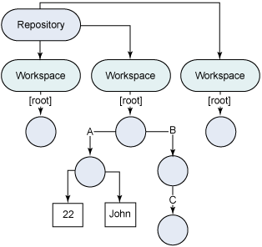
Content Repository Model

Slide 10
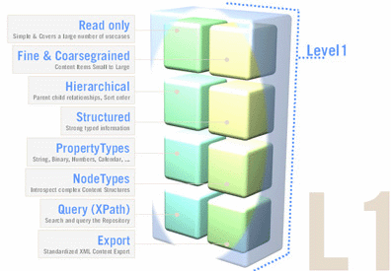
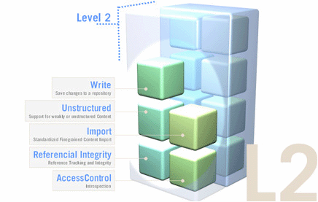
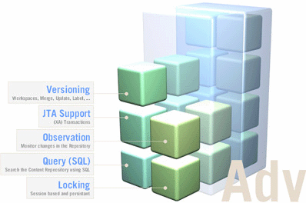
Compliance Levels

Slide 11
Available Implementations
eXo JCR
  http://www.jboss.org/exojcr.html
Apache Jackrabbit
  http://jackrabbit.apache.org
Alfresco Java Content Repository API
  http://wiki.alfresco.com/wiki/Introducing_the_Alfresco_Java_Content_Repository_API
Oracle Beehive
  http://www.oracle.com/technetwork/middleware/beehive/overview/index.html
Jboss ModeShape (JCR 2.0/JSR-283)
  http://www.jboss.org/modeshape

Slide 12
eXo-JCR Implementation

Slide 13
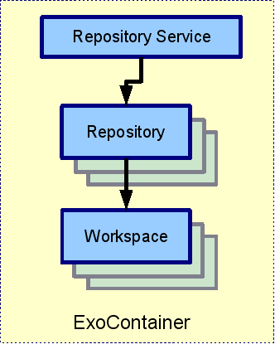
Repository Service

Slide 14
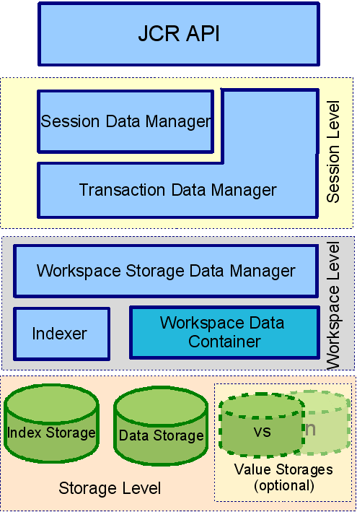
Workspace Data Model

Slide 15
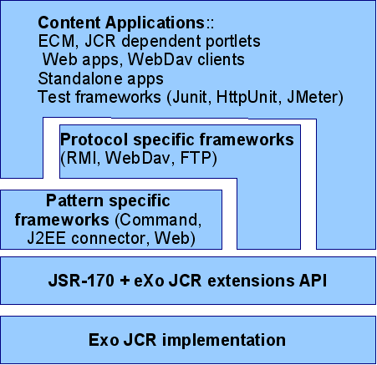
eXo JCR Application Model

Slide 16
eXo-JCR Query Usage

Slide 17
Query Lifecycle
Query creation
Execution
Result processing
QueryManager queryManager = workspace.getQueryManager(); Query query = queryManager.createQuery("SELECT * FROM nt:base ", Query.SQL);
QueryResult result = query.execute();
NodeIterator it = result.getNodes();

Slide 18
Basic Queries
Finding nodes by Primary Type or Mixin Type
Property comparison
NOT, AND, OR constraint
SELECT * FROM nt:file SELECT * FROM mix:title
SELECT jcr:title FROM mix:title WHERE prop_pagecount < 90
SELECT * FROM mix:title WHERE NOT jcr:title ='t1' SELECT * FROM mix:title WHERE jcr:title = 't1' AND prop_pagecount > 90 SELECT * FROM mix:title WHERE jcr:title = 't1' OR jcr:title = 't2'

Slide 19
Basic Queries (cont)
LIKE constraint & escaping
UPPER case & LOWER case
Property existence constraint
SELECT * FROM mix:title WHERE jcr:title LIKE 'P%' SELECT * FROM mytype WHERE a LIKE 'foo\%' ESCAPE '\'
SELECT * FROM mix:title WHERE UPPER(jcr:title) = 'CASESENSITIVE' SELECT * FROM mix:title WHERE LOWER(jcr:title) = 'casesensitive'
SELECT * FROM mix:title WHERE jcr:description IS NULL

Slide 20
Basic Queries (cont)
Date property comparison
Path & node name constraint
Sorting
SELECT * FROM nt:file WHERE jcr:lastModified >= TIMESTAMP '2011-06-04T15:34:15.917+02:00'
SELECT * FROM nt:folder WHERE jcr:path LIKE '/folder1/folder2/%' SELECT * FROM nt:file WHERE fn:name() = 'document' [fn:name() can be used ONLY with an equal('=') comparison.]
SELECT * FROM mix:title ORDER BY prop_pagecount ASC [Ordering by jcr:path or jcr:name does not supported.]

Slide 21
Advanced Queries With Lucene
What is Lucene
Lucene Indexing & Searching
eXo-JCR Advanced Queries
  Fulltext search by property
  Scoring
  Ignoring accent symbols
  High-lighting result of fulltext search
  Searching by synonim
  Checking the spelling
  Finding similar nodes
  Fuzzy searches

Slide 22
What is Lucene
An open-source project implemented in Java.
A high performance, scalable Information Retrieval (IR) library.
Lets you add indexing and searching capabilities to your applications.
Was originally written by Doug Cutting.
Joined the Apache Jakarta family in September 2001.
Is an important part of eXo-JCR

Slide 23
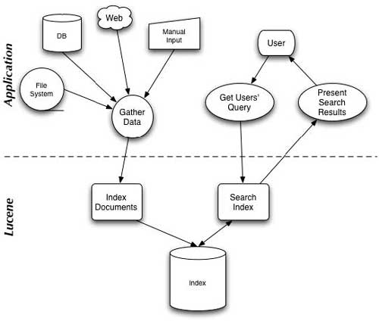
What is Lucene (cont)

Slide 24
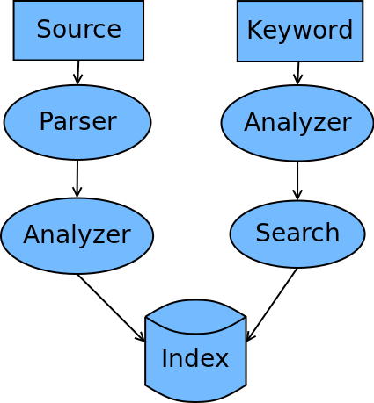
Lucene Indexing & Searching

Slide 25
Lucene Indexing & Searching (cont)
The theory
  An Index is a sequence of documents (a.k.a. Directory)
  A Document is a sequence of Fields.
  A Field is a pair of text (name/value).
  Field values is a sequence of terms & may be stored, indexed or analyzed
Source parser: parses the source data to text
Query parser:
  Parses query expression into Query instance
  Example: “+lucene publisher:manning”

Slide 26
Lucene Indexing & Searching (cont)
Analyzer: Occurs for each tokenized field during indexing or each term or phrase in QueryParser.
Built-in Analyzers:
Text: "The quick brown fox jumped over the lazy dogs"
Analyzer | Parsed
WhitespaceAnalyzer | [The] [quick] [brown] [fox] [jumped] [over] [the] [lazy] [dogs]
SimpleAnalyzer | [the] [quick] [brown] [fox] [jumped] [over] [the] [lazy] [dogs]
StopAnalyzer | [quick] [brown] [fox] [jumped] [over] [lazy] [dogs]
StandardAnalyzer | [quick] [brown] [fox] [jumped] [over] [lazy] [dogs]
SnowballAnalyzer | [quick] [brown] [fox] [jump] [over] [lazi] [dog]
StandardAnalyzer (configured without stop word - jcr default analyzer) | [the] [quick] [brown] [fox] [jumped] [over] [the] [lazy] [dogs]

Slide 27
eXo-JCR Advanced Queries

Slide 28
eXo-JCR Advanced Queries
Fulltext search by property
Scoring
Finding nt:file node by content of child jcr:content node
SELECT * FROM mix:title WHERE CONTAINS(jcr:description, 'forest') SELECT * FROM mix:title WHERE CONTAINS(*,'break')
SELECT * FROM nt:base ORDER BY jcr:score [ASC|DESC] SELECT * FROM nt:base ORDER BY jcr:score() [ASC|DESC]
[indexing-configuration.xml] ... <aggregate primaryType="nt:file"> <include>jcr:content</include> <include>jcr:content/*</include> <include-property>jcr:content/jcr:lastModified</include-property> </aggregate> ...

Slide 29
eXo-JCR Advanced Queries (cont)
Ignoring accent symbols
[repository-configuration.xml] ... <query-handler class="org.exoplatform.services.jcr.impl.core.query.lucene.SearchIndex"> <properties> <property name="analyzer" value="myPackage.MyAnalyzer"/> ... </properties> </query-handler>
public class MyAnalyzer extends Analyzer { @Override public TokenStream tokenStream(String fieldName, Reader reader) { StandardTokenizer tokenStream = new StandardTokenizer(reader); TokenStream result = new StandardFilter(tokenStream); result = new LowerCaseFilter(result); return new ISOLatin1AccentFilter(result); } }

Slide 30
eXo-JCR Advanced Queries (cont)
High-lighting result of fulltext search
[repository-configuration.xml] ... <query-handler class="org.exoplatform.services.jcr.impl.core.query.lucene.SearchIndex"> <properties> <property name="support-highlighting" value="true" /> <property name="excerptprovider-class" value="[package].DefaultXMLExcerpt"/> ... </properties> </query-handler>
QueryManager qm = session.getWorkspace().getQueryManager(); String strQuery = "select excerpt(.) from nt:resource where contains(., 'eXo')" Query q = qm.createQuery(strQuery, Query.SQL); QueryResult result = q.execute(); for (RowIterator it = result.getRows(); it.hasNext(); ) { Row r = it.nextRow(); Value excerpt = r.getValue("rep:excerpt(.)"); }

Slide 31
eXo-JCR Advanced Queries (cont)
Searching by synonim
[repository-configuration.xml] ... <query-handler class="org.exoplatform.services.jcr.impl.core.query.lucene.SearchIndex"> <properties> <property name="synonymprovider-config-path" value="../../synonyms.properties" /> <property name="synonymprovider-class" value="[package].PropertiesSynonymProvider"/> ... </properties> </query-handler>
SELECT * FROM mix:title WHERE CONTAINS(jcr:title, '~fast')

Slide 32
eXo-JCR Advanced Queries (cont)
Checking the spelling
[repository-configuration.xml] ... <query-handler class="org.exoplatform.services.jcr.impl.core.query.lucene.SearchIndex"> <properties> <property name="spellchecker-class" value="[package].LuceneSpellChecker$FiveSecondsRefreshInterval" /> ... </properties> </query-handler>
SELECT rep:spellcheck() FROM nt:base WHERE jcr:path = '/' AND SPELLCHECK('explatform')

Slide 33
eXo-JCR Advanced Queries (cont)
Finding similar nodes
[repository-configuration.xml] ... <query-handler class="org.exoplatform.services.jcr.impl.core.query.lucene.SearchIndex"> <properties> <property name="support-highlighting" value="true" /> ... </properties> </query-handler>
SELECT * FROM nt:resource WHERE SIMILAR(.,'/baseFile/jcr:content') [Relative path is not supported yet]

Slide 34
eXo-JCR Advanced Queries (cont)
Fuzzy searches
SELECT * FROM nt:base WHERE CONTAINS(field, 'roam~') SELECT * FROM nt:base WHERE CONTAINS(field, 'roam~0.8')

Slide 35
References

Slide 36
References
JCR
  http://jcp.org/en/jsr/detail?id=170
  http://www.jboss.org/exojcr/documentation
  http://en.wikipedia.org/wiki/Content_repository_API_for_Java
Lucene
  http://lucene.apache.org/java/docs/index.html
  http://www.webreference.com/programming/lucene/2.html
  http://www.slideshare.net/node/lucene-in-action
  http://www.codeproject.com/KB/applications/LuceneSearchProgramming.aspx

Slide 37
Thank you!

