Slide 1

PROJECT ON
Chat Link
Name:
ĐOÀN XUÂN DŨNG
BÙI VĂN TOÀN

Slide 2
CHAT LINK
Chat application base on java
Can have group chat or individual chat
User can register new account
Work over intranet

Slide 3
SYSTEM ANALYSIS
Using java network technology with socket
Data base with MS SQL server
Chat over network with multiple pc
Vietnamese interface
Implement all requirement from project

Slide 4
FEATURES V2
Save chat history
Send file
Export history
Emoticons

Slide 5
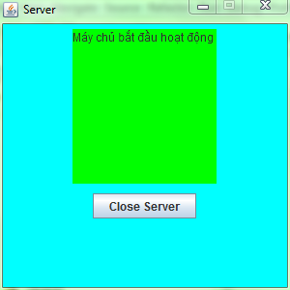
UI DESIGN
Interface Design for Server

Slide 6
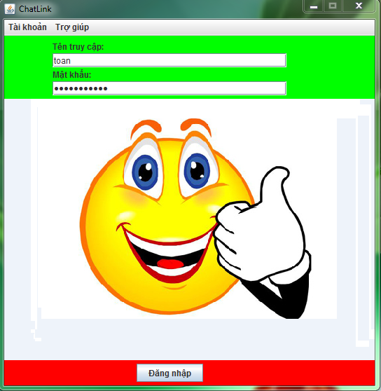
UI DESIGN
Interface Design for Login

Slide 7
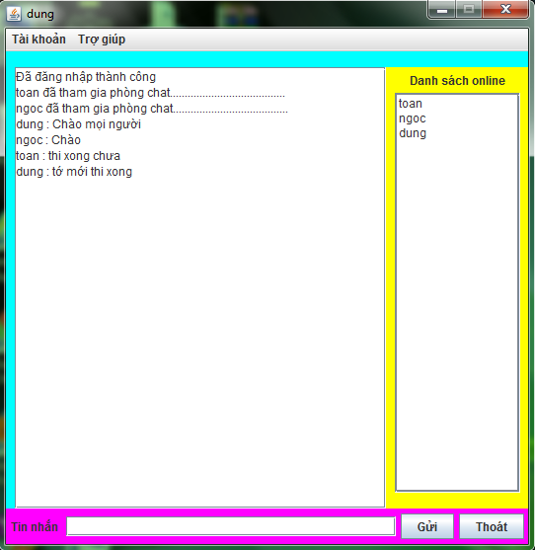
UI DESIGN
Interface Design for General Chat

Slide 8
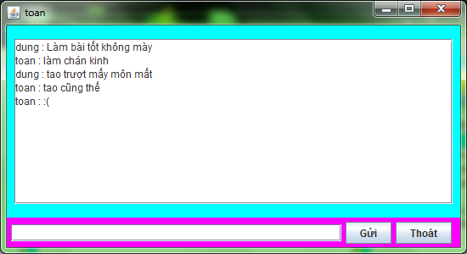
UI DESIGN
Interface Design for Private Chat

Slide 9
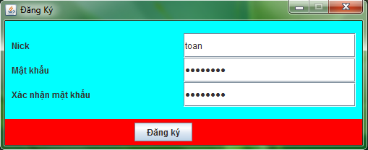
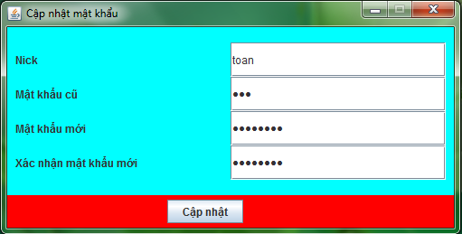
UI DESIGN
Interface Design for Registry Account in Menu Account
Interface Design for Update Account in Menu Account

Slide 10
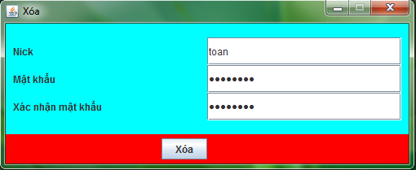
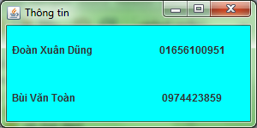
UI DESIGN
Interface Design for Delete Account in Menu Account
Interface Design for Information in Menu Help

Slide 11
DEMO

Slide 12

QUESTIONS

Slide 13
THANKS A LOT!

