Slide 1
Session 6
Connecting to the world

Slide 2
Networking in J2ME
The networking in J2ME has to be very flexible to support a variety of devices .
To meet these challenges, the Generic Connection framework is first introduced in the CLDC.
The idea of the Generic Connection framework is to define the abstractions of the networking and file I/O as general as possible to support a broad range of handheld devices.
These abstractions are defined as Java interfaces. The device manufacturers choose which one to implement in their MIDP based on the actual device capabilities.

Slide 3
There is 1 class (Connector) and 7 connection interfaces (Connection,ContentConnection, DatagramConnection, InputConnection, OutputConnection,StreamConnection, and StreamConnectionNotifier) defined in the Generic

Slide 4
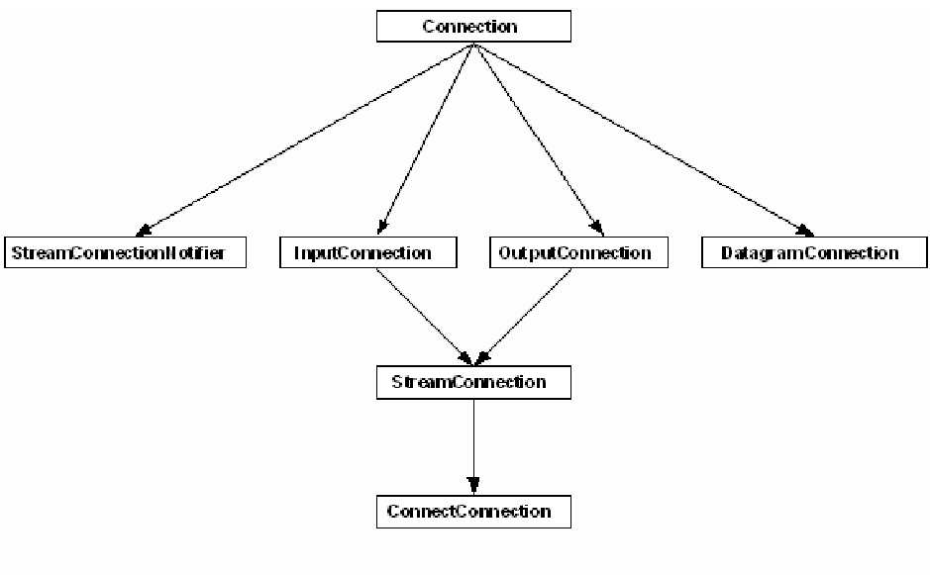
Generic Connection Framework

Slide 5
The Connector class is the core of Generic Connection framework. The reason we say that is because all connection objects we mentioned above are created by the static method open defined in Connector class. Different types of communication can be created by the same method with different parameters. The connection could be file I/O, serial port communication, datagram connection, or an http connection depending on the string parameter passed to the method. Such design makes J2ME implementation very extensible and flexible in supporting new devices and products.

Slide 6
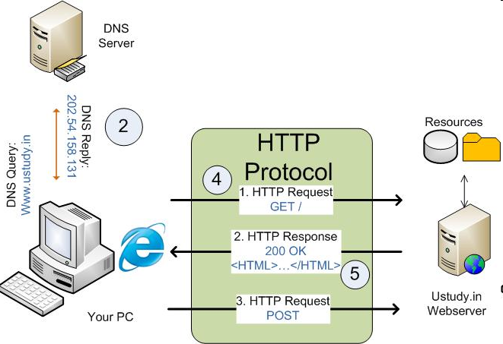
Review of HTTP

Slide 7
HTTP Connection
The HttpConnection class is defined in J2ME MIDP to allow developer to handle http connections in their wireless applications. The HttpConnection class is guaranteed available on all MIDP devices.

Slide 8
HTTP communication:
Stream-based Socket communication:
Serial port communication:

Slide 9
Input Stream and Output Stream
An input stream can be used to read contents from a Web server while output stream can be used to send request to a Web server.
These streams can be obtained from the HttpConnection object after the connection has been established with the Web Server

Slide 10
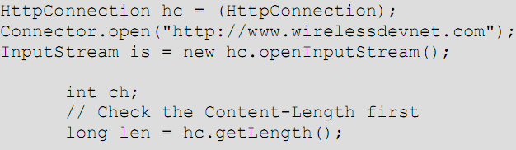

Slide 11
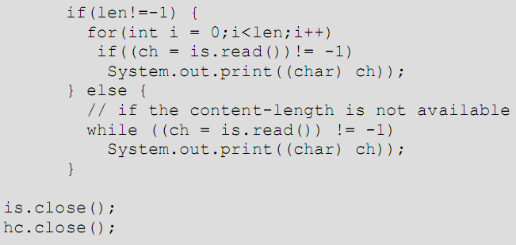

Slide 12
Using Cookies for Session Tracking
HTTP: stateless protocol – each request and response pair is a separate conversation
Session: collection of information that helps server to remember “who you are”
Cookie: common way to store session ID; passed from server to client in an HTTP response

Slide 13
Cookie in J2ME
try{
con = (HttpConnection) Connector.open(url);
con.setRequestMethod(HttpConnection.GET);
if(cookie != null){
con.setRequestProperty("cookie", cookie);
}

Slide 14
String server_cookie = con.getHeaderField("set-cookie");
if(server_cookie != null){
writeRecord(server_cookie);

