Slide 1
Session 9
Bluetooth and OBEX

Slide 2
Introduction
Solutions for connecting to things that are next to you?
Bluetooth: radio connectivity technology for creating Personal Area Networks (PANs)
Object Exchange Protocol (OBEX): communication protocol enable to talk to one another easily over infrared.

Slide 3
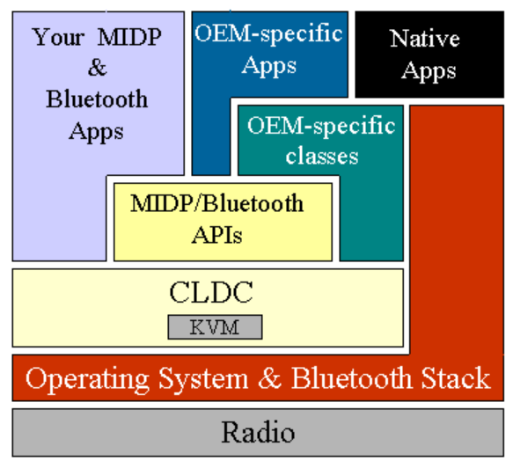
High-level Architecture of J2ME CDLC/MIDP and Bluetooth

Slide 4
Bluetooth Service Model
Bluetooth-enabled devices: organize in groups called piconets.
A piconet consists of a master and up to seven active slaves.
A master and a single slave use point-to-point communication; if there are multiple slaves, point-to-multipoint communication is used.
A master unit is the device that initiates the communication. A device in one piconet can communicate to another device in another piconet.

Slide 5
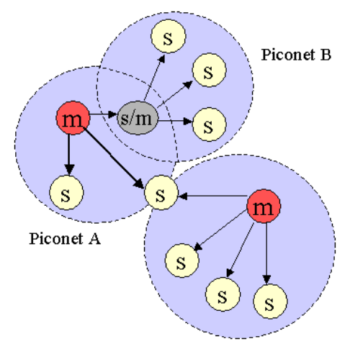
Scatternet Comprising Three Piconets

Slide 6
Bluetooth JSR (JSR 82)
Java API for Bluetooth
Java API for OBEX

Slide 7
Bluetooth API
Application Programming:
The anatomy of a Blueooth application has five parts: stack initialization, device management, device discovery, service discovery, and communication.

Slide 8
btspp://localhost:" + RFCOMM_UUID + ";name=rfcommtest;authorize=true

Slide 9
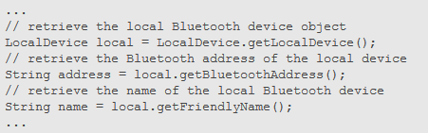
Devices management
The Java Bluetooth APIs contain the classes LocalDevice and RemoteDevice, which provide the device-management capabilities defined in the Generic Access Profile

Slide 10
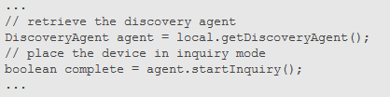
Device Discovery
Core Bluetooth API's DiscoveryAgent class and DiscoveryListener interface provide the necessary discovery services.

Slide 11
Service Discovery
Once the local device has discovered at least one remote device, it can begin to search for available services
Before a service can be discovered, it must first be registered - advertised on a Bluetooth server device

Slide 12

To create a new service record that represents the service, invoke Connector.open
Obtain the service record created by the server device:

Slide 13

Indicate that the service is ready to accept a client connection:

Slide 14
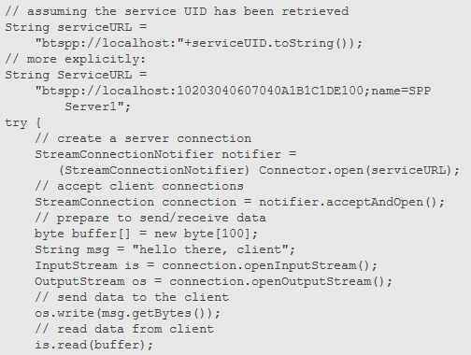
Communication

Slide 15
OBEX
Enable exchange of data such as contact, scheduling information
It’s request/response protocol

Slide 16
OBEX Requests
Get current connection ID:
public long getConnectionID();
Communications using Headers
Object getHeader(int headerID);
Obtaining OBEX Client and Server Connections

Slide 17
References
http://developers.sun.com/mobility/midp/articles/bluetooth1/
http://developers.sun.com/mobility/midp/articles/bluetooth2/

