Slide 1
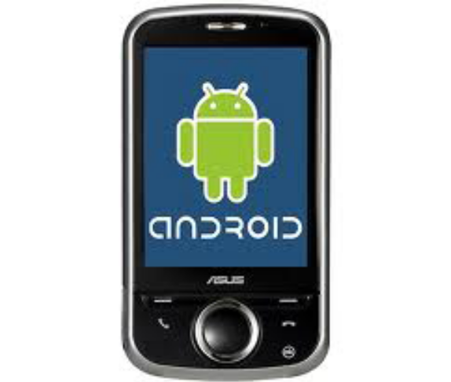

Introduction to Android
Session 1

Slide 2
Objectives
Introduction
Platform
Software development
Overall evaluation
Install Android in Eclipse

Slide 3
1. Introduction (1)
Few reasons to go Android?
Smart Phones
  Internet access anywhere
  Social networking
Millions of mobile users
Open standards

Slide 4
1. Introduction (2)
What is Android?
  A software platform and operating system for mobile devices
  Based on the Linux kernel
  Developed by Google and later the Open Handset Alliance (OHA)
  Allows writing managed code in the Java language

Slide 5
1. Introduction (3)
  Possibility to write applications in other languages and compiling it to ARM native code (support of Google? No)
  Unveiling of the Android platform was announced on 5 November 2007 with the founding of OHA

Slide 6

1. Introduction (4)
What is the Open Handset Alliance (OHA)? (1)
→ It's a consortium of several companies

Slide 7
1. Introduction (5)
What is the Open Handset Alliance (OHA)? (2)
  Devoted to advancing open standards for mobile devices
  Develop technologies that will significantly lower the cost of developing and distributing mobile devices and services

Slide 8
1. Introduction (6)
License
Android is under version 2 of the Apache Software License (ASL)

Slide 9
1. Introduction (7)
Features
Application framework enabling reuse and replacement of components
Dalvik virtual machine optimized for mobile devices
Integrated browser based on the open source WebKit engine
Optimized graphics powered by a custom 2D graphics library; 3D graphics based on the OpenGL ES 1.0 specification (hardware acceleration optional)
SQLite for structured data storage
Media support for common audio, video, and still image formats (MPEG4, H.264, MP3, AAC, AMR, JPG, PNG, GIF)
GSM Telephony (hardware dependent)
Bluetooth, EDGE, 3G, and WiFi (hardware dependent)
Camera, GPS, compass, and accelerometer (hardware dependent)
Rich development environment including a device emulator, tools for debugging, memory and performance profiling, and a plugin for the Eclipse IDE

Slide 10

1. Introduction (8)
Android Architecture

Slide 11
1. Introduction (9)
Applications
Android will ship with a set of core applications including an email client, SMS program, calendar, maps, browser, contacts, and others. All applications are written using the Java programming language.

Slide 12
1. Introduction (10)
Application Framework
By providing an open development platform, Android offers developers the ability to build extremely rich and innovative applications. Developers are free to take advantage of the device hardware, access location information, run background services, set alarms, add notifications to the status bar, and much, much more.
Developers have full access to the same framework APIs used by the core applications. The application architecture is designed to simplify the reuse of components; any application can publish its capabilities and any other application may then make use of those capabilities (subject to security constraints enforced by the framework). This same mechanism allows components to be replaced by the user.

Slide 13
1. Introduction (11)
Libraries
Android includes a set of C/C++ libraries used by various components of the Android system. These capabilities are exposed to developers through the Android application framework. Some of the core libraries are listed below:
System C library - a BSD-derived implementation of the standard C system library (libc), tuned for embedded Linux-based devices
Media Libraries - based on PacketVideo's OpenCORE; the libraries support playback and recording of many popular audio and video formats, as well as static image files, including MPEG4, H.264, MP3, AAC, AMR, JPG, and PNG
Surface Manager - manages access to the display subsystem and seamlessly composites 2D and 3D graphic layers from multiple applications
LibWebCore - a modern web browser engine which powers both the Android browser and an embeddable web view
SGL - the underlying 2D graphics engine
3D libraries - an implementation based on OpenGL ES 1.0 APIs; the libraries use either hardware 3D acceleration (where available) or the included, highly optimized 3D software rasterizer
FreeType - bitmap and vector font rendering
SQLite - a powerful and lightweight relational database engine available to all applications

Slide 14
1. Introduction (12)
Android Runtime
Android includes a set of core libraries that provides most of the functionality available in the core libraries of the Java programming language.
Every Android application runs in its own process, with its own instance of the Dalvik virtual machine. Dalvik has been written so that a device can run multiple VMs efficiently. The Dalvik VM executes files in the Dalvik Executable (.dex) format which is optimized for minimal memory footprint. The VM is register-based, and runs classes compiled by a Java language compiler that have been transformed into the .dex format by the included "dx" tool.
The Dalvik VM relies on the Linux kernel for underlying functionality such as threading and low-level memory management.

Slide 15
2. Platform (1)
Hardware
Android is not a single piece of hardware; it's a complete, end-to-end software platform that can be adapted to work on any number of hardware configurations. Everything is there, from the bootloader all the way up to the applications.

Slide 16
2. Platform (2)
Operating System(s)
  Android uses Linux for its device drivers, memory management, process management, and networking.
  The next level up contains the Android native libraries. They are all written in C/C++ internally, but you’ll be calling them through Java interfaces. In this layer you can find the Surface Manager, 2D and 3D graphics, Media codecs, the SQL database (SQLite), and a native web browser engine (WebKit).
  Dalvik Virtual Machine. Dalvik runs dex files, which are coverted at compile time from standard class and jar files

Slide 17
2. Platform (3)
Network Connectivity
  It supports wireless communications using:
    GSM mobile-phone technology
    3G
    Edge
    802.11 Wi-Fi networks

Slide 18
2. Platform (4)
Security
Android is a multi-process system, in which each application (and parts of the system) runs in its own process. Most security between applications and the system is enforced at the process level through standard Linux facilities, such as user and group IDs that are assigned to applications.
Additional finer-grained security features are provided through a "permission" mechanism that enforces restrictions on the specific operations that a particular process can perform, and per-URI permissions for granting ad-hoc access to specific pieces of data.

Slide 19
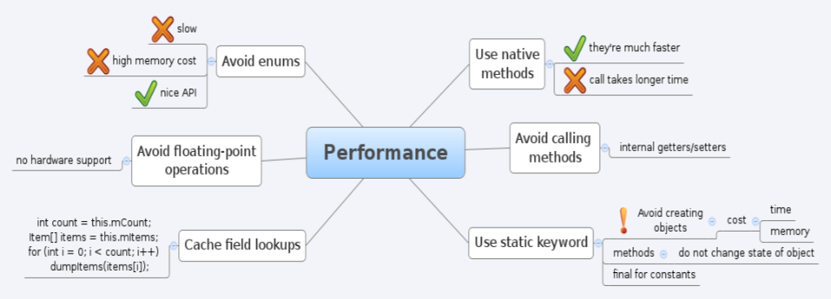
2. Platform (5)
Performance

Slide 20
2. Platform (6)
Future possibilities
  Google Android Sales to Overtake iPhone in 2012
  The OHA is committed to make their vision a reality: to deploy the Android platform for every mobile operator, handset manufacturers and developers to build innovative devices
  Intel doesn’t want to lose ownership of the netbook market, so they need to prepare for anything, including Android
  Fujitsu launched an initiative to offer consulting and engineering expertise to help run Android on embedded hardware, which aside from cellphones, mobile internet devices, and portable media players, could include GPS devices, thin-client computers and set-top boxes.
  More Android devices are coming and some will push the envelope even further

Slide 21
3. Software development (1)
Development requirements
  Java
  Android SDK
  Eclipse IDE (optional)

Slide 22
3. Software development (2)
IDE and Tools
Android SDK
  Class Library
  Developer Tools
      dx – Dalvik Cross-Assembler
      aapt – Android Asset Packaging Tool
      adb – Android Debug Bridge
      ddms – Dalvik Debug Monitor Service
  Emulator and System Images
  Documentation and Sample Code
Eclipse IDE + ADT (Android Development Tools)
  Reduces Development and Testing Time
  Makes User Interface-Creation easier
  Makes Application Description Easier

Slide 23
3. Software development (3)
Programming Language(s)
  Java – officially supported
  C/C++ – also possible but not supported

Slide 24
4. Overall evaluation (1)
Advantages
There are a host of advantages that Google’s Android will derive from being an open source software. Some of the advantages include:
  The ability for anyone to customize the Google Android platform
  The consumer will benefit from having a wide range of mobile applications to choose from since the monopoly will be broken by Google Android
  Men will be able to customize a mobile phones using Google Android platform like never before
  Features like weather details, opening screen, live RSS feeds and even the icons on the opening screen will be able to be customized
  As a result of many mobile phones carrying Google Android, companies will come up with such innovative products like the location
  In addition the entertainment functionalities will be taken a notch higher by Google Android being able to offer online real time multiplayer games

Slide 25
4. Overall evaluation (2)
Limitations
  Bluetooth limitations
    Android doesn't support:
      Bluetooth stereo
      Contacts exchange
      Modem pairing
      Wireless keyboards
But it'll work with Bluetooth headsets, but that's about it
  Firefox Mobile isn't coming to Android
  Apps in Android Market need to be programmed with a custom form of Java
  → Mozilla and the Fennec won't have that

Slide 26
4. Overall evaluation (3)
Conclusion
We can only hope that the next versions of Android have overcome the actual limitations and that the future possibilities became a reality

Slide 27
5. Install Android in Eclipse
Refer:
Setup_AndroidEnvironment.pdf
HuongDanCaiDat_Android_Eclipse.doc

Slide 28
Summary - I
  Android is:
  A software platform and operating system for mobile devices
  Based on the Linux kernel
  Developed by Google and later the Open Handset Alliance (OHA)
  Allows writing managed code in the Java language

Slide 29
Summary - II
  Platform :
  Android is not a single piece of hardware
  Android supports wireless communications
  Android is a multi-process system

Slide 30
Summary - III
Development requirements
  Java
  Android SDK
  Eclipse IDE (optional)
Advantages
There are a host of advantages that Google’s Android will derive from being an open source software

Slide 31
Summary - IV
Features
Application framework enabling reuse and replacement of components
Dalvik virtual machine optimized for mobile devices
Integrated browser based on the open source WebKit engine
Optimized graphics powered by a custom 2D graphics library; 3D graphics based on the OpenGL ES 1.0 specification (hardware acceleration optional)
SQLite for structured data storage
Media support for common audio, video, and still image formats (MPEG4, H.264, MP3, AAC, AMR, JPG, PNG, GIF)
GSM Telephony (hardware dependent)
Bluetooth, EDGE, 3G, and WiFi (hardware dependent)
Camera, GPS, compass, and accelerometer (hardware dependent)
Rich development environment including a device emulator, tools for debugging, memory and performance profiling, and a plugin for the Eclipse IDE

Slide 32

Q&A
Any questions?

