Slide 1
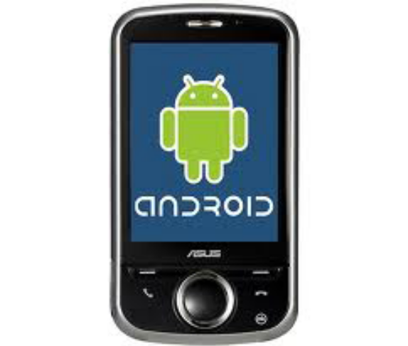

Google Map
Session 13

Slide 2
Objectives
Google Map
Android Application Logging

Slide 3
1. Google Map (1)
Introduction
Google Maps is one of the many applications bundled with the Android platform. In addition to simply using the Maps application, you can also embed it into your own applications and make it do some very cool things. In this article, I will show you how to use Google Maps in your Android applications and how to programmatically perform the following:
Change the views of Google Maps
Obtain the latitude and longitude of locations in Google Maps
Perform geocoding and reverse geocoding
Add markers to Google Maps
Google Maps is one of the many applications bundled with the Android platform. In addition to simply using the Maps application, you can also embed it into your own applications and make it do some very cool things. In this article, I will show you how to use Google Maps in your Android applications and how to programmatically perform the following:
Change the views of Google Maps
Obtain the latitude and longitude of locations in Google Maps
Perform geocoding and reverse geocoding
Add markers to Google Maps

Slide 4
1. Google Map (2)
Obtaining a Maps API key
Beginning with the Android SDK, you need to apply for a free Google Maps API key before you can integrate Google Maps into your Android application. To apply for a key, you need to follow the series of steps outlined below. You can also refer to Google's detailed documentation on the process at http://code.google.com/android/toolbox/apis/mapkey.html.
First, if you are testing the application on the Android emulator, locate the SDK debug certificate located in the default folder of "C:\Documents and Settings\<username>\Local Settings\Application Data\Android". The filename of the debug keystore is debug.keystore. For deploying to a real Android device, substitute the debug.keystore file with your own keystore file. .
For simplicity, copy this file (debug.keystore) to a folder in C:\ (for example, create a folder called "C:\Android").
Using the debug keystore, you need to extract its MD5 fingerprint using the Keytool.exe application included with your JDK installation. This fingerprint is needed to apply for the free Google Maps key. You can usually find the Keytool.exe from the "C:\Program Files\Java\<JDK_version_number>\bin" folder.
Issue the following command (see also Figure 2) to extract the MD5 fingerprint.
keytool.exe -list -alias androiddebugkey -keystore "C:\android\debug.keystore" -storepass android -keypass android
Copy the MD5 certificate fingerprint and navigate your web browser to: http://code.google.com/android/maps-api-signup.html. Follow the instructions on the page to complete the application and obtain the Google Maps key.

Slide 5
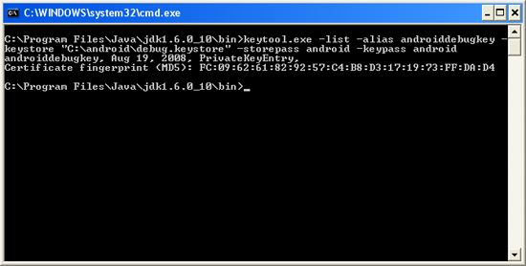
1. Google Map (3)
Figure 2 Obtaining the MD5 fingerprint of the debug keystore

Slide 6
1. Google Map (4)
To use the Google Maps in your Android application, you need to modify your AndroidManifest.xml file by adding the <uses-library> element together with the INTERNET permission:

Slide 7
1. Google Map (5)
<?xml version="1.0" encoding="utf-8"?>
<manifest xmlns:android="http://schemas.android.com/apk/res/android"
package="net.learn2develop.GoogleMaps"
android:versionCode="1"
android:versionName="1.0.0">
<application android:icon="@drawable/icon" android:label="@string/app_name">
<uses-library android:name="com.google.android.maps" />
<activity android:name=".MapsActivity"
android:label="@string/app_name">
<intent-filter>
<action android:name="android.intent.action.MAIN" />
<category android:name="android.intent.category.LAUNCHER" />
</intent-filter>
</activity>
</application>
<uses-permission android:name="android.permission.INTERNET" />
</manifest>
</xml>

Slide 8
1. Google Map (6)
Displaying the Map
To display the Google Maps in your Android application, modify the main.xml file located in the res/layout folder. You shall use the <com.google.android.maps.MapView> element to display the Google Maps in your activity. In addition, let's use the <RelativeLayout> element to position the map within the activity:

Slide 9
1. Google Map (7)
<?xml version="1.0" encoding="utf-8"?>
<RelativeLayout xmlns:android="http://schemas.android.com/apk/res/android"
android:layout_width="fill_parent"
android:layout_height="fill_parent">
<com.google.android.maps.MapView
android:id="@+id/mapView"
android:layout_width="fill_parent"
android:layout_height="fill_parent"
android:enabled="true"
android:clickable="true"
android:apiKey="0l4sCTTyRmXTNo7k8DREHvEaLar2UmHGwnhZVHQ"
/>
</RelativeLayout>

Slide 10
1. Google Map (8)
Notice from above that I have used the Google Maps key that I obtained earlier and put it into the apiKey attribute.
In the MapsActivity.java file, modify the class to extend from the MapActivity class, instead of the normal Activity class:

Slide 11
1. Google Map (9)
package net.learn2develop.GoogleMaps;
import com.google.android.maps.MapActivity;
import com.google.android.maps.MapView;
import android.os.Bundle;
public class MapsActivity extends MapActivity
{
/** Called when the activity is first created. */
@Override
public void onCreate(Bundle savedInstanceState)
{
super.onCreate(savedInstanceState);
setContentView(R.layout.main);
}
@Override
protected boolean isRouteDisplayed() {
return false;
}
}

Slide 12
1. Google Map (10)
Observe that if your class extends the MapActivity class, you need to override the isRouteDisplayed() method. You can simply do so by setting the method to return false.

Slide 13
1. Google Map (11)
At this juncture, take note of a few troubleshooting details. If your program does not run (i.e. it crashes), then it is likely you forgot to put the following statement in your AndroidManifest.xml file:
<uses-library android:name="com.google.android.maps" />
If your application manages to load but you cannot see the map (all you see is a grid), then it is very likely you do not have a valid Map key, or that you did not specify the INTERNET permission:
<uses-permission android:name="android.permission.INTERNET" />

Slide 14
1. Google Map (12)
Displaying the Zoom View
The previous section showed how you can display the Google Maps in your Android device. You can drag the map to any desired location and it will be updated on the fly. However, observe that there is no way to zoom in or out from a particular location. Thus, in this section, you will learn how you can let users zoom into or out of the map.
First, add a <LinearLayout> element to the main.xml file as shown below:

Slide 15
1. Google Map (13)
<?xml version="1.0" encoding="utf-8"?>
<RelativeLayout xmlns:android="http://schemas.android.com/apk/res/android"
android:layout_width="fill_parent"
android:layout_height="fill_parent">
<com.google.android.maps.MapView
android:id="@+id/mapView"
android:layout_width="fill_parent"
android:layout_height="fill_parent"
android:enabled="true"
android:clickable="true"
android:apiKey="0l4sCTTyRmXTNo7k8DREHvEaLar2UmHGwnhZVHQ"
/>
<LinearLayout android:id="@+id/zoom"
android:layout_width="wrap_content"
android:layout_height="wrap_content"
android:layout_alignParentBottom="true"
android:layout_centerHorizontal="true"
/>
</RelativeLayout>

Slide 16
1. Google Map (14)
You will use the <LinearLayout> element to hold the two zoom controls in Google Maps (you will see this shortly).
In the MapsActivity.java file, add the following imports:
import com.google.android.maps.MapView.LayoutParams;
import android.view.View;
import android.widget.LinearLayout;
and add the following code after the line setContentView(R.layout.main);
mapView = (MapView) findViewById(R.id.mapView);
LinearLayout zoomLayout = (LinearLayout)findViewById(R.id.zoom);
View zoomView = mapView.getZoomControls();
zoomLayout.addView(zoomView,
new LinearLayout.LayoutParams(
LayoutParams.WRAP_CONTENT,
LayoutParams.WRAP_CONTENT));
mapView.displayZoomControls(true);
The complete MapsActivity.java file is given below:

Slide 17
1. Google Map (15)
package net.learn2develop.GoogleMaps;
import com.google.android.maps.MapActivity;
import com.google.android.maps.MapView;
import com.google.android.maps.MapView.LayoutParams;
import android.os.Bundle;
import android.view.View;
import android.widget.LinearLayout;
public class MapsActivity extends MapActivity
{
MapView mapView;
/** Called when the activity is first created. */
@Override
public void onCreate(Bundle savedInstanceState)
{
super.onCreate(savedInstanceState);
setContentView(R.layout.main);
mapView = (MapView) findViewById(R.id.mapView);
LinearLayout zoomLayout = (LinearLayout)findViewById(R.id.zoom);
View zoomView = mapView.getZoomControls();
zoomLayout.addView(zoomView,
new LinearLayout.LayoutParams(
LayoutParams.WRAP_CONTENT,
LayoutParams.WRAP_CONTENT));
mapView.displayZoomControls(true);
}
@Override
protected boolean isRouteDisplayed() {
// TODO Auto-generated method stub
return false;
}
}

Slide 18
1. Google Map (16)
Basically, you obtain the MapView instance on the activity, obtain its zoom controls and then add it to the LinearLayout element you added to the activity earlier on. In the above case, the zoom control will be displayed at the bottom of the screen
Using the zoom control, you can zoom in or out of a location by simply touching the "+ or "-" buttons on the screen.
Alternatively, you can also programmatically zoom in or out of the map using the zoomIn() and zoomOut() methods from the MapController class:

Slide 19
1. Google Map (17)
package net.learn2develop.GoogleMaps;
//...
import android.os.Bundle;
import android.view.KeyEvent;
public class MapsActivity extends MapActivity
{
MapView mapView;
public boolean onKeyDown(int keyCode, KeyEvent event)
{
MapController mc = mapView.getController();
switch (keyCode)
{
case KeyEvent.KEYCODE_3:
mc.zoomIn();
break;
case KeyEvent.KEYCODE_1:
mc.zoomOut();
break;
}
return super.onKeyDown(keyCode, event);
}
/** Called when the activity is first created. */
@Override
public void onCreate(Bundle savedInstanceState)
{
//...
}
@Override
protected boolean isRouteDisplayed() {
// TODO Auto-generated method stub
return false;
}
}

Slide 20
1. Google Map (18)
In the above code, when the user presses the number 3 on the keyboard the map will zoom in into the next level. Pressing number 1 will zoom out one level.

Slide 21
1. Google Map (19)
Changing Views of the Map
By default, the Google Maps displays in the map mode. If you wish to display the map in satellite view, you can use the setSatellite() method of the MapView class, like this:
mapView.setSatellite(true);
You can also display the map in street view, using the setStreetView() method:
mapView.setStreetView(true);

Slide 22
1. Google Map (20)
Displaying a Particular Location
Be default, the Google Maps displays the map of the United States when it is first loaded. However, you can also set the Google Maps to display a particular location. In this case, you can use the animateTo() method of the MapController class.
The following code shows how this is done:

Slide 23
1. Google Map (21)
package net.learn2develop.GoogleMaps;
import com.google.android.maps.GeoPoint;
import com.google.android.maps.MapActivity;
import com.google.android.maps.MapController;
import com.google.android.maps.MapView;
import com.google.android.maps.MapView.LayoutParams;
import android.os.Bundle;
import android.view.View;
import android.widget.LinearLayout;
public class MapsActivity extends MapActivity
{
MapView mapView;
MapController mc;
GeoPoint p;
/** Called when the activity is first created. */
@Override
public void onCreate(Bundle savedInstanceState)
{
super.onCreate(savedInstanceState);
setContentView(R.layout.main);
mapView = (MapView) findViewById(R.id.mapView);
LinearLayout zoomLayout = (LinearLayout)findViewById(R.id.zoom);
View zoomView = mapView.getZoomControls();

Slide 24
1. Google Map (22)
zoomLayout.addView(zoomView,
new LinearLayout.LayoutParams(
LayoutParams.WRAP_CONTENT,
LayoutParams.WRAP_CONTENT));
mapView.displayZoomControls(true);
mc = mapView.getController();
String coordinates[] = {"1.352566007", "103.78921587"};
double lat = Double.parseDouble(coordinates[0]);
double lng = Double.parseDouble(coordinates[1]);
p = new GeoPoint(
(int) (lat * 1E6),
(int) (lng * 1E6));
mc.animateTo(p);
mc.setZoom(17);
mapView.invalidate();
}
@Override
protected boolean isRouteDisplayed() {
// TODO Auto-generated method stub
return false;
}
}

Slide 25
1. Google Map (23)
In the above code, you first obtain a controller from the MapView instance and assign it to a MapController object (mc). You use a GeoPoint object to represent a geographical location. Note that for this class the latitude and longitude of a location are represented in micro degrees. This means that they are stored as integer values.
For a latitude value of 40.747778, you need to multiply it by 1e6 to obtain 40747778.
To navigate the map to a particular location, you can use the animateTo() method of the MapController class (an instance which is obtained from the MapView object). The setZoom() method allows you to specify the zoom level in which the map is displayed. Figure 6 shows the Google Maps displaying the map of Singapore.

Slide 26
1. Google Map (24)
Adding Markers
Very often, you may wish to add markers to the map to indicate places of interests. Let's see how you can do this in Android. First, create a GIF image containing a pushpin (see Figure 7) and copy it into the res/drawable folder of the project. For best effect, you should make the background of the image transparent so that it does not block off parts of the map when the image is added to the map.

Slide 27
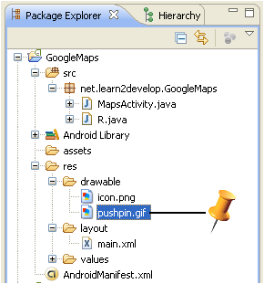
1. Google Map (25)

Slide 28
1. Google Map (26)
To add a marker to the map, you first need to define a class that extends the Overlay class:
package net.learn2develop.GoogleMaps;
import java.util.List;
import com.google.android.maps.GeoPoint;
import com.google.android.maps.MapActivity;
import com.google.android.maps.MapController;
import com.google.android.maps.MapView;
import com.google.android.maps.Overlay;
import com.google.android.maps.MapView.LayoutParams;
import android.graphics.Bitmap;
import android.graphics.BitmapFactory;
import android.graphics.Canvas;
import android.graphics.Point;
import android.os.Bundle;
import android.view.View;
import android.widget.LinearLayout;
public class MapsActivity extends MapActivity
{
MapView mapView;
MapController mc;
GeoPoint p;

Slide 29
1. Google Map (27)
class MapOverlay extends com.google.android.maps.Overlay
{
@Override
public boolean draw(Canvas canvas, MapView mapView,
boolean shadow, long when)
{
super.draw(canvas, mapView, shadow);
//---translate the GeoPoint to screen pixels---
Point screenPts = new Point();
mapView.getProjection().toPixels(p, screenPts);
//---add the marker---
Bitmap bmp = BitmapFactory.decodeResource(
getResources(), R.drawable.pushpin);
canvas.drawBitmap(bmp, screenPts.x, screenPts.y-50, null);
return true;
}
}
/** Called when the activity is first created. */
@Override
public void onCreate(Bundle savedInstanceState)
{
//...
}
@Override
protected boolean isRouteDisplayed() {
// TODO Auto-generated method stub
return false;
}
}

Slide 30
1. Google Map (28)
In the MapOverlay class that you have defined, override the draw() method so that you can draw the pushpin image on the map. In particular, note that you need to translate the geographical location (represented by a GeoPoint object, p) into screen coordinates.
As you want the pointed tip of the push pin to indicate the position of the location, you would need to deduct the height of the image (which is 50 pixels) from the y-coordinate of the point (see Figure 8) and draw the image at that location.

Slide 31
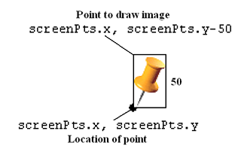
1. Google Map (29)

Slide 32
1. Google Map (30)
To add the marker, create an instance of the MapOverlap class and add it to the list of overlays available on the MapView object:
@Override
public void onCreate(Bundle savedInstanceState)
{
super.onCreate(savedInstanceState);
setContentView(R.layout.main);
//...
mc.animateTo(p);
mc.setZoom(17);
//---Add a location marker---
MapOverlay mapOverlay = new MapOverlay();
List<Overlay> listOfOverlays = mapView.getOverlays();
listOfOverlays.clear();
listOfOverlays.add(mapOverlay);
mapView.invalidate();
}

Slide 33
1. Google Map (31)
Getting the Location that was touched
After using Google Maps for a while, you may wish to know the latitude and longitude of a location corresponding to the position on the screen that you have just touched. Knowing this information is very useful as you can find out the address of a location, a process known as Geocoding (you will see how this is done in the next section).
If you have added an overlay to the map, you can override the onTouchEvent() method within the Overlay class. This method is fired every time the user touches the map. This method has two parameters - MotionEvent and MapView. Using the MotionEvent parameter, you can know if the user has lifted his finger from the screen using the getAction() method.

Slide 34
1. Google Map (32)
class MapOverlay extends com.google.android.maps.Overlay
{
@Override
public boolean draw(Canvas canvas, MapView mapView,
boolean shadow, long when)
{
//...
}
@Override
public boolean onTouchEvent(MotionEvent event, MapView mapView)
{
//---when user lifts his finger---
if (event.getAction() == 1) {
GeoPoint p = mapView.getProjection().fromPixels(
(int) event.getX(),
(int) event.getY());
Toast.makeText(getBaseContext(),
p.getLatitudeE6() / 1E6 + "," +
p.getLongitudeE6() /1E6 ,
Toast.LENGTH_SHORT).show();
}
return false;
}
}

Slide 35
1. Google Map (33)
Geocoding and Reverse Geocoding
If you know the latitude and longitude of a location, you can find out its address using a process known as Geocoding. Google Maps in Android supports this via the Geocoder class. The following code shows how you can find out the address of a location you have just touched using the getFromLocation() method:

Slide 36
1. Google Map (34)
class MapOverlay extends com.google.android.maps.Overlay
{
@Override
public boolean draw(Canvas canvas, MapView mapView,
boolean shadow, long when)
{
//...
}
@Override
public boolean onTouchEvent(MotionEvent event, MapView mapView)
{
//---when user lifts his finger---
if (event.getAction() == 1) {
GeoPoint p = mapView.getProjection().fromPixels(
(int) event.getX(),
(int) event.getY());
Geocoder geoCoder = new Geocoder(
getBaseContext(), Locale.getDefault());
try {
List<Address> addresses = geoCoder.getFromLocation(
p.getLatitudeE6() / 1E6,
p.getLongitudeE6() / 1E6, 1);
String add = "";
if (addresses.size() > 0)
{
for (int i=0; i<addresses.get(0).getMaxAddressLineIndex();
i++)
add += addresses.get(0).getAddressLine(i) + "\n";
}
Toast.makeText(getBaseContext(), add, Toast.LENGTH_SHORT).show();
}
catch (IOException e) {
e.printStackTrace();
}
return true;
}
else
return false;
}
}

Slide 37
1. Google Map (35)
If you know the address of a location but want to know its latitude and longitude, you can do so via reverse-Geocoding. Again, you can use the Geocoder class for this purpose. The following code shows how you can find the exact location of the Empire State Building by using the getFromLocationName() method:

Slide 38
1. Google Map (36)
Geocoder geoCoder = new Geocoder(this, Locale.getDefault());
try {
List<Address> addresses = geoCoder.getFromLocationName(
"empire state building", 5);
String add = "";
if (addresses.size() > 0) {
p = new GeoPoint(
(int) (addresses.get(0).getLatitude() * 1E6),
(int) (addresses.get(0).getLongitude() * 1E6));
mc.animateTo(p);
mapView.invalidate();
}
} catch (IOException e) {
e.printStackTrace();
}

Slide 39
1. Google Map (37)
Using Google Maps, there are many interesting projects you can work on, such as geo-tagging, geo-tracking, etc. If you have cool ideas on building cool location-based services, share with us in the comments box below.

Slide 40
1. Google Map (1)
Refer:
http://www.android10.org/index.php/articleslocationmaps/253-how-to-use-google-maps-in-android
http://vietandroid.com/map/2050-[googlemaps-tutorial]-bài-1-google-maps-helloworld.html

Slide 41
2. Android Application Logging (1)
Introduction
This quick tip shows you the steps to incorporate logging support into your applications and then use the LogCat logging utility to monitor your application’s log output, either on the emulator or a device that is attached to Eclipse via the debugger. This skill is invaluable for debugging issues, even when great debuggers are available for stepping through code
In this quick tip tutorial, you’ll learn how to use application logging support in your Android applications for diagnostic purposes.
This quick tip shows you the steps to incorporate logging support into your applications and then use the LogCat logging utility to monitor your application’s log output, either on the emulator or a device that is attached to Eclipse via the debugger. This skill is invaluable for debugging issues, even when great debuggers are available for stepping through code.

Slide 42
2. Android Application Logging (2)
Step 1: Create an Android Application
Begin by creating an Android project. Implement your Android application as normal. Once you’ve setup your Android project, you are ready to proceed with this quick tip.

Slide 43
2. Android Application Logging (3)
Step 2: Logging Options for Android Applications
The Android SDK includes a useful logging utility class called android.util.Log. Logging messages are categorized by severity (and verbosity), with errors being the most severe, then warnings, informational messages, debug messages and verbose messages being the least severe. Each type of logging message has its own method. Simply call the method and a log message is created. The message types, and their related method calls are:
The Log.e() method is used to log errors.
The Log.w() method is used to log warnings.
The Log.i() method is used to log informational messages.
The Log.d() method is used to log debug messages.
The Log.v() method is used to log verbose messages.
The Log.wtf() method is used to log terrible failures that should never happen. (“WTF” stands for “What a Terrible Failure!” of course.)
The first parameter of each Log method is a string called a tag. It’s common practice to define a global static string to represent the overall application or the specific activity within the application such that log filters can be created to limit the log output to specific data. For example, you could define a string called TAG, as follows:

Slide 44
2. Android Application Logging (4)
private static final String TAG = "MyApp";
You will often find that the tag is defined as the class in which the Log statement occurs. This is a reasonable convention, but anything identifiable or useful to you will do.
Now anytime you use a Log method, you supply this tag. An informational logging message might look like this:
Log.i(TAG, "I am logging something informational!");

Slide 45
2. Android Application Logging (5)
You can also pass a Throwable object, usually on Exception, that will allow the Log to print a stack trace or other useful information.
try {
// ...
} catch (Exception exception) {
Log.e(TAG, "Received an exception", exception);
}
NOTE: Calling the Log.wtf() method will always print a stack trace and may cause the process to end with an error message. It is really intended only for extreme errors. For standard logging of exceptions, we recommend using the Log.e() method. The Log.wtf() method is available only in Android 2.2 or later. The rest are available in all versions of Android.

Slide 46
2. Android Application Logging (6)
Step 3: Adding Log Support to an Activity Class
Now let’s add some logging to your Activity class. First, add the appropriate import statement for the logging class android.util.Log. Next, declare a logging tag for use within your class (or whole application); in this case, we call this variable DEBUG_TAG. Finally, add logging method calls wherever you want logging output. For example, you might add an informational log message within the onCreate() method of your Activity class.
Below is some sample code that illustrates how all these steps come together:

Slide 47
2. Android Application Logging (7)
package com.mamlambo.simpleapp;
import android.app.Activity;
import android.os.Bundle;
import android.util.Log;
public class MySimpleAppActivity extends Activity {
private static final String DEBUG_TAG= "MySimpleAppLogging";
@Override
public void onCreate(Bundle savedInstanceState) {
super.onCreate(savedInstanceState);
setContentView(R.layout.main);
Log.i(DEBUG_TAG, "Info about MySimpleAppActivity.");
}
}

Slide 48
2. Android Application Logging (8)
Step 4: Monitoring Application Log Output – The Easy Way
You can use the LogCat utility from within Eclipse to view the log output from an emulator or device. LogCat is integrated into Eclipse using the Android Development plug-in. You’ll find the LogCat panel integrated into the DDMS and Debug perspectives of Eclipse.

Slide 49
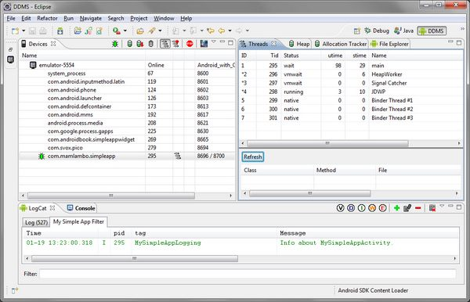
2. Android Application Logging (9)

Slide 50
2. Android Application Logging (10)
Step 5:Monitoring Application Log Output – Creating Log Filters
As you can see, the basic LogCat logging output includes log data from lots of different sources. For debugging purposes, it can be useful to filter the output to only the tags for your specific application. This way, you can focus on your application log output, amidst all the clutter.
You can use the LogCat utility from within Eclipse to filter your log messages to the tag string you supplied for your application. To add a new filter, click the green plus sign button in the LogCat pane of Eclipse. Name the filter—perhaps using the tag name—and fill in the tag you want to filter on. A new tab is created in LogCat that will show only log messages that contain this tag. You can create filters that display items by severity level.

Slide 51
2. Android Application Logging (11)
Performance Considerations with Logging
Logging output puts a damper on application performance. Excessive use can result in decreased application performance. At minimum, debug and verbose logging should be used only for development purposes and removed before release. It’s also a good idea to review other logging output before publication as well.

Slide 52
2. Android Application Logging (12)
Conclusion
Logging is a very handy debugging and diagnostic technique used by developers. Use the logging class provided as part of the Android SDK to log important information about your application to LogCat, but make sure you review your application’s logging implementation prior to publication, as logging has performance drawbacks.

Slide 53
Summary
Google Map
Android Application Logging

Slide 54

Q&A
Any questions?

