Slide 1
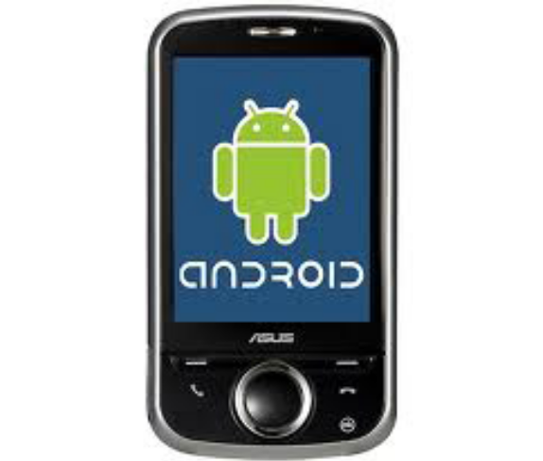

Advance
Session 14

Slide 2
Objectives
Webservice (Ksoap2)
Android MVC
Android NDK

Slide 3
1. Web-service (Ksoap2) (1)
kSoap2
It is a library that hides the complexity of establishing connection with back-end SOAP service, does XML parsing, and provides a nice object-oriented abstraction for SOAP calls.
The library can be downloaded from
http://code.google.com/p/ksoap2-android/

Slide 4
1. Web-service (Ksoap2) (2)
How to use it ?
After downloading, you have to add this external library to your project.
Instructions on how to add external library, can be found
http://developer.android.com/resources/faq/commontasks.html
If you are like me, and don't like reading instructions, then check out below pictures to figure out how to add external library

Slide 5
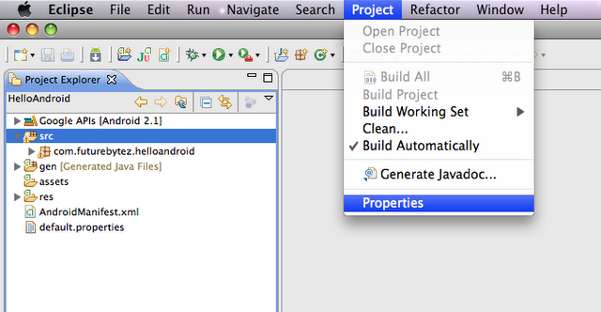
1. Web-service (Ksoap2) (3)

Slide 6
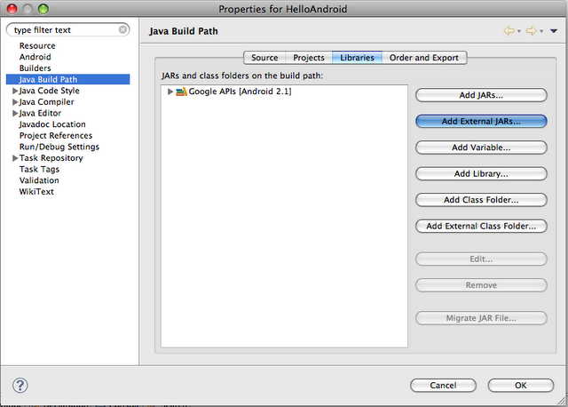
1. Web-service (Ksoap2) (4)

Slide 7
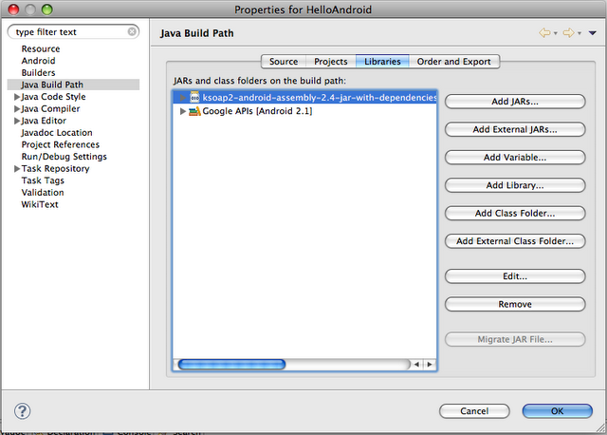
1. Web-service (Ksoap2) (5)

Slide 8
1. Web-service (Ksoap2) (6)
After adding the external .jar to your project, you can now start making SOAP calls. Shown below is sample code, to make SOAP call asynchronously. We do it asynchronous by just making the call in separate thread, so that main UI thread is not tied up and continues to be responsive which background thread is making the call, parsing the reply data, etc.

Slide 9
1. Web-service (Ksoap2) (7)
Since, you will be accessing the internet in order to make the call, don't forget to add permission of accessing the internet in your manifest file.
<uses-permission name="android.permission.INTERNET"></uses-permission>

Slide 10
1. Web-service (Ksoap2) (8)
// Need handler for callbacks to UI Threads
// For background operations
final Handler mHandler = new Handler();
// Create Runnable for posting results
final Runnable mUpdateResults = new Runnable() {
public void run() {
updateResultsInUI();
}
};
// Back in UI Thread after background network operation is completed
private void updateResultsInUI() {
// Network activity completed.
setProgressBarIndeterminateVisibility(false);
}

Slide 11
1. Web-service (Ksoap2) (9)
private void doAuthenticate(String user, String pass) {
// Prepare the SOAP request
SoapObject request = new SoapObject(NAMESPACE, METHOD_NAME);
request.addProperty("userName", user);
request.addProperty("password", pass);
// Preparing the SOAP envelope
SoapSerializationEnvelope envelope = new SoapSerializationEnvelope(SoapEnvelope.VER11); // Setting it to VER11, since this is SOAP 1.1
envelope.dotNet = true; // Since this is .asmx (.NET web service)
// Add the request to envelope
envelope.setOutputSoapObject(request);

Slide 12
1. Web-service (Ksoap2) (10)
// Actually make the call
try {
HttpTransportSE androidHttpTransport = new HttpTransportSE(URL);
androidHttpTransport.call(SOAP_ACTION, envelope);
result = (SoapObject)envelope.getResponse();
Log.w(TAG, "Got the response");
String articleTitle = result.getProperty("articleID").toString();
Log.w(TAG, "The value of Article ID is " + articleTitle);
}
catch (Exception e) {
e.printStackTrace();
result = null;
}
}

Slide 13
1. Web-service (Ksoap2) (11)
// This is authenticate web-service call.
private void prepareToAuthenticate(final String user, final String pass) {
// To display network indicator in the title
setProgressBarIndeterminateVisibility(true);
// Create a background thread to complete the network web service call
new Thread() {
public void run() {
doAuthenticate(user, pass);
mHandler.post(mUpdateResults);
}
}.start();
}

Slide 14
2. Android MVC (1)
Android GUI Architecture
The Android environment adds yet another Graphical User Interface (GUI) toolkit to the Java ecosphere, joining AWT, Swing, SWT, and J2ME (leaving aside the web UI toolkits). If you've worked with any of these, the Android framework will look familiar. Like them, it is single-threaded, event-driven, and built on a library of nestable components.
The Android UI framework is, like the other UI frameworks, organized around the common Model-View-Controller pattern illustrated in Figure 1. It provides structure and tools for building a Controller that handles user input (like key presses and screen taps) and a View that renders graphical information to the screen.

Slide 15
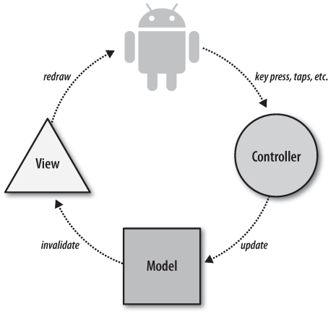
2. Android MVC (2)
Figure 1. Model-View-Controller concept

Slide 16
2. Android MVC (3)
The Model
The Model is the guts of your application: what it actually does. It might be, for instance, the database of tunes on your device and the code for playing them. It might be your list of contacts and the code that places phone calls or sends IMs to them.
While a particular application's View and Controller will necessarily reflect the Model they manipulate, a single Model might be used by several different applications. Think, for instance, of an MP3 player and an application that converts MP3 files into WAV files. For both applications, the Model includes the MP3 file format and codecs for it. The former application, however, has the familiar Stop, Start, and Pause controls, and plays the track. The latter may not produce any sound at all; instead, it will have controls for setting bitrate, etc. The Model is all about the data. It is the subject of most of the rest of this book.

Slide 17
2. Android MVC (4)
The View
The View is the application's feedback to the user. It is the portion of the application responsible for rendering the display, sending audio to speakers, generating tactile feedback, and so on. The graphical portion of the Android UI framework's View, is implemented as a tree of subclasses of the View class. Graphically, each of these objects represents a rectangular area on the screen that is completely within the rectangular area represented by its parent in the tree. The root of this tree is the application window.
As an example, the display in a hypothetical MP3 player might contain a component that shows the album cover for the currently playing tune. Another component might display the name of the currently playing song, while a third contains subcomponents such as the Play, Pause, and Stop buttons.

Slide 18
2. Android MVC (5)
The UI framework paints the screen by walking the View tree, asking each component to draw itself in a preorder traversal. In other words, each component draws itself and then asks each of its children to do the same. When the whole tree has been rendered, the smaller, nested components that are the leaves of the tree—and that were, therefore, painted later—appear to be painted on top of the components that are nearer to the root and that were painted first.
The Android UI framework is actually quite a bit more efficient than this oversimplified description suggests. It does not paint an area of a parent view if it can be certain that some child will later paint the same area, because it would be a waste of time to paint background underneath an opaque object! It would also be a waste of time to repaint portions of a view that have not changed.

Slide 19
2. Android MVC (6)
The Controller
The Controller is the portion of an application that responds to external actions: a keystroke, a screen tap, an incoming call, etc. It is implemented as an event queue. Each external action is represented as a unique event in the queue. The framework removes each event from the queue in order and dispatches it.
For example, when a user presses a key on his phone, the Android system generates a KeyEvent and adds it to an event queue. Eventually, after previously enqueued events have been processed, the KeyEvent is removed from the queue and passed as the parameter of a call to the dispatchKeyEvent method of the View that is currently selected.
Once an event is dispatched to the in-focus component, that component may take appropriate action to change the internal state of the program. In an MP3 player application, for instance, when the user taps a Play/Pause button on the screen and the event is dispatched to that button's object, the handler method might update the Model to resume playing some previously selected tune.
This chapter describes the construction of a Controller for an Android application

Slide 20
2. Android MVC (7)
Putting It Together
We now have all the concepts necessary to describe the complete UI system. When an external action occurs (for example, when the user scrolls, drags, or presses a button; a call comes in; or an MP3 player arrives at the end of its playlist), the Android system enqueues an event representing the action on the event queue. Eventually the event is dequeued—first in, first out—and dispatched to an appropriate event handler. The handler, probably code you write as part of your application, responds to the event by notifying the Model that there has been a change in state. The Model takes the appropriate action.
Nearly any change in Model state will require a corresponding change in the View. In response to a key press, for instance, an EditText component must show the newly typed character at the insertion point. Similarly, in a phone book application, clicking on a contact will cause that contact to be highlighted and the previously highlighted contact to have its highlighting removed.

Slide 21
2. Android MVC (8)
In order to update the display, the Model must notify the UI Framework that some portion of the display is now stale and has to be redrawn. The redraw request is, actually, nothing more than another event enqueued in the same framework event queue that held the Controller event a moment ago. The redraw event is processed, in order, like any other UI event.
Eventually, the redraw event is removed from the queue and dispatched. The event handler for a redraw event is the View. The View tree is redrawn, and each View object is responsible for rendering its current state at the time it is drawn.

Slide 22
2. Android MVC (9)
To make this concrete, we can trace the cycle through a hypothetical MP3 player application:
When the user taps the screen image of the Play/Pause button, the framework creates a new MotionEvent containing, among other things, the screen coordinates of the tap. The framework enqueues the new event at the end of the event queue.
When the event percolates through the queue, the framework removes it and passes it down the View tree to the leaf widget within whose bounding rectangle the tap occurred.
Because the button widget represents the Play/Pause button, the application button handling code tells the core (the Model) that it should resume playing a tune.
The application Model code starts playing the selected tune. In addition, it sends a redraw request to the UI framework.
The redraw request is added to the event queue and eventually processed
The screen gets redrawn with the Play button in its playing state, and everything is again in sync.

Slide 23
2. Android MVC (10)
UI component objects such as buttons and text boxes actually implement both View and Controller methods. This only makes sense. When you add a Button to your application's UI, you want it to appear on the screen as well as do something when the user pushes it. Even though the two logical elements of the UI—the View and the Controller—are implemented in the same object, you should take care that they do not directly interact. Controller methods, for instance, should never directly change the display. Leave it to the code that actually changes state to request a redraw, and trust that later calls to rendering methods will allow the component to reflect its new state. Coding in this way minimizes synchronization problems and helps to keep your program robust and bug-free.
There is one more aspect of the Android UI framework that it is important to understand: it is single-threaded. There is a single thread removing events from the event queue to make Controller callbacks and to render the View. This is significant for several reasons.
The simplest consequence of a single-threaded UI is that it is not necessary to use synchronized blocks to coordinate state between the View and the Controller. This is a valuable optimization.

Slide 24
2. Android MVC (11)
Another advantage of a single-threaded UI is the guarantee that each event on the event queue is processed completely and in the order in which it was enqueued. That may seem fairly obvious, but its implications make coding the UI much easier. When a UI component is called to handle an event, it is guaranteed that no additional UI processing will take place until it returns. That means, for instance, that when a component requests multiple changes in the program state—each of which causes a corresponding request that the screen be repainted—it is guaranteed that the repaint will not start until it has completed processing, performed all of its updates, and returned. In short, UI callbacks are atomic.
There is a third reason to remember that there is only a single thread dequeuing and dispatching events from the UI event queue: if your code stalls that thread, for any reason, your UI will freeze! If a component's response to an event is simple (changing the state of variables, creating new objects, etc.), it is perfectly correct to do that processing on the main event thread. If, on the other hand, the handler must retrieve a response from some distant network service or run a complex database query, the entire UI will become unresponsive until the request completes. That definitely does not make for a great user experience! Long-running tasks must be delegated to another thread, as described in Section 10.3.5.

Slide 25
2. Android MVC (12)
Refer:
http://mindtherobot.com/blog/675/android-architecture-message-based-mvc/
http://droidumm.blogspot.com/2011/11/concept-model-view-present-mvp-pattern.html
http://androidapps.org.ua/i_sect13_d1e11121.html

Slide 26
3. Android NDK (1)
Prerequisite Experience
Before we get started, we need to take a moment here to discuss the level of this tutorial. It’s flagged as advanced. The reason for this is that we, the authors, are going to assume that you would agree with the following statements:
You are experienced with Java and C.
You are comfortable using the command line.
You know how to figure out what version of Cygwin, awk, and other tools you have.
You are comfortable with Android Development.
You have a working Android development environment (as if this writing, the authors are using Android 2.2)
You use Eclipse or can translate Eclipse instructions to your own IDE with ease.
If you aren’t comfortable with these, you’re welcome to read this tutorial, of course, but you may have difficulties at certain steps that would be resolved by being comfortable with the above. That said, using the NDK is still a process that is prone to problems and issues even if you consider yourself a mobile development veteran. Be aware that you may have to do some troubleshooting of your own before you get everything working smoothly on your development system.

Slide 27
3. Android NDK (2)
A Note About When to Use NDK
So, if you’re reading this tutorial, you may already be considering the NDK for your Android projects. However, we’d like to take a moment to talk about why the NDK is important, when it should be used, and—just as importantly, when it should not be used.
Generally speaking, you only need to use the NDK if your application is truly processor bound. That is, you have algorithms that are using all of the processor within the DalvikVM and would benefit from running natively. Also, don’t forget that in Android 2.2, a JIT compiler will improve the performance of such code as well.
Another reason to use the NDK is for ease of porting. If you’ve got loads of C code for your existing application, using the NDK could speed up your project’s development process as well as help keep changes synchronized between your Android and non-Android projects. This can be particularly true of OpenGL ES applications written for other platforms.
Don’t assume you’ll increase your application’s performance just because you’re using native code. The Java<->Native C exchanges add some overhead, so it’s only really worthwhile if you’ve got some intensive processing to do.

Slide 28
3. Android NDK (3)
Step 0: Downloading the Tools
Alright, let’s get started. You need to download the NDK. We’ll do this first, as while it’s downloading you can check to make sure you have the right versions of the rest of the tools you need.
Download the NDK for your operating system from the Android site.
Now, check the versions of your tools against these:
If on Windows, Cygwin 1.7 or later
Update awk to the most recent version (We’re using 20070501)
GNU Make 3.81 or later (We’re using 3.81)
If any of these versions are too old, please update them before continuing.

Slide 29
3. Android NDK (4)
Step 1: Installing the NDK
Now that the NDK is downloaded (it is, right?), you need to unzip it. Do so and place it in an appropriate directory. We put ours in the same directory that we put the Android SDK. Remember where you put it.
At this point, you may want to add the NDK tools to your path. If you’re on Mac or Linux, you can do this with your native path setting. If you’re on Windows using Cygwin, you need to configure the Cygwin path setting.

Slide 30
3. Android NDK (5)
Step 2: Creating the Project
Create a regular Android project. To avoid problems later, your project must reside in a path that contains no spaces. Our project has a package name of “com.mamlambo.sample.ndk1” with a default Activity name of “AndroidNDK1SampleActivity” – you’ll see these appear again soon.
At the top level of this project, create a directory called “jni” – this is where you’ll put your native code. If you’re familiar with JNI, the Android NDK is heavily based on JNI concepts – it is, essentially, JNI with a limited set of headers for C compilation.

Slide 31
3. Android NDK (6)
Step 3: Adding Some C Code
Now, within the jni folder, create a file called native.c. Place the following C code in this file to start; we’ll add another function later:
#include <jni.h>
#include <string.h>
#include <android/log.h>
#define DEBUG_TAG "NDK_AndroidNDK1SampleActivity"
void Java_com_mamlambo_sample_ndk1_AndroidNDK1SampleActivity_helloLog(JNIEnv * env, jobject this, jstring logThis)
{
jboolean isCopy;
const char * szLogThis = (*env)->GetStringUTFChars(env, logThis, &isCopy);
__android_log_print(ANDROID_LOG_DEBUG, DEBUG_TAG, "NDK:LC: [%s]", szLogThis);
(*env)->ReleaseStringUTFChars(env, logThis, szLogThis);
}

Slide 32
3. Android NDK (7)
This function is actually fairly straightforward. It takes in a Java object String parameter, converts it in to a C-string, and then writes it out to LogCat.
The name of the function, though, is important. It follows the specific pattern of “Java,” followed by the package name, followed by the class name, followed by the method name, as defined from Java. Every piece is separated by an underscore instead of a dot.
The first two parameters of the function are critical, too. The first parameter is the JNI environment, frequently used with helper functions. The second parameter is the Java object that this function is a part of.

Slide 33
3. Android NDK (8)
Step 4: Calling Native From Java
Now that you have written the native code, let’s switch back over to Java. In the default Activity, create a button and add a button handler however you want. From within your button handler, make the call to helloLog:
helloLog("This will log to LogCat via the native call.");

Slide 34
3. Android NDK (9)
Then you have to add the function declaration on the Java side. Add the following declaration to your Activity class:
private native void helloLog(String logThis);
This tells the compilation and linking system that the implementation for this method will be from the native code.
Finally, you need to load the library that the native code will ultimately compile to. Add the following static initializer to the Activity class to load the library by name (the library name itself is up to you, and will be referenced again in the next step):
static {
System.loadLibrary("ndk1");
}

Slide 35
3. Android NDK (10)
Step 5: Adding the Native Code Make File
Within the jni folder, you now need to add the makefile that will be used during compilation. This file must be named “Android.mk” and if you named your file native.c and your library ndk1, then the Android.mk contents will look like this:
LOCAL_PATH := $(call my-dir)
include $(CLEAR_VARS)
LOCAL_LDLIBS := -llog
LOCAL_MODULE := ndk1
LOCAL_SRC_FILES := native.c
include $(BUILD_SHARED_LIBRARY)

Slide 36
3. Android NDK (11)
Step 6: Compiling the Native Code
Now that your native code is written and your make file is in place, it’s time to compile the native code. From the command line (Windows users, you’ll want to do this within Cygwin), you’ll need to run the ndk-build command from the root directory of your project. The ndk-build tool is found within the NDK tools directory. We find it easiest to add this tool to our path.

Slide 37
3. Android NDK (12)
Step 7: Running the Code
Now you’re all set to run the code. Load the project in to your favorite emulator or handset, watch LogCat, and push the button.
One of two things may have happened. First, it may have worked. If so, congratulations! But you might want to read on, anyway. You probably got an error to LogCat saying something like, “Could not execute method of activity.” This is fine. It just means you missed a step. This is easy to do in Eclipse. Usually, Eclipse is configured to recompile automatically. What it doesn’t do is recompile and relink automatically if it doesn’t know anything has changed. And, in this case, what Eclipse doesn’t know is that you compiled the native code. So, force Eclipse to recompile by “cleaning” the project (Project->Clean from the Eclipse toolbar).

Slide 38
3. Android NDK (13)
Step 8: Adding Another Native Function
This next function will demonstrate the ability to not only return values, but to return an object, such as a String. Add the following function to native.c:

Slide 39
3. Android NDK (14)
jstring Java_com_mamlambo_sample_ndk1_AndroidNDK1SampleActivity_
getString(JNIEnv * env, jobject this, jint value1, jint value2)
{
char *szFormat = "The sum of the two numbers is: %i";
char *szResult;
// add the two values
jlong sum = value1+value2;
// malloc room for the resulting string
szResult = malloc(sizeof(szFormat) + 20);
// standard sprintf
sprintf(szResult, szFormat, sum);
// get an object string
jstring result = (*env)->NewStringUTF(env, szResult);
// cleanup
free(szResult);
return result;
}

Slide 40
3. Android NDK (15)
For this to compile, you’ll want to add an include statement as well for stdio.h. And, to correspond to this new native function, add the following declaration in your Activity Java class:
private native String getString(int value1, int value2);
You can now wire up the functionality however you like. We used the following two calls and outputs:
String result = getString(5,2);
Log.v(DEBUG_TAG, "Result: "+result);
result = getString(105, 1232);
Log.v(DEBUG_TAG, "Result2: "+result);

Slide 41
3. Android NDK (16)
Back to the C function, you’ll note that we did a couple things. First, we create need a buffer to write to for the sprintf() call using the malloc() function. This is reasonable so long as you don’t forget to free the results when you’re done using the free() function. Then, to pass the result back, you can use a JNI helper function called NewStringUTF(). This function basically it takes the C string and makes a new Java object out of it. This new String object can then be returned as the result and you’ll be able to use it as a regular Java String object from the Java class.

Slide 42
3. Android NDK (17)
Instruction Sets, Compatibility, Etc.
The Android NDK requires Android SDK 1.5 or later. In later versions of the NDK, new headers have been made available for expanded access to certain APIs—in particular, OpenGL ES libraries.
However, that’s not the compatibility we’re talking about. This is native code, compiled to the processor architecture in use. So, one question you might be asking yourself is what processor architectures are supported? In the current NDK (as of this writing) only the ARMv5TE and ARMv7-A instruction sets are supported. By default, the target is set to ARMv5TE, which will work on all Android devices with ARM chips.
There are plans for further instruction sets (x86 has been mentioned). This has an interesting implication: an NDK solution will not work on all devices. For instance, there are Android tablets out there that use the Intel Atom processor, which has an x86 instruction set.
So how does the NDK work on the emulator? The emulator is running a true virtual machine, including full processor emulation. And yes, that means when running Java within the emulator you’re running a VM inside a VM.

Slide 43
3. Android NDK (18)
http://www.android10.org/index.php/articleswhitepapers/194-ndk-getting-started-advanced-android

Slide 44
Summary
Webservice (Ksoap2)
Android MVC
Android NDK

Slide 45

Q&A
Any questions?

