Slide 1
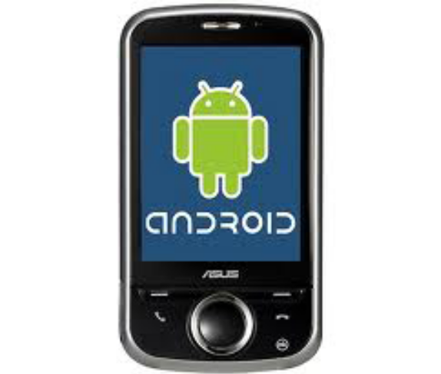

Design Patterns
Session 16

Slide 2
Objectives
Design Patterns in the Android Framework

Slide 3
What are Design Patterns?
In software engineering, a design pattern is a general reusable solution to a commonly occurring problem in software design.
  is not a finished design
  is a description or template for how to solve a problem that can be used in many different situations.
  Object-oriented design patterns typically show relationships and interactions between classes or objects.
  Design patterns are widely used in the process of designing component-based systems

Slide 4
Definitions of Software Engineering
The application of engineering to software
Field of computer science dealing with software systems
  large and complex
  built by teams
  exist in many versions
  last many years
  undergo changes
More definitions
  Application of a systematic, disciplined, quantifiable approach to the development, operation, and maintenance of software (IEEE 1990)
  Multi-person construction of multi-version software (Parnas 1978)

Slide 5
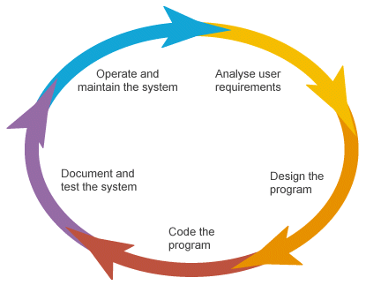
Software Development Life Cycle

Slide 6
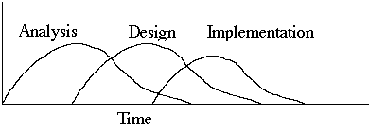
Object-Oriented Life Cycle
More time is spent in analysis and design, less time in implementation, testing and maintenance.
Life cycle phases intermix

Slide 7
Object-oriented (OO) design
  The system is viewed as a collection of interacting objects.
  The system state is decentralized and each object manages its own state.
  Objects may be instances of an object class and communicate by exchanging messages.

Slide 8
OO Design Concepts
Design classes
  Entity classes
  Boundary classes
  Controller classes
Inheritance—all responsibilities of a superclass is immediately inherited by all subclasses
Messages—stimulate some behavior to occur in the receiving object
Polymorphism—a characteristic that greatly reduces the effort required to extend the design

Slide 9
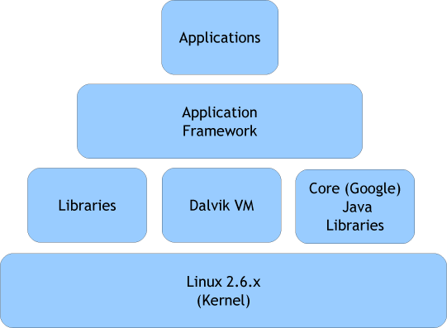
Android Framework
Android framework is based on object-oriented design
Part of Android Operating Systems
What is a framework?
Android Operating Systems

Slide 10
An important component
WebKit
  An open source web page layout engine
  Used in Apple’s Safari browser, Google’s Chrome Browser, …
  Coded in C++
  Ported to Nokia Symbian OS, iPhone OS, Android OS, Palm’s WebOS, …

Slide 11
First android application example
Inheritance enables software reuse.

Slide 12
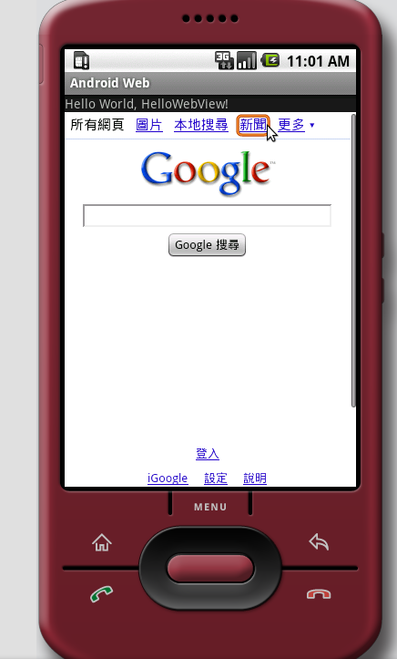
An inheritance example
package com.android.webviews;
import android.app.Activity;
import android.os.Bundle;
import android.view.KeyEvent;
import android.webkit.WebView;
import android.webkit.WebViewClient;
public class HelloWebView extends Activity {
/** Called when the activity is first created. */
WebView webview;
@Override
public void onCreate(Bundle savedInstanceState) {
super.onCreate(savedInstanceState);
setContentView(R.layout.main);
webview = (WebView) findViewById(R.id.webview);
webview.getSettings().setJavaScriptEnabled(true);
webview.loadUrl("http://www.google.com");
}

Slide 13
webview.setWebViewClient(new HelloWebViewClient());
@Override
public boolean onKeyDown(int keyCode, KeyEvent event) {
if ((keyCode == KeyEvent.KEYCODE_BACK) && webview.canGoBack()) {
webview.goBack();
return true;
}
return super.onKeyDown(keyCode, event);
}
private class HelloWebViewClient extends WebViewClient {
@Override
public boolean shouldOverrideUrlLoading(WebView view, String url) {
view.loadUrl(url);
return true;
}
}
}

Slide 14
Software Frameworks
Components-Based Software Engineering means that we build software by "putting pieces together".
  Frameworks provide the context in which the pieces can be used.
A framework may be seen as:
  A reusable design of a system,
  A skeleton of an application which can be customized by an application developer.

Slide 15
Component Frameworks
While frameworks in general describe a typical and reusable situation at a model level, a component framework describes a “circuit-board” with empty slots into which components can be inserted to create a working instance.
Component
Framework
Coordination Services (transactions, persistence..)

Slide 16
Relationships Between Concepts
Interface that satisfies contracts
Component-type
Specific interface
Component
implementation
Independent
deployment
Component
model
Component
Framework
Coordination Services (transactions, persistence..)

Slide 17
The components-based software engineering aspects of the Android framework
Key components (classes):
Activity, Service, BroadcastReceiver, ContentProvider, Intent

Slide 18
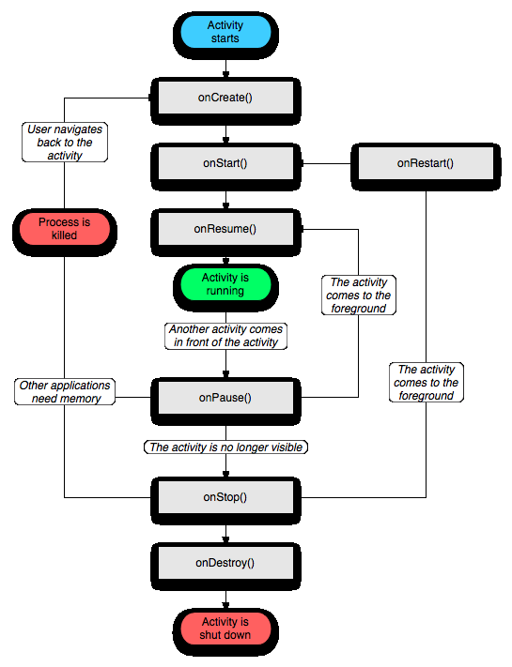
Activity life cycle
Entire lifetime
Visible lifetime
Foreground lifetime
3 nested loops
7 hooks or callbacks

Slide 19
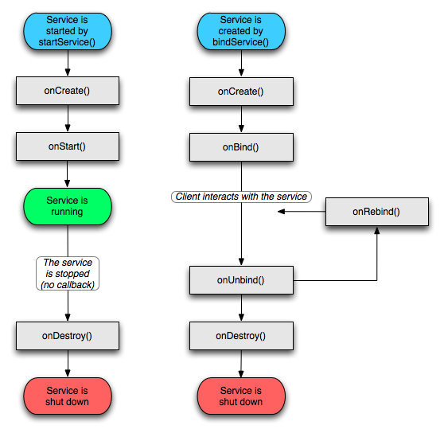
Service Life Cycle

Slide 20
Frameworks and Patterns
It is important to realize that design patterns and frameworks are distinct concepts of different natures.
  Frameworks are of a physical nature, and are executable software used in either the design or the run-time phase.
  Design patterns are of a logical nature, representing knowledge of and experience gained with software.

Slide 21
Categories of Design Patterns
Creational Pattern: Deal with initializing and configuring of classes and objects.
Structural Patterns: Deal with decoupling interface and implementation of classes and objects
  Composition of classes or objects
Behavioral patterns:Deal with dynamic interactions among societies of classes and objects
  How they distribute responsibility

Slide 22
Design Pattern Space
 |  | Purpose
 |  | Creational | Structural | Behavioral
Scope | Class | Factory Method | Adapter (class) | Interpreter Template Method
 | Object | Abstract Factory Builder Prototype Singleton | Adapter (object) Bridge Composite Decorator Facade Flyweight Proxy | Chain of Responsibility Command Iterator Mediator Memento Observer State Strategy Visitor
Defer object creation to
another class
Defer object creation to
another object
Describe ways to
assemble objects
Describe algorithms and
flow control

Slide 23
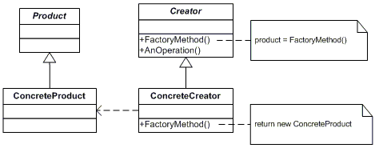
Factory Method Pattern
The Factory method lets a class defer instantiation to subclasses.

Slide 24

Android Example of Factory Method Pattern
Activity
View
...
View= FactoryMethod()
...
OnCreate()
GraphicView
MyDraw
return new GraphicView
OnCreate()

Slide 25
Android Example of Factory Method Pattern- code
public class MyDraw extends Activity {
@Override public void onCreate(Bundle savedInstanceState) {
super.onCreate(savedInstanceState);
setContentView(new GraphicView(this));
}
}
public class GraphicView extends View{
private Paint paint= new Paint();
GraphicView(Context ctx) {
super(ctx);
}
@Override protected void onDraw(Canvas canvas) {
int line_x = 10;
int line_y = 50;
canvas.drawColor(Color.WHITE);
paint.setColor(Color.GRAY);
paint.setStrokeWidth(3);
canvas.drawLine(line_x, line_y, line_x+120, line_y, paint);
…
}
}

Slide 26
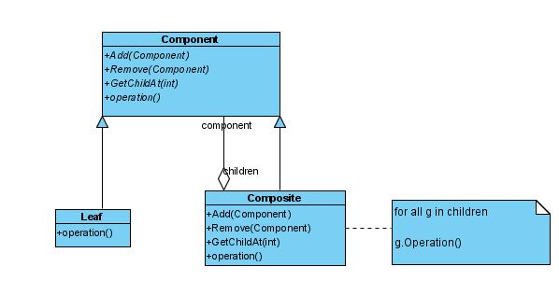
Composite Pattern
Composite allows a group of objects to be treated in the same way as a single instance of an object.

Slide 27
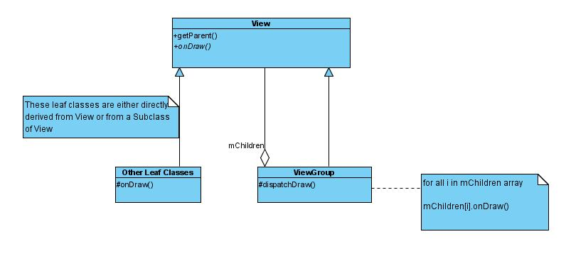
Android View and ViewGroup

Slide 28
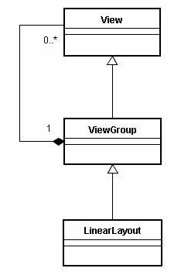
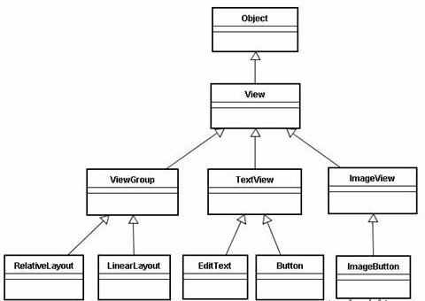
More Android Composite Pattern Example

Slide 29
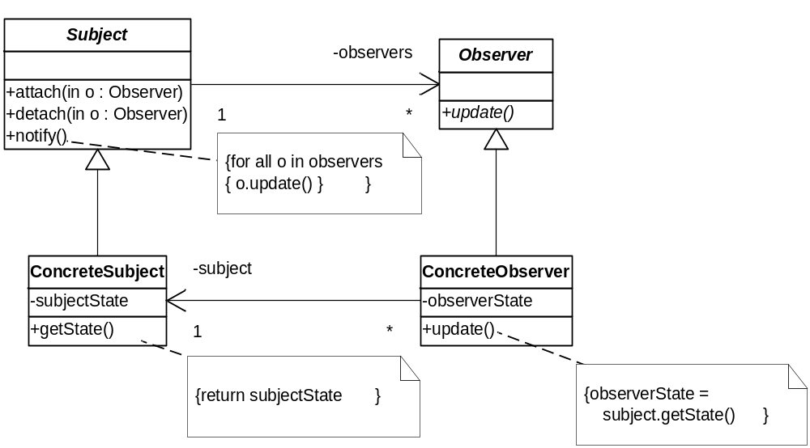
Observer Pattern
A subset of the asynchronous publish/subscribe pattern

Slide 30
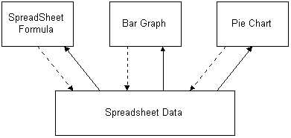
Observer Pattern Example
Observers
Subject

Slide 31
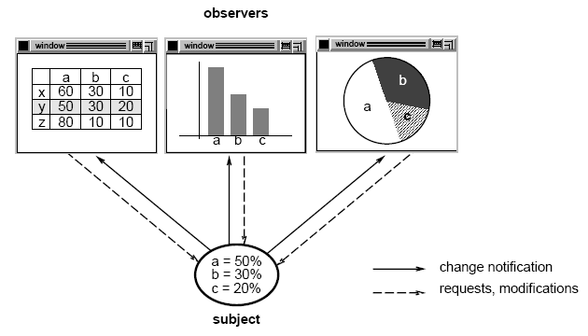
More Observer Pattern Example

Slide 32
Example: Stock Quote Service
Real time
Market Data
Feed
Stock Quotes
Customer
Customer
Customer
Customer
Customer
Observers

Slide 33
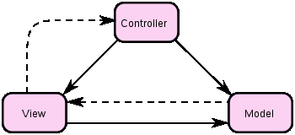
Model-View-Controller Pattern
Application of Observer Pattern
Benefits
  Design reuse, Loose Coupling
The solid line represents a direct association, the dashed an indirect association via an observer (for example).

Slide 34
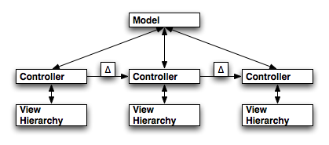
MVC Pattern in Android
Cursor: model
ListView: view
Activity: control
control
SimpleCursorAdapter
ListAdapter
Cursor
TextView
ListView

Slide 35
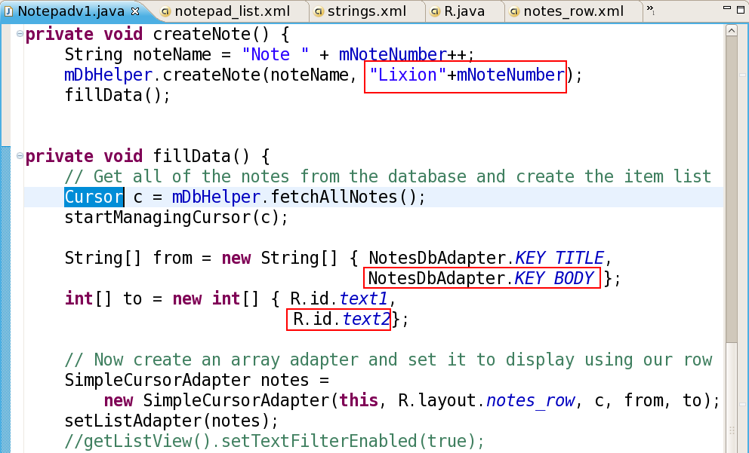
Model

Slide 36
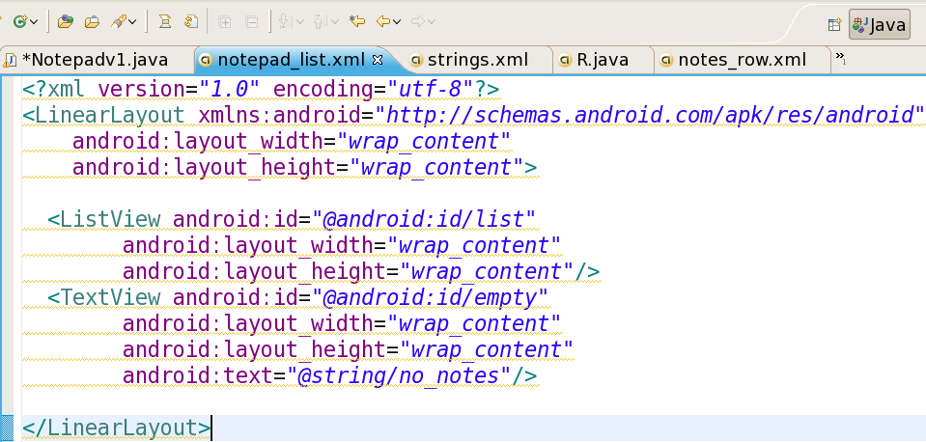
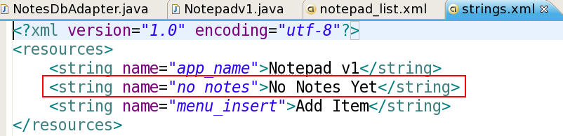
View

Slide 37
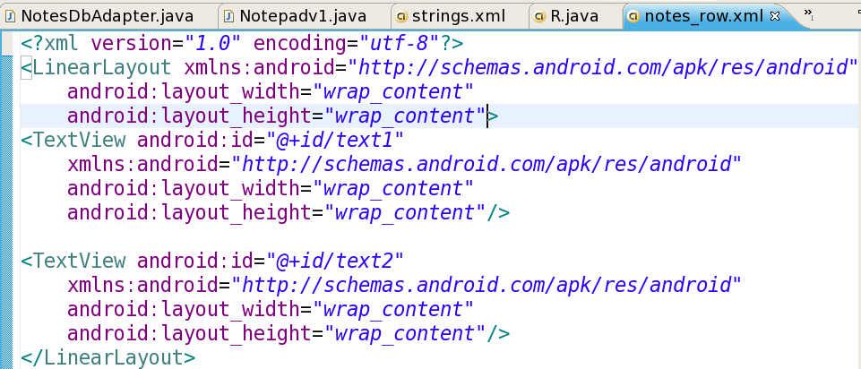
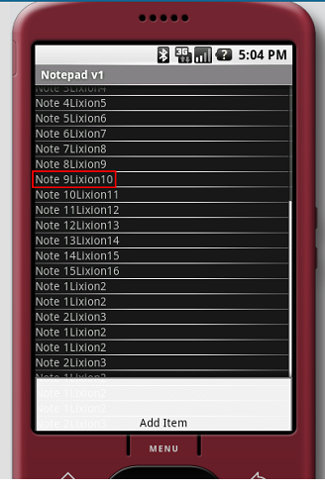

Slide 38
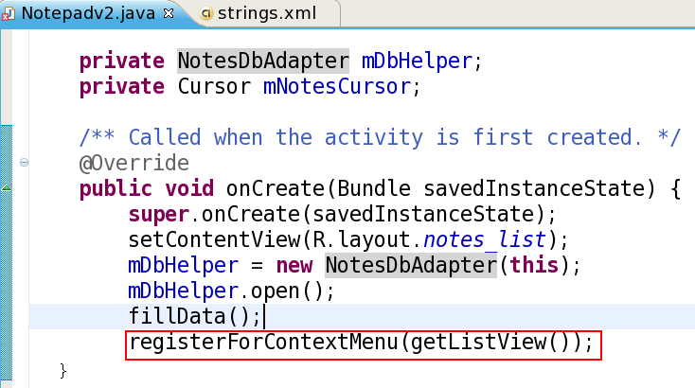
Control

Slide 39
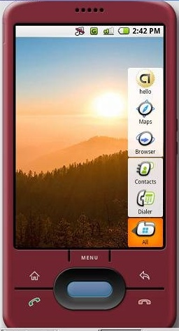
More MVC example
// Get a Spinner and bind it to an ArrayAdapter that
// references a String array.
Spinner s1 = (Spinner) findViewById(R.id.spinner1);
ArrayAdapter adapter = ArrayAdapter.createFromResource(
this, R.array.colors, android.R.layout.simple_spinner_item);
adapter.setDropDownViewResource(android.R.layout.simple_spinner_dropdown_item);
s1.setAdapter(adapter);
ArrayAdapter
R
Spinner
XML

Slide 40
// Load a Spinner and bind it to a data query.
private static String[] PROJECTION = new String[] {
People._ID, People.NAME
};
Spinner s2 = (Spinner) findViewById(R.id.spinner2);
Cursor cur = managedQuery(People.CONTENT_URI, PROJECTION, null, null);
SimpleCursorAdapter adapter2 = new SimpleCursorAdapter(this,
android.R.layout.simple_spinner_item, // Use a template
// that displays a
// text view
cur, // Give the cursor to the list adatper
new String[] {People.NAME}, // Map the NAME column in the
// people database to...
new int[] {android.R.id.text1}); // The "text1" view defined in
// the XML template
adapter2.setDropDownViewResource(android.R.layout.simple_spinner_dropdown_item);
s2.setAdapter(adapter2);

Slide 41
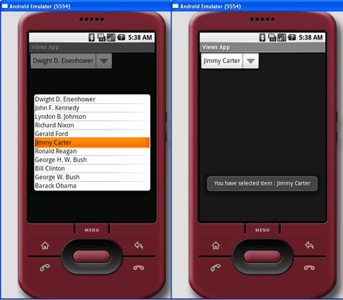
SimpeCursorAdapter
cursor
Spinner
SQLite

Slide 42
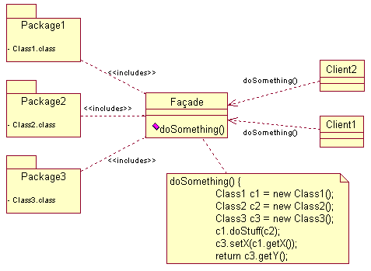
Façade Pattern
A facade is an object that provides a simplified interface to a larger body of code, such as a class library.

Slide 43
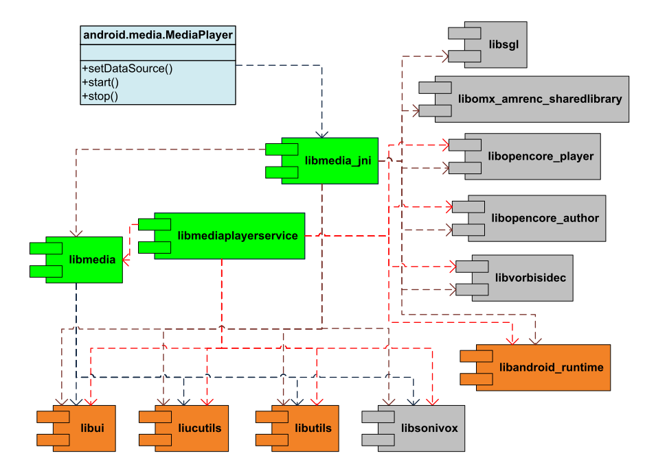
Android Media Framework
Notes:
Green components: the core of media framework, resided in /frameworks/base/media
Yellow components: Android internal libraries
Grey components: external libraries

Slide 44
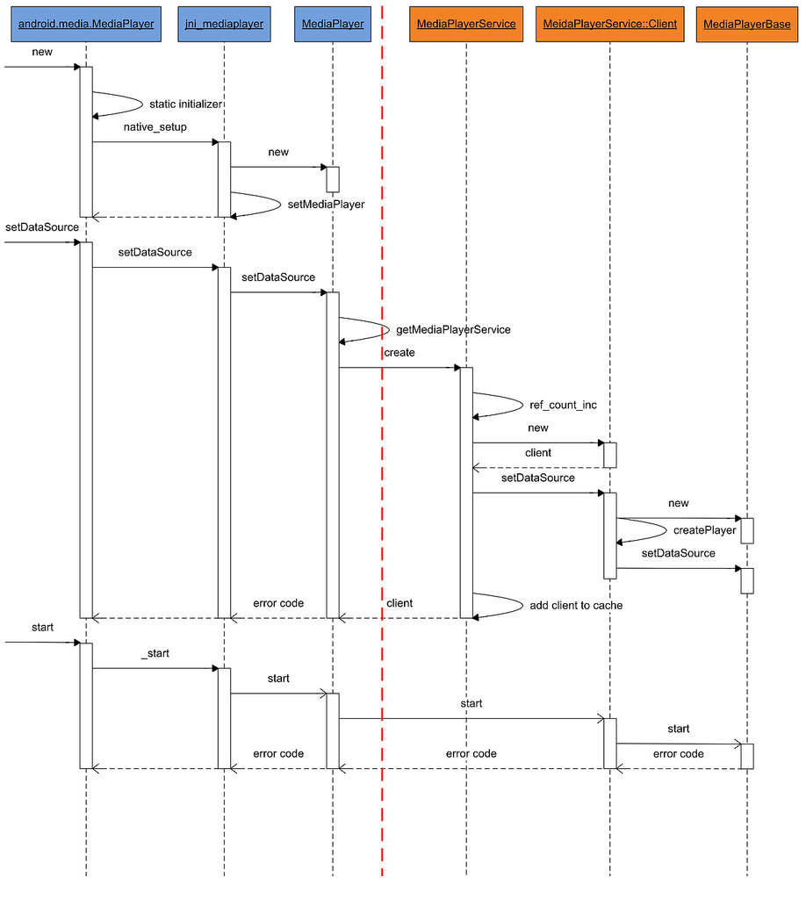
Binder:
IPC Mechanism of Android
MediaPlayerBase: Interface of some concrete media player such as VorbisPlayer, PVPlayer

Slide 45
Playing a Video
VideoView _player=(VideoView) findViewById(R.id.videoplay);
Intent intent=this.getIntent();
_player.setVideoPath(intent.getDataString());
_player.start();

Slide 46
A video player with simple GUI
import android.app.Activity;
import android.os.Bundle;
import android.view.View;
import android.view.View.OnClickListener;
import android.widget.Button;
import android.widget.VideoView;
public class VideoPlayer extends Activity {
/** Called when the activity is first created. */
@Override
public void onCreate(Bundle icicle) {
super.onCreate(icicle);
setContentView(R.layout.main);
final VideoView w =(VideoView)findViewById(R.id.vdoplayer);
Button cmdload = (Button)this.findViewById(R.id.cmd_load);
cmdload.setOnClickListener(new OnClickListener(){
public void onClick(View arg0) {
// TODO Auto-generated method stub
w.setVideoPath("/sdcard/android/kongfu.mp4");
}
});
Button cmdplay = (Button)this.findViewById(R.id.cmd_play);
cmdplay.setOnClickListener(new OnClickListener(){
public void onClick(View arg0) {
// TODO Auto-generated method stub
w.start();
}
});
Button cmdpause = (Button)this.findViewById(R.id.cmd_pause);
cmdpause.setOnClickListener(new OnClickListener(){
public void onClick(View arg0) {
// TODO Auto-generated method stub
w.pause();
}
});
} //end of onCreate()
} //end of VideoPlayer

Slide 47
Some More Design Patterns
Proxy Pattern
Mediator Pattern
Bridge Pattern

Slide 48
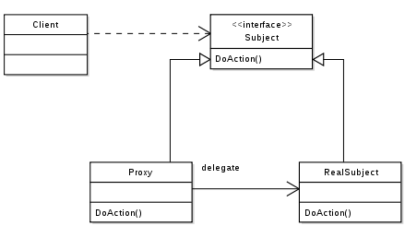
Proxy Pattern
The proxy could interface to anything: a network connection, a large object in memory, a file, or some other resource that is expensive or impossible to duplicate.

Slide 49
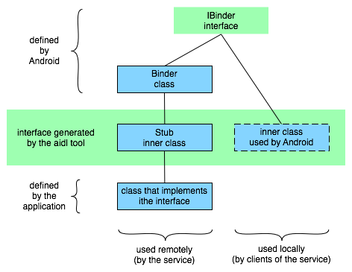
Android Proxy Pattern

Slide 50
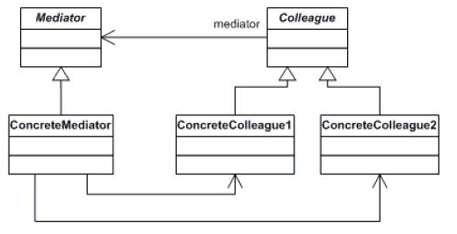
Mediator Pattern
With the mediator pattern, communication between objects is encapsulated with a mediator object.

Slide 51
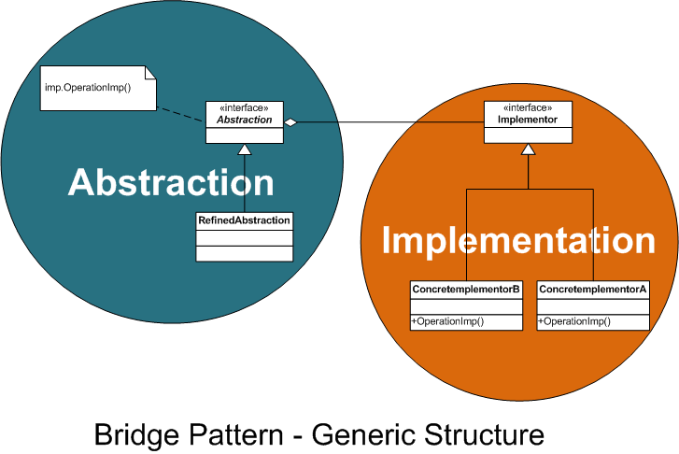
Bridge Pattern
“decouple an abstraction from its implementation so that the two can vary independently”

Slide 52
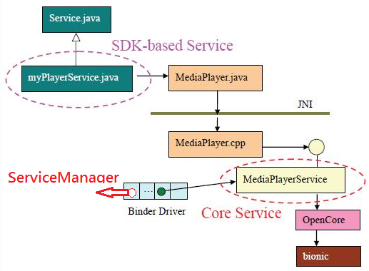
Bridge and Mediator Patterns in Android
Bridge patterns in linking Java and Cpp
Mediator patterns

Slide 53
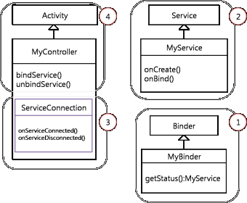
Binder IPC Mechanism

Slide 54
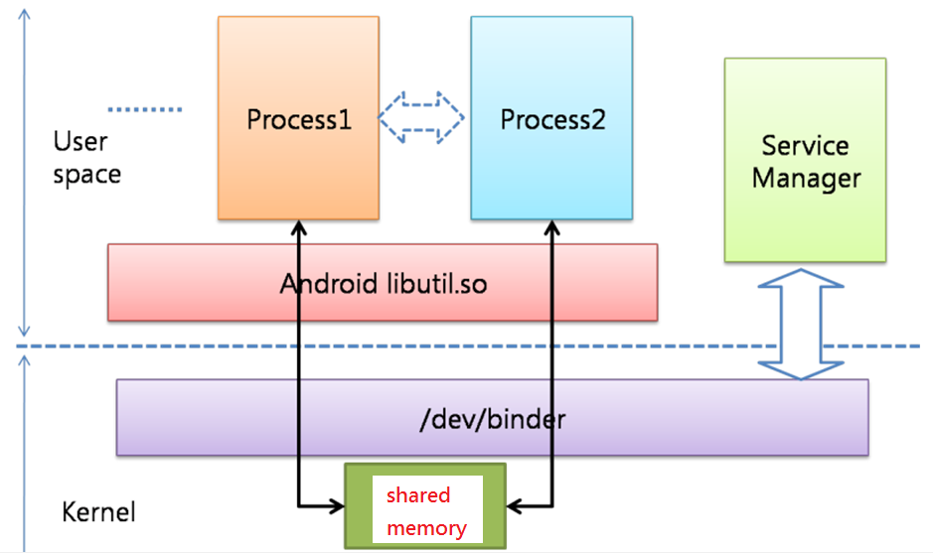
Binder IPC Mechanism

Slide 55
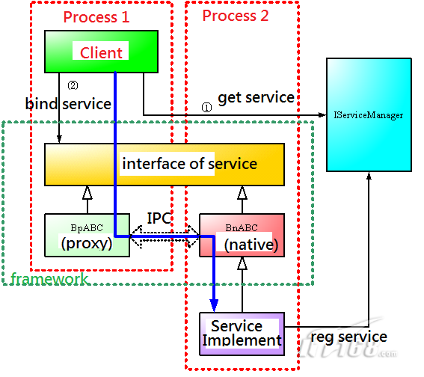
Implementation of IPC

Slide 56
Concluding Remarks
Android Framework
  Object-Oriented Design
  Making use of Design Patterns
  Containing run-time routines
Android Operating Systems
  Making use of three well-developed technologies:
    Linux Kernel, Java, XML
Design Patterns facilitate
  Software reuse
  Mainteinance
  Flexibility

Slide 57
Summary-I
What are Design Patterns?
Object-oriented (OO) design
Factory Method Pattern
Composite Pattern
Observer Pattern
Model-View-Controller Pattern
Façade Pattern

Slide 58
Summary-II
Proxy Pattern
Mediator Pattern
Bridge Pattern

Slide 59

Q&A
Any questions?

