Slide 1
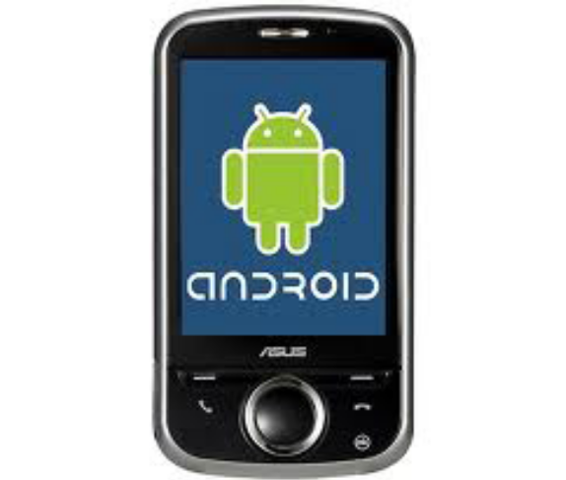

Android Basic
Session 2

Slide 2
Objectives
Create first project
The manifest file
Layout resource
Run the Application
Component of Android Application

Slide 3
1. Create first project (1)
To Create a New Android Project in Eclipse
1. In Eclipse, select File > New > Project.... If the ADT Plugin for Eclipse has been successfully installed, the resulting dialog should have a folder labeled "Android" which should contain "Android Project". (After you create one or more Android projects, an entry for "Android XML File" will also be available.)

Slide 4
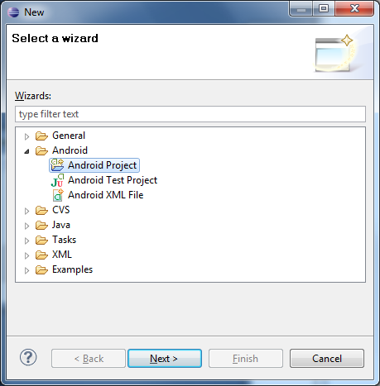
1. Create first project (2)
2. Select "Android Project" and click Next.

Slide 5
1. Create first project (3)
  3. Fill in the project details with the following values:
  Project name: HelloAndroid
  Build Target: Select a platform version that is equal to or lower than the target you chose for your AVD.
  Application name: Hello, Android
  Package name: com.example.helloandroid (or your own private namespace)
  Create Activity: HelloAndroid
  Click Finish.

Slide 6
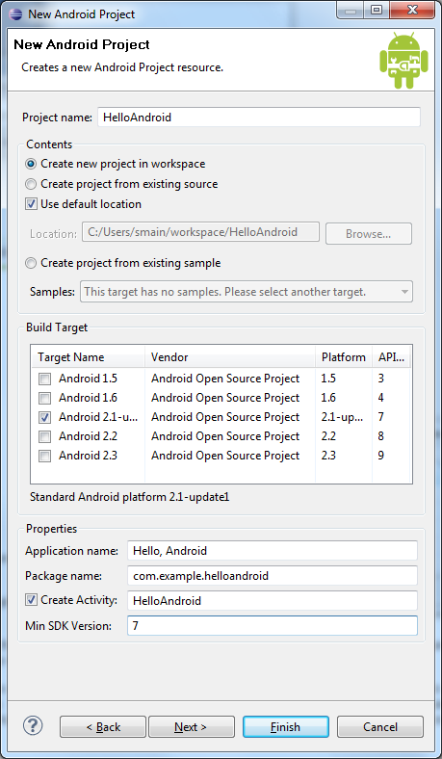
1. Create first project (4)

Slide 7
1. Create first project (5)
  Here is a description of each field:
  Project Name
    This is the Eclipse project name — the name of the directory that contains the project files.
  Build Target
    This is the version of the Android SDK that you're using to build your application. For example, if you choose Android 2.1, your application will be compiled against the Android 2.1 platform library. The target you choose here does not have to match the target you chose for your AVD; however, the target must be equal to or lower than the target you chose for your AVD. Android applications are forward-compatible, which means an application will run on the platform against which it is built as well as all platforms that are released in the future. For example, an application that is built against the 2.1 platform library will run normally on an AVD or device that is running the 2.3.3. The reverse is not true.
  Application Name
    This is the human-readable title for your application — the name that appears on the Android device.

Slide 8
1. Create first project (6)
  Package Name
    This is the package namespace (following the same rules as for packages in the Java programming language) that you want all your source code to reside under. This also sets the package name under which the stub Activity is generated. Your package name must be unique across all packages installed on the Android system; for this reason, it's important to use a standard domain-style package for your applications. The example above uses the "com.example" namespace, which is a namespace reserved for example documentation — when you develop your own applications, you should use a namespace that's appropriate to your organization or entity.

Slide 9
1. Create first project (7)
  Create Activity
    This is the name for the class stub that is generated by the plugin. This is a subclass of Android's Activity class. An Activity is simply a class that can run and do work. It can create a UI if it chooses, but it doesn't need to. As the checkbox suggests, this is optional, but an Activity is almost always used as the basis for an application.
  Min SDK Version
    This value specifies the minimum API Level on which your application will run. The Min SDK Version should be the same as the Build Target you chose. For example, if the Build Target is Android 2.1, then the Min SDK Version should be 7 or lower (it can never be higher than 7). For more information, see Android API Levels.
  Other fields: The checkbox for "Use default location" allows you to change the location on disk where the project's files are generated and stored.

Slide 10
2. The manifest file (1)
  Every application must have an AndroidManifest.xml file (with precisely that name) in its root directory. The manifest presents essential information about the application to the Android system, information the system must have before it can run any of the application's code. Among other things, the manifest does the following:
  It names the Java package for the application. The package name serves as a unique identifier for the application.

Slide 11
2. The manifest file (2)
  It describes the components of the application — the activities, services, broadcast receivers, and content providers that the application is composed of. It names the classes that implement each of the components and publishes their capabilities (for example, which Intent messages they can handle). These declarations let the Android system know what the components are and under what conditions they can be launched.
  It determines which processes will host application components.
  It declares which permissions the application must have in order to access protected parts of the API and interact with other applications.

Slide 12
2. The manifest file (3)
  It also declares the permissions that others are required to have in order to interact with the application's components.
  It lists the Instrumentation classes that provide profiling and other information as the application is running. These declarations are present in the manifest only while the application is being developed and tested; they're removed before the application is published.
  It declares the minimum level of the Android API that the application requires.
  It lists the libraries that the application must be linked against.

Slide 13
2. The manifest file (4)
  Syntax:
  <manifest xmlns:android="http://schemas.android.com/apk/res/android"
  package="string"
  android:sharedUserId="string"
  android:sharedUserLabel="string resource"
  android:versionCode="integer"
  android:versionName="string"
  android:installLocation=["auto" | "internalOnly" | "preferExternal"] >
  . . .
  </manifest>

Slide 14
3. Layout resource (1)
  The "Hello, World" example you just completed uses what is called a "programmatic" UI layout. This means that you constructed and built your application's UI directly in source code. If you've done much UI programming, you're probably familiar with how brittle that approach can sometimes be: small changes in layout can result in big source-code headaches. It's also easy to forget to properly connect Views together, which can result in errors in your layout and wasted time debugging your code.

Slide 15
3. Layout resource (2)
  That's why Android provides an alternate UI construction model: XML-based layout files. The easiest way to explain this concept is to show an example. Here's an XML layout file that is identical in behavior to the programmatically-constructed example:
  <?xml version="1.0" encoding="utf-8"?>
  <TextView xmlns:android="http://schemas.android.com/apk/res/android"
  android:id="@+id/textview"
  android:layout_width="fill_parent"
  android:layout_height="fill_parent"
  android:text="@string/hello"/>

Slide 16
3. Layout resource (3)
Attribute | Meaning
xmlns:android | This is an XML namespace declaration that tells the Android tools that you are going to refer to common attributes defined in the Android namespace. The outermost tag in every Android layout file must have this attribute.
android:id | This attribute assigns a unique identifier to the TextView element. You can use the assigned ID to reference this View from your source code or from other XML resource declarations.
android:layout_width | This attribute defines how much of the available width on the screen this View should consume. In this case, it's the only View so you want it to take up the entire screen, which is what a value of "fill_parent" means.
android:layout_height | This is just like android:layout_width, except that it refers to available screen height.
android:text | This sets the text that the TextView should display. In this example, you use a string resource instead of a hard-coded string value. The hello string is defined in the res/values/strings.xml file. This is the recommended practice for inserting strings to your application, because it makes the localization of your application to other languages graceful, without need to hard-code changes to the layout file. For more information, see Resources and Internationalization.

Slide 17
4. Run the Application
  The Eclipse plugin makes it easy to run your applications:
  Select Run > Run.
  Select "Android Application

Slide 18
5. Debug Your Project
  To find out more about the error, set a breakpoint in your source code (double-click on the marker bar next to the source code line). Then select Run > Debug History > Hello, Android from the menu to enter debug mode. Your app will restart in the emulator, but this time it will suspend when it reaches the breakpoint you set. You can then step through the code in Eclipse's Debug Perspective, just as you would for any other application.
  Refer:
  http://www.android10.org/index.php/articlesother/240-debugging-your-android-app

Slide 19
6. Component of Android Application (1)
  1. Activities
  An Activity is an application component that provides a screen with which users can interact in order to do something, such as dial the phone, take a photo, send an email, or view a map. Each activity is given a window in which to draw its user interface. The window typically fills the screen, but may be smaller than the screen and float on top of other windows.

Slide 20
6. Component of Android Application (2)
  2. Service
  A Service is an application component that can perform long-running operations in the background and does not provide a user interface. Another application component can start a service and it will continue to run in the background even if the user switches to another application. Additionally, a component can bind to a service to interact with it and even perform interprocess communication (IPC). For example, a service might handle network transactions, play music, perform file I/O, or interact with a content provider, all from the background.

Slide 21
6. Component of Android Application (3)
  3. Content Provider
  Content providers store and retrieve data and make it accessible to all applications. They're the only way to share data across applications; there's no common storage area that all Android packages can access.
  Android ships with a number of content providers for common data types (audio, video, images, personal contact information, and so on). You can see some of them listed in the android.provider package. You can query these providers for the data they contain (although, for some, you must acquire the proper permission to read the data).

Slide 22
6. Component of Android Application (4)
  4. Intent
  Three of the core components of an application activities, services, and broadcast receivers are activated through messages, called intents. Intent messaging is a facility for late run-time binding between components in the same or different applications. The intent itself, an Intent object, is a passive data structure holding an abstract description of an operation to be performed or, often in the case of broadcasts, a description of something that has happened and is being announced.

Slide 23
6. Component of Android Application (5)
  5. Broadcast Receiver
  A broadcast receiver is a component that responds to system-wide broadcast announcements. Many broadcasts originate from the system—for example, a broadcast announcing that the screen has turned off, the battery is low, or a picture was captured. Applications can also initiate broadcasts—for example, to let other applications know that some data has been downloaded to the device and is available for them to use. Although broadcast receivers don't display a user interface, they may create a status bar notification to alert the user when a broadcast event occurs. More commonly, though, a broadcast receiver is just a "gateway" to other components and is intended to do a very minimal amount of work. For instance, it might initiate a service to perform some work based on the event.

Slide 24
6. Component of Android Application (6)
  6. Notification
  Notification in android is handy way to notify your user.
  Refer:
  http://developer.android.com/guide/topics/fundamentals.html

Slide 25
Summary
  Step create new android project
  Understand the manifest file
  Understand the Layout resource
  How to run application
  How to debug your project
  Understand the components of android project

Slide 26

Q&A
Any questions?

