Slide 1
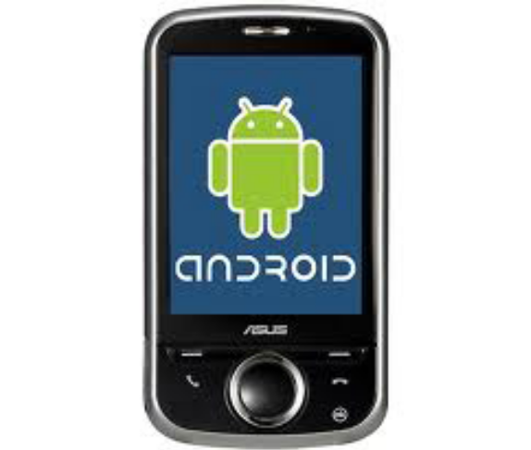

Main Building Blocks
Session 3

Slide 2
Objectives
Activite
Intents and Intent Filters

Slide 3
I. Activites
  About Activites
  Creating an Activity
  Starting an Activity
  Managing the Activity Lifecycle
  Activity and Task Design Guidelines

Slide 4
1. About Activites (1)
An Activity is an application component that provides a screen with which users can interact in order to do something, such as dial the phone, take a photo, send an email, or view a map. Each activity is given a window in which to draw its user interface. The window typically fills the screen, but may be smaller than the screen and float on top of other windows.
An application usually consists of multiple activities that are loosely bound to each other. Typically, one activity in an application is specified as the "main" activity, which is presented to the user when launching the application for the first time. Each activity can then start another activity in order to perform different actions. Each time a new activity starts, the previous activity is stopped, but the system preserves the activity in a stack (the "back stack"). When a new activity starts, it is pushed onto the back stack and takes user focus. The back stack abides to the basic "last in, first out" queue mechanism, so, when the user is done with the current activity and presses the BACK key, it is popped from the stack (and destroyed) and the previous activity resumes. (The back stack is discussed more in the Tasks and Back Stack document.)

Slide 5
1. About Activites (2)
  When an activity is stopped because a new activity starts, it is notified of this change in state through the activity's lifecycle callback methods. There are several callback methods that an activity might receive, due to a change in its state—whether the system is creating it, stopping it, resuming it, or destroying it—and each callback provides you the opportunity to perform specific work that's appropriate to that state change. For instance, when stopped, your activity should release any large objects, such as network or database connections. When the activity resumes, you can reacquire the necessary resources and resume actions that were interrupted. These state transitions are all part of the activity lifecycle.
  The rest of this document discusses the basics of how to build and use an activity, including a complete discussion of how the activity lifecycle works, so you can properly manage the transition between various activity states.

Slide 6
1. About Activites (3)
  An activity represents a single screen with a user interface. An activity is implemented as a subclass of Activity.
  For example, an email application might have one activity that shows a list of new emails, another activity to compose an email, and another activity for reading emails. Although the activities work together to form a cohesive user experience in the email application, each one is independent of the others. As such, a different application can start any one of these activities (if the email application allows it). For example, a camera application can start the activity in the email application that composes new mail, in order for the user to share a picture.

Slide 7
2. Creating an Activity (1)
To create an activity, you must create a subclass of Activity (or an existing subclass of it). In your subclass, you need to implement callback methods that the system calls when the activity transitions between various states of its lifecycle, such as when the activity is being created, stopped, resumed, or destroyed. The two most important callback methods are:

Slide 8
2. Creating an Activity (2)
onCreate()
  You must implement this method. The system calls this when creating your activity. Within your implementation, you should initialize the essential components of your activity. Most importantly, this is where you must call setContentView() to define the layout for the activity's user interface.
onPause()
  The system calls this method as the first indication that the user is leaving your activity (though it does not always mean the activity is being destroyed). This is usually where you should commit any changes that should be persisted beyond the current user session (because the user might not come back).
There are several other lifecycle callback methods that you should use in order to provide a fluid user experience between activities and handle unexpected interuptions that cause your activity to be stopped and even destroyed. All of the lifecycle callback methods are discussed later, in the section about Managing the Activity Lifecycle.

Slide 9
2. Creating an Activity (3)
Implementing a user interface
The user interface for an activity is provided by a hierarchy of views—objects derived from the View class. Each view controls a particular rectangular space within the activity's window and can respond to user interaction. For example, a view might be a button that initiates an action when the user touches it.
Android provides a number of ready-made views that you can use to design and organize your layout. "Widgets" are views that provide a visual (and interactive) elements for the screen, such as a button, text field, checkbox, or just an image. "Layouts" are views derived from ViewGroup that provide a unique layout model for its child views, such as a linear layout, a grid layout, or relative layout. You can also subclass the View and ViewGroup classes (or existing subclasses) to create your own widgets and layouts and apply them to your activity layout.
The most common way to define a layout using views is with an XML layout file saved in your application resources. This way, you can maintain the design of your user interface separately from the source code that defines the activity's behavior. You can set the layout as the UI for your activity with setContentView(), passing the resource ID for the layout. However, you can also create new Views in your activity code and build a view hierarchy by inserting new Views into a ViewGroup, then use that layout by passing the root ViewGroup to setContentView().
For information about creating a user interface, see the User Interface documentation.

Slide 10
2. Creating an Activity (4)
Declaring the activity in the manifest
You must declare your activity in the manifest file in order for it to be accessible to the system. To declare your activity, open your manifest file and add an <activity> element as a child of the <application> element. For example:
<manifest ... >
<application ... >
<activity android:name=".ExampleActivity" />
...
</application ... >
...
</manifest > There are several other attributes that you can include in this element, to define properties such as the label for the activity, an icon for the activity, or a theme to style the activity's UI. The android:name attribute is the only required attribute—it specifies the class name of the activity. Once you publish your application, you should not change this name, because if you do, you might break some functionality, such as application shortcuts (read the blog post, Things That Cannot Change).
See the <activity> element reference for more information about declaring your activity in the manifest.

Slide 11
2. Creating an Activity (5)
Using intent filters
An <activity> element can also specify various intent filters—using the <intent-filter> element—in order to declare how other application components may activate it.
When you create a new application using the Android SDK tools, the stub activity that's created for you automatically includes an intent filter that declares the activity responds to the "main" action and should be placed in the "launcher" category. The intent filter looks like this:
<activity android:name=".ExampleActivity" android:icon="@drawable/app_icon">
<intent-filter>
<action android:name="android.intent.action.MAIN" />
<category android:name="android.intent.category.LAUNCHER" />
</intent-filter>
</activity>

Slide 12
2. Creating an Activity (6)
The <action> element specifies that this is the "main" entry point to the application. The <category> element specifies that this activity should be listed in the system's application launcher (to allow users to launch this activity).
If you intend for your application to be self-contained and not allow other applications to activate its activities, then you don't need any other intent filters. Only one activity should have the "main" action and "launcher" category, as in the previous example. Activities that you don't want to make available to other applications should have no intent filters and you can start them yourself using explicit intents (as discussed in the following section).
However, if you want your activity to respond to implicit intents that are delivered from other applications (and your own), then you must define additional intent filters for your activity. For each type of intent to which you want to respond, you must include an <intent-filter> that includes an <action> element and, optionally, a <category> element and/or a <data> element. These elements specify the type of intent to which your activity can respond.
For more information about how your activities can respond to intents, see the Intents and Intent Filters document.

Slide 13
3. Starting an Activity (1)
Starting an Activity
You can start another activity by calling startActivity(), passing it an Intent that describes the activity you want to start. The intent specifies either the exact activity you want to start or describes the type of action you want to perform (and the system selects the appropriate activity for you, which can even be from a different application). An intent can also carry small amounts of data to be used by the activity that is started.
When working within your own application, you'll often need to simply launch a known activity. You can do so by creating an intent that explicitly defines the activity you want to start, using the class name. For example, here's how one activity starts another activity named SignInActivity:
Intent intent = new Intent(this, SignInActivity.class);
startActivity(intent);

Slide 14
3. Starting an Activity (2)
However, your application might also want to perform some action, such as send an email, text message, or status update, using data from your activity. In this case, your application might not have its own activities to perform such actions, so you can instead leverage the activities provided by other applications on the device, which can perform the actions for you. This is where intents are really valuable—you can create an intent that describes an action you want to perform and the system launches the appropriate activity from another application. If there are multiple activities that can handle the intent, then the user can select which one to use. For example, if you want to allow the user to send an email message, you can create the following intent:
Intent intent = new Intent(Intent.ACTION_SEND);
intent.putExtra(Intent.EXTRA_EMAIL, recipientArray);
startActivity(intent); The EXTRA_EMAIL extra added to the intent is a string array of email addresses to which the email should be sent. When an email application responds to this intent, it reads the string array provided in the extra and places them in the "to" field of the email composition form. In this situation, the email application's activity starts and when the user is done, your activity resumes

Slide 15
3. Starting an Activity (3)
Starting an activity for a result
Sometimes, you might want to receive a result from the activity that you start. In that case, start the activity by calling startActivityForResult() (instead of startActivity()). To then receive the result from the subsequent activity, implement the onActivityResult() callback method. When the subsequent activity is done, it returns a result in an Intent to your onActivityResult() method.
For example, perhaps you want the user to pick one of their contacts, so your activity can do something with the information in that contact. Here's how you can create such an intent and handle the result:
private void pickContact() {
// Create an intent to "pick" a contact, as defined by the content provider URI
Intent intent = new Intent(Intent.ACTION_PICK, Contacts.CONTENT_URI);
startActivityForResult(intent, PICK_CONTACT_REQUEST);
}
@Override
protected void onActivityResult(int requestCode, int resultCode, Intent data) {
// If the request went well (OK) and the request was PICK_CONTACT_REQUEST
if (resultCode == Activity.RESULT_OK && requestCode == PICK_CONTACT_REQUEST) {
// Perform a query to the contact's content provider for the contact's name
Cursor cursor = getContentResolver().query(data.getData(),
new String[] {Contacts.DISPLAY_NAME}, null, null, null);
if (cursor.moveToFirst()) { // True if the cursor is not empty
int columnIndex = cursor.getColumnIndex(Contacts.DISPLAY_NAME);
String name = cursor.getString(columnIndex);
// Do something with the selected contact's name...
}
}
}

Slide 16
3. Starting an Activity (4)
This example shows the basic logic you should use in your onActivityResult() method in order to handle an activity result. The first condition checks whether the request was successful—if it was, then the resultCode will be RESULT_OK—and whether the request to which this result is responding is known—in this case, the requestCode matches the second parameter sent with startActivityForResult(). From there, the code handles the activity result by querying the data returned in an Intent (the data parameter).
What happens is, a ContentResolver performs a query against a content provider, which returns a Cursor that allows the queried data to be read. For more information, see the Content Providers document.
For more information about using intents, see the Intents and Intent Filters document

Slide 17
3. Starting an Activity (5)
Shutting Down an Activity
You can shut down an activity by calling its finish() method. You can also shut down a separate activity that you previously started by calling finishActivity().
Note: In most cases, you should not explicitly finish an activity using these methods. As discussed in the following section about the activity lifecycle, the Android system manages the life of an activity for you, so you do not need to finish your own activities. Calling these methods could adversely affect the expected user experience and should only be used when you absolutely do not want the user to return to this instance of the activity.

Slide 18
4. Managing the Activity Lifecycle (1)
Managing the lifecycle of your activities by implementing callback methods is crucial to developing a strong and flexible application. The lifecycle of an activity is directly affected by its association with other activities, its task and back stack.
An activity can exist in essentially three states:
Resumed
  The activity is in the foreground of the screen and has user focus. (This state is also sometimes referred to as "running".)
Paused
  Another activity is in the foreground and has focus, but this one is still visible. That is, another activity is visible on top of this one and that activity is partially transparent or doesn't cover the entire screen. A paused activity is completely alive (the Activity object is retained in memory, it maintains all state and member information, and remains attached to the window manager), but can be killed by the system in extremely low memory situations.
Stopped
  The activity is completely obscured by another activity (the activity is now in the "background"). A stopped activity is also still alive (the Activity object is retained in memory, it maintains all state and member information, but is not attached to the window manager). However, it is no longer visible to the user and it can be killed by the system when memory is needed elsewhere.
If an activity is paused or stopped, the system can drop it from memory either by asking it to finish (calling its finish() method), or simply killing its process. When the activity is opened again (after being finished or killed), it must be created all over.

Slide 19
4. Managing the Activity Lifecycle (2)
The entire lifetime of an activity happens between the call to onCreate() and the call to onDestroy(). Your activity should perform setup of "global" state (such as defining layout) in onCreate(), and release all remaining resources in onDestroy(). For example, if your activity has a thread running in the background to download data from the network, it might create that thread in onCreate() and then stop the thread in onDestroy().
The visible lifetime of an activity happens between the call to onStart() and the call to onStop(). During this time, the user can see the activity on-screen and interact with it. For example, onStop() is called when a new activity starts and this one is no longer visible. Between these two methods, you can maintain resources that are needed to show the activity to the user. For example, you can register a BroadcastReceiver in onStart() to monitor changes that impact your UI, and unregister it in onStop() when the user can no longer see what you are displaying. The system might call onStart() and onStop() multiple times during the entire lifetime of the activity, as the activity alternates between being visible and hidden to the user.
The foreground lifetime of an activity happens between the call to onResume() and the call to onPause(). During this time, the activity is in front of all other activities on screen and has user input focus. An activity can frequently transition in and out of the foreground—for example, onPause() is called when the device goes to sleep or when a dialog appears. Because this state can transition often, the code in these two methods should be fairly lightweight in order to avoid slow transitions that make the user wait.

Slide 20
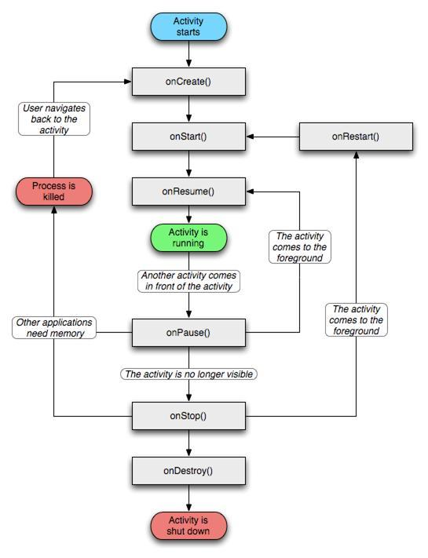
4. Managing the Activity Lifecycle (3)

Slide 21
4. Managing the Activity Lifecycle (4)
Implementing the lifecycle callbacks
When an activity transitions into and out of the different states described above, it is notified through various callback methods. All of the callback methods are hooks that you can override to do appropriate work when the state of your activity changes. The following skeleton activity includes each of the fundamental lifecycle methods:

Slide 22
4. Managing the Activity Lifecycle (5)
public class ExampleActivity extends Activity {
@Override
public void onCreate(Bundle savedInstanceState) {
super.onCreate(savedInstanceState);
// The activity is being created.
}
@Override
protected void onStart() {
super.onStart();
// The activity is about to become visible.
}
@Override
protected void onResume() {
super.onResume();
// The activity has become visible (it is now "resumed").
}
@Override
protected void onPause() {
super.onPause();
// Another activity is taking focus (this activity is about to be "paused").
}
@Override
protected void onStop() {
super.onStop();
// The activity is no longer visible (it is now "stopped")
}
@Override
protected void onDestroy() {
super.onDestroy();
// The activity is about to be destroyed.
}
}

Slide 23
4. Managing the Activity Lifecycle (6)
Method | Description | Killable after? | Next
onCreate() | Called when the activity is first created. This is where you should do all of your normal static set up — create views, bind data to lists, and so on. This method is passed a Bundle object containing the activity's previous state, if that state was captured (see Saving Activity State, later). Always followed by onStart(). | No | onStart()
onRestart() | Called after the activity has been stopped, just prior to it being started again. Always followed by onStart() | No | onStart()
onStart() | Called just before the activity becomes visible to the user. Followed by onResume() if the activity comes to the foreground, or onStop() if it becomes hidden. | No | onResume() or onStop()
onResume() | Called just before the activity starts interacting with the user. At this point the activity is at the top of the activity stack, with user input going to it. Always followed by onPause(). | No | onPause()

Slide 24
4. Managing the Activity Lifecycle (7)
Method | Description | Killable after? | Next
onPause() | Called when the system is about to start resuming another activity. This method is typically used to commit unsaved changes to persistent data, stop animations and other things that may be consuming CPU, and so on. It should do whatever it does very quickly, because the next activity will not be resumed until it returns. Followed either by onResume() if the activity returns back to the front, or by onStop() if it becomes invisible to the user. | Yes | onResume() or onStop()
onStop() | Called when the activity is no longer visible to the user. This may happen because it is being destroyed, or because another activity (either an existing one or a new one) has been resumed and is covering it. Followed either by onRestart() if the activity is coming back to interact with the user, or by onDestroy() if this activity is going away. | Yes | onRestart() or onDestroy()
onDestroy() | Called before the activity is destroyed. This is the final call that the activity will receive. It could be called either because the activity is finishing (someone called finish() on it), or because the system is temporarily destroying this instance of the activity to save space. You can distinguish between these two scenarios with the isFinishing() method. | Yes | nothing

Slide 25
4. Managing the Activity Lifecycle (8)
Table 1. A summary of the activity lifecycle's callback methods.
The column labeled "Killable after?" indicates whether or not the system can kill the process hosting the activity at any time after the method returns, without executing another line of the activity's code. Three methods are marked "yes": (onPause(), onStop(), and onDestroy()). Because onPause() is the first of the three, once the activity is created, onPause() is the last method that's guaranteed to be called before the process can be killed—if the system must recover memory in an emergency, then onStop() and onDestroy() might not be called. Therefore, you should use onPause() to write crucial persistent data (such as user edits) to storage. However, you should be selective about what information must be retained during onPause(), because any blocking procedures in this method block the transition to the next activity and slow the user experience.
Methods that are marked "No" in the Killable column protect the process hosting the activity from being killed from the moment they are called. Thus, an activity is killable from the time onPause() returns to the time onResume() is called. It will not again be killable until onPause() is again called and returns.

Slide 26
4. Managing the Activity Lifecycle (9)
Saving activity state
The introduction to Managing the Activity Lifecycle briefly mentions that when an activity is paused or stopped, the state of the activity is retained. This is true because the Activity object is still held in memory when it is paused or stopped—all information about its members and current state is still alive. Thus, any changes the user made within the activity are retained in memory, so that when the activity returns to the foreground (when it "resumes"), those changes are still there.

Slide 27
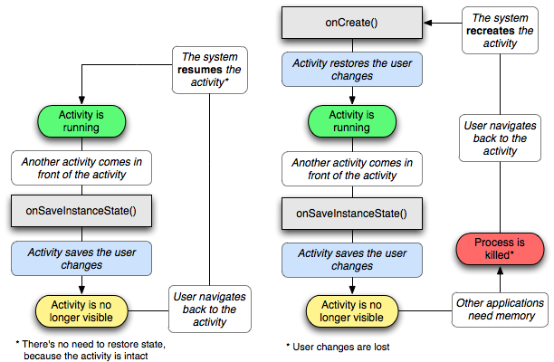
4. Managing the Activity Lifecycle (10)

Slide 28
4. Managing the Activity Lifecycle (11)
Handling configuration changes
Some device configurations can change during runtime (such as screen orientation, keyboard availability, and language). When such a change occurs, Android restarts the running Activity (onDestroy() is called, followed immediately by onCreate()). The restart behavior is designed to help your application adapt to new configurations by automatically reloading your application with alternative resources that you've provided. If you design your activity to properly handle this event, it will be more resilient to unexpected events in the activity lifecycle.
The best way to handle a configuration change, such as a change in the screen orientation, is to simply preserve the state of your application using onSaveInstanceState() and onRestoreInstanceState() (or onCreate()), as discussed in the previous section.
For a detailed discussion about configuration changes that happen at runtime and how you should handle them, read Handling Runtime Changes.

Slide 29
4. Managing the Activity Lifecycle (12)
Coordinating activities
When one activity starts another, they both experience lifecycle transitions. The first activity pauses and stops (though, it won't stop if it's still visible in the background), while the other activity is created. In case these activities share data saved to disc or elsewhere, it's important to understand that the first activity is not completely stopped before the second one is created. Rather, the process of starting the second one overlaps with the process of stopping the first one.
The order of lifecycle callbacks is well defined, particularly when the two activities are in the same process and one is starting the other. Here's the order of operations that occur when Activity A starts Acivity B:
Activity A's onPause() method executes.
Activity B's onCreate(), onStart(), and onResume() methods execute in sequence. (Activity B now has user focus.)
Then, if Activity A is no longer visible on screen, its onStop() method executes.
This predictable sequence of lifecycle callbacks allows you to manage the transition of information from one activity to another. For example, if you must write to a database when the first activity stops so that the following activity can read it, then you should write to the database during onPause() instead of during onStop().

Slide 30
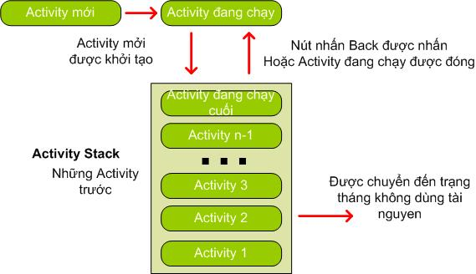
4. Managing the Activity Lifecycle (13)
Activity Stack

Slide 31
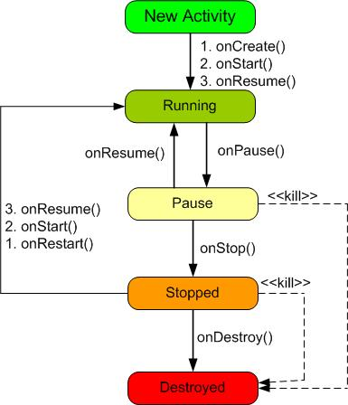
4. Managing the Activity Lifecycle (14)
Status of Activity Lifecycle

Slide 32
5. Activity and Task Design
http://developer.android.com/guide/practices/ui_guidelines/activity_task_design.html
Android Activity and sub-Activity Tutorial:
http://developerlife.com/tutorials/?p=302

Slide 33
4. Managing the Activity Lifecycle (13)

Slide 34
II. Intents and Intent Filters
  About Intents
  Intent Objects
  Intent Resolution
  Note Pad Example

Slide 35
1. About Intents (1)
Three of the core components of an application — activities, services, and broadcast receivers — are activated through messages, called intents. Intent messaging is a facility for late run-time binding between components in the same or different applications. The intent itself, an Intent object, is a passive data structure holding an abstract description of an operation to be performed — or, often in the case of broadcasts, a description of something that has happened and is being announced. There are separate mechanisms for delivering intents to each type of component:

Slide 36
1. About Intents (2)
An Intent object is passed to Context.startActivity() or Activity.startActivityForResult() to launch an activity or get an existing activity to do something new. (It can also be passed to Activity.setResult() to return information to the activity that called startActivityForResult().)
An Intent object is passed to Context.startService() to initiate a service or deliver new instructions to an ongoing service. Similarly, an intent can be passed to Context.bindService() to establish a connection between the calling component and a target service. It can optionally initiate the service if it's not already running.
Intent objects passed to any of the broadcast methods (such as Context.sendBroadcast(), Context.sendOrderedBroadcast(), or Context.sendStickyBroadcast()) are delivered to all interested broadcast receivers. Many kinds of broadcasts originate in system code.

Slide 37
1. About Intents (3)
In each case, the Android system finds the appropriate activity, service, or set of broadcast receivers to respond to the intent, instantiating them if necessary. There is no overlap within these messaging systems: Broadcast intents are delivered only to broadcast receivers, never to activities or services. An intent passed to startActivity() is delivered only to an activity, never to a service or broadcast receiver, and so on.
This document begins with a description of Intent objects. It then describes the rules Android uses to map intents to components — how it resolves which component should receive an intent message. For intents that don't explicitly name a target component, this process involves testing the Intent object against intent filters associated with potential targets.

Slide 38
2. Intent Objects (1)
An Intent object is a bundle of information. It contains information of interest to the component that receives the intent (such as the action to be taken and the data to act on) plus information of interest to the Android system (such as the category of component that should handle the intent and instructions on how to launch a target activity). Principally, it can contain the following:
Component name
  The name of the component that should handle the intent. This field is a ComponentName object — a combination of the fully qualified class name of the target component (for example "com.example.project.app.FreneticActivity") and the package name set in the manifest file of the application where the component resides (for example, "com.example.project"). The package part of the component name and the package name set in the manifest do not necessarily have to match. The component name is optional. If it is set, the Intent object is delivered to an instance of the designated class. If it is not set, Android uses other information in the Intent object to locate a suitable target — see Intent Resolution, later in this document.
  The component name is set by setComponent(), setClass(), or setClassName() and read by getComponent().

Slide 39
2. Intent Objects (2)
Action
  A string naming the action to be performed — or, in the case of broadcast intents, the action that took place and is being reported. The Intent class defines a number of action constants, including these:

Slide 40
2. Intent Objects (3)
Constant | Target component | Action
ACTION_CALL | activity | Initiate a phone call.
ACTION_EDIT | activity | Display data for the user to edit.
ACTION_MAIN | activity | Start up as the initial activity of a task, with no data input and no returned output.
ACTION_SYNC | activity | Synchronize data on a server with data on the mobile device.
ACTION_BATTERY_LOW | broadcast receiver | A warning that the battery is low.
ACTION_HEADSET_PLUG | broadcast receiver | A headset has been plugged into the device, or unplugged from it.
ACTION_SCREEN_ON | broadcast receiver | The screen has been turned on.
ACTION_TIMEZONE_CHANGED | broadcast receiver | The setting for the time zone has changed.

Slide 41
2. Intent Objects (4)
See the Intent class description for a list of pre-defined constants for generic actions. Other actions are defined elsewhere in the Android API. You can also define your own action strings for activating the components in your application. Those you invent should include the application package as a prefix — for example: "com.example.project.SHOW_COLOR".
The action largely determines how the rest of the intent is structured — particularly the data and extras fields — much as a method name determines a set of arguments and a return value. For this reason, it's a good idea to use action names that are as specific as possible, and to couple them tightly to the other fields of the intent. In other words, instead of defining an action in isolation, define an entire protocol for the Intent objects your components can handle.
The action in an Intent object is set by the setAction() method and read by getAction().

Slide 42
2. Intent Objects (5)
Data
  The URI of the data to be acted on and the MIME type of that data. Different actions are paired with different kinds of data specifications. For example, if the action field is ACTION_EDIT, the data field would contain the URI of the document to be displayed for editing. If the action is ACTION_CALL, the data field would be a tel: URI with the number to call. Similarly, if the action is ACTION_VIEW and the data field is an http: URI, the receiving activity would be called upon to download and display whatever data the URI refers to. When matching an intent to a component that is capable of handling the data, it's often important to know the type of data (its MIME type) in addition to its URI. For example, a component able to display image data should not be called upon to play an audio file.
  In many cases, the data type can be inferred from the URI — particularly content: URIs, which indicate that the data is located on the device and controlled by a content provider (see the separate discussion on content providers). But the type can also be explicitly set in the Intent object. The setData() method specifies data only as a URI, setType() specifies it only as a MIME type, and setDataAndType() specifies it as both a URI and a MIME type. The URI is read by getData() and the type by getType().

Slide 43
2. Intent Objects (6)
Category
  A string containing additional information about the kind of component that should handle the intent. Any number of category descriptions can be placed in an Intent object. As it does for actions, the Intent class defines several category constants, including these

Slide 44
2. Intent Objects (7)
Constant | Meaning
CATEGORY_BROWSABLE | The target activity can be safely invoked by the browser to display data referenced by a link — for example, an image or an e-mail message.
CATEGORY_GADGET | The activity can be embedded inside of another activity that hosts gadgets.
CATEGORY_HOME | The activity displays the home screen, the first screen the user sees when the device is turned on or when the HOME key is pressed.
CATEGORY_LAUNCHER | The activity can be the initial activity of a task and is listed in the top-level application launcher.
CATEGORY_PREFERENCE | The target activity is a preference panel.

Slide 45
2. Intent Objects (8)
See the Intent class description for the full list of categories.
The addCategory() method places a category in an Intent object, removeCategory() deletes a category previously added, and getCategories() gets the set of all categories currently in the object.

Slide 46
2. Intent Objects (9)
Extras
  Key-value pairs for additional information that should be delivered to the component handling the intent. Just as some actions are paired with particular kinds of data URIs, some are paired with particular extras. For example, an ACTION_TIMEZONE_CHANGED intent has a "time-zone" extra that identifies the new time zone, and ACTION_HEADSET_PLUG has a "state" extra indicating whether the headset is now plugged in or unplugged, as well as a "name" extra for the type of headset. If you were to invent a SHOW_COLOR action, the color value would be set in an extra key-value pair. The Intent object has a series of put...() methods for inserting various types of extra data and a similar set of get...() methods for reading the data. These methods parallel those for Bundle objects. In fact, the extras can be installed and read as a Bundle using the putExtras() and getExtras() methods.

Slide 47
2. Intent Objects (10)
Flags
  Flags of various sorts. Many instruct the Android system how to launch an activity (for example, which task the activity should belong to) and how to treat it after it's launched (for example, whether it belongs in the list of recent activities). All these flags are defined in the Intent class.
The Android system and the applications that come with the platform employ Intent objects both to send out system-originated broadcasts and to activate system-defined components. To see how to structure an intent to activate a system component, consult the list of intents in the reference.

Slide 48
3. Intent Resolution (1)
Intents can be divided into two groups:
Explicit intents designate the target component by its name (the component name field, mentioned earlier, has a value set). Since component names would generally not be known to developers of other applications, explicit intents are typically used for application-internal messages — such as an activity starting a subordinate service or launching a sister activity.
Implicit intents do not name a target (the field for the component name is blank). Implicit intents are often used to activate components in other applications.
Android delivers an explicit intent to an instance of the designated target class. Nothing in the Intent object other than the component name matters for determining which component should get the intent.

Slide 49
3. Intent Resolution (2)
A different strategy is needed for implicit intents. In the absence of a designated target, the Android system must find the best component (or components) to handle the intent — a single activity or service to perform the requested action or the set of broadcast receivers to respond to the broadcast announcement. It does so by comparing the contents of the Intent object to intent filters, structures associated with components that can potentially receive intents. Filters advertise the capabilities of a component and delimit the intents it can handle. They open the component to the possibility of receiving implicit intents of the advertised type. If a component does not have any intent filters, it can receive only explicit intents. A component with filters can receive both explicit and implicit intents.
Only three aspects of an Intent object are consulted when the object is tested against an intent filter:
action
data (both URI and data type)
category
The extras and flags play no part in resolving which component receives an intent

Slide 50
3. Intent Resolution (3)
Intent filters
To inform the system which implicit intents they can handle, activities, services, and broadcast receivers can have one or more intent filters. Each filter describes a capability of the component, a set of intents that the component is willing to receive. It, in effect, filters in intents of a desired type, while filtering out unwanted intents — but only unwanted implicit intents (those that don't name a target class). An explicit intent is always delivered to its target, no matter what it contains; the filter is not consulted. But an implicit intent is delivered to a component only if it can pass through one of the component's filters.
A component has separate filters for each job it can do, each face it can present to the user. For example, the NoteEditor activity of the sample Note Pad application has two filters — one for starting up with a specific note that the user can view or edit, and another for starting with a new, blank note that the user can fill in and save. (All of Note Pad's filters are described in the Note Pad Example section, later.)

Slide 51
3. Intent Resolution (4)
An intent filter is an instance of the IntentFilter class. However, since the Android system must know about the capabilities of a component before it can launch that component, intent filters are generally not set up in Java code, but in the application's manifest file (AndroidManifest.xml) as <intent-filter> elements. (The one exception would be filters for broadcast receivers that are registered dynamically by calling Context.registerReceiver(); they are directly created as IntentFilter objects.)
A filter has fields that parallel the action, data, and category fields of an Intent object. An implicit intent is tested against the filter in all three areas. To be delivered to the component that owns the filter, it must pass all three tests. If it fails even one of them, the Android system won't deliver it to the component — at least not on the basis of that filter. However, since a component can have multiple intent filters, an intent that does not pass through one of a component's filters might make it through on another.
Each of the three tests is described in detail below:

Slide 52
3. Intent Resolution (5)
Action test
  An <intent-filter> element in the manifest file lists actions as <action> subelements. For example: <intent-filter . . . >
  <action android:name="com.example.project.SHOW_CURRENT" />
  <action android:name="com.example.project.SHOW_RECENT" />
  <action android:name="com.example.project.SHOW_PENDING" />
  . . .
  </intent-filter> As the example shows, while an Intent object names just a single action, a filter may list more than one. The list cannot be empty; a filter must contain at least one <action> element, or it will block all intents.
  To pass this test, the action specified in the Intent object must match one of the actions listed in the filter. If the object or the filter does not specify an action, the results are as follows:
    If the filter fails to list any actions, there is nothing for an intent to match, so all intents fail the test. No intents can get through the filter.
    On the other hand, an Intent object that doesn't specify an action automatically passes the test — as long as the filter contains at least one action.

Slide 53
3. Intent Resolution (6)
Category test
  An <intent-filter> element also lists categories as subelements. For example: <intent-filter . . . >
  <category android:name="android.intent.category.DEFAULT" />
  <category android:name="android.intent.category.BROWSABLE" />
  . . .
  </intent-filter> Note that the constants described earlier for actions and categories are not used in the manifest file. The full string values are used instead. For instance, the "android.intent.category.BROWSABLE" string in the example above corresponds to the CATEGORY_BROWSABLE constant mentioned earlier in this document. Similarly, the string "android.intent.action.EDIT" corresponds to the ACTION_EDIT constant.

Slide 54
3. Intent Resolution (7)
For an intent to pass the category test, every category in the Intent object must match a category in the filter. The filter can list additional categories, but it cannot omit any that are in the intent.
In principle, therefore, an Intent object with no categories should always pass this test, regardless of what's in the filter. That's mostly true. However, with one exception, Android treats all implicit intents passed to startActivity() as if they contained at least one category: "android.intent.category.DEFAULT" (the CATEGORY_DEFAULT constant). Therefore, activities that are willing to receive implicit intents must include "android.intent.category.DEFAULT" in their intent filters. (Filters with "android.intent.action.MAIN" and "android.intent.category.LAUNCHER" settings are the exception. They mark activities that begin new tasks and that are represented on the launcher screen. They can include "android.intent.category.DEFAULT" in the list of categories, but don't need to.) See Using intent matching, later, for more on these filters.)

Slide 55
3. Intent Resolution (8)
Data test
  Like the action and categories, the data specification for an intent filter is contained in a subelement. And, as in those cases, the subelement can appear multiple times, or not at all. For example: <intent-filter . . . >
  <data android:mimeType="video/mpeg" android:scheme="http" . . . />
  <data android:mimeType="audio/mpeg" android:scheme="http" . . . />
  . . .
  </intent-filter> Each <data> element can specify a URI and a data type (MIME media type). There are separate attributes — scheme, host, port, and path — for each part of the URI:
  scheme://host:port/path
  For example, in the following URI,
  content://com.example.project:200/folder/subfolder/etc
  the scheme is "content", the host is "com.example.project", the port is "200", and the path is "folder/subfolder/etc". The host and port together constitute the URI authority; if a host is not specified, the port is ignored.

Slide 56
3. Intent Resolution (9)
Each of these attributes is optional, but they are not independent of each other: For an authority to be meaningful, a scheme must also be specified. For a path to be meaningful, both a scheme and an authority must be specified.
When the URI in an Intent object is compared to a URI specification in a filter, it's compared only to the parts of the URI actually mentioned in the filter. For example, if a filter specifies only a scheme, all URIs with that scheme match the filter. If a filter specifies a scheme and an authority but no path, all URIs with the same scheme and authority match, regardless of their paths. If a filter specifies a scheme, an authority, and a path, only URIs with the same scheme, authority, and path match. However, a path specification in the filter can contain wildcards to require only a partial match of the path.
The type attribute of a <data> element specifies the MIME type of the data. It's more common in filters than a URI. Both the Intent object and the filter can use a "*" wildcard for the subtype field — for example, "text/*" or "audio/*" — indicating any subtype matches.

Slide 57
3. Intent Resolution (10)
  The data test compares both the URI and the data type in the Intent object to a URI and data type specified in the filter. The rules are as follows:
      An Intent object that contains neither a URI nor a data type passes the test only if the filter likewise does not specify any URIs or data types.
      An Intent object that contains a URI but no data type (and a type cannot be inferred from the URI) passes the test only if its URI matches a URI in the filter and the filter likewise does not specify a type. This will be the case only for URIs like mailto: and tel: that do not refer to actual data.
      An Intent object that contains a data type but not a URI passes the test only if the filter lists the same data type and similarly does not specify a URI.
      An Intent object that contains both a URI and a data type (or a data type can be inferred from the URI) passes the data type part of the test only if its type matches a type listed in the filter. It passes the URI part of the test either if its URI matches a URI in the filter or if it has a content: or file: URI and the filter does not specify a URI. In other words, a component is presumed to support content: and file: data if its filter lists only a data type.
If an intent can pass through the filters of more than one activity or service, the user may be asked which component to activate. An exception is raised if no target can be found.

Slide 58
3. Intent Resolution (11)
Common cases
The last rule shown above for the data test, rule (d), reflects the expectation that components are able to get local data from a file or content provider. Therefore, their filters can list just a data type and do not need to explicitly name the content: and file: schemes. This is a typical case. A <data> element like the following, for example, tells Android that the component can get image data from a content provider and display it:
<data android:mimeType="image/*" /> Since most available data is dispensed by content providers, filters that specify a data type but not a URI are perhaps the most common.
Another common configuration is filters with a scheme and a data type. For example, a <data> element like the following tells Android that the component can get video data from the network and display it:
<data android:scheme="http" android:type="video/*" />

Slide 59
3. Intent Resolution (12)
Consider, for example, what the browser application does when the user follows a link on a web page. It first tries to display the data (as it could if the link was to an HTML page). If it can't display the data, it puts together an implicit intent with the scheme and data type and tries to start an activity that can do the job. If there are no takers, it asks the download manager to download the data. That puts it under the control of a content provider, so a potentially larger pool of activities (those with filters that just name a data type) can respond.
Most applications also have a way to start fresh, without a reference to any particular data. Activities that can initiate applications have filters with "android.intent.action.MAIN" specified as the action. If they are to be represented in the application launcher, they also specify the "android.intent.category.LAUNCHER" category:
<intent-filter . . . >
<action android:name="code android.intent.action.MAIN" />
<category android:name="code android.intent.category.LAUNCHER" />
</intent-filter>

Slide 60
3. Intent Resolution (13)
Using intent matching
Intents are matched against intent filters not only to discover a target component to activate, but also to discover something about the set of components on the device. For example, the Android system populates the application launcher, the top-level screen that shows the applications that are available for the user to launch, by finding all the activities with intent filters that specify the "android.intent.action.MAIN" action and "android.intent.category.LAUNCHER" category (as illustrated in the previous section). It then displays the icons and labels of those activities in the launcher. Similarly, it discovers the home screen by looking for the activity with "android.intent.category.HOME" in its filter.
Your application can use intent matching is a similar way. The PackageManager has a set of query...() methods that return all components that can accept a particular intent, and a similar series of resolve...() methods that determine the best component to respond to an intent. For example, queryIntentActivities() returns a list of all activities that can perform the intent passed as an argument, and queryIntentServices() returns a similar list of services. Neither method activates the components; they just list the ones that can respond. There's a similar method, queryBroadcastReceivers(), for broadcast receivers.

Slide 61
4. Note Pad Example
Refer:
http://developer.android.com/resources/samples/NotePad/index.html

Slide 62
Summary - I
Activite
  About Activities
  Creating an Activity
  Implementing a user interface
  Declaring the activity in the manifest
  Starting an Activity
  Starting an activity for a result
  Shutting Down an Activity
  Managing the Activity Lifecycle
  Implementing the lifecycle callbacks

Slide 63
Summary - II
Intents and Intent Filters
  About Intents
  Intent Objects
  Intent Resolution
  Intent filters

Slide 64

Q&A
Any questions?

