Slide 1
Objectives
In this session, you will learn to:
  Identify the phases in the test planning process
  Create a test plan
  Explain the V model
  Explain the W model

Slide 2
Test Planning Process
A test plan is a document that describes the scope, resources, approach, and schedule for the required test activities.
The test plan describes the various test items, the features to be tested, the testing tasks, the task allocation, the contingency plans, and the schedule of the testing activity.
The test planning process includes the following phases:
  Pre-planning
  Test planning
  Post-planning

Slide 3
Pre-Planning
The pre-planning phase includes activities that must be completed before creating the final test plan.
This phase identifies the test specifications. The test specifications include the following components:
  Test objectives
  Test assumptions
  Test success/acceptance criteria
  Test entrance/exit criteria

Slide 4
Test Planning
The test planning phase includes the following activities:
  Performing requirements traceability
  Estimating test effort
  Scheduling the test iterations
  Planning resources
  Identifying testing approaches
  Defining test quality control
The end product of the test planning phase is the test plan.
The creation of a test plan is essential for effective testing and requires about one-third of the total testing effort.

Slide 5
Creating a Test Plan
The test plan focuses on the following components:
  Scope of test
  Test objectives
  List of assumptions
  Results of risk analysis
  Resource allocation
  Test schedule
  Test design
  Test environment
  Testing tools and techniques
  Test completion criteria

Slide 6
Creating a Test Plan (Contd.)
To create a test plan, the steps to be followed are:
  Forming a test team:
    An effective testing team comprises of members who have technical and domain expertise relevant to the software project.
    The testing team must be properly structured with defined roles and responsibilities.
  Understanding project risks:
    The test plan should include the various activities that help prevent risks. In addition, the plan should include activities to reduce the impact of the risks and contingency plans to be followed if a risk occurs.
  Building the test plan:
    The development of a test plan involves the following activities:
      Documenting test objectives
      Creating test matrix
      Writing the test plan

Slide 7
Post-Planning
It is crucial to maintain control over the changes made to all project artifacts.
These artifacts include source code, product requirements, test cases, and test data.
Configuration management monitors the artifacts of a software system so that any changes to the configuration of these artifacts can be systematically traced.
Configuration management allows control over the various evolving artifacts of the software throughout the development life cycle.
The post-planning phase of the test planning process includes identifying a configuration management plan for the software project.

Slide 8
Post-Planning (Contd.)
Configuration management includes the following activities:
  Baseline control
  Software configuration identification
  Configuration control
  Configuration status accounting
  Software configuration authentication
  Software development libraries
The configuration management plan must address all the preceding activities.
The plan must identify the tools to be used for configuration management.

Slide 9
The V Model
The cost of correcting a defect that is detected early in the development life cycle is much less than the cost of correcting a defect detected at a later stage.
To reduce the cost of correcting defects, the defects must be detected early in the development life cycle.
The V model proposes an approach to software development in which both the software development process and the software test process begin simultaneously.
When the project starts, the development team starts the software development process and the testing team starts planning for the test process.
This planning is based on the documents created during the development process.

Slide 10
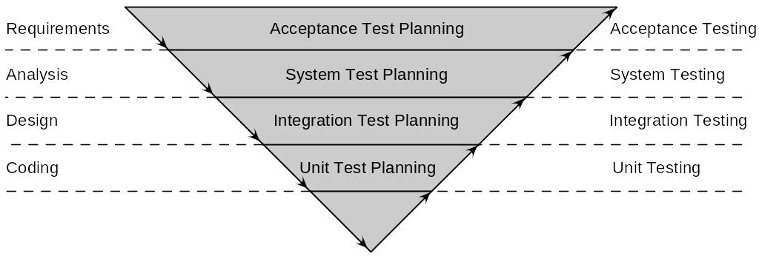
The V Model (Contd.)
The following figure shows the V model of testing.
The V model places the development phases such as requirements, analysis, design, and coding on one side of the V.
The various types of testing such as unit, integration, system, and acceptance, are placed on the other side of the V.

Slide 11
The V Model (Contd.)
The V model focuses only on dynamic testing and does not mention the benefits and effectiveness of static testing techniques such as reviews, inspections, and static code analysis.
The following table describes the test activities performed in each phase of the development life cycle.
Phase of the development life cycle | Test Activity
Requirements | Acceptance Test Plan
High-Level Design | System Test Plan Integration Test Plan
Detailed Design | Unit Test Plan
Coding | Unit Testing
Integration | Integration Testing System Testing
Acceptance | Acceptance Testing

Slide 12
The W Model
The W model is an extension of and addresses the limitations of the V model.
It focuses on a testing methodology where static testing techniques are applied during the various stages of development. This results in tests being performed in parallel with the development process.
These techniques are cheaper and more effective than dynamic testing.
When creating a test strategy, you can implement the concept of a W model by performing the following steps:
  Specifying the products that need to be tested.
  Selecting testing techniques such as static reviews to be used for those products
The W model places the test process on an equal footing with the development process.

Slide 13
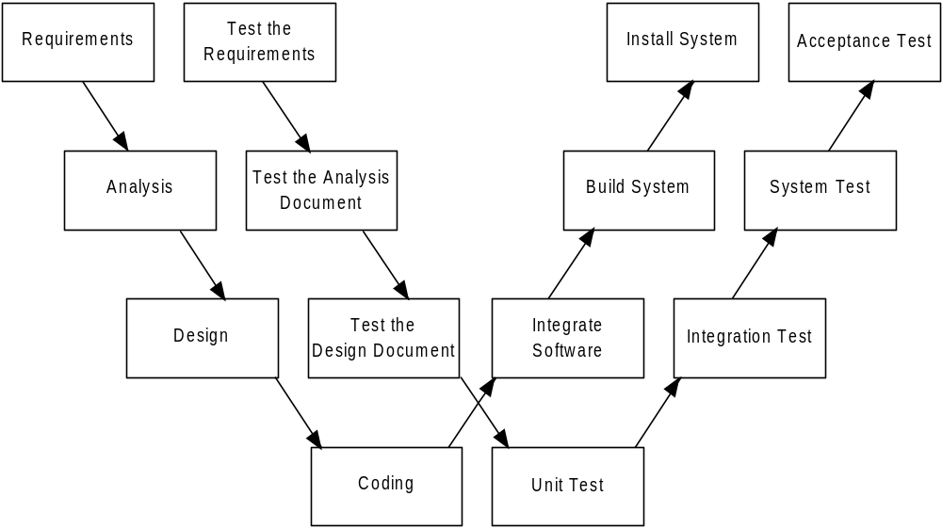
The W Model (Contd.)
The following figure shows the W model of testing.

Slide 14
Activity: Creating a Test Plan
Problem Statement:
  The WestSide online banking website will be developed using ASP.NET. After developing the website, the testing team will test the website for cross-browser and cross-platform compatibility. The team will also test the website for functionality.
  The testing team for this project will have Donald Jones as the Test Manager, Barbara Jacob as the Test Lead, Harry Smith, Sandra Williams, and Bob Gomes as software testers. Although Barbara and Harry are comfortable with ASP.NET, Sandra and Bob do not have any formal training in the technology. The organization needs to deliver the application to the client within six months. However, Don feels that with the allocated team of three testers, this target is not achievable. Therefore, two more testers need to be involved in the test process. The budget allocated for the testing process is $20,000.

Slide 15
Activity: Creating a Test Plan (Contd.)
  Donald, the Test Manager, has to create a test plan by considering all these factors. You can help Donald create the test plan for the WestSide online banking project by identifying the following components of the test plan:
    Overview:
      Project objectives
      System description
      Test objectives
    Scope of test:
      Features to be tested
    Plan:
      Test team
      Staffing and training needs
      Budget
      Technology requirements

Slide 16

Activity: Creating a Test Plan (Contd.)
Solution:

Slide 17
Summary
In this chapter, you learned that:
  Before starting the actual testing process, you need to plan for the test.
  A test plan is a document that describes the scope, resources, approach, and schedule of intended test activities.
  The test planning process has three phases:
    Pre-planning phase
    Test planning phase
    Post-planning phase
  Activities in the pre-planning phase include:
    Defining the success/acceptance criteria
    Identifying the test objectives
    Identifying the assumptions made in creating the test plan
    Defining the entrance/exit criteria

Slide 18
Summary (Contd.)
  Test planning phase includes the following activities:
    Performing requirements traceability
    Estimating the test effort
    Scheduling the test
    Planning resources
    Identifying approaches to be used to accomplish test objectives
    Defining test quality control
  The end product of the test planning phase is the test plan.

Slide 19
Summary (Contd.)
  The components of a test plan are:
    Scope of test
    Test objectives
    List of assumptions
    Results of risk analysis
    Resource allocation
    Test schedule
    Test design
    Testing tools and techniques
    Test completion criteria
  In the post-planning phase, a configuration management plan must be identified.

