Slide 1

Objectives
In this session, you will learn to:
  Identify test reporting tools
  Identify test reporting standards
  Explain the role of various statistical tools in analyzing data
  Explain the various ways of analyzing statistical data

Slide 2
Creating Test Reports
After testing a software application for its validity and reliability, a software tester needs to create a consolidated report of the results.
The process is known as test reporting.
Developers and testers of the software application use the test report to track the status of the software application.
Test reporting involves reporting the results of test execution to the relevant stakeholders.
This report is later analyzed to measure the effectiveness of the testing process and the quality of the software.
The senior management uses the test report to identify the gaps in the development process and initiate process improvement.

Slide 3
Test Reporting Tools
There are certain software tools that enable a software tester to effectively generate a test report.
These test-reporting tools provide features to:
  Generate test report formats
  Provide statistical output of test results
  Track the defects found during testing
  Record the results of the test
Examples of test reporting tools are:
  Analysis tools
  Database tools
  Defect tracking tools
  Test report formats

Slide 4

Test Reporting Standards
When designing test reports, the following information need to be provided clearly:
  The details of the defects detected during testing
  The type of test conducted
  The environment and the conditions in which the defect is detected
  The scope of the test
  The inconsistency between the actual and expected results of the module tested
Sample test report:

Slide 5
Test Reporting Standards (Contd.)
Problem Statement:
Consider a software application, AutoCal, which performs the function of a calculator. A test is done on the application to verify the add and subtract functions of the application. While testing the following errors are found:
  Subtraction of two-digit numbers gives the product of the numbers.
  Subtracting a greater number from a lesser number does not display a negative result.
  Adding two three-digit numbers gives the square of the first number.
Develop a test report for the same.

Slide 6
Test Reporting Standards (Contd.)
Solution:

Slide 7
Statistical Analysis in Test Reporting
The results obtained from test reports can be represented and analyzed in a meaningful way using statistical analysis tools.
In this section, the following statistical analysis tools are discussed:
  Pareto chart
  Histogram
  Cause and Effect diagram
  Scatter plot
  Check sheet
  Run chart
  Control chart

Slide 8
Statistical Analysis Tools
Pareto Chart:
  A Pareto chart is a graphical tool used to rank the causes of a problem from the most significant to the least significant.
  Analyzing data using a Pareto chart enables a software tester to:
    Focus on critical issues of a software project by categorizing them in terms of importance and frequency of occurrence.
    Prioritize the problems or causes of a problem to effectively initiate problem solving.
    Appreciate the effectiveness of the improvement in the software application. This is achieved by developing Pareto charts before and after improvement in the software application.

Slide 9
Statistical Analysis Tools (Contd.)
Histogram:
  A histogram is a bar graph of a quantifiable data set that displays the frequency of occurrence of each data set type.
  If sufficient data is available, a histogram can be used to determine the following:
    Range of the data set
    Mean of the data set
    Standard deviation of the data set
    Skewness of the frequency curve

Slide 10
Statistical Analysis Tools (Contd.)
Scatter Plot:
  Scatter plots show the relationship between two variables by displaying data points on a two dimensional graph.
  A scatter plot provides the following information:
    The strength of the relationship between the tested variables
    The cause and effect relationship between the variables – the influence of one variable on the other
    The correlation between the variables- positive, negative, or zero

Slide 11
Statistical Analysis Tools (Contd.)
Cause and Effect Diagram:
  The Cause and Effect diagram is a useful tool to visualize, identify, and classify the possible causes of a problem in an organized manner.
  It is also known as a “fishbone diagram” or an “Ishkawa diagram”.
  Careful analysis of a Cause and Effect diagram enables the team members to:
    Determine the lowest level of the root cause of a problem.
    Determine the key causes of a problem for which an immediate action must be taken.

Slide 12
Statistical Analysis Tools (Contd.)
Check Sheet:
  A check sheet is a tool for recording data from a process in an easy, systematic, and organized manner.
  A check sheet stores the number of occurrences of an event during a specified interval of time.
  A check sheet is the most effective tool to perform the following activities:
    Obtain objective and accurate data to evaluate problems or processes.
    Track the frequency of an event.
    Provide data for statistical tools.
  The benefits of using a check sheet are:
    Increase in efficiency because the data is quickly collected.
    Systematic and organized collection of relevant data.
    Easy way of recording data.

Slide 13
Statistical Analysis Tools (Contd.)
Run Chart:
  A run chart represents sample data in a chronological order displaying shifts in the central tendency.
  It is a type of line graph used to detect patterns in data over a period of time.
  A run chart enables you to:
    Track events or observations over a period of time.
    Monitor the performance of a process.
    Track changes in processes.

Slide 14
Statistical Analysis Tools (Contd.)
Control Chart:
  A control chart helps determine whether or not the distribution of data values generated by a process is stable over time against established control limits.
  It determines whether or not the process is "in control" or needs adjustment.
  The objective of a control chart is to monitor the variation of a statistically stable process where activities are repetitive.
  Two types of variations are observed, random and unique.
  The charts are used to assess the variations to determine the necessary modifications.

Slide 15
Analyzing Statistical Data
Exploratory Analysis:
  Exploratory analysis is a type of data analysis that uses graphical and descriptive statistical techniques to:
    Maximize insight into a data set
    Study the structure of a data set
    Extract information related to variables in a data set
    Test underlying assumptions
    Highlight unusual conditions

Slide 16
Analyzing Statistical Data (Contd.)
Cluster Analysis:
  Cluster analysis classifies a set of observations into two or more mutually exclusive groups.
  The purpose of cluster analysis is to discover a system of organizing observations into groups, where members of a group share properties in common.
  Cluster analysis is useful in:
    Identifying common characteristics within subcategories, such as projects behind schedule and over budget
    Identifying multivariable relationships, such as the budget and schedule relationship

Slide 17
Analyzing Statistical Data (Contd.)
Regression Analysis:
  Regression analysis is a statistical technique that can be used to assess the relationship between two variables.
  It provides the following information:
    Graphics showing the relationship between two variables
    The nature of the relationship between the two variables, such that the value of one can be predicted if the value of the other is known
    The correlation between the two variables
  Regression analysis is used to:
    Determine the Cause and Effect relationship between two variables.
    Determine project performance based on multiple variables.

Slide 18
Activity: Statistical Analysis in Test Reporting
Problem Statement:
  In the acceptance testing phase of the online banking application, 40 errors were identified. The management of Newways Solutions wants a report on the type of errors that developers frequently make. This data will later be used to design appropriate training for developers.
  To prepare this report, the test manager of the online banking application collects the following information.
  Create a Pareto chart and identify the type of errors that occur most frequently and demand high priority.
Defect Category | Frequency
Functionaly-related defects | 20
Design- related defects | 12
Interface-related defects | 8
TOTAL | 40

Slide 19
Activity: Statistical Analysis in Test Reporting (Contd.)
Solution:
  To create a Pareto chart, you need to calculate cumulative percentage for all categories. The following table lists the calculated data for the Pareto chart.
Error Category | Frequency | Cumulative Frequency | Cumulative Percentage
Functionaly-related defects | 20 | 0+20=20 | 50
Design-related defects | 12 | 12+20=32 | 64
Interface-related defects | 8 | 8+32=40 | 80

Slide 20
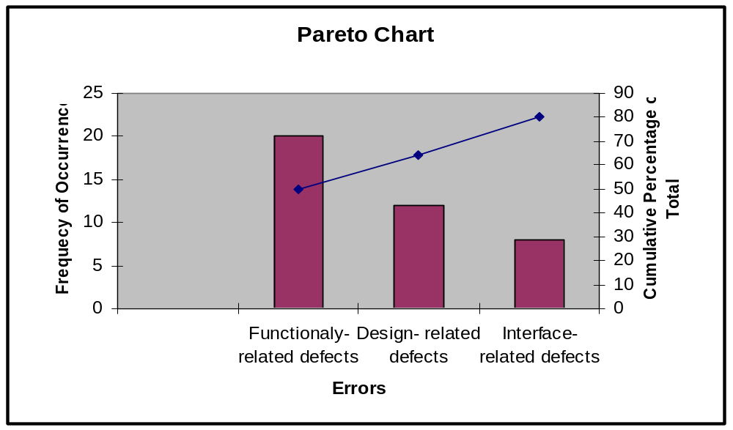
Activity: Statistical Analysis in Test Reporting (Contd.)
  A Pareto chart is constructed on the basis of the above data.

Slide 21
Activity: Statistical Analysis in Test Reporting (Contd.)
  After analyzing the above Pareto chart, you can conclude the following:
    Interface-related errors contribute the maximum errors in a document.
    Functionality-related errors contribute the least number of errors in a document. This means that although functionality-related errors occur most frequently, they do not demand high priority.

Slide 22
Summary
In this session, you learned that:
  Test reporting is the task of reporting the results of test execution to the relevant stakeholders.
  Test reporting tools help a software tester to generate test reports effectively. A few types of test reporting tools are:
    Analysis tools
    Database tools
    Defect tracking tools
    Test report formats
  Statistical analysis tools are used to represent and analyze effectively the data obtained from test reports. Some statistical analysis tools are:
    Pareto chart
    Histogram
    Cause and Effect diagram

Slide 23
Summary (Contd.)
    Scatter plot
    Check sheet
    Run chart
    Control chart
  Statistical data can be analyzed using the following tools:
    Exploratory Analysis
    Cluster Analysis
    Regression Analysis

