Slide 1
LẬP TRÌNH J2ME CHO THIẾT BỊ DI ĐỘNG

Slide 2
Eliminator: Game Menu, EliminatorBasicMenu (1)
Basic Main Menu
import javax.microedition.lcdui.*; public class MainMenuScreen extends List implements CommandListener { private Eliminator midlet; private Command selectCommand = new Command("Select", Command.ITEM,1); private Command exitCommand = new Command("Exit", Command.EXIT,1); private Alert alert; public MainMenuScreen(Eliminator midlet) { super("Eliminator",Choice.IMPLICIT); this.midlet = midlet; append("New Game",null); append("Settings",null); append("High Scores", null); append("Help",null); append("About",null); | addCommand(exitCommand); addCommand(selectCommand); setCommandListener(this); } public void commandAction(Command c, Displayable d) { if (c == exitCommand) { midlet.mainMenuScreenQuit(); return; } else if (c == selectCommand) { processMenu(); return; } else { processMenu(); return; } }

Slide 3
Eliminator: Game Menu, EliminatorBasicMenu (2)
private void processMenu() { try { List down = (List)midlet.display.getCurrent(); switch (down.getSelectedIndex()) { case 0: scnNewGame(); break; case 1: scnSettings(); break; case 2: scnHighScores(); break; case 3: scnHelp(); break; case 4: scnAbout(); break;}; } catch (Exception ex) { // Proper Error Handling should be done here System.out.println("processMenu::"+ex);} } private void scnNewGame() { midlet.mainMenuScreenShow(null); } private void scnSettings() { | alert = new Alert("Settings","Settings.......",null,null); alert.setTimeout(Alert.FOREVER); alert.setType(AlertType.INFO); midlet.mainMenuScreenShow(alert); } private void scnHighScores() { alert = new Alert("High Scores" ,"High Scores.......",null,null); alert.setTimeout(Alert.FOREVER); alert.setType(AlertType.INFO); midlet.mainMenuScreenShow(alert); }

Slide 4
Eliminator: Game Menu, EliminatorBasicMenu (3)
private void scnHelp() {
alert = new Alert("Help","Help....................",null,null);
alert.setTimeout(Alert.FOREVER);
alert.setType(AlertType.INFO);
midlet.mainMenuScreenShow(alert);
}
private void scnAbout() {
alert = new Alert("About","Eliminator\nVersion 1.0.0\nby Jason Lam",null,null);
alert.setTimeout(Alert.FOREVER);
alert.setType(AlertType.INFO);
midlet.mainMenuScreenShow(alert);
}
}

Slide 5
Eliminator: Game Menu, EliminatorBasicMenu (4)
Main Midlet Source Code:
import javax.microedition.midlet.*; import javax.microedition.lcdui.*; public class Eliminator extends MIDlet { protected Display display; private Image splashLogo; private boolean isSplash = true; MainMenuScreen mainMenuScreen; public Eliminator() {} public void startApp() { display = Display.getDisplay(this); mainMenuScreen = new MainMenuScreen(this); if(isSplash) { | isSplash = false; try { splashLogo =Image.createImage("/splash.png"); new SplashScreen(display, mainMenuScreen, splashLogo,3000); } catch(Exception ex) { mainMenuScreenShow(null); } } else { mainMenuScreenShow(null); } }

Slide 6
Eliminator: Game Menu, EliminatorBasicMenu (5)
public Display getDisplay() { return display;} public void pauseApp() {} public void destroyApp(boolean unconditional) { System.gc(); notifyDestroyed(); } private Image createImage(String filename) { Image image = null; try { image = Image.createImage(filename); } catch (Exception e) { }return image; } | public void mainMenuScreenShow(Alert alert) { if (alert==null) display.setCurrent(mainMenuScreen); else display.setCurrent(alert,mainMenuScreen); } public void mainMenuScreenQuit() { destroyApp(true); } }

Slide 7
Eliminator: Game Menu, EliminatorSubMenu (1)
private void scnNewGame() {
midlet.mainMenuScreenShow();
}
private void scnSettings() {
midlet.settingsScreenShow();
}
private void scnHighScore() {
midlet.highScoreScreenShow();
}
private void scnHelp() {
midlet.helpScreenShow();
}
private void scnAbout() {
midlet.aboutScreenShow();
}
}

Slide 8
Eliminator: Game Menu, EliminatorSubMenu (2)
High Score Screen Source Code:
import javax.microedition.lcdui.*;
public class HighScoreScreen extends Form implements CommandListener {
private Eliminator midlet;
private Command backCommand = new Command("Back", Command.BACK,1);
private Command resetCommand = new Command("Rest", Command.SCREEN,1);
public HighScoreScreen (Eliminator midlet) {
super("High Score"); this.midlet = midlet;
StringItem stringItem = new StringItem(null,"JL 100\nJL 50\nJL 10");
append(stringItem); addCommand(backCommand);
addCommand(resetCommand); setCommandListener(this); }
public void commandAction(Command c, Displayable d) {
if (c == backCommand) {
midlet.mainMenuScreenShow();
return;
}if (c == resetCommand) { // not implemented yet
System.out.println("Reset High Scores Not Implemented Yet");
}}}

Slide 9
Eliminator: Game Menu, EliminatorSubMenu (3)
Help Screen Source Code:
import javax.microedition.lcdui.*;
public class HelpScreen extends Form implements CommandListener {
private Eliminator midlet;
private Command backCommand = new Command("Back", Command.BACK, 1);
public HelpScreen (Eliminator midlet) {
super("Help"); this.midlet = midlet;
StringItem stringItem = new StringItem(null,"It is the year 3023, many things have changed over the years " +
…………
);
append(stringItem); addCommand(backCommand);
setCommandListener(this); }
public void commandAction(Command c, Displayable d) {
if (c == backCommand) {
midlet.mainMenuScreenShow();
return;
}}}

Slide 10
Eliminator: Game Menu, EliminatorSubMenu (4)
About Screen Source Code:
import javax.microedition.lcdui.*;
public class AboutScreen extends Form implements CommandListener {
private Eliminator midlet;
private Command backCommand = new Command("Back", Command.BACK, 1);
public AboutScreen (Eliminator midlet) {
super("About"); this.midlet = midlet;
StringItem stringItem = new StringItem(null,"Eliminator\nVersion 1.0.0\nBy Jason Lam");
append(stringItem);
addCommand(backCommand); setCommandListener(this);
}
public void commandAction(Command c, Displayable d) {
if (c == backCommand) {
midlet.mainMenuScreenShow();
return;
}}}

Slide 11
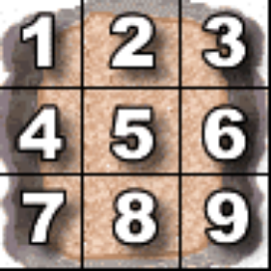
Eliminator: Terrain (Scrolling Background)
private TiledLayer loadTerrain() throws Exception { Image tileImages = Image.createImage("/terrain.png"); TiledLayer tiledLayer = new TiledLayer(TILE_NUM_COL,TILE_NUM_ROW,tileImages,TILE_WIDTH,TILE_HEIGHT); // Define Terrain Map int[][] map = { {0,0,0,0,0,0}, {3,0,0,0,0,0}, {6,0,0,0,0,0}, {6,0,0,0,1,2}, {6,0,0,0,4,5}, {6,0,0,0,7,8}, {6,0,0,0,0,0},{9,0,1,2,3,0}, {0,0,4,5,6,0}, {0,0,7,8,9,0},{0,0,0,0,0,0}, {0,0,0,0,0,0}, {0,0,0,0,0,0},{3,0,0,0,0,0}, {6,0,0,0,0,0}, | {6,0,0,0,1,2}, {6,0,0,0,4,5}, {6,0,0,0,7,8}, {6,0,0,0,0,0}, {9,0,1,2,3,0}, {0,0,4,5,6,0}, {0,0,7,8,9,0}, {0,0,0,0,0,0},{0,0,0,0,0,0}, {0,0,0,0,0,0},{3,0,0,0,0,0}, {6,0,0,0,0,0}, {6,0,0,0,1,2},{6,0,0,0,4,5}, {6,0,0,0,7,8}, {6,0,0,0,0,0},{9,0,0,0,0,0}, {0,0,0,0,0,0}, {0,0,0,0,0,0},{0,0,0,0,0,0}, {3,0,0,0,0,1} }; // Map Terrain Map with actual graphic from terrain.png for (int row=0; row<TILE_NUM_ROW; row++) { for (int col=0; col<TILE_NUM_COL; col++) { tiledLayer.setCell(col,row,map[row][col]); } }return tiledLayer; } Ví dụ: EliminatorScrolling

Slide 12
Eliminator: Player , ví dụ : EliminatorPlayer
Player Sprite
public class PlayerSprite extends Sprite { private static final int MOVE = 3; private int x,y; private int scnWidth,scnHeight; private int frameWidth, frameHeight; private int frame; private int lives; public PlayerSprite(Image image, int frameWidth, int frameHeight, int scnWidth, int scnHeight) throws Exception { super(image, frameWidth, frameHeight); x = frameWidth/2; y = frameHeight/2; this.scnWidth = scnWidth; this.scnHeight = scnHeight; this.frameWidth = frameWidth; this.frameHeight = frameHeight; this.frame = 1; this.lives = 3;} | public void startPosition() { setPosition(scnWidth/2,scnHeight/2);} public void moveLeft() { getXY(); if (x - MOVE > 0) move(MOVE * -1,0);} public void moveRight() { getXY(); if (x + MOVE + frameWidth < scnWidth) move(MOVE,0);} public void moveUp() { getXY(); if (y - MOVE > 0) move(0,MOVE * -1);} public void moveDown() { getXY(); if (y + MOVE + frameHeight < scnHeight) move(0,MOVE);}

Slide 13
Communications in J2ME
Connect to Internet
Wireless Messaging API
Blutooth and OBEX API

Slide 14
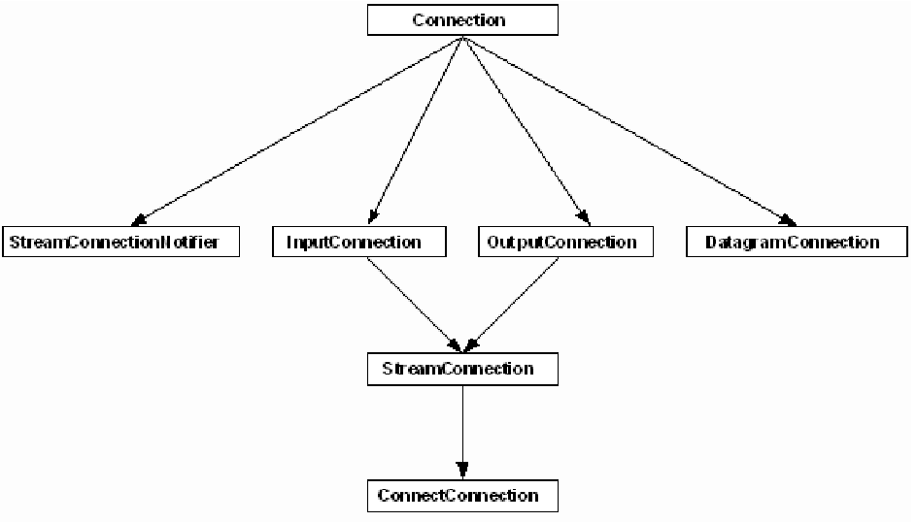
Wireless messaging API

Slide 15
