Slide 1
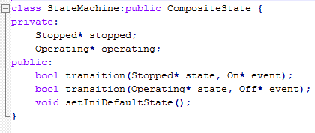
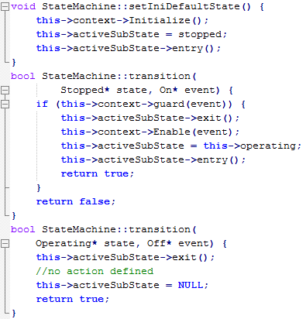
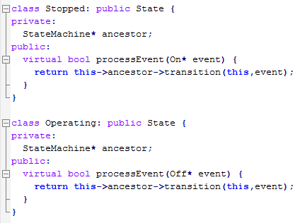
StateMachine
/Initialize
Operating
Stopped
On[x == 0]/ Enable
/entry Prepare
/exit Disable
Off

