Slide 1

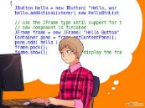

-Structure changes
-Behavior changes
-User code changes
-Behavior changes
-Structure changes
UML Model
Model-front-end
sync
Front-end Code
Back-end
generation
Back-end Code
Code
compilaton

