Slide 1
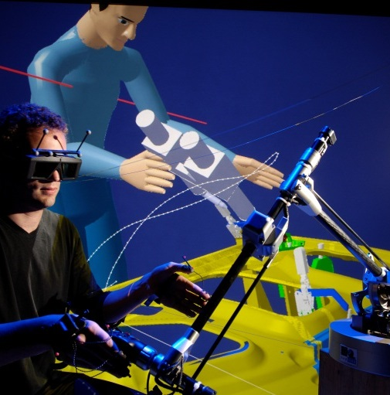
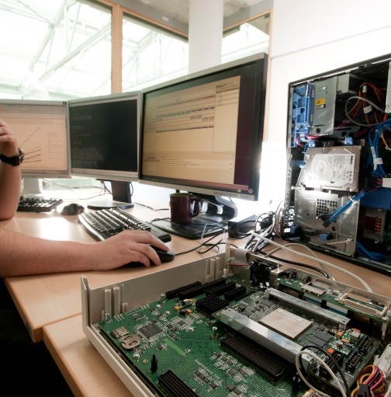


Retro-engineering of UML-RT runtime and Code Generation

Slide 2
Context
UML-RT Runtime
Library to compile and execute code generated from UML-RT models
Written in C/C++ manually
Classes and structures are all placed within a same package
Proposition
Retro-engineer the UML-RT runtime to have a UML model of it (including diagrams)
Refactor the runtime by re-packaging its elements and re-defining its architecture
Re-generate the code of the runtime
Advantages
Benefit from the all the advantages of a Model-Driven Engineering (MDE) development approach…
…opening up several perspectives as we will see

Slide 3
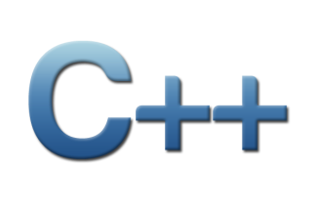

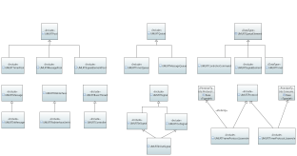
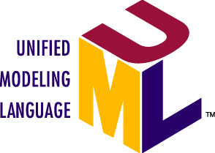

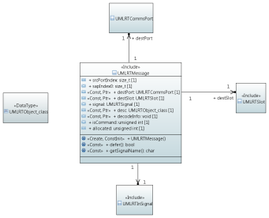

Retro-engineering Work
Retro-engineering process
UML-RT runtime code
Code generation
Semi-auto retro-engineering with Papyrus/CDT synchronisation plugin
UML model of UML-RT runtime, with C_Cpp and Standard profiles applied
Refactoring
Papyrus C++ code generator
Re-packaged model, with added associations

Slide 4
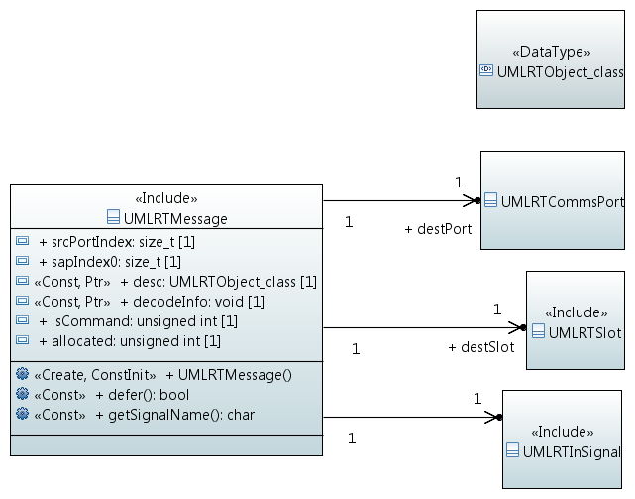
Retro-engineering Work
Some examples of the model
UMLRTMessage class diagram

Slide 5

Retro-engineering Work
Some examples of the model
Inheritances

Slide 6
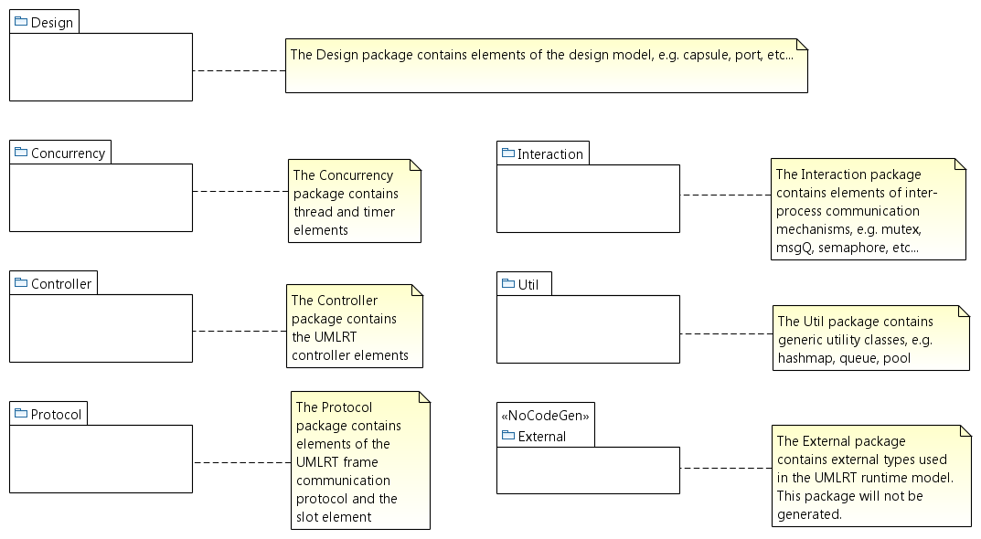
Retro-engineering Work
Some examples of the model
Packages

Slide 7
Retro-engineering Work
Model and code generation demo
Live demo ►

Slide 8
Results
!
65 classes of the runtime were modeled. 20815 lines of code were generated. Generation takes 5 seconds.
Modeling/code generation possibilities and shortages
Possible to model and generate | Shortages
Class and structure Method implementation Constructors and constant initialization Destructor Type definition C primitive type External library and type Constant (any combination) Pointer (any combination) Reference Virtual and abstract method Static method and attribute Manual include and define Function pointer Variadic function Mutable Inner class (Automatic) forward declaration and include policy | OS abstraction layer (to model instead of using external type and linking at compilation) Function template Bitfield Extern variable ➔ Some of these shortages aren’t blocking.
Notes:
8504 code + 9207 comment + 3104 blank
49 C++ files + 65 header files

Slide 9
Results
Differences between runtimes
Original runtime | Modeled/generated runtime | Comment
Structure with implemented method | Class with public features | A structure in C++ is equivalent to a class with public features.
All-in-one package | Re-packaging of elements according to their semantic | Namespaces, includes, and forward declarations are handled automatically.
No namespace | Namespace in model | …but model can be generated without namespaces
No common format for comments before attributes or methods | Comments must follow a certain format. | /
Extern and file scope variables/functions | Private/public static const attribute of class | Extern variables can be modeled as public static attribute of a class. File scope is modeled as static variable, with a visibility that depends on who uses the static variable in the file.
Not all types are defined (e.g. function pointer, enum) | Some extra types to wrap-up another type or enum, in order to not overload the model | Just an extra step when specifying the type of an attribute or parameter
Manual forward declarations and includes | Declarations and includes handled automatically | Automatic for header, based on dependencies in body; We don’t encourage manual includes with <<include>>
File with no class, only methods | Class with public static operations | /
Methods with OS-dependent implementation | Stereotyped <<NoCodeGen>> and kept original OS-dependent implementations, linked at compilation | A better solution will be proposed later with an OS abstraction layer in the model.

Slide 10
Roadmap
Reverse code to model
Define architecture
Model C/C++ features
Graphical diagrams
Modify code generation framework
Compile and debug
Doc on modeling method and rules
Share stable version
Execution and diff
Several iterations; currently on:
Circular dependencies
Comments
Debug code in OpaqueBehavior
End of
2015-11
2016-01

Slide 11
Conclusion
Summary
A graphical UML model of the whole runtime, with a defined architecture
All 65 classes were modeled, resulting in 20815 lines of code generated in 5 seconds
Differences between runtimes exist, but must not result in different behaviors of the runtimes
Most missing C/C++ features have been added to the code generation framework; after the missing features are modeled, the bulk of the work should move on to debugging the generated code (outside of modeling scope)

Slide 12
Conclusion
Ongoing technical work
OS abstraction layer for OS-dependent entities, i.e. thread, semaphore, mutex, notify, time, timespec
Enforce modeling rules and validation, e.g.
  Class A depends on class B on if class A has an operation or method that uses class B
  Package P1 depends on package P2 if P1 contains A, and P2 contains B, A depends on B
Modification of C_Cpp profile and code generator for unsupported C/C++ features and add them to model
Comments handling
Debugging
Generation of fully functional UML-RT runtime, i.e. compilable, executable, and behavior equivalent to original runtime
[Other technical work to be added after discussion with Zeligsoft]

Slide 13
Conclusion
Ongoing research work (PhD thesis)
Support of incremental transformations in C++ code generator
Avoid unnecessary re-generation (& subsequent compilation)
Better bi-directional updates: model to code, code to model
Opportunity to merge existing code generators into single one (e.g. C++, Java, Ada)

Slide 14
Perspectives: future toolchain
Runtime as a model library
Product line approach with
  Explicitly modeled variation points ➔ required runtime is derived
  Different profiles of same runtime
Common application model, container classes, and OS abstraction layer
UML/RT
Rhapsody
XT-UML
Application model
Application model
Application model
interaction library
service library
interaction library
service library
interaction library
service library
runtime (model)
runtime (model)
runtime (model)
All in one

Slide 15
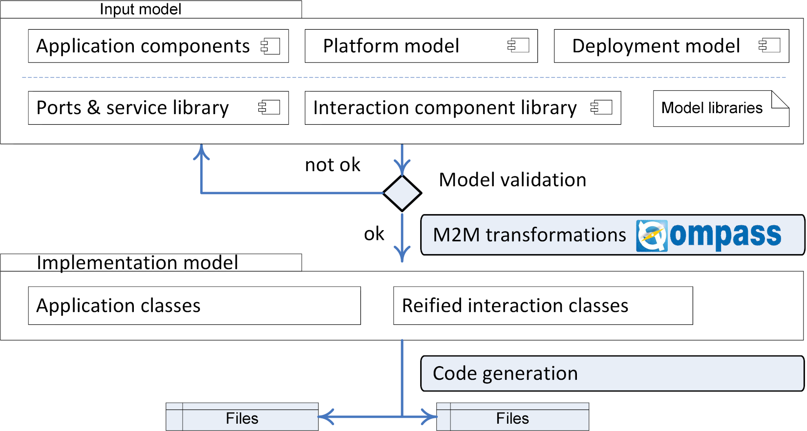
Perspectives: future toolchain
Runtime as a model library
Identify & model interaction mechanisms and services
(as in Qompass designer)
Generate automatically specific runtime depending on used interaction mechanisms & services
M2M transformations
Weaving interaction mechanisms and services into resulting model

Slide 16

Questions & Answers
How will you use the model and generated code?
Are there C/C++ features that are absolutely necessary?
What would you like to modify? E.g. comments
Which method do you prefer for sharing? E.g. Papyrus-RT Git
What evolutions do we plan for the model? E.g. ALF?

