Slide 1
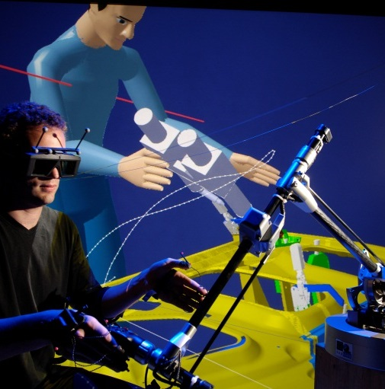



Retro-engineering of UML-RT runtime and Code Generation – November 2015 Update

Slide 2
Context
Previous work
Retro-engineer the UML-RT runtime to have a UML model of it (including diagrams)
Refactor the runtime by re-packaging its elements and re-defining its architecture
Re-generate the code of the runtime
Previous results
A graphical UML model of the whole runtime, with a defined architecture, for which code can be generated in 5 seconds
Several justified differences between original runtime and generated runtime
Some lacking C/C++ features that had to be added to our code generation framework
Today’s agenda
Update on status of work and roadmap
Discussion (questions, suggestions, expectations…)

Slide 3
Roadmap
Reverse code to model
Define architecture
Model C/C++ features
Graphical diagrams
Modify code generation framework
Compile and debug
Doc on modeling method and rules
Share stable version
Execution and diff
Several iterations; currently on:
Circular dependencies
Comments
End of
2015-11
2015-12

Slide 4
Progress in Modeling and Generation Possibilities
Possible to model and generate | Shortages
Class and structure Method implementation Constructors and constant initialization Destructor Type definition C primitive type External library and type Constant (any combination) Pointer (any combination) Reference Virtual and abstract method Static method and attribute Manual include and define Function pointer Variadic function Mutable Inner class (Automatic) forward declaration and include policy | OS abstraction layer (to model instead of using external type and linking at compilation) Function template Bitfield ➔ Some of these shortages aren’t blocking.

Slide 5
Differences between Runtimes
Original runtime | Modeled/generated runtime | Comment
Structure with implemented method | Class with public features | A structure in C++ is equivalent to a class with public features. Structures are modeled with DataType in UML but DataType cannot have a method (implementation of operation).
All-in-one package | Re-packaging of elements according to their semantic | Namespaces, includes, and forward declarations are handled automatically.
No common format for comments before attributes or methods | Comments must follow a certain format. | /
Extern and file scope variables/functions | Private/public static const attribute of class | Extern variables can be modeled as public static attribute of a class. File scope is modeled as static variable, with a visibility that depends on who uses the static variable in the file (case of several classes or structures defined in same file).
Function pointer variables without types | A function pointer typing a variable must be defined (typedef) beforehand. | Just an extra step when specifying a variable typed by a function pointer. A primitive type is created with the name of the variable postfixed with “_func”.
Includes for method implementation in header or body | A UML dependency is used to model an implementation dependency. | Since all method implementations are in bodies (cpp file), implementation includes are generated in bodies only. We try not to have to manually add includes with <<include>>.
File with no class, only methods | Class with public static operations | /
Methods with OS-dependent implementation | Stereotyped <<NoCodeGen>> and kept original OS-dependent implementations, linked at compilation | A bette solution will be proposed later with an OS abstraction layer in the model.
Forward declaration in manually included files | Forward declarations handled automatically according to what is in header and body | /
No namespace | Namespace in model (see comment) | …but model can be generated without namespaces
Typedef enum {…} Error | An enum is first specified, then its name is used to define a type. | An extra step in modeling, that avoids us to have too complex manual type definitions in the UML model.

Slide 6

Discussion
How will you use the model and generated code?
Are there C/C++ features that are absolutely necessary?
What would you like to modify? E.g. comments
Which method do you prefer for sharing? E.g. Papyrus-RT Git
What evolutions do we plan for the model? E.g. ALF?

