Slide 1
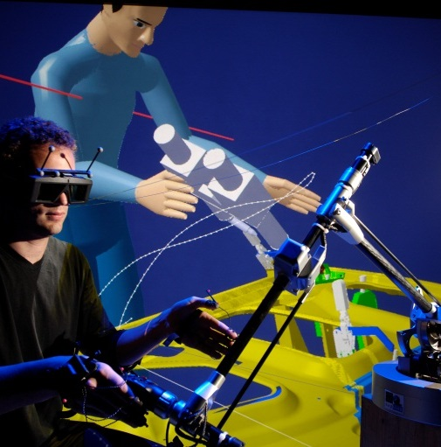
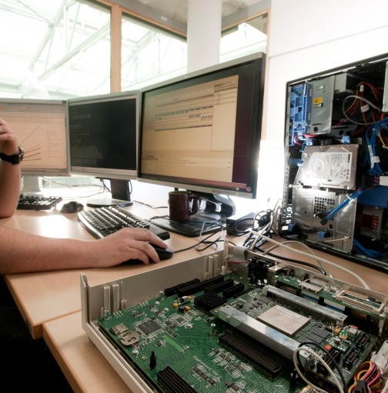
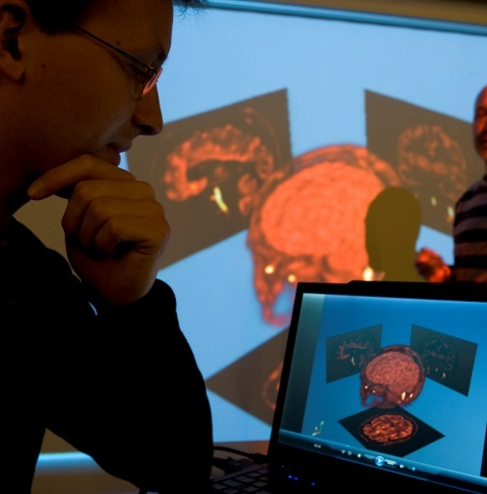

Round-trip Engineering of UMLRT Runtime System

Slide 2
Context
Previous work
Manual reverse of UMLRT runtime C++ code to UML model
Task was tedious and we couldn’t catch up with the latest version if reverse is done manually
➔ Proposition of a round-trip engineering tool in Papyrus to automatically handle differences between code and model
Topic of the day
Round-trip engineering of the UMLRT runtime
Discuss collaboration

Slide 3
Code Refactoring
Objective
Refactor some parts of the runtime so they respect more the object-oriented design
Refactor rules
Extern fields refactored as public static members of class
File scope fields refactored as private static members of a class
Type definitions outside of class refactored within the class that uses the type (if it is there is only one class that uses the type)
Files that only contain utility functions, variables, types, etc… are refactored within a class (e.g. UMLRTApi, UMLRTPriority)
!
Original project still compiles after refactoring.

Slide 4
Code Refactoring
Example
UMLRTCapsuleId.hh
extern const UMLRTObject_class * const UMLRTType_UMLRTCapsuleId;
static int UMLRTObject_fprintf_UMLRTCapsuleId(...) {...}
static const UMLRTObject_class UMLRTType_UMLRTCapsuleId_ = {...};
const UMLRTObject_class * const UMLRTType_UMLRTCapsuleId = &UMLRTType_UMLRTCapsuleId_;
UMLRTCapsuleId.cc
class UMLRTCapsuleId {
public:
static const UMLRTObject_class* const UMLRTType_UMLRTCapsuleId;
private:
static const UMLRTObject_class UMLRTType_UMLRTCapsuleId_;
static int UMLRTObject_fprintf_UMLRTCapsuleId(...);
};
UMLRTCapsuleId.h
const UMLRTObject_class UMLRTCapsuleId::UMLRTType_UMLRTCapsuleId_ {...};
int UMLRTCapsuleId::UMLRTObject_fprintf_UMLRTCapsuleId(...) {...}
const UMLRTObject_class* const UMLRTCapsuleId::UMLRTType_UMLRTCapsuleId =
&UMLRTCapsuleId::UMLRTType_UMLRTCapsuleId_;
UMLRTCapsuleId.cpp

Slide 5
Round-trip Results
Reverse results
Automatically reversed UMLRT runtime C++ code to UML model
Some interesting automation features:
  Associations, aggregations and compositions between classes are automatically created during reverse
  Dependencies between classes are automatically created during reverse by analyzing the bodies of methods
  Papyrus has synchronized diagrams to automatically show all classes in a package for example
Manual validation still necessary as this is the initialization step in the proposed round-trip method…
…still 1/7 of the time necessary for a manual reverse (including checking that code generated from model compiles)

Slide 6
Round-trip Results
Code generation results
Generated code is conform to C++11
50% of the classes compile
Only two kinds of compiling errors:
  Missing dependency between two classes in the model because reverse couldn’t guess the dependency
  E.g. getCapsule()->getName()
  Different parameter name in method body and declaration because parameters in header and cpp files are not entirely consistent
  E.g.
  Header: SignalElementPutToPool(UMLRTSignalElement* signal);
  Cpp: SignalElementPutToPool(UMLRTSignalElement* element) {...}

Slide 7
Conclusion
Some links
Update-site for Papyrus-Designer with the round-trip tools:
https://hudson.eclipse.org/papyrus/view/Designer/job/papyrus-designer-neon-papyrusnightly/ws/releng/org.eclipse.papyrus.designer.p2/target/repository/index.html
Latest UML model: https://git.eclipse.org/r/#/c/65772/
Refactoring of original UMLRT runtime and generated code will be pushed to Gerrit
Future work
Finish compiling and run tests
Do a full round-trip of the generated code
Future meetings
Weekly meeting every Friday at 8am EST (2pm CET)
Are you interested in participating in these meetings? (Not necessarily every week)

