Slide 1
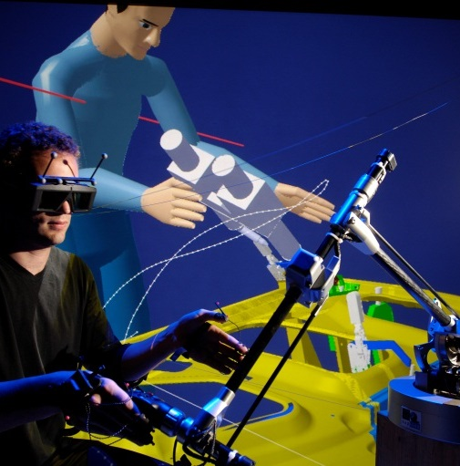
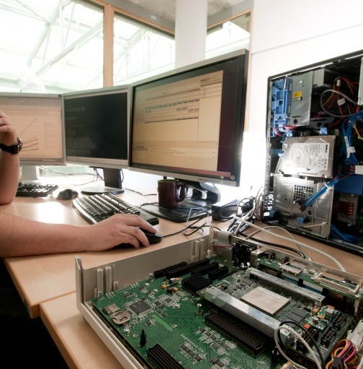
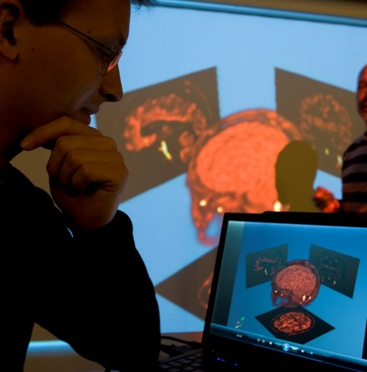

Papyrus Round-trip Engineering

Slide 2
Content
Introduction
Conclusion and Future Work
Demo Video
Round-trip Use-cases and Scenarios
Implementation Technologies

Slide 3
Content
Introduction
Conclusion and Future Work
Demo Video
Round-trip Use-cases and Scenarios
Implementation Technologies

Slide 4

Introduction
What is round-trip engineering?
Related to traditional software engineering disciplines:
  Forward engineering: creating software from specifications
  Reverse engineering: creating specifications from existing software
Round-trip engineering adds synchronization of existing artifacts that evolved concurrently by incrementally updating each artifact to reflect changes made to the other artifact
Round-trip generalizes both forward and reverse engineering
“The ability to automatically maintain the consistency of multiple, changing software artifacts, in software development environments/tools, is commonly referred to as round-trip engineering”
[Sendall04]
[Sendall04] S. Sendall and J. Küster. Taming model round-trip engineering. In Proceedings of Workshop on Best Practices for Model-Driven Software Development, Vancouver, Canada, 2004.

Slide 5
Introduction
A real need for round-trip engineering
Previously, UML-RT runtime code was manually reversed to a Papyrus UML model and code was generated
The task was “long” and “tedious”
In the mean time model and code evolved concurrently
Papyrus offer for round-trip engineering
UML modeler and C++ code generator are released…
…but reverse and incremental update tool are still in development
!
A real problem of synchronization

Propose a IDE for C++ round-trip engineering

Slide 6
Content
Introduction
Conclusion and Future Work
Demo Video
Round-trip Use-cases and Scenarios
Implementation Technologies

Slide 7
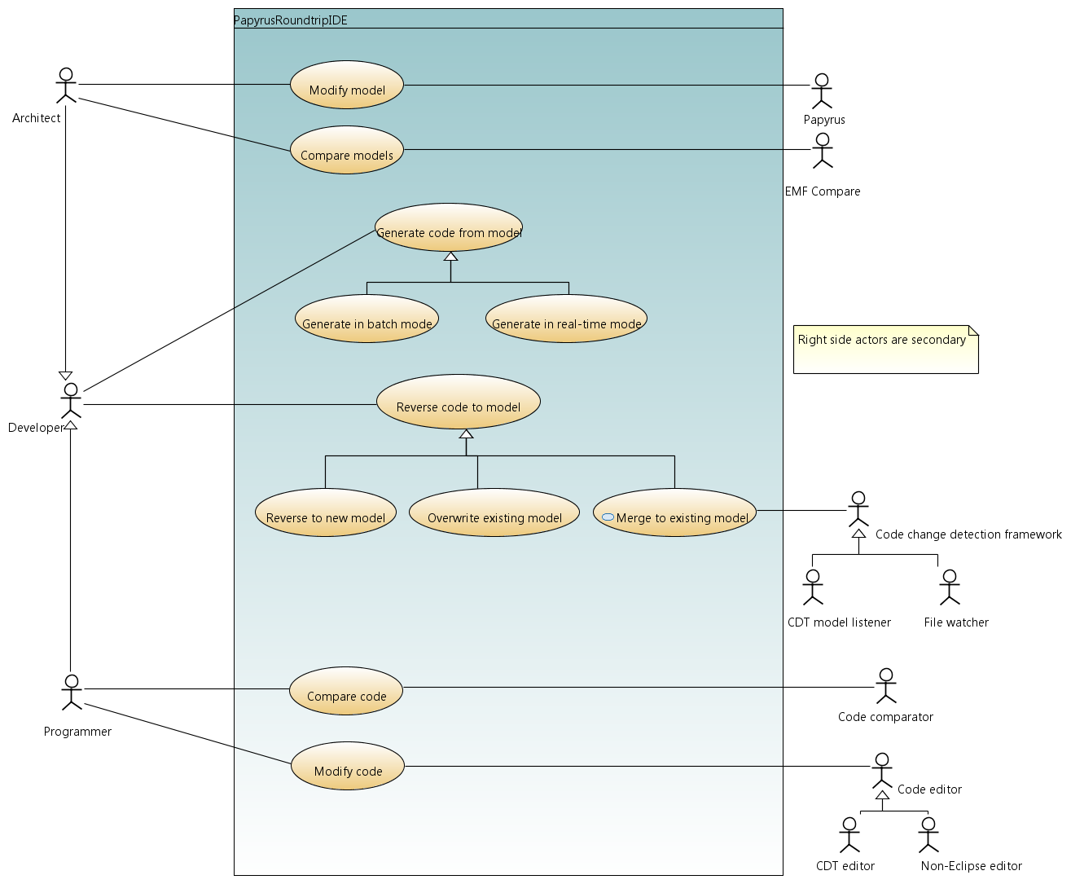
Round-Trip Use-Cases and Scenarios
A developer who works mostly with models
Existing feature in Papyrus
New feature in Papyrus
User of the Papyrus Round-trip IDE
A developer who works mostly with code

Slide 8
Round-Trip Use-Cases and Scenarios
Initialization step
Legacy code
1
Reverse to new model + validation
Model
2
Code generation
Generated code
4
Reverse (Overwrite)
3
Modification
(Manual) Validation is needed because we use some patterns to transform pure C code (not C++) to an object-oriented model (e.g. file scope functions, extern variables)
Modified code
Scenario 1: only code is modified

Slide 9
Round-Trip Use-Cases and Scenarios
Initialization step
Legacy code
1
Reverse to new model + validation
Model
2
Code generation
Generated code
3
Modification
4
Code generation
Modified model
Scenario 2: only model is modified

Slide 10
Round-Trip Use-Cases and Scenarios
Initialization step
Legacy code
1
Reverse to new model + validation
Model
2
Code generation
Generated code
Several possible strategies
We propose one based on comparing manually modified code with “image of model”
Image of model = representation of model as code
3
Modification
3
Modification
Modified model
4
Merge
Modified code
Scenario 3: model and code are both modified

Slide 11

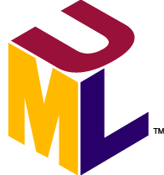
Round-Trip Use-Cases and Scenarios
Scenario 3.1: merge by creating an image of the model as code
Modified model
1
Code generation
Image of model
2
Code compare
Modified code
3
Reverse (merge)
“Reverse (merge)” is an incremental update of the model (preserve non-affected elements)
Scenario 3.2: merge by creating an image of the code as model
Modified model
2
Model compare
Image of code
1
Reverse (overwrite)
Modified code
3
Code generation
(optional: incremental)

Slide 12
Content
Introduction
Conclusion and Future Work
Demo Video
Round-trip Use-cases and Scenarios
Implementation Technologies

Slide 13





Round-Trip Use-Cases and Scenarios
Scenario 3.1: merge by creating an image of the model as code
Modified model
1
Code generation
Image of model
2
Code sync.
Modified code
3
Reverse (merge)
Eclipse
Papyrus Designer
Papyrus Designer + CDT
Scenario 3.2: merge by creating an image of the code as model
Papyrus Designer
Modified model
2
Model sync.
Image of code
1
Reverse (overwrite)
Modified code
3
Code generation
(optional: incremental)
EMF Compare
Papyrus Designer + EMF IncQuery

Slide 14
Round-Trip Use-Cases and Scenarios
Technology comparison
Criteria | Merge using code | Merge using model | Winner
UI usability | Suited for algorithmic changes | Suited for architectural changes | Draw
Change detector | CDT listener is unreliable and not fine-grained | EMF IncQuery is reliable and fine-grained | Merge using model
Comparison tool | Many mature comparators (but basic can be messy) | EMF Compare comparison fine-grained in Papyrus, needs some UI work outside of Papyrus, xmi:id limitation needs to be leveraged | Merge using code
Overall robustness | “Reverse (merge)” operation is dependent on code changes detector and handling of changes, which in the current state is error-prone | Incremental code generation is based on more reliable EMF IncQuery AND it’s optional | Merge using model
Technology dependency | CDT | EMF technologies | Draw

Slide 15
Content
Introduction
Conclusion and Future Work
Demo Video
Round-trip Use-cases and Scenarios
Implementation Technologies

Slide 16
Demo Video
Video ►
https://youtu.be/sudtoPvvyTA

Slide 17
Content
Introduction
Conclusion and Future Work
Demo Video
Round-trip Use-cases and Scenarios
Implementation Technologies

Slide 18
Conclusion
Summary
Papyrus round-trip engineering proof of concept
Most limitations are on the implementation side due to technology issues
Current and future work
Unitary testing and debugging of reverse tool for robustness
Improvement of code generator
Test on several real case studies:
  UML-RT runtime
  Diversity
  Embedded applications developed by CEA in C++
  LEGO EV3 C++ library
Java version (integration of Cédric Dumoulin’s work)
Research work (thesis of Van Cam Pham): incremental code generation
Roadmap and project
Target Eclipse Neon M6 milestone (end Q1 2016) for release of round-trip features
European project on this subject being proposed?

