Slide 1
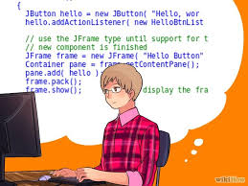

Architecture Model
M2M
…
Design Model
M2C
Code
Architect
Programmer
modify
modify
Architecture Model*
Code*
Consistency

