Slide 1
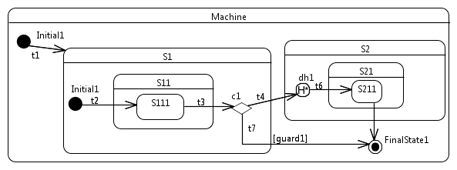
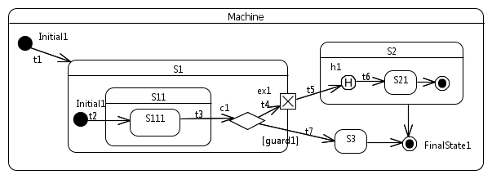
1
3
5
7
9
11
13
15
17
19
21
23
25
27
systemState = EVENT_PROCESSING;
if (states[S11_ID].actives[0]==S111_ID
&&(currentEvent->stateId==S111_ID)){
Exit(states[S11_ID].actives[0]);
states[S11_ID].actives[0]=STATE_MAX;
Exit(states[S1_ID].actives[0]);
states[S1_ID].actives[0]=STATE_MAX;
if (guard1) {
Exit(S1_ID);
activeStateID = S3_ID;
Entry(S3_ID);
} else {
Exit(S1_ID);
activeStateID = S2_ID;
Entry(S2_ID);
unsigned int loc_ActiveId;
if(states[S2_ID].previousStates[0]
!=STATE_MAX) {
loc_ActiveId=states[S2_ID]
.previousStates[0];
} else {
loc_ActiveId = S21_ID;
}
states[S2_ID].actives[0]=
loc_ActiveId;
Entry(loc_ActiveId);
}
systemState = EVENT_CONSUMED;
}
1
3
5
7
9
11
13
15
17
19
21
23
25
27
29
31
33
systemState = EVENT_PROCESSING;
if (states[S11_ID].actives[0]==S111_ID
&& (currentEvent->stateId==S111_ID)){
Exit(states[S11_ID].actives[0]);
states[S11_ID].actives[0]=STATE_MAX;
Exit(states[S1_ID].actives[0]);
states[S1_ID].actives[0]=STATE_MAX;
if (guard1) {
Exit(S1_ID);
activeStateID = STATE_MAX;
} else {
Exit(S1_ID);
activeStateID = S2_ID;
Entry(S2_ID);
unsigned int S2_Region1_dh1;
if (states[S2_ID].previousStates[0]
!= STATE_MAX) {
S2_Region1_dh1 =
states[S2_ID].previousStates[0];
Entry(S2_Region1_dh1);
if (S21_ID==S2_Region1_dh1) {
unsigned int S21_Region1_dh1 =
states[S21_ID].previousStates[0];
Entry(S21_Region1_dh1);
}
} else {
states[S2_ID].actives[0]=S21_ID;
Entry(S21_ID);
states[S21_ID].actives[0]=S211_ID;
Entry(S211_ID);
}
}
systemState = EVENT_CONSUMED;
}
m1
m2
a
b

