Slide 1
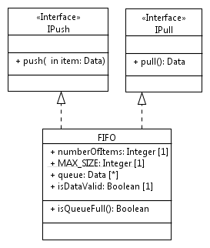
System
p :
Producer
IPush
fifo:
FIFO
IPull
c :
Consumer

