Slide 1

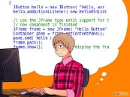
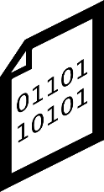
Architect
Programmer
-User-code changes
-Structure changes
Current approaches
-Structure changes
-Behavior changes
Modification
Modification
UML Model
Code
generation
Code
Code
compilaton
-Structure changes
-Behavior changes
-User code changes
-Behavior changes
-Structure changes
RAOES
Modification
Modification
UML Model
Front-end Code
Back-end
generation
Back-end Code
Code
compilaton
Synchronization

