Slide 1
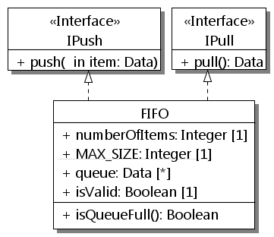
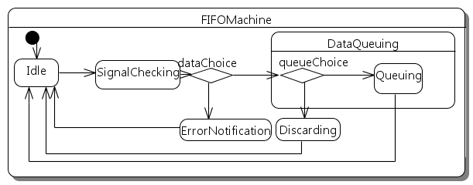
System
class System {
public:
Part<Producer> p;
Part<Consumer> c;
Part<FIFO> fifo;
void configuration(){
bindPorts(p.pPush, fifo.pPush);
bindPorts(c.pPull, fifo.pPull);
}
}
class IPull {
public:
virtual Data* pull() = 0;
}
class IPush {
public:
virtual void push(Data& data) = 0;
}
class Producer {
public:
RequiredPort<IPush>* pPush;
};
class Consumer {
public:
RequiredPort<IPull>* pPull;
};
class FIFO : public IPush, IPull {
public:
ProvidedPort<IPush>* pPush;
ProvidedPort<IPull>* pPull;
Data* pull(){//fine-grained code}
void push(Data& data){//..}
//attributes + methods…
Statemachine FIFOMachine {
InitialState Idle;
State SignalChecking {
StateEntry entryCheck;
StateExit exitCheck;
};
State ErrorNotification {
StateEntry entryError;
};
State DataQueuing {
StateEntry entryQueue;
PseudoChoice queueChoice;
State Queuing;
};
State Discarding;
PseudoChoice dataChoice;
CallEvent(DataPushEvent,push);
TransitionTable {
ExT(Idle,SignalChecking,
DataPushEvent,NULL,signalCheck);
ExT(SignalChecking,dataChoice,
NULL,NULL,NULL);
ExT(dataChoice,queueChoice,
NULL,Valid,NULL);
}
};
void entryCheck(){//fine-grained code}
void exitCheck(){//fine-grained code}
void entryError(){//fine-grained code}
void signalCheck(Data& item) {
//trans effect from Idle to SignalChecking
}
}
pPush
pPush
pPull
pPull
p :
Producer
fifo:
FIFO
c :
Consumer
IPush
IPull
a
b
DataPushEvent/
signalCheck
[else]
[isValid]
[else]
[isQueueFull]
c
d

