Slide 1
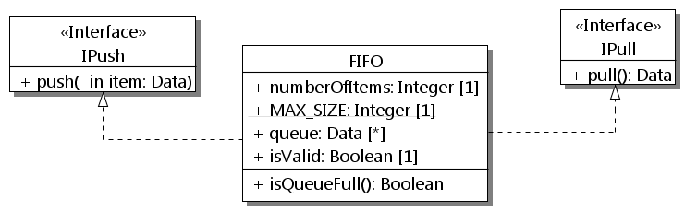
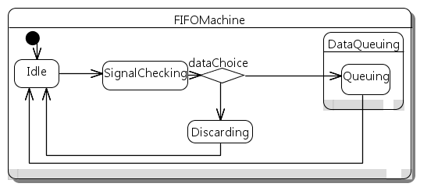
System
class System {
public:
Producer p;
Consumer c;
FIFO fifo;
void configuration(){
bindPorts(p.pPush, fifo.pPush);
bindPorts(c.pPull, fifo.pPull);
}
}
class IPull {
public: virtual Data* pull() = 0;
}
class IPush {
public:
virtual void push(Data& data) = 0;
}
class Producer {
public: RequiredPort<IPush> pPush;
};
class Consumer {
public: RequiredPort<IPull> pPull;
};
class FIFO : public IPush, IPull {
public:
ProvidedPort<IPush> pPush;
ProvidedPort<IPull> pPull;
Data* pull(){//fine-grained code}
void push(Data& data){//..}
//attributes + methods…
Statemachine FIFOMachine {
InitialState Idle;
State SignalChecking {
StateEntry entryCheck;
StateExit exitCheck;
};
State DataQueuing {
StateEntry entryQueue;
State Queuing;
};
State Discarding;
PseudoChoice dataChoice;
CallEvent(DataPushEvent,push(Data&));
TransitionTable {
ExT(Idle,SignalChecking,
DataPushEvent,NULL,signalCheck);
ExT(SignalChecking,dataChoice,
NULL,NULL,NULL);
ExT(dataChoice,Queuing,NULL,valid,NULL)
}
};
void entryCheck(){//fine-grained code}
void exitCheck(){//fine-grained code}
void entryError(){//fine-grained code}
void signalCheck(Data& item) {
//trans effect from Idle to SignalChecking
}
bool valid(){return isValid&&isQueueFull()}
}
pPush
pPush
pPull
pPull
p :
Producer
fifo:
FIFO
c :
Consumer
IPush
IPull
a
b
DataPushEvent/
signalCheck
[isValid && !isQueueFull()]
[else]
c
d

