Slide 1
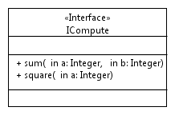
public def marshall(Operation op) {
'''
int size = 0;
«FOR p:op.InOutParameters»
{
«p.type.cppType» varName_ASN = «p.name»;
BEncAsnContent(&pBuffer, &varName_ASN);
size += sizeof(«p.name»);
}
«ENDFOR»
send(pBuffer, size);
'''
}
Template T
/*non generated*/
int sum(int a, int b) {
int size;
{
int varName = a;
BEncAsnContent(&pBuffer, &varName);
size += sizeof(a);
}
{
int varName = b;
BEncAsnContent(&pBuffer, &varName);
size += sizeof(b);
}
size = size + 5;
send(pBuffer, size);
}
Generated code C
Use template T
Code generation

