Slide 1

An efficient method to improve the accuracy of Vietnamese vehicle license plate recognition in unconstrained environment
Khanh Nguyen Quoc, Dan Pham Van, Van Pham Thi Bich
Faculty Of Information Technology
Le Quy Don Technical University
khanh29bk@mta.edu.vn, phamvandan.cntt2@gmail.com, vanptb@lqdtu.edu.vn

Slide 2
Content
Preface
Introduction
Related work
Proposed method
Experiments and results
Conclusion

Slide 3
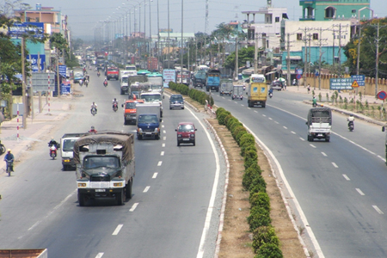
Means of transport
Preface
Reality
Nowadays, with the rapid increase of vehicles, the intelligent automatic license plate recognition (ALPR) system is attracting more and more attention.
Means of transport on a highway in our country.

Slide 4
Preface
Our goal
Previous studies in ALPR focused on recognizing license plate (LP) in constrained environment.
Recent studies on ALPR in Vietnam have conducted small datasets and have not covered various cases of Vietnamese LPs
→ Our goal: To develop a model for ALPR that is effective in unconstrained environment in Vietnam

Slide 5
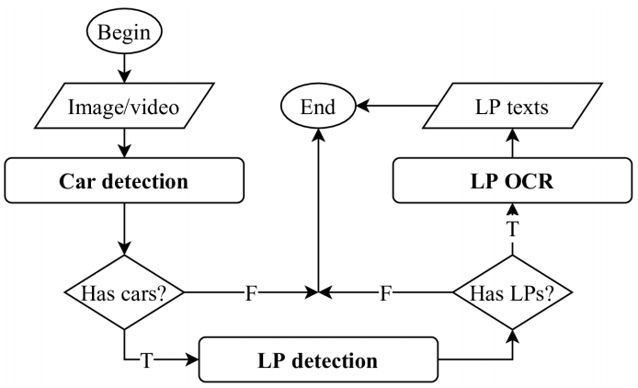
A typical ALPR system
Introduction
ALPR system
A typical ALPR system

Slide 6
Main challenges for ALPR system
Introduction
Challenges
Environment conditions: sunshine, rainy, night time, day time.
Image resolution and view of cameras.
Size and quality of license plate images.
Color, shape and font of license plate images.
Density of vehicle at the same time.

Slide 7
Our main contributions in this work
Introduction
Contributions
We solved non-rectangular object detection based on keypoints detection by modifying a semantic segmentation network called DDRNet.
Our system identifies plate based on segmentation-free approach combined CNN with RNN integrated with Attention mechanism.
We build MATVLP, which is a large and diverse dataset, including Vietnamese vehicle images and license plate images.

Slide 8
Two main approaches for ALPR
Related work
Approaches
Multi-stage license plate recognition systems.
License plate detection: traditional image processing techniques, CNN.
LP OCR: segmentation-based and segmentation-free approaches.
Single-stage LP recognition systems.
They design a complex neural network to do both LP detection and LP OCR tasks.

Slide 9
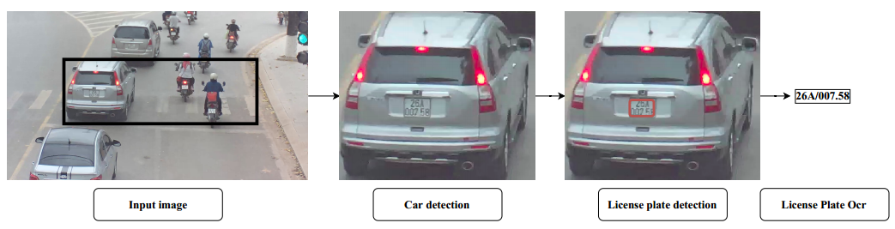
A typical multi-stage ALPR system
Related work
Multi-stage
Illustration of a multi-stage ALPR system

Slide 10
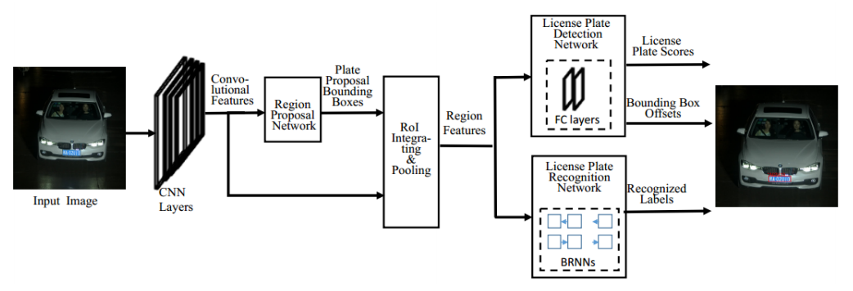
A typical single-stage ALPR system
Related work
Single-stage
Illustration of a single-stage ALPR system

Slide 11
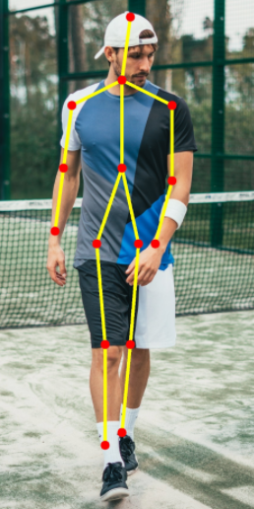
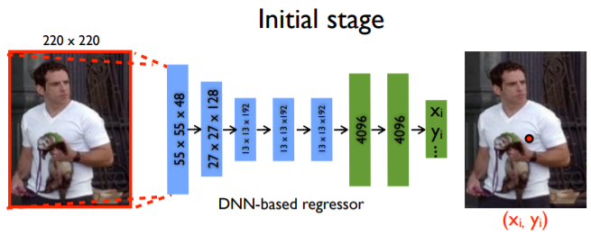
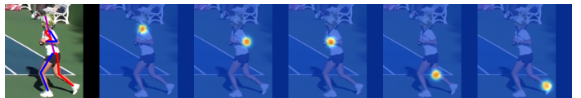
Key-points detection problem – Human Pose Estimation (HPE)
Related work
Key-points detection
Coordinate regression
Heatmap regression
HPE problem

Slide 12
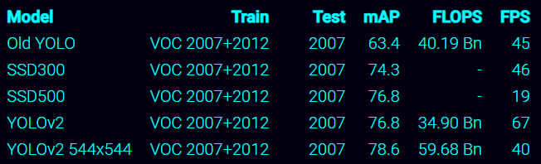
Car detection
Proposed method
Car detection
Vehicles are basic objects presented in large datasets such as COCO, VOC, PASCAL datasets.
We decided to use YOLOv2 544x544 network trained on VOC 2007+2012 dataset.
Accuracy and speed of YOLOv2 on a Titan X GPU.

Slide 13
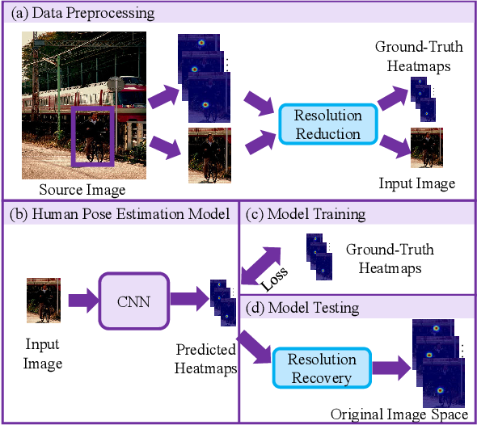
Heatmap regression for HPE
Proposed method
License plate detection
Our LP detection was inspired from top-down HPE approach

Slide 14
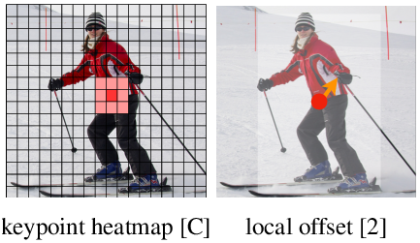
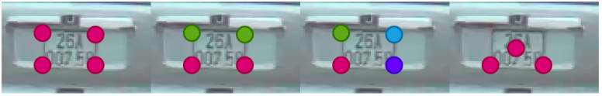
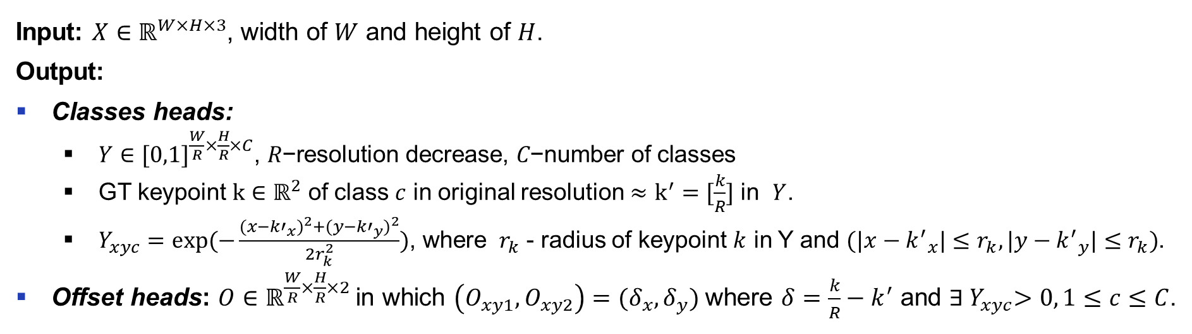
Data preprocessing
Proposed method
License plate detection
Input: $X∈ℝ^{W×H×3}$, width of $W$ and height of $H$.
Output:
Classes heads:
$Y∈{[0,1]}^{\frac{W}{R}×\frac{H}{R}×C}\text{, }R\text{−}\text{resolution} \text{decrease}\text{, }C\text{−}\text{number} \text{of} \text{classes}$
GT keypoint $k∈ℝ^{2}$ of class $c$ in original resolution $≈$ $k^{′}=[\frac{k}{R}]$ in $Y$.
$Y_{xyc}=exp⁡(−\frac{{(x−{k′}_{x})}^{2}+{(y−{k′}_{y})}^{2}}{2r_{k}^{2}})$, where $r_{k}$ - radius of keypoint $k$ in Y and $(|x−{k^{′}}_{x}|≤r_{k},|y−{k^{′}}_{y}|≤r_{k})$.
Offset heads: $O∈ℝ^{\frac{W}{R}×\frac{H}{R}×2}$in which $\left(O_{xy1},O_{xy2}\right)=(δ_{x}, δ_{y})$ where $δ=\frac{k}{R}−k^{′}$ and ${∃ Y}_{xyc}>0, 1≤c≤C$.
Key-points design for a license plate (colors are according to number of classes)

Slide 15
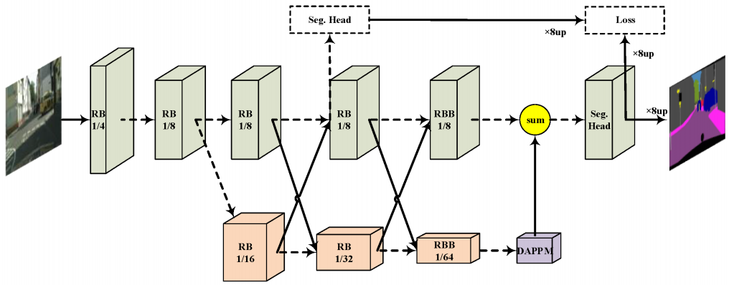
Architecture
Proposed method
License plate detection
HPE architecture: DLA-34, HRNet-18, Restnet18.
Modify a semantic segmentation architecture: DDRNet.
Original DDRNet architecture

Slide 16
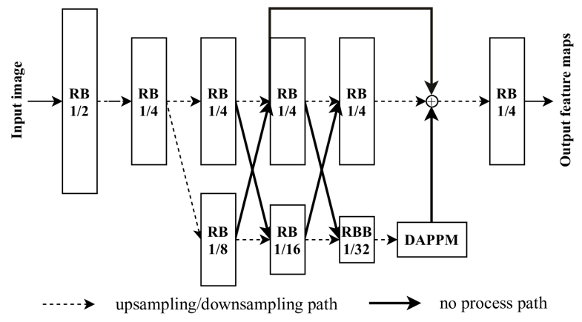
Architecture
Proposed method
License plate detection
Up-scale feature resolution and add skip connections
DDRNetsh network, “RB” - sequential residual basic blocks. “RBB” - single residual bottleneck block. “DAPPM” - Deep Aggregation Pyramid Pooling Module

Slide 17
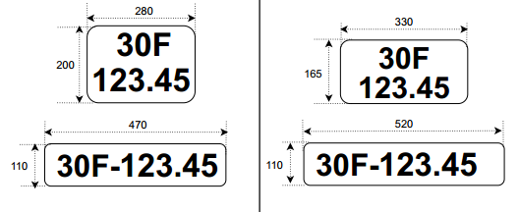

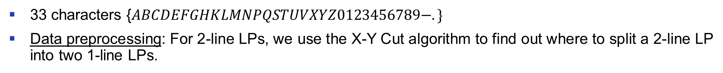
The characteristics of Vietnamese license plates
Proposed method
License plate OCR
33 characters {$ABCDEFGHKLMNPQSTUVXYZ0123456789−.\}$
Data preprocessing: For 2-line LPs, we use the X-Y Cut algorithm to find out where to split a 2-line LP into two 1-line LPs.
Color and text formats of Vietnamese LP
Size of old and new Vietnamese LP (unit mm)

Slide 18
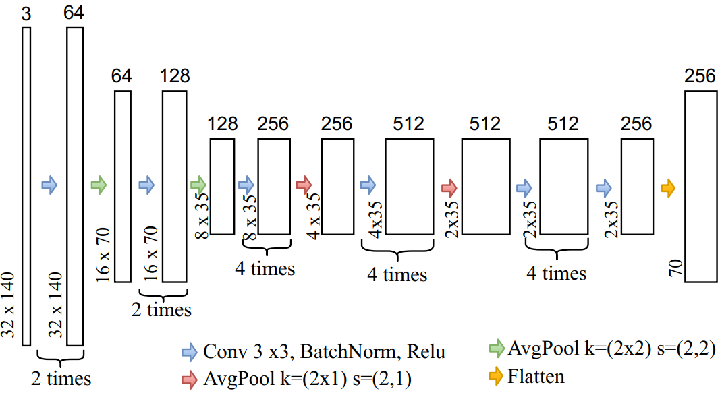
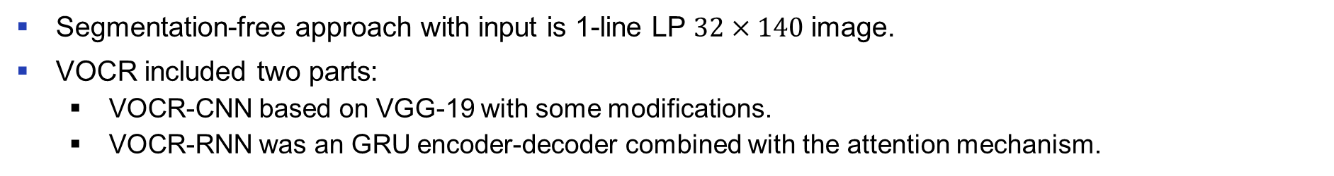
VOCR Architecture
Proposed method
License plate OCR
Segmentation-free approach with input is 1-line LP $32×140$ image.
VOCR included two parts:
VOCR-CNN based on VGG-19 with some modifications.
VOCR-RNN was an GRU encoder-decoder combined with the attention mechanism.
VOCR-CNN architecture

Slide 19
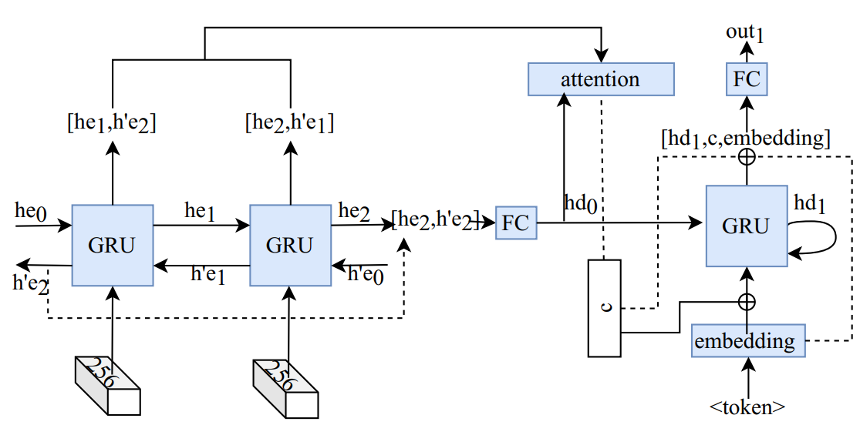
VOCR Architecture
Proposed method
License plate OCR
VOCR-RNN architecture

Slide 20
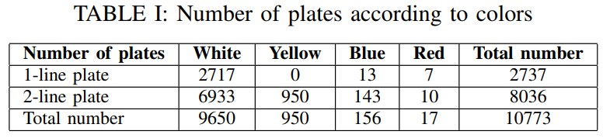
Dataset MTAVLP
Experiment
Dataset
Dataset collection: 2 traffic cameras on two different road tracks, 3 weeks from 6 am to 6 pm daily in different weather and light conditions.
MTAVLP:
Vehicle images: 15571 images = 3000 VLPs published + 12571 collected.
LP images: 10773, smaller than vehicle images as we removed images in redundant times. After pre-processing 2-line plate images, we obtained 16012 images of 1-line plate.

Slide 21
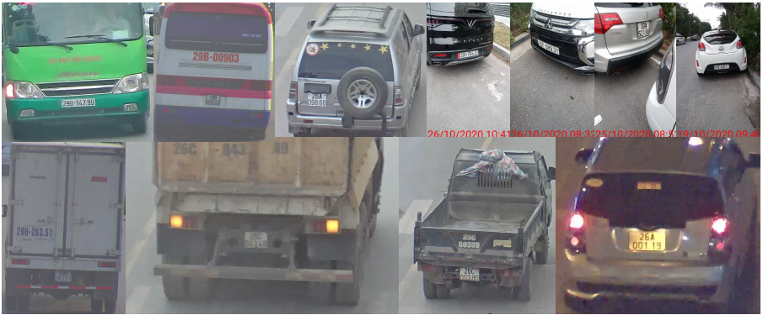
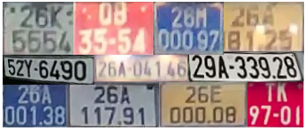
Samples in MTAVLP dataset
Experiment
Dataset
License plate images
Vehicle images

Slide 22
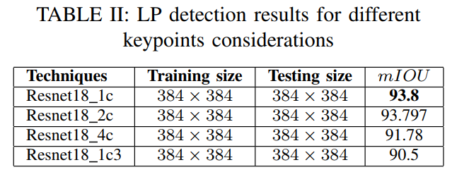
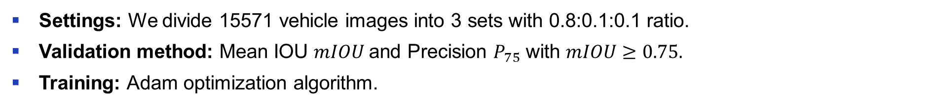
License plate detection
Experiment
Results
Settings: We divide 15571 vehicle images into 3 sets with 0.8:0.1:0.1 ratio.
Validation method: Mean IOU $mIOU$and Precision $P_{75}$ with $mIOU≥0.75.$
Training: Adam optimization algorithm.
Key-points design for a license plate (colors are according to number of classes)
from left to right is 1c, 2c, 4c, 1c3 design respectively

Slide 23
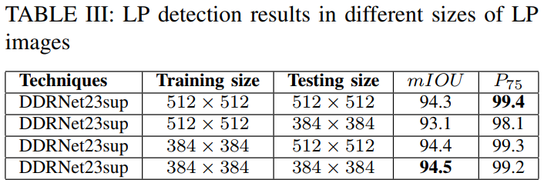
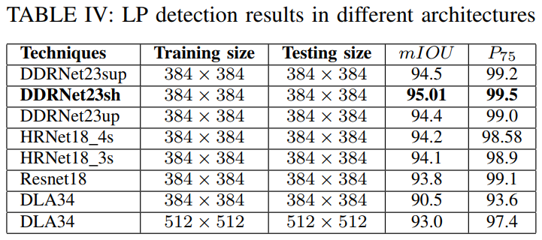
License plate detection
Experiment
Results

Slide 24
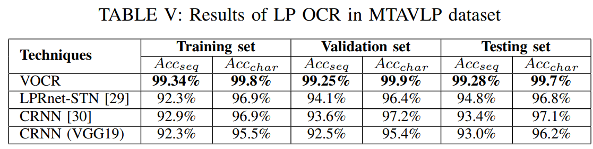
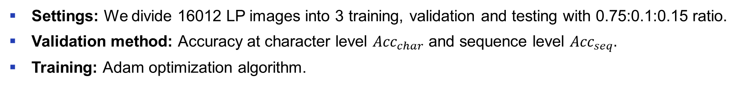
License plate OCR
Experiment
Results
Settings: We divide 16012 LP images into 3 training, validation and testing with 0.75:0.1:0.15 ratio.
Validation method: Accuracy at character level ${Acc}_{char}$ and sequence level ${Acc}_{seq}.$
Training: Adam optimization algorithm.

Slide 25
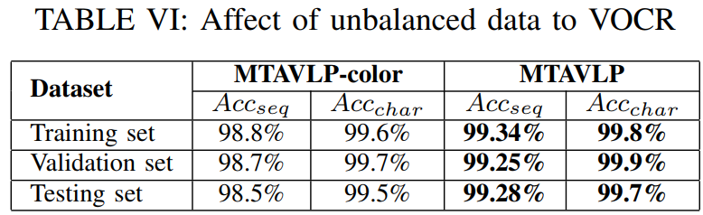
License plate OCR
Experiment
Results
90% of LP images in the MTAVLP dataset have white background.
We used image negative and histogram matching algorithm to generate MTAVLP-color dataset including blue, red, yellow plates from white plates in all 3 training, testing and validation sets.

Slide 26
Overall performance
Experiment
Results
On a single RTX 2080 without inference optimization techniques:
Car detection: YOLOv2 run at 38.28 FPS.
LP detection: DDRNet23sh run at 103.5 FPS.
LP OCR: VOCR run at 36 FPS.
Overall performance: 15 FPS.

Slide 27
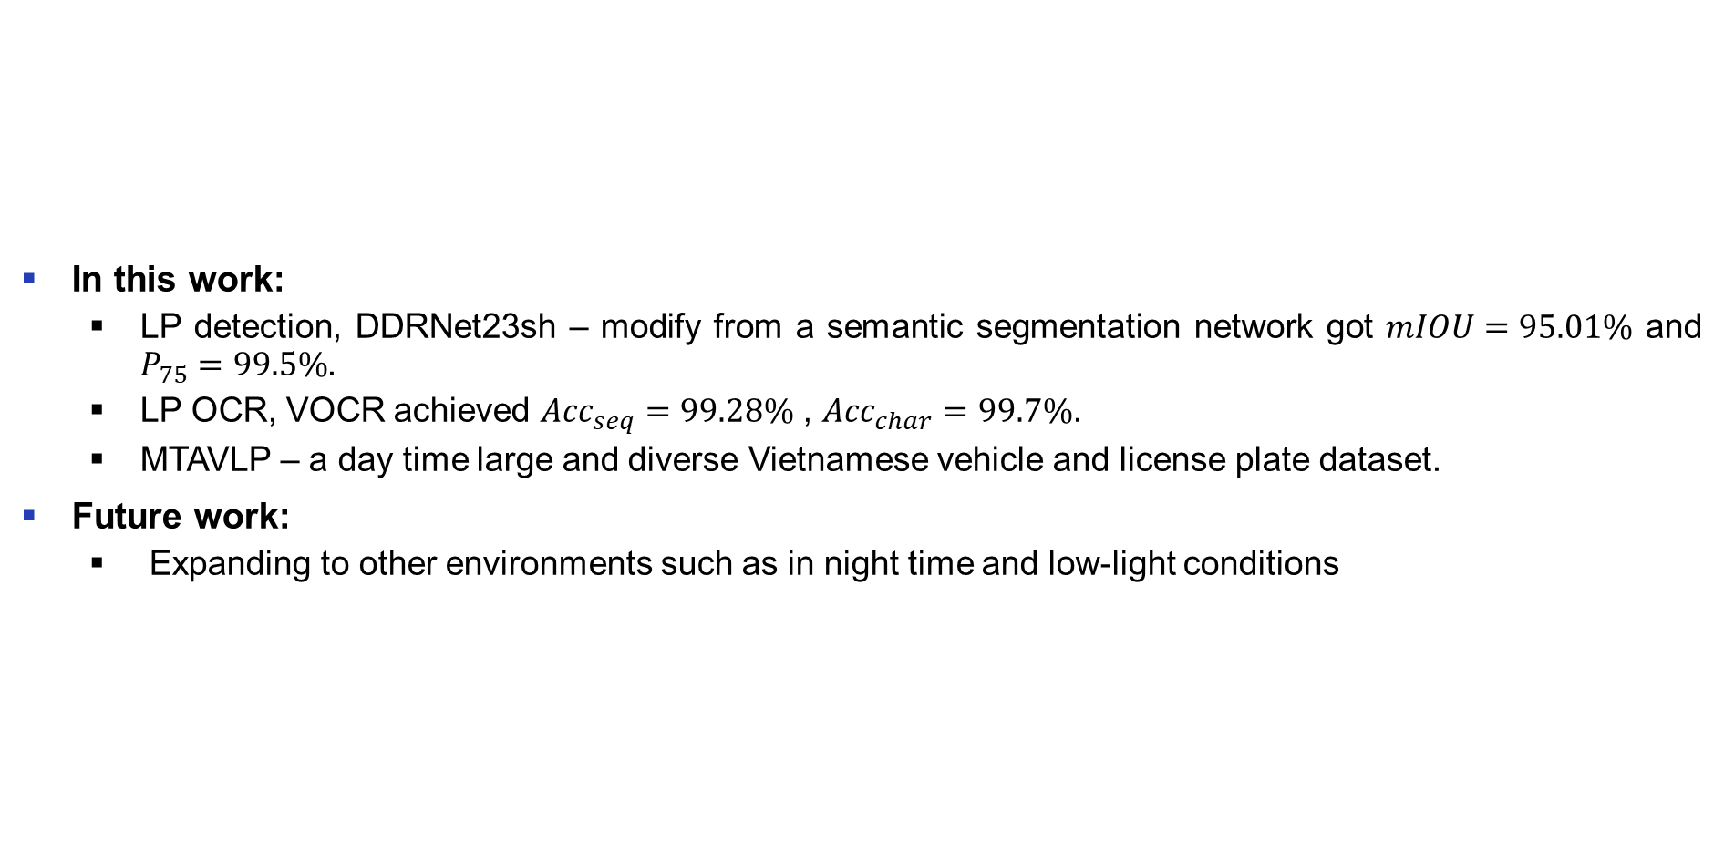
Conclusion and future work
Conclusion
In this work:
LP detection, DDRNet23sh – modify from a semantic segmentation network got $mIOU=95.01\%$ and $P_{75}=99.5\%$.
LP OCR, VOCR achieved ${Acc}_{seq}=99.28\%$ , ${Acc}_{char}=99.7\%$.
MTAVLP – a day time large and diverse Vietnamese vehicle and license plate dataset.
Future work:
Expanding to other environments such as in night time and low-light conditions

Slide 28
THANK FOR YOUR ATTENTION!

