Slide 1

HỌC VIỆN KỸ THUẬT QUÂN SỰ KHOA CÔNG NGHỆ THÔNG TIN
An efficient method to improve the accuracy of Vietnamese vehicle license plate recognition in unconstrained environment
Authors
Khanh Nguyen Quoc
Faculty Of Information Technology
Le Quy Don Technical University
khanh29bk@mta.edu.vn
Dan Pham Van
Faculty Of Information Technology
Le Quy Don Technical University
phamvandan.cntt2@gmail.com
Van Pham Thi Bich
Faculty Of Information Technology
Le Quy Don Technical University
vanptb@lqdtu.edu.vn

Slide 2
PREFACE
INTRODUCTION
RELATED WORK
Content
PROPOSED METHOD
CONCLUSION
EXPERIMENTS AND RESULTS

Slide 3
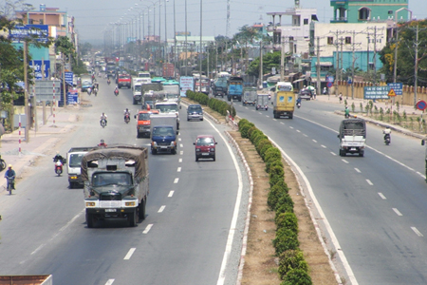
PREFACE - REALITY
Nowadays, with the rapid increase of vehicles, the intelligent automatic license plate recognition (ALPR) system is attracting more and more attention.
Fig 1. Means of transport on a highway in our country.

Slide 4
Preface – our goal
Previous studies in ALPR focused on recognizing license plate (LP) in constrained environment.
Recent studies on ALPR in Vietnam have conducted small datasets and have not covered various cases of Vietnamese LPs
→ Our goal: To develop a model for ALPR that is effective in unconstrained environment in Vietnam

Slide 5
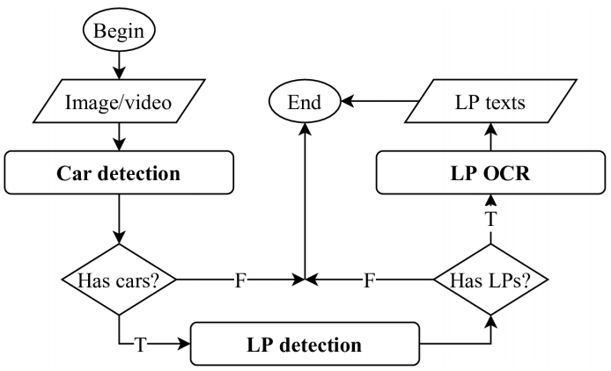
introduction – ALPR SYSTEM
Fig 2. A typical ALPR system
Notes:
From images captured by cameras, an ALPR system detects areas containing vehicles and then detects areas containing a license plate. Characters of a licence plate can be identified from these areas. The illustration of a typical ALPR systems is showed in Fig 2.

Slide 6
INTRODUCTION - Challenges
Environment conditions: sunshine, rainy, night time, day time.
Image resolution and view of cameras.
Size and quality of license plate images.
Color, shape and font of license plate images.
Density of vehicle at the same time.
Notes:
Plate detection is based on key-points detection to solve non-rectangular objects by modifying a semantic segmentation architecture called DDRNet.
Our system identifies plate based on segmentation free approach integrated with Attention mechanism. Feature extraction part is designed based on VGG-19 [5] in in more fine-grained level.
We build the MTAVLP dataset that includes 15571 photos of vehicles containing license plates and 16012 photos of Vietnamese license plates. This dataset is large and various in image capturing conditions.

Slide 7
INTRODUCTION – MAIN CONTRIBUTIONS
We propose an approach that is based on key-points detection for LP detection.
Our system identifies plate based on segmentation free approach integrated with Attention mechanism.
We build a large MTAVLP dataset, large and various in image capturing conditions.
Notes:
Plate detection is based on key-points detection to solve non-rectangular objects by modifying a semantic segmentation architecture called DDRNet.
Our system identifies plate based on segmentation free approach integrated with Attention mechanism. Feature extraction part is designed based on VGG-19 [5] in in more fine-grained level.
We build the MTAVLP dataset that includes 15571 photos of vehicles containing license plates and 16012 photos of Vietnamese license plates. This dataset is large and various in image capturing conditions.

Slide 8
Related work - APPROACHES
There are two main approaches for ALPR:
Multi-stage license plate recognition systems.
License plate detection: traditional image processing techniques, CNN.
LP OCR: segmentation-based and segmentation-free approaches.
Single-stage LP recognition systems.
They design a complex neural network to do both LP detection and LP OCR tasks.
Notes:
Plate detection is based on key-points detection to solve non-rectangular objects by modifying a semantic segmentation architecture called DDRNet.
Our system identifies plate based on segmentation free approach integrated with Attention mechanism. Feature extraction part is designed based on VGG-19 [5] in in more fine-grained level.
We build the MTAVLP dataset that includes 15571 photos of vehicles containing license plates and 16012 photos of Vietnamese license plates. This dataset is large and various in image capturing conditions.

Slide 9
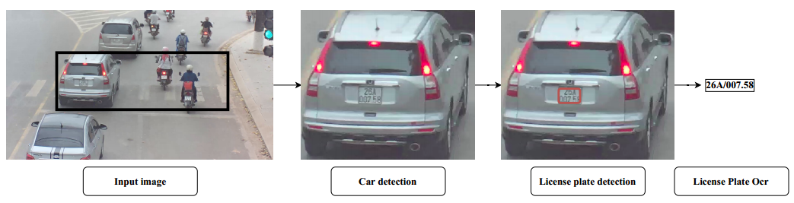
Related work – multi-stage
Fig 3. Illustration of multi-stage ALPR system.
Notes:
Plate detection is based on key-points detection to solve non-rectangular objects by modifying a semantic segmentation architecture called DDRNet.
Our system identifies plate based on segmentation free approach integrated with Attention mechanism. Feature extraction part is designed based on VGG-19 [5] in in more fine-grained level.
We build the MTAVLP dataset that includes 15571 photos of vehicles containing license plates and 16012 photos of Vietnamese license plates. This dataset is large and various in image capturing conditions.

Slide 10
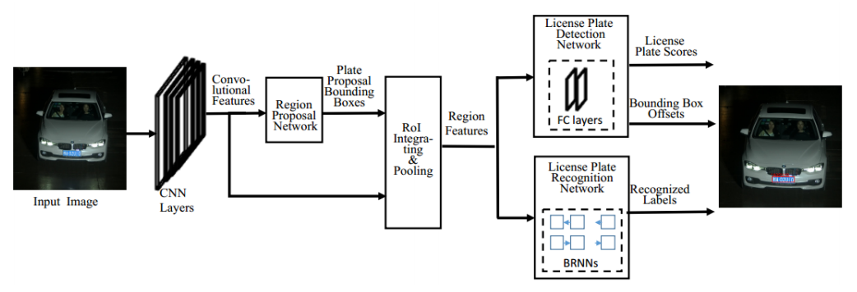
Related work – single-stage
Fig 4. Illustration of single-stage ALPR system.
Notes:
Plate detection is based on key-points detection to solve non-rectangular objects by modifying a semantic segmentation architecture called DDRNet.
Our system identifies plate based on segmentation free approach integrated with Attention mechanism. Feature extraction part is designed based on VGG-19 [5] in in more fine-grained level.
We build the MTAVLP dataset that includes 15571 photos of vehicles containing license plates and 16012 photos of Vietnamese license plates. This dataset is large and various in image capturing conditions.

Slide 11
Related work – KEY-POINTS DETECTION
Human pose estimation (HPE) problem, two main approaches:
Coordinate regression
Heatmap regression (have been shown to be more effective)
Notes:
Plate detection is based on key-points detection to solve non-rectangular objects by modifying a semantic segmentation architecture called DDRNet.
Our system identifies plate based on segmentation free approach integrated with Attention mechanism. Feature extraction part is designed based on VGG-19 [5] in in more fine-grained level.
We build the MTAVLP dataset that includes 15571 photos of vehicles containing license plates and 16012 photos of Vietnamese license plates. This dataset is large and various in image capturing conditions.

Slide 12
Proposed method – our alpr system
Fig 5. Our multi-stage ALPR system.
Notes:
Plate detection is based on key-points detection to solve non-rectangular objects by modifying a semantic segmentation architecture called DDRNet.
Our system identifies plate based on segmentation free approach integrated with Attention mechanism. Feature extraction part is designed based on VGG-19 [5] in in more fine-grained level.
We build the MTAVLP dataset that includes 15571 photos of vehicles containing license plates and 16012 photos of Vietnamese license plates. This dataset is large and various in image capturing conditions.

Slide 13
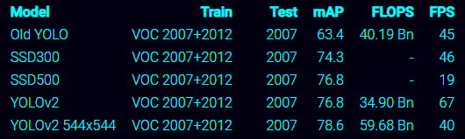
Proposed method – vehicle detection
Vehicle detection:
Vehicles are basic objects presented in large datasets such as COCO, VOC, PASCAL datasets.
We decided to use YOLOv2 544x544 network trained on VOC 2007+2012 dataset.
Fig 6. Accuracy and speed of YOLOv2 on a Titan X GPU.
Notes:
Plate detection is based on key-points detection to solve non-rectangular objects by modifying a semantic segmentation architecture called DDRNet.
Our system identifies plate based on segmentation free approach integrated with Attention mechanism. Feature extraction part is designed based on VGG-19 [5] in in more fine-grained level.
We build the MTAVLP dataset that includes 15571 photos of vehicles containing license plates and 16012 photos of Vietnamese license plates. This dataset is large and various in image capturing conditions.

Slide 14
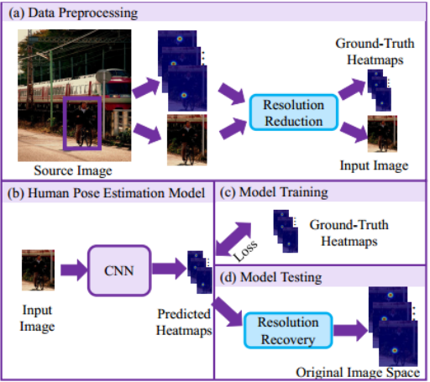
Proposed method (2/2)
Fig 7. LP detection was inspired from top-down HPE approach.
Notes:
Plate detection is based on key-points detection to solve non-rectangular objects by modifying a semantic segmentation architecture called DDRNet.
Our system identifies plate based on segmentation free approach integrated with Attention mechanism. Feature extraction part is designed based on VGG-19 [5] in in more fine-grained level.
We build the MTAVLP dataset that includes 15571 photos of vehicles containing license plates and 16012 photos of Vietnamese license plates. This dataset is large and various in image capturing conditions.

Slide 15
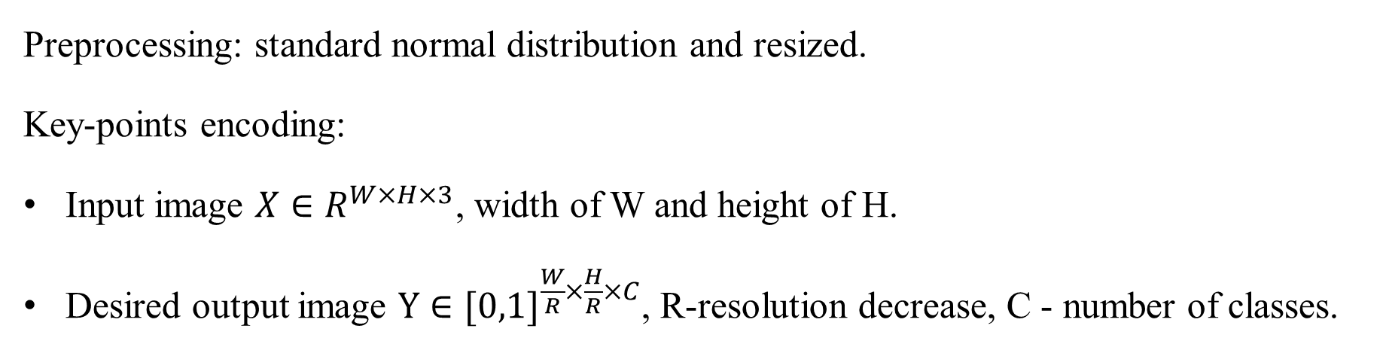
Proposed method (2/2)
License plate detection:
Preprocessing: standard normal distribution and resized.
Key-points encoding:
Input image $X∈R^{W×H×3}$, width of W and height of H.
Desired output image $Y∈{[0,1]}^{\frac{W}{R}×\frac{H}{R}×C}$, R-resolution decrease, C - number of classes.
Notes:
Plate detection is based on key-points detection to solve non-rectangular objects by modifying a semantic segmentation architecture called DDRNet.
Our system identifies plate based on segmentation free approach integrated with Attention mechanism. Feature extraction part is designed based on VGG-19 [5] in in more fine-grained level.
We build the MTAVLP dataset that includes 15571 photos of vehicles containing license plates and 16012 photos of Vietnamese license plates. This dataset is large and various in image capturing conditions.

Slide 16
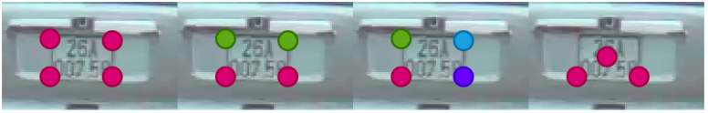
Proposed method (2/2)
License plate detection:
Fig 8. Key-points design for a license plate (colors are according to number of classes)
Notes:
Plate detection is based on key-points detection to solve non-rectangular objects by modifying a semantic segmentation architecture called DDRNet.
Our system identifies plate based on segmentation free approach integrated with Attention mechanism. Feature extraction part is designed based on VGG-19 [5] in in more fine-grained level.
We build the MTAVLP dataset that includes 15571 photos of vehicles containing license plates and 16012 photos of Vietnamese license plates. This dataset is large and various in image capturing conditions.

Slide 17
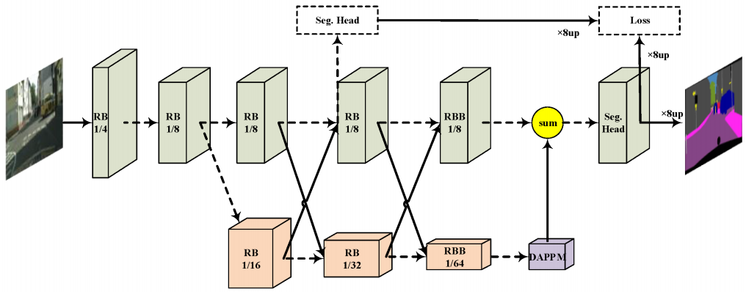
Proposed method (2/2)
Architecture:
HPE architecture: DLA-34, HRNet-18, Restnet18.
Modify a semantic segmentation architecture: DDRNet.
Fig 9. Original DDRNet architecture
Notes:
Modification 1: Adding up-convolution and skip connections.
Modification 2: Up-scale feature resolution and add skip connections.

Slide 18
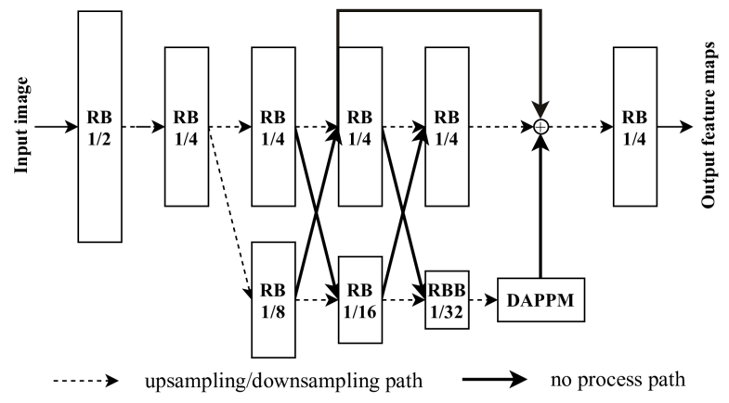
Proposed method (2/2)
Up-scale feature resolution and add skip connections
Fig 9. DDRNetsh Network, “RB” - sequential residual basic blocks. “RBB” - single residual bottleneck block. “DAPPM” - Deep Aggregation Pyramid Pooling Module
Notes:
Plate detection is based on key-points detection to solve non-rectangular objects by modifying a semantic segmentation architecture called DDRNet.
Our system identifies plate based on segmentation free approach integrated with Attention mechanism. Feature extraction part is designed based on VGG-19 [5] in in more fine-grained level.
We build the MTAVLP dataset that includes 15571 photos of vehicles containing license plates and 16012 photos of Vietnamese license plates. This dataset is large and various in image capturing conditions.

Slide 19
Proposed method-License plate OCR
License plate OCR:
Vehicles are basic objects presented in large datasets such as COCO, VOC, PASCAL datasets.
We decided to use YOLOv2 544x544 network trained on VOC 2007+2012 dataset.
Fig 6. Accuracy and speed of YOLOv2 on a Titan X GPU.
Notes:
Plate detection is based on key-points detection to solve non-rectangular objects by modifying a semantic segmentation architecture called DDRNet.
Our system identifies plate based on segmentation free approach integrated with Attention mechanism. Feature extraction part is designed based on VGG-19 [5] in in more fine-grained level.
We build the MTAVLP dataset that includes 15571 photos of vehicles containing license plates and 16012 photos of Vietnamese license plates. This dataset is large and various in image capturing conditions.

Slide 20
Proposed method (2/2)
Vehicle detection:
Vehicles are basic objects presented in large datasets such as COCO, VOC, PASCAL datasets.
We decided to use YOLOv2 544x544 network trained on VOC 2007+2012 dataset.
Fig 6. Accuracy and speed of YOLOv2 on a Titan X GPU.
Notes:
Plate detection is based on key-points detection to solve non-rectangular objects by modifying a semantic segmentation architecture called DDRNet.
Our system identifies plate based on segmentation free approach integrated with Attention mechanism. Feature extraction part is designed based on VGG-19 [5] in in more fine-grained level.
We build the MTAVLP dataset that includes 15571 photos of vehicles containing license plates and 16012 photos of Vietnamese license plates. This dataset is large and various in image capturing conditions.

Slide 21



