Slide 1

An efficient method to improve the accuracy of Vietnamese vehicle license plate recognition in unconstrained environment
Khanh Nguyen Quoc, Dan Pham Van, Van Pham Thi Bich
Faculty Of Information Technology
Le Quy Don Technical University
khanh29bk@mta.edu.vn, phamvandan.cntt2@gmail.com, vanptb@lqdtu.edu.vn

Slide 2
Content
Preface
Introduction
Related work
Proposed method
Experiments and results
Conclusion

Slide 3
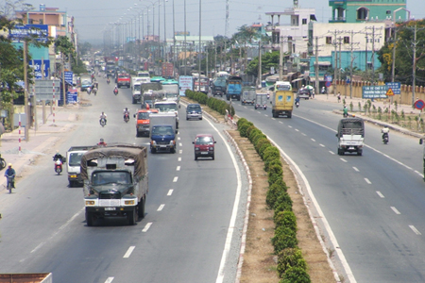
Means of transport
Preface
Reality
Nowadays, with the rapid increase of vehicles, the intelligent automatic license plate recognition (ALPR) system is attracting more and more attention.
Means of transport on a highway in our country.

Slide 4
Preface
Our goal
Previous studies in ALPR focused on recognizing license plate (LP) in constrained environment.
Recent studies on ALPR in Vietnam have conducted small datasets and have not covered various cases of Vietnamese LPs
→ Our goal: To develop a model for ALPR that is effective in unconstrained environment in Vietnam

Slide 5
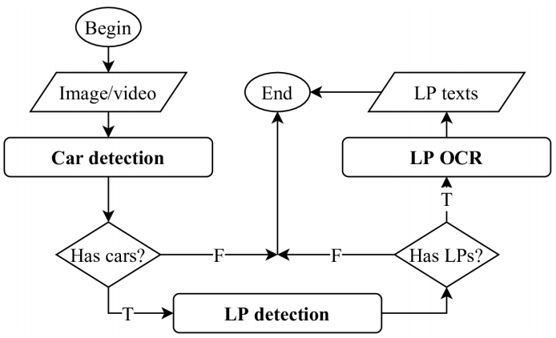
A typical ALPR system
Introduction
ALPR system
A typical ALPR system

