Slide 1

An efficient method to improve the accuracy of Vietnamese vehicle license plate recognition in unconstrained environment
Khanh Nguyen Quoc, Dan Pham Van, Van Pham Thi Bich
Faculty Of Information Technology
Le Quy Don Technical University
khanh29bk@mta.edu.vn, phamvandan.cntt2@gmail.com, vanptb@lqdtu.edu.vn

Slide 2
Content
Preface
Introduction
Related work
Proposed method
Experiments and results
Conclusion

Slide 3
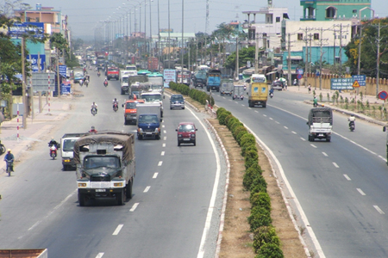
Means of transport
Preface
Reality
Nowadays, with the rapid increase of vehicles, the intelligent automatic license plate recognition (ALPR) system is attracting more and more attention.
Means of transport on a highway in our country.

Slide 4
Preface
Our goal
Previous studies in ALPR focused on recognizing license plate (LP) in constrained environment.
Recent studies on ALPR in Vietnam have conducted small datasets and have not covered various cases of Vietnamese LPs
→ Our goal: To develop a model for ALPR that is effective in unconstrained environment in Vietnam

Slide 5
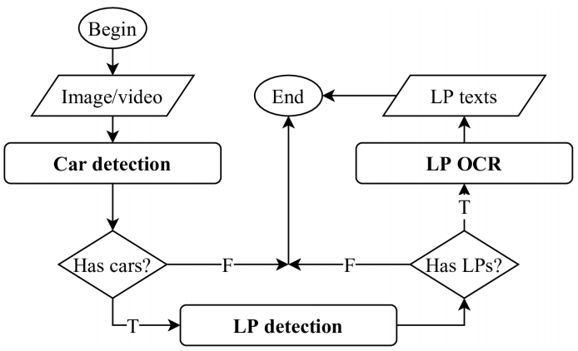
A typical ALPR system
Introduction
ALPR system
A typical ALPR system

Slide 6
Main challenges for ALPR system
Introduction
Challenges
Environment conditions: sunshine, rainy, night time, day time.
Image resolution and view of cameras.
Size and quality of license plate images.
Color, shape and font of license plate images.
Density of vehicle at the same time.

Slide 7
Two main approaches for ALPR
Related work
Approaches
Multi-stage license plate recognition systems.
License plate detection: traditional image processing techniques, CNN.
LP OCR: segmentation-based and segmentation-free approaches.
Single-stage LP recognition systems.
They design a complex neural network to do both LP detection and LP OCR tasks.

Slide 8
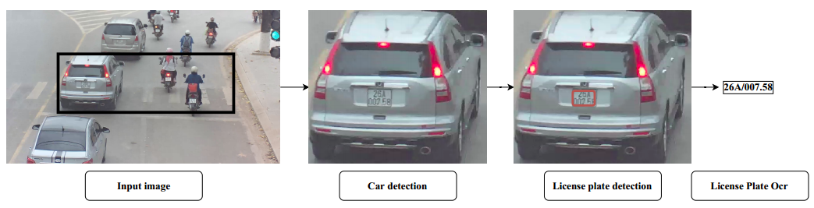
A typical multi-stage ALPR system
Related work
Multi-stage
Illustration of a multi-stage ALPR system

Slide 9
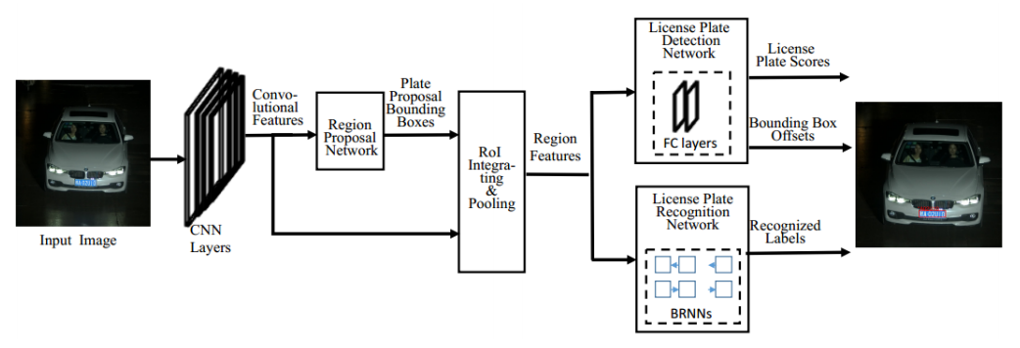
A typical single-stage ALPR system
Related work
Single-stage
Illustration of a single-stage ALPR system

Slide 10
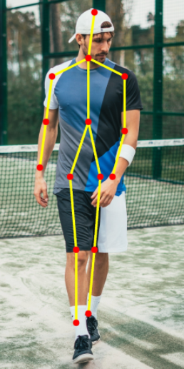
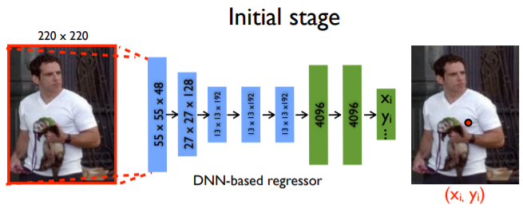
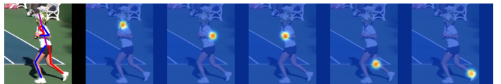
Key-points detection problem – Human Pose Estimation (HPE)
Related work
Key-points detection
Coordinate regression
Heatmap regression
HPE problem

Slide 11
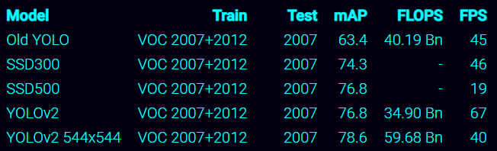
Car detection
Proposed method
Car detection
Vehicles are basic objects presented in large datasets such as COCO, VOC, PASCAL datasets.
We decided to use YOLOv2 544x544 network trained on VOC 2007+2012 dataset.
Accuracy and speed of YOLOv2 on a Titan X GPU.

Slide 12
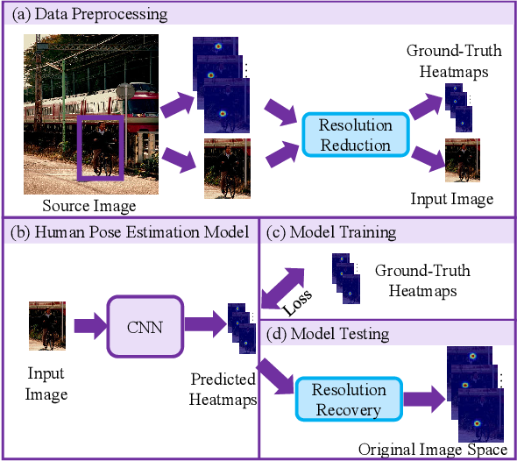
Heatmap regression for HPE
Proposed method
License plate detection
Our LP detection was inspired from top-down HPE approach

Slide 13
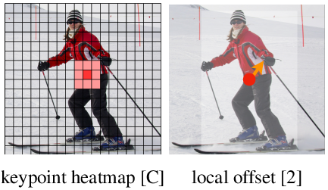
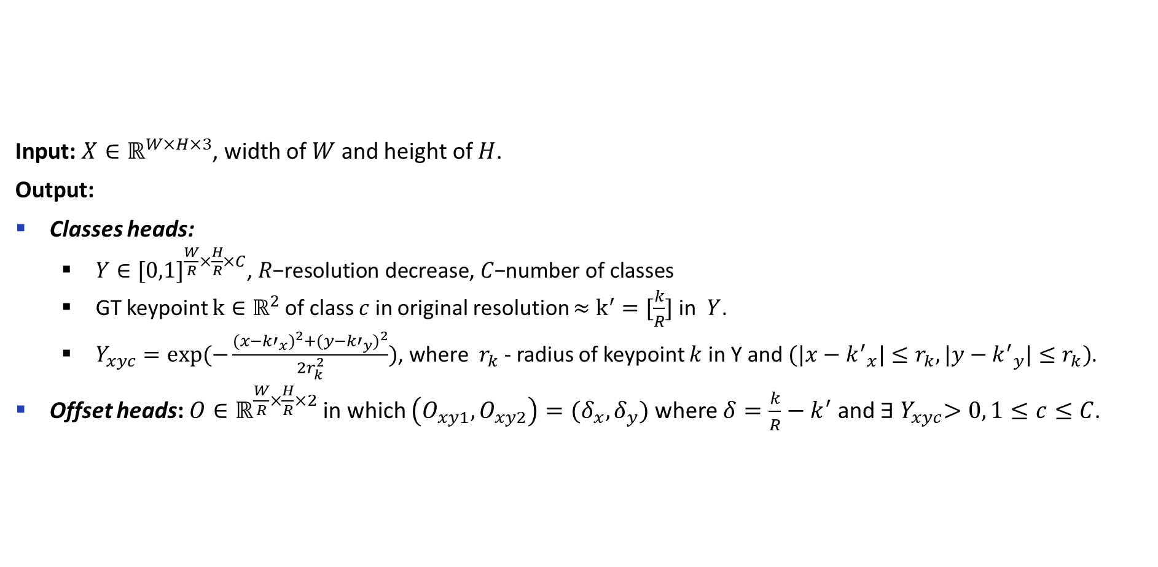
Data preprocessing
Proposed method
License plate detection
Input: $X∈ℝ^{W×H×3}$, width of $W$ and height of $H$.
Output:
Classes heads:
$Y∈{[0,1]}^{\frac{W}{R}×\frac{H}{R}×C}\text{, }R\text{−}\text{resolution} \text{decrease}\text{, }C\text{−}\text{number} \text{of} \text{classes}$
GT keypoint $k∈ℝ^{2}$ of class $c$ in original resolution $≈$ $k^{′}=[\frac{k}{R}]$ in $Y$.
$Y_{xyc}=exp⁡(−\frac{{(x−{k′}_{x})}^{2}+{(y−{k′}_{y})}^{2}}{2r_{k}^{2}})$, where $r_{k}$ - radius of keypoint $k$ in Y and $(|x−{k^{′}}_{x}|≤r_{k},|y−{k^{′}}_{y}|≤r_{k})$.
Offset heads: $O∈ℝ^{\frac{W}{R}×\frac{H}{R}×2}$in which $\left(O_{xy1},O_{xy2}\right)=(δ_{x}, δ_{y})$ where $δ=\frac{k}{R}−k^{′}$ and ${∃ Y}_{xyc}>0, 1≤c≤C$.

Slide 14
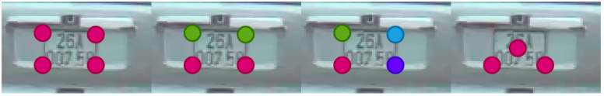
Data preprocessing - Keypoints design for license plate
Proposed method
License plate detection
Key-points design for a license plate (colors are according to number of classes)

Slide 15
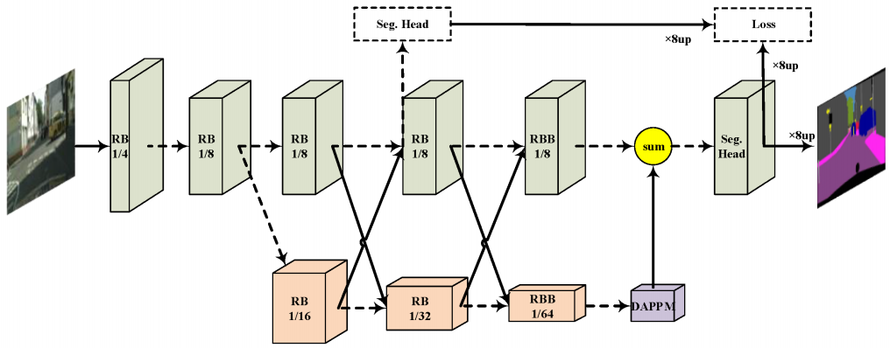
Architecture
Proposed method
License plate detection
HPE architecture: DLA-34, HRNet-18, Restnet18.
Modify a semantic segmentation architecture: DDRNet.
Original DDRNet architecture

Slide 16
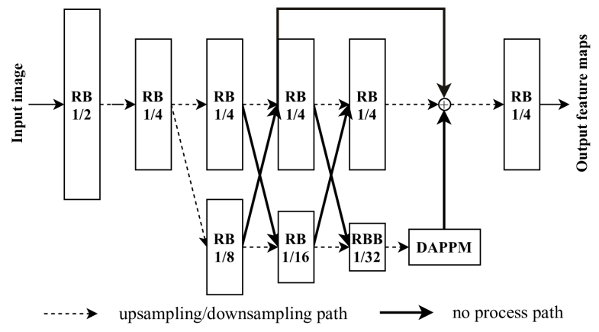
Architecture
Proposed method
License plate detection
Up-scale feature resolution and add skip connections
DDRNetsh network, “RB” - sequential residual basic blocks. “RBB” - single residual bottleneck block. “DAPPM” - Deep Aggregation Pyramid Pooling Module

Slide 17
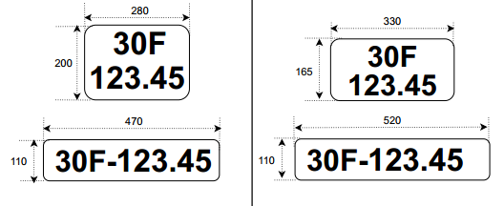

The characteristics of Vietnamese license plates
Proposed method
License plate OCR
33 characters {$ABCDEFGHKLMNPQSTUVXYZ0123456789-.\}$

Slide 18
Keypoints design for license plate
Proposed method
License plate detection

