Slide 1
Innovation

Slide 2
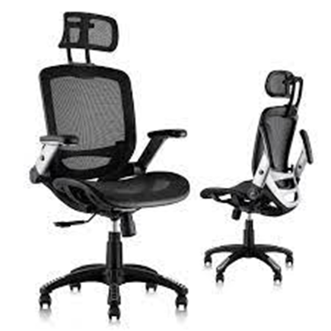
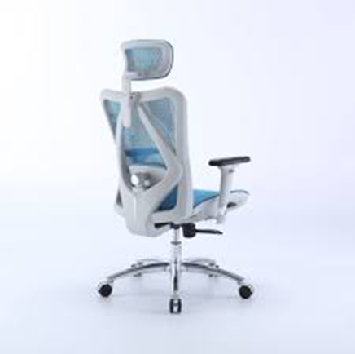
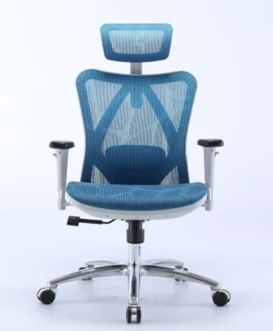
AI integrated specification
Scan the back of consumer’s body
Automatically adjust to fix correct position
Make adjustments as body movements

Slide 3

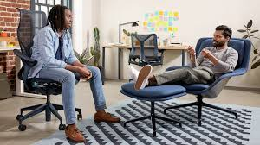
Improvement
Adding a wide range of adjustability
AI integration
Headrest & tilt comfortably

