Slide 1
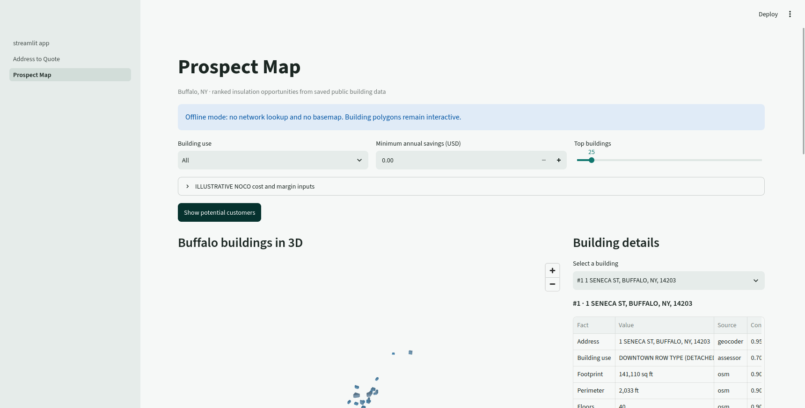
NOCO Scout
From an address to a customer ready quote in seconds
AI for Good Hackathon
NOCO challenge
Nguyen-Le-Tuan Anh-08 phamvotriduc241106 NguyenQBao
(c) OpenStreetMap contributors
Notes:
Presenter: Nguyen-Le-Tuan. Timing: 0:00-0:15.
Say: A NOCO rep today has to visit a building, collect data, and go back to the office before quoting. We do it from an address.
Visual source: screenshot captured from the real offline NOCO Scout app. Map data: (c) OpenStreetMap contributors.

Slide 2
02
The quoting workflow today
01
02
03
SITE VISIT
RESEARCH
QUOTE
All of it takes time
Source: AI for Good briefing [03:49]-[04:13]
Notes:
Presenter: Nguyen-Le-Tuan. Timing: 0:15-0:40.
Say: Your own team told us it takes time. A rep cannot visit every building in the city, so most are never quoted.
Source: AI for Good briefing [03:49]-[04:13]. No unsupported claim about the number of days appears on the slide.

Slide 3
03
Address to quote
1
2
3
4
ADDRESS
CENSUS
OSM
BUFFALO
CALCULATOR
QUOTE
Public data fills inputs. Every number shows its source.
(c) OpenStreetMap contributors
Notes:
Presenter: Nguyen-Le-Tuan. Timing: 0:40-1:05.
Say: Public map and property data give us perimeter, floors, and building type. Then we run the deterministic calculator based on NOCO's workbook.
Sources: US Census Geocoder, OpenStreetMap, City of Buffalo Final Assessment Roll, and the supplied NOCO reference workbook.
Map attribution: (c) OpenStreetMap contributors.

Slide 4
Live demo
110 seconds
Notes:
Demo driver: NguyenQBao. Presenter keeps talking. Timing: 1:05-2:55.
D1, about 40 seconds: Type the prepared Buffalo address. Show the 3D footprint and the Facts and confidence table. Click Estimate insulation upgrade. Point out that payback says needs installed cost when cost is unknown.
D2, about 50 seconds: Open Prospect Map. Click Show potential customers. Hover two or three buildings. Click one building for details. Say: Hover anywhere and you see where each number comes from.
D3, about 20 seconds: Open the customer report, then show the manager report and CSV controls. Keep the customer page visible for five seconds.
Backup: If the app fails, switch to the prepared 60-second recording and say: Here is the recorded run.

Slide 5
04
Reference test
0.1%
Deterministic math
Source and confidence stay visible
test tolerance
Unknown cost stays unknown
Workbook values omitted because reuse permission remains unconfirmed.
Notes:
Presenter: Nguyen-Le-Tuan. Timing: 2:55-3:15.
Say: We tested the deterministic model against a reference case. The golden test passes within zero point one percent. Inputs, sources, and confidence remain visible, and unknown project cost stays unknown.
Evidence: tests/test_noco_calc.py passed before export. The supplied workbook's permission statement remains unanswered, so this slide intentionally omits its values and screenshot.

Slide 6
05
One tool, three decisions
300
Buffalo buildings mapped
REP
quote
MANAGER
ranked prospects
CUSTOMER
one page
NOCO opportunity figures remain ILLUSTRATIVE.
(c) OpenStreetMap contributors
Notes:
Presenter: Nguyen-Le-Tuan. Timing: 3:15-3:30.
Say: The same tool serves the rep, the manager, and the building owner. Our offline demo dataset contains 300 Buffalo buildings ready to rank.
Evidence: data/public/demo_buildings.json contains 300 public-data records. NOCO opportunity figures remain illustrative until NOCO provides cost and margin definitions.
Map attribution: (c) OpenStreetMap contributors.

Slide 7
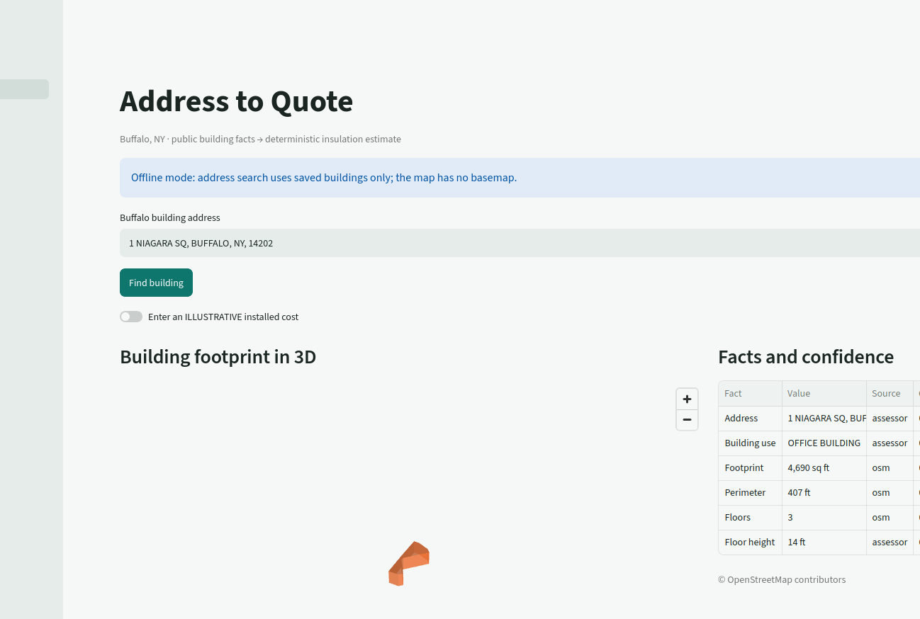
06
The same pipeline extends
GIS inputs
Provenance on hover
Citywide prospecting
Next: windows HVAC solar CRM more cities
(c) OpenStreetMap contributors
Notes:
Presenter: Nguyen-Le-Tuan. Timing: 3:30-3:50.
Say: Insulation is the first measure. The same pipeline extends to windows, HVAC, solar, more incentives, and every city NOCO serves. A future CRM connection can put ranked prospects into the sales workflow.
Future items are roadmap concepts, not features in the current demo. Disadvantaged-community targeting requires a verified public classification source before implementation.
Map attribution: (c) OpenStreetMap contributors.

Slide 8

Pilot
50
Buffalo buildings
Thank you
One week with the NOCO sales team
Nguyen-Le-Tuan Anh-08
phamvotriduc241106 NguyenQBao
Notes:
Presenter: Nguyen-Le-Tuan. Timing: 3:50-4:00.
Say: Give us 50 buildings and a week, and we will show your reps what a quote from an address looks like. Thank you.
The 50-building pilot is the team's proposed next step, not an existing commitment from NOCO.

