Slide 1
Project:
Plan, Reduce, Repeat
Phan Van Thuy
25/11/2024

Slide 2

How to Use this Template
Make a copy of this Google Slide deck.
We have provided these slides as a guide to ensure that you submit all the required components to successfully complete your project.
When presenting your project, please only think of this as a guide. We encourage you to use creative freedom when making changes as long as the required information is present.
Feel free to create additional slides if you need more space to write your responses or include screenshots.
Feel free to delete this page and the other pages with instructions before you submit your project.
Remember to add your name and the date to the cover page.
Remove this slide

Slide 3
Overview:
You have recently joined the SRE team for an exotic plant reseller startup. They already have a small SRE team in place consisting of two other members. You are just finishing up your training period and are now ready to be on your own.
You have a busy week ahead of you as there is a release this week plus your on-call shift. Part of your release duties includes helping to maintain the as-built document by adding this new release, as well as planning for system resource changes. For your on-call shift, you have to respond to alerts as they come in and write up an on-call summary to document your shift. Finally, you’ll round out your week by helping to reduce toil. You will have to identify any toil you encounter throughout the week and create a toil reduction plan. After you have a plan all ready, you will need to work on implementing that plan by writing some scripts to help automate tasks.

Slide 4
Scenario 1
Release Day

Slide 5
Release Night
Summary
Tonight is release night, and it will be your first time assisting with a release as an SRE. The process now is manual, with no real consideration for how releases may impact resource allocation. Luckily, your other team members have started implementing an as-built document. You'll have to add tonight's release to the document. The release is a pretty major release with the addition of a new feature that will bring in a large number of new clients. Looking at the results from testing, you can see that this new feature is going to add additional resource requirements as it is both more memory and, to a lesser extent, CPU intensive than before.
Current Release Features
This release will have the following changes that will need to be documented on the as-built design document. The developers have been hard at work implementing the following tickets:
Ticket 203 added a new catalog for exotic plants. This ticket added new tables in the database to handle the additional catalogs.
Ticket 202 rearranged the catalog menu in the UI to accommodate the additional catalog, as well as making it more user-friendly.
Ticket 201 added an additional component to the application, an order processor. The order processor is responsible for batch processing orders on a schedule. The reasoning behind this was to decouple the UI from order processing, and since order processing can be CPU intensive, this decoupling prevents the app from performing poorly. The Design Doc 5247 goes into more detail about the design specifics.
Ticket 205 fixed a security flaw where attackers could execute a SQL injection attack.

Slide 6
Release Night, cont.
Release Process
The established release process is a manual affair generally done by one of the operations team members. The OPs team generally will download the latest code, shut down the app, run the database migrations, change or add any needed configurations and then start the app back up. In the past this has caused issues as steps have been forgotten, not all the scripts were executed, the app was not restarted properly, among other issues. During the release window, the OPs engineer would also add new resources as needed. This has led to downtime in the past as the app became overloaded and could not serve requests anymore.
Release Planning
During load testing for this release, it was determined that
Main Application
The new catalog feature increases RAM usage by 25% for the same number of users while not increasing CPU significantly. Currently, the main application containers utilize almost 85% of the RAM allocated.
At the current resource allocation, each replication can handle 500 concurrent users. Currently, there are 3 application containers to support 1500 total users. This release is expected to add about 2.5 times the total number of users.
Order Processor
This component has a high CPU utilization with moderate RAM requirements. In testing, a fully loaded queue used a bit less than 1 Gb of RAM.
The component runs with 4 concurrent processes, pulling orders from the database and processing them for fulfillment. QA recommends twice the CPU as the main application.
Database
The database was provisioned to handle a much larger application than what the company has now and passed the load tests with flying colors.

Slide 7
As-Built Doc Template
Release Version
Stakeholders
These are the teams and members involved in this reason. This should include ops members, developers, SRE members, database admin, etc
Code Changes
This section should include a list of code changes going into this release separated into groups (for example, by bug fix, feature addition, and security fixes). This should be a short summary of the change with a ticket included to follow up with for more detailed information.
Data and System Changes
This should be formatted similarly to the code changes section, except listing any changes to the data model (database or API changes) or system changes.
Design decision highlights
Document the high-level reasoning behind any design choices. This section should only include a summary of the design decision with links to supporting documentation to follow up with for more detailed information.
Test Section
In this section, list any notable highlights from testing. Things to include here would be any changes to the testing methodology, changes to the test performed, and any tests that are not currently pass (or pass with a warning).
Deployment Notes
Include any changes made to the deployment process or any changes that should be made to improve in feature releases.

Slide 8
As-Built Doc Release 1
Stakeholders
Developers
John Doe
Jane Peters
Sam Ross
Ops
Jay Smith
SRE
Thuy Phan Van
Code Changes
Security fixes
Added new password requirements (Tk-100)
Fixed how SQL queries were handled (Tk-103)
Feature Additions
Added new menu options for users (Tk-102)
Users can now have middle names (Tk-101)
Data and System Changes
Data model changes
Added columns for middle names in user table (TK-101)
Added additional New Menu table (Tk-102)
Users table was split into 2 smaller tables (TK-101)

Slide 9
As-Built Doc Release 1
Design decision highlights
Users table was split into two smaller tables to create more efficient queries and mappings. Keeping it as one big table began to cause slow queries and allowed for a larger number of users. See Design Doc 134 for further discussion.
Test Section
All test suites are passing 100%.
Deployment Notes
The database admins asked for an additional set of scripts to be run for data corrections.

Slide 10
Deployment File
Release 1
ApiVersion: apps/v1
kind: Deployment
metadata:
name: app-deployment
namespace: course4
labels:
app: mainApp
spec:
replicas: 3
selector:
matchLabels:
app: mainApp
template:
metadata:
labels:
app: mainApp
spec:
containers:
- name: mainApp
image: nginx:latest
resources:
requests:
memory: 256mb
cpu: 250m
ports:
- containerPort: 80

Slide 11
As-Built Doc Release 2
Stakeholders
Developers:
John Doe
Jane Peters
Sam Ross
Ops:
Jay Smith
SRE:
Thuy Phan Van
QA:
Alex Carter
Database Admin:
Maria Lee

Slide 12
Code Changes
Feature Additions
Tk-203: Added a new catalog for exotic plants.
Tk-202: Rearranged the catalog menu in the UI for better usability.
Tk-201: Introduced a new order processor component to decouple order processing from the UI.
Bug Fixes
Tk-205: Resolved a SQL injection vulnerability.

Slide 13
Data and System Changes
Data Model Changes
New tables were added to the database to support the exotic plants catalog (Tk-203).
System Changes
Added an order processor component requiring higher CPU allocation (Tk-201).
Updated the UI to accommodate the new catalog menu (Tk-202).

Slide 14
Design Decision Highlights
Order Processor Design: Decoupling order processing from the UI prevents performance degradation during heavy loads. This allows the application to maintain responsiveness. Details in Design Doc 5247.
Catalog Menu Redesign: Improved user experience by reorganizing the menu to make navigation intuitive.

Slide 15
Test Section
Main Application:
Load tests indicated a 25% increase in RAM usage per user for the catalog feature.
Each container supports 500 concurrent users, and with the expected 2.5x increase in users, the replication count will need to scale.
Order Processor:
High CPU usage during batch processing was tested and deemed manageable with adequate resources.
Database:
No bottlenecks detected during load testing.
Security Tests:
SQL injection vulnerability resolved and tested successfully.

Slide 16
Deployment Notes
Resource Adjustments:
Main Application: Increase replicas from 3 to 8 to support the increased user base (2.5x users).
Order Processor: Allocate twice the CPU of the main application containers.
Process Improvements:
Update the deployment script to include order processor configurations.
Verify that all database migration scripts are executed correctly.
Risk Mitigation:
Monitor the application closely for memory usage spikes after the release.

Slide 17
Deployment File
Release 2
Update the file for Release 2 to match the description in the scenario:
ApiVersion: apps/v1
kind: Deployment
metadata:
name: app-deployment
namespace: course4
labels:
app: mainApp
spec:
Replicas: 8
selector:
matchLabels:
app: mainApp
template:
metadata:
labels:
app: mainApp
spec:
containers:
- name: mainApp
image: nginx:latest
resources:
requests:
memory: 256Mi
cpu: 250m
ports:
- containerPort: 80
- name: order_processor
image: nginx:latest
resources:
requests:
memory: 1Gi
cpu: 500m
ports:
- containerPort: 80

Slide 18
Scenario 2
On-Call Shift

Slide 19
On-Call Shift
Summary
Today is your first on-call shift as an SRE. During your shift, you will have to respond to alerts to keep the system running at its best using the on-call best practices learned in this course. During your on-call shift, make sure to be thinking of ways to reduce toil. After your on-call shift is over, you will be responsible for writing a summary of your shift and a post-mortem. On the following slides you will encounter several different “alerts” from your monitoring stack. Each “alert” will contain several different parts that will help you write your on-call log for your shift. Additionally, you’ll encounter an application outage that will require a post-mortem.
Alert Components
Summary -- This will be general knowledge about the systems involved that you would know if you had actually been working at the company. It will include a brief description of the systems involved as well information about how it is managed.
Standard Operating Procedure (SOP) -- This will be a short description of the steps to troubleshoot and potentially correct the cause of the alert.
Log and Monitoring Details -- This section will contain snippets of relevant logs and monitoring data (graphs, metrics, etc.) that are associated with responding to an alert.
On-Call Log
After your on-call shift you’ll need to add to the on-call log. There is a provided sample template for you to use that includes all the necessary fields. Remember your on-call log is used to help track recurring alerts/issues as well as providing a record of the steps taken to resolve the issue.
Post-Mortem
Unfortunately there will be an application outage on your shift that will require a post-mortem. You will only be responsible for filling in your involvement, plus you’ll be in charge of creating an action plan and impact assessment.

Slide 20
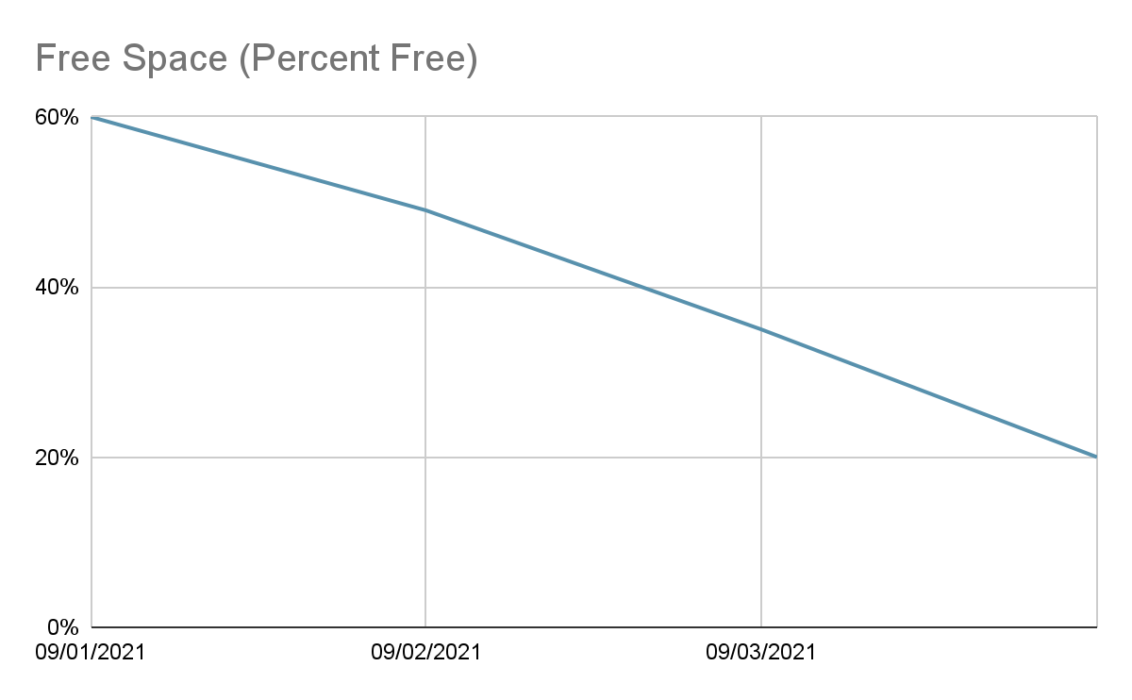
On-Call Shift -- Alert 1
Low Storage Alert
Summary
You receive an alert that the storage is running out on the mount where application logs are being written to. After consulting the SOP, you reach out to the team responsible for the server. They respond that Steve is normally in charge of handling the logs. Every morning he would run the commands listed in the run book, but he has been out sick for a week. The other members of the team forgot that it needed to be done, so the mount filled up.
SOP
Log/Monitoring Details
Low Storage
Depending on the specific alert take the following action:
/home/sre/course4/app.log -- If this mount is low on storage, reach out to Compliance. They will know what logs can be cleared out or will request additional storage.

Slide 21
On-Call Shift -- Alert 2
DNS Troubles
Summary
The networking team recently added a secondary backup DNS server to increase reliability since the one they are using now tends to go down frequently. Your team has several checks in place monitoring the DNS servers to make sure they are up at all times.
SOP
DNS Server Not Answering Requests
If you receive this alert, you should check to see if DNS1 or DNS2 is the current server answering requests. After determining which is the active server, check to see if the server is reachable. If the server is not reachable, immediately initiate the failover procedure to prevent any further network disruptions. If the server is reachable, check the logs to determine what the error is. If the active server cannot be brought back online within 5 mins, initiate the failover procedure. Either way, engage the Networking team to bring the standby server back online.
Failover Procedure
Determine the active server with the dnsTool.
dnsTool -q active_server
If the active server is reachable you can initiate the shutdown process. If this command fails, make sure the dns process is shutdown on the server before continuing
dnsTool -a shutdown -s dns1
Start the failover.
If shutdown was successful: dnsTool -a failover -s dns2
If shutdown was not successful, include the force flag, dnsTool -a failover -s dns -f

Slide 22
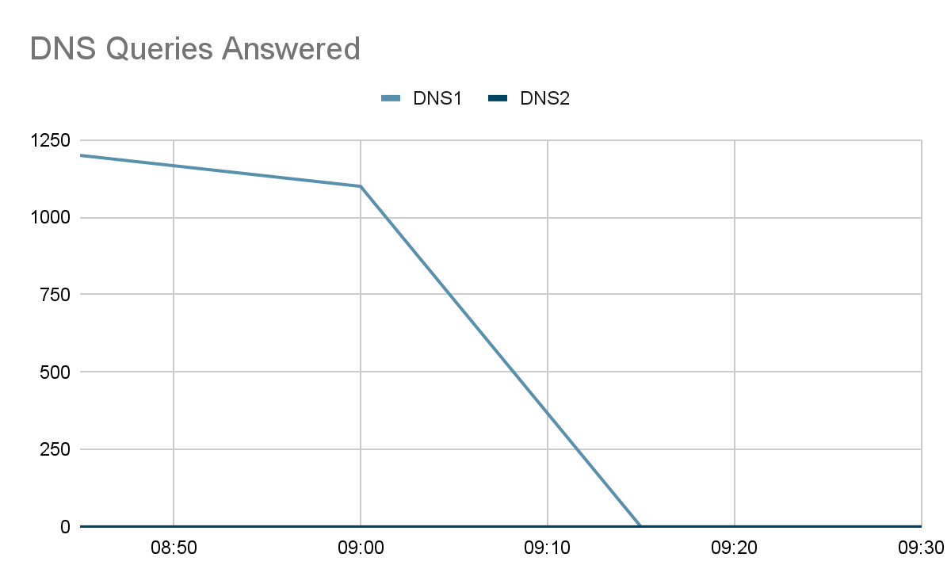
On-Call Shift -- Alert 2
DNS Troubles, cont
Log/Monitoring Details
Networking Server Status Page
Server | Status
DNS1 | UP
DNS2 | UP

Slide 23
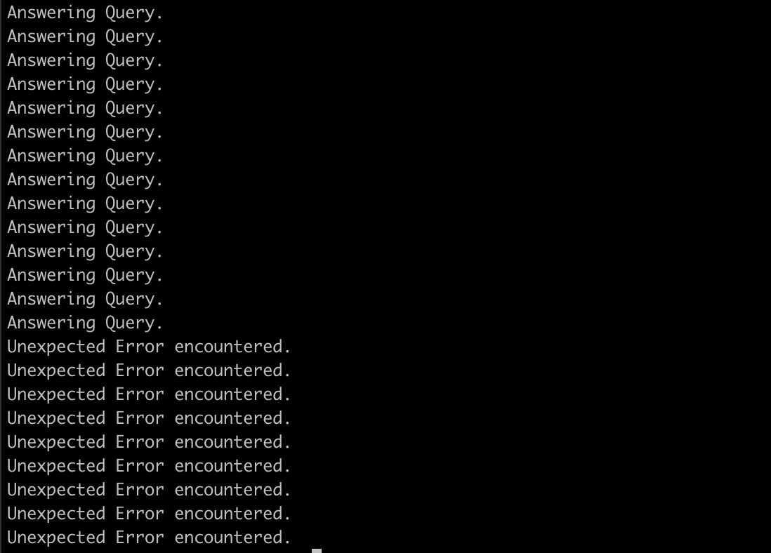
On-Call Shift -- Alert 2
DNS Troubles, cont
Log/Monitoring Details

Slide 24
On-Call Shift -- Alert 3
Application Outage
Summary
You receive the dreaded Application Down alert. Not only do you receive an alert for the application being down, but Customer Support also sent out a page to get all hands on deck for a report of the application being down.
SOP
Log/Monitoring Details
Application Down
If you receive this alert, you need to act immediately. First, verify the application is indeed unreachable. If the application is unreachable, check to make sure the hosts are up and the application processes are running. You must start escalation for this immediately after verification the app is unreachable. Contact the following POCs:
Customer Support -- Susan Vega
Networking -- Bob Sparrow
Ops -- Glen Hammer
Database Admin -- Karen House
Development Team – Gal Tree
Main App Status
Endpoint or Host | Status
exoticplant.plant | UNREACHABLE
planthost1.internal | UP
planthost2.internal | UP
exoticplant.plant.internal | UNREACHABLE

Slide 25
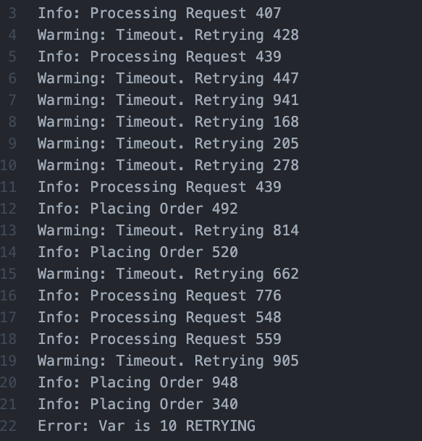
On-Call Shift -- Alert 3
Application Outage, cont
Log/Monitoring, cont.

Slide 26
On-Call Shift -- Alert 3
Application Outage, cont
Log/Monitoring, cont.
09:15 Hey we have reports of an application outage and we can not reach the app either. FROM: svega
09:16 I have an alert for that too. I’m looking at things now, will start a communication channel to coordinate. Checking logs and app servers now. FROM: YOU
09:20 -- !svega !bsparrow !ghammer !khouse !gtree we have an application outage FROM: YOU.
0930 -- Everything looks good from the network FROM: sparrow
0932 -- I can access the DB and it is reporting back normal FROM: khouse
0935 -- Everything here looks normal. FROM: ghammer
0937 -- We are still reviewing logs and seeing if we can reproduce on our end FROM: gtree
0938 -- We should try restarting the app, Maybe that will help FROM: ghammer
0940 -- Maybe that will help. FROM: svega
0943 -- Okay I will try. Bringing down. FROM: YOU
0945 -- App is down. Bring back up. FROM: YOU
0947 -- App is starting. FROM: YOU
0952 -- Main app is back up. FROM: hammer
0955 -- App is still not respond. FROM: svega
0956 -- I’m sending you some new logs !gtree these look off FROM: hammer
1005 -- !sre !ghammer when was the last deploy? What were the details? This looks like a qa build. FROM: gtree
1007 -- I did a deploy with one of the devs to qa to do some testing. Let me check. FROM: ghammer
1010 -- I think there was a mixup when doing the deployment. The wrong scripts was used and that build was deployed to prod. FROM hammer
1011 -- Were there any migrations for that !ghammer FROM: khouse
1012 -- No, just code changes. FROM: hammer
1013 -- Thats good. We should be able to just revert back then. !svega
1015 -- Let me take down the app and redeploy it. FROM: YOU
1017 -- App is down. Bring back up. FROM: YOU
1023 -- App is starting. FROM: YOU
1026 -- Main app is back up. FROM: hammer
1030 -- Everything looks like it is responding now. FROM: svega

Slide 27
On-Call Summary Log Template
Date/Time 25/11/2024
Alert Name: Storage Alert
Troubleshooting
+ Reviewed the alert details indicating low storage on /home/sre/course4/app.log.
+ Referred to the Standard Operating Procedure (SOP) and reached out to the Compliance team for guidance.
+ Identified the cause: the responsible team member (Steve) was unavailable, and log maintenance was not performed.
Resolution
+ Compliance team confirmed it was safe to clear specific logs.
+ Cleared old logs to free up space.
+ Suggested automating log rotation or scheduling a cron job to prevent recurrence.

Slide 28
On-Call Summary Log Template
Date/Time 25/11/2024
Alert Name: DNS Troubles
Troubleshooting
+ Verified the active DNS server using dnsTool -q active_server.
+ Checked if the active server was reachable; determined it was not.
+ Reviewed logs for DNS1, which indicated issues with the service.
Resolution
+ Initiated failover to DNS2 using the SOP steps (dnsTool -a failover -s dns2).
+ Engaged the Networking team to restore DNS1 to standby status.
+ Recommended setting up automated failover detection and periodic DNS health checks.

Slide 29
On-Call Summary Log Template
Date/Time 25/11/2024
Alert Name: Application Outage
Troubleshooting
+ Confirmed the application was unreachable using logs and monitoring tools.
+ Verified the status of hosts (planthost1 and planthost2) – both were operational.
+ Notified all relevant stakeholders (Customer Support, Networking, Ops, Database Admin, Development).
+ Reviewed logs and discovered an incorrect deployment of a QA build to production.
Resolution
+ Took the application down and reverted to the last stable build.
+ Restarted the application and confirmed its availability.
+ Suggested stricter deployment procedures, including automated deployment validations.

Slide 30
Post-Mortem
Incident Title: Application Outage
Date/Time: 25/11/2024
Stakeholders
- Customer Support: Susan Vega
- Networking: Bob Sparrow
- Operations: Glen Hammer
- Database Administration: Karen House
- Development: Greg Tree
Incident Timeline
- 09:15: Alert received for application outage; customer reports follow.
- 09:16-09:20: Troubleshooting initiated and communication channel created.
- 09:30-09:37: Networking, database, and ops teams confirm no issues on their end.
- 09:43-09:52: Application restarted; issue persists.
- 10:05-10:10: Logs reviewed; QA build deployment to production identified as the cause.
10:15-10:26: Application redeployed with the correct build and verified as operational.

Slide 31
Post-Mortem
Incident Title: Application Outage
Date/Time: 25/11/2024
Impact
+ Business: Temporary service outage affected order processing and customer satisfaction.
+ Customers: Users experienced application unavailability for over an hour.
+ Systems: Incorrect build deployment resulted in compatibility issues and downtime.
Resolution
- Application taken down and reverted to the previous stable build.
- Redeployed and restarted with correct scripts.
- Verified system functionality and monitored for additional issues.

Slide 32
Post-Mortem
Incident Title: Application Outage
Date/Time: 25/11/2024
Action Plan
1. Deployment Safeguards:
- Enforce tagging and validation of builds before deployment.
- Automate pre-deployment checks using CI/CD pipelines.
2. Monitoring Improvements:
- Enhance logging to detect incompatible builds early.
- Set up alerts for unexpected build or configuration changes.
3. Process Enhancements:
- Implement stricter deployment SOPs, including approvals.
- Conduct training for all involved teams on deployment best practices.
4. Accountability:
- Assign Greg Tree to automate deployment validations (due in 2 weeks).
- Susan Vega to provide a customer-facing post-outage summary (due in 3 days).

Slide 33
Scenario 3
Toil Reduction

Slide 34
Toil Reduction Plan
Summary
Now that you have spent some time on your own as an SRE, you now have to round out your week by handling some of the toil you encountered. Looking through the on-call summary, post-mortem, as-built design doc, and your experience, you decided that there are several ways to reduce toil. You need to list out 4 of the major items for this week, explain the reason for choosing each item briefly, and provide at least one benefit automating the toil would have. After that, you will need to implement two of these items in pseudocode to help your team move forward.
Toil Items | Why it is considered toil? | Benefits of automating
Storage Management for Log Files | Regular manual log clearing, such as those missed due to Steve's absence, led to a storage alert. This task is repetitive and prone to human error. | Automating log rotation and cleanup will ensure consistent management of log storage, prevent outages, and reduce manual intervention.
DNS Failover Handling | DNS failover currently requires manual intervention based on alerts, which can delay response times. | Automating DNS failover would reduce downtime during DNS outages, ensuring faster resolution and improved reliability.
Deployment Validation | The application outage occurred due to an incorrect QA build being deployed to production. This issue could have been prevented with automated validation of deployment scripts. | Implementing deployment validation checks would prevent accidental production deployments of incorrect builds, ensuring stability and reducing recovery time.
Outage Escalation and Communication | Coordinating communication during the application outage required manual messaging and tracking of involved stakeholders. | Automating escalation and stakeholder notifications would streamline communication, ensure quicker responses, and reduce workload on on-call engineers.

Slide 35
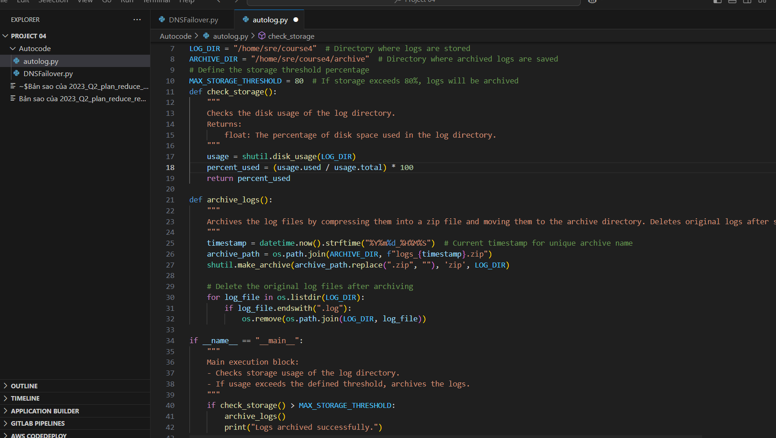
Automation Implementation
Automating Log Management:
Documentation/Comments:
How it works:
+ The script calculates the disk usage percentage of the LOG_DIR.
+ If the usage exceeds 80%, it compresses the logs into a zip file with a timestamp.
+ The archive is stored in the ARCHIVE_DIR, and the original logs are deleted.
When to use:
+ Run this script daily as part of a cron job to automate log management.
+ Useful in environments where large logs accumulate, potentially filling storage space.

Slide 36
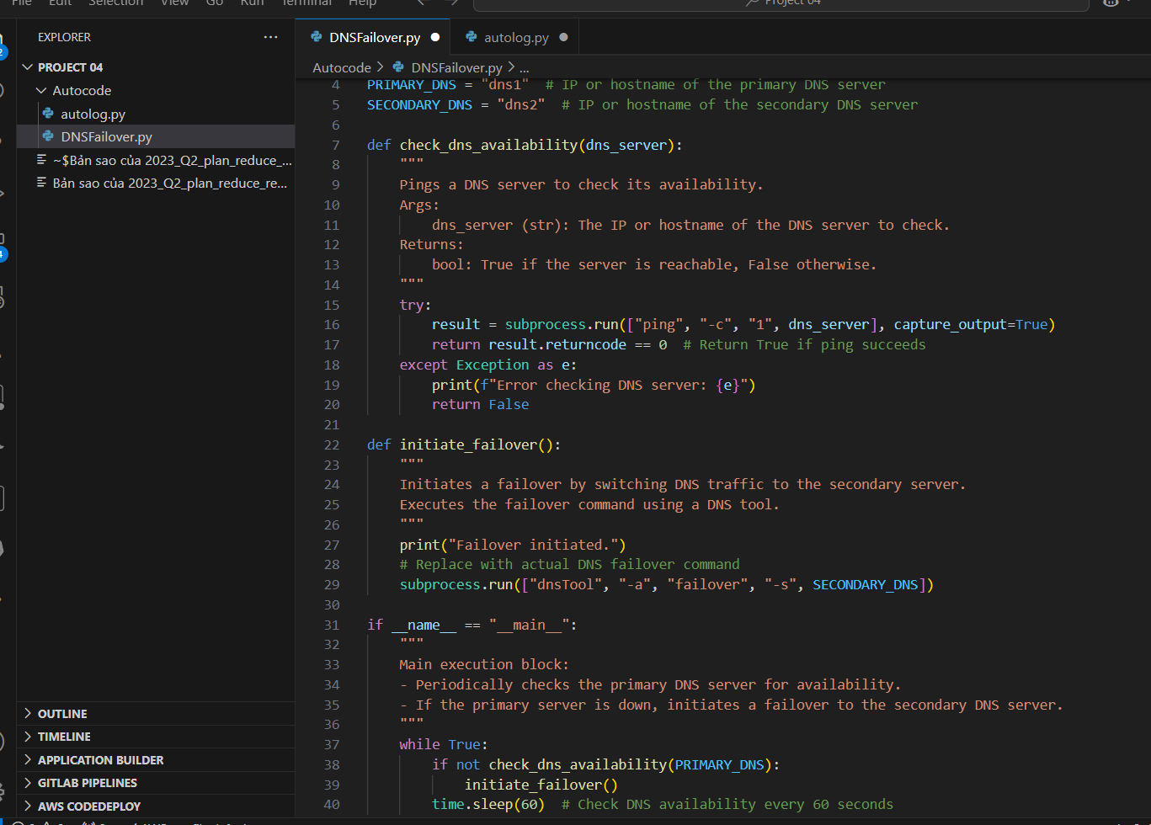
Automation Implementation
Automating DNS Failover
Documentation/Comments:
How it works:
- The script periodically pings the primary DNS server (PRIMARY_DNS) to verify its availability.
- If the primary server is unreachable, it triggers a failover by executing a command to redirect traffic to the secondary DNS server (SECONDARY_DNS).
When to use:
- Use this script as a monitoring tool for DNS server health.
- Ideal for environments requiring high availability where DNS disruptions could impact service reliability.
- Run this script as a daemon or background service on a monitoring server.

