Slide 1

LARAVEL
C3-S3 – PRACTICE - MVC

Slide 2
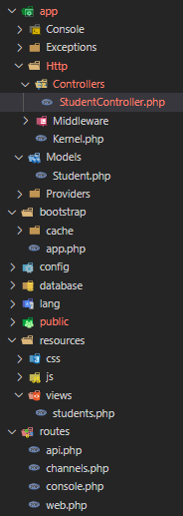
In the project downloaded from google classroom, you already have a Model, a Controller and a View defined
In the Model Student we define already a list of students
For this practice, you need to edit only these files:
app/Http/Controllers/StudentController.php
resources/views/students.php
routes/api.php
routes/web.php
To install the required packages (defined in composer.json) run :
composer install

Slide 3
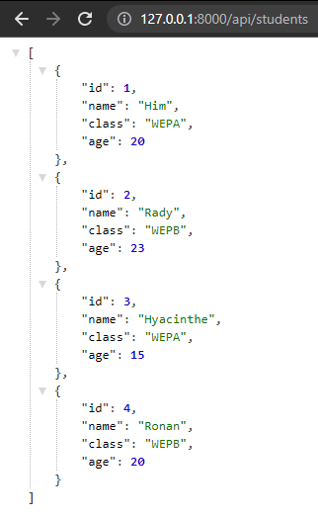
Mission 1: API route
Define a API ROUTE bind to controller StudentController :
HTTP method: GET
Path: /api/students
Function to bind in controller: getStudents
Response: The list of students
In controller StudentController, define the function getStudents() :
Get all data from Model
return data to client

Slide 4
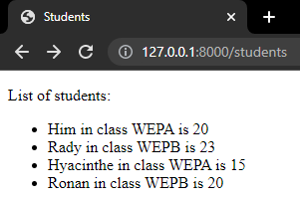
Mission 2: WEB route
Define a WEB ROUTE bind to Controller StudentController :
HTTP method: GET
Path: /students
Function to bind in controller: showStudents
Response: A view with the list of students
In Controller StudentController, define the function showStudents() :
Get all data from database
Invoke the students view
return the view to the client
In View students.php:
Display the list of students

Slide 5
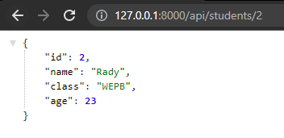
Mission 3: Controller with parameter
Define a API ROUTE bind to Controller StudentController :
HTTP method: GET
Path: /api/students/{id}
Function to bind in controller: getStudentById($id)
Response: The student with id in parameter
In Controller StudentController, define the function getStudentById($id) :
Get all data from database
Filter only the student with id from parameter
return the data to the client
If there is no student with this id, return : ”Student not found”

