Slide 1
AISWARYA GORIPARTHI
VIJAY VENKATRAO GOPARAJU
BALA PHANEENDRA POTHURI
Group 6
INFO 5082

Slide 2
Blood Cell Cancer Classification: Deep Learning Model Performance
This project compares multiple deep learning architectures for classifying blood cell cancer types using microscopic images. Models like CNNs, Vision Transformers, and ensembles were evaluated on accuracy, precision, recall, and AUC-ROC. The analysis identifies the most effective models for supporting automated cancer diagnosis.

Slide 3
Agenda
Title
Motivation
Background
Abstract(Problem statement)
Literature Survey
Objectives of the Study
Data Set and Data Processing
Research Design(Blueprint/Workflow)
Data Analysis and Model Description
Data Visualization and Results
Conclusion
References

Slide 4
Motivation
Early cancer classification is crucial for effective treatment, especially for hematological cancers like leukemia
Traditional analysis by pathologists is time-consuming and may lead to inconsistencies
Deep learning offers automated, efficient alternatives to manual microscopic analysis
Addressing the limitation of poor generalization in existing models
Creating a more reliable clinical model through stacked learning approach

Slide 5
Background
Convolutional neural networks (CNNs) have proven effective in recognizing blood cells
Existing models often show good training performance but poor generalization
Single-stage classification models have limitations in diagnostic prediction
Deep learning models are often treated as "black boxes" in medical applications
Stacking ensemble techniques can enhance model accuracy and reliability

Slide 6
Problem Statement
Challenge: Accurate classification of malignant cells is foundational for blood cancer detection
Limitations:
Current algorithms predict well on training data but struggle with generalization
Uneven class distribution and inconsistent image quality affect performance
Single-stage classification lacks comprehensive diagnostic prediction
Limited interpretability of deep learning models hinders medical adoption
Our Solution:
Multi-stage classification framework using stacking mechanisms
Integration of multiple deep learning architectures
Enhanced interpretability through LIME and SHAP visualizations

Slide 7
Literature review
Comparative Analysis of Diverse Architectures (Muttakin et al., 2024) Deep learning approaches improve blood cancer classification
ResNet, VGG16, and Inception models show good results
DVS: Blood Cancer Detection using Novel CNN-based Ensemble Approach (Ahad et al., 2024) CNN enables extraction of sophisticated image patterns
Ensemble learning enhances diagnostic precision
Dense Convolutional Network and Its Application in Medical Image Analysis (Zhou et al., 2022) Dense networks effective for medical image analysis
Feature reuse improves model efficiency

Slide 8
Objectives of the study
Create a classification framework made up of multiple deep learning models through stacking implementation
A meta-learning framework will improve the refinement of prediction results as well as enhance metric performance.
An improved blood cell image classification method needs to address the challenges of single-stage limitations.
Model predictive capabilities will reach their apex when ensemble learning methods with stacking mechanism are used.
Improving model interpretability involves using LIME tools

Slide 9
Dataset and Data-Preprocessing
Dataset: Blood Cell Images for Cancer Detection (Kaggle)
Processing Pipeline:
Image resizing to standardized dimensions (299×299 for most models, 224×224 for ViT)
Data normalization and augmentation (random crops, horizontal flips, rotations, color jitter)
Train/validation/test split (80%/10%/10%)
Class balancing techniques to address potential imbalances
Custom transforms for specific model architectures

Slide 10
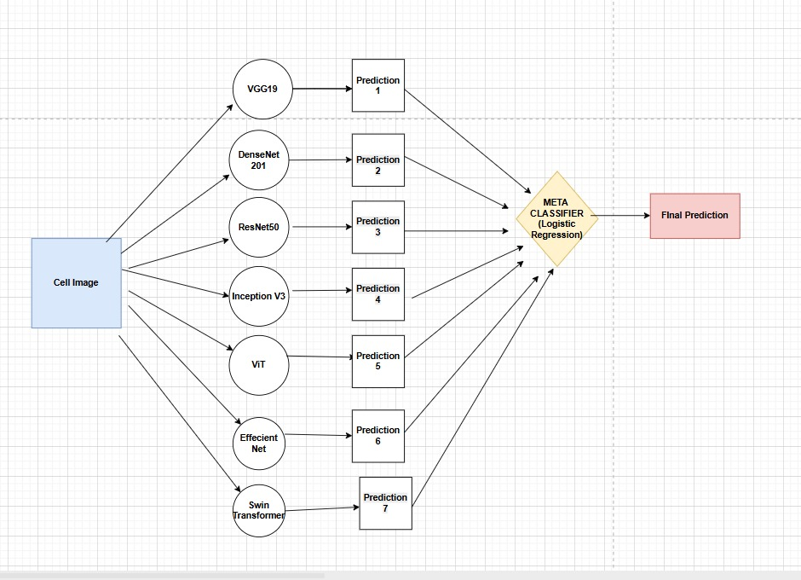
Research design

Slide 11
Data Analysis and Model Description
VGG19 with Batch Normalization:
Deep CNN architecture with 19 layers
Batch normalization for training stability
Feature extraction followed by custom classifier head
DenseNet201:
Dense connectivity pattern for improved feature reuse
201 layers with each layer connected to every other layer
Reduces vanishing gradient problem
ResNet50:
Residual connections to address vanishing gradient
50 layers with skip connections
Efficient training of deep networks

Slide 12
Data Analysis and Model Description
Inception V3:
Multi-scale processing through parallel convolutions
Efficient computation with dimension reduction
Advanced inception modules
Vision Transformer (ViT):
Attention-based approach instead of convolutions
Image patches processed as sequences
Self-attention mechanisms for global context
Stacked Model
Using Stacking we can combine multiple models so that accuracy and reliability gets increased.
We used all the algorithms and

Slide 13
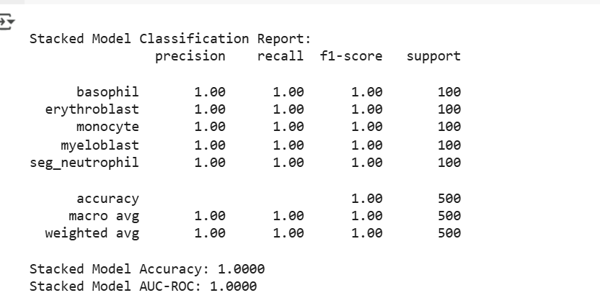
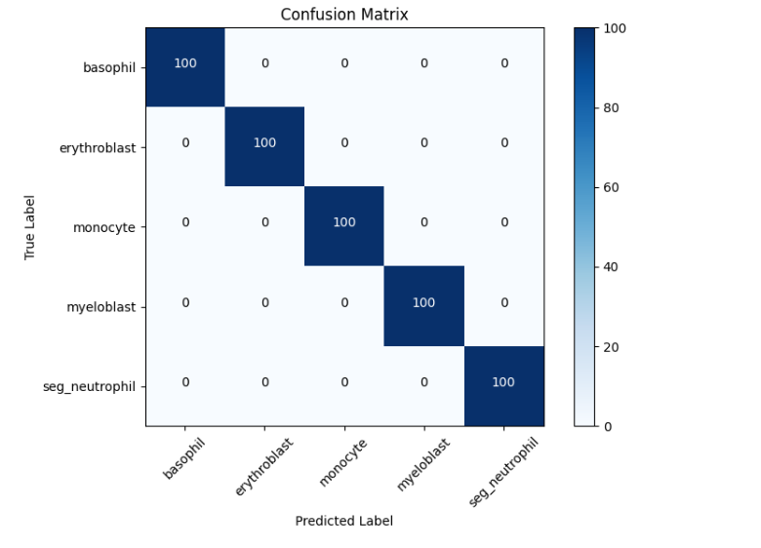
Data Visualization and Results

Slide 14
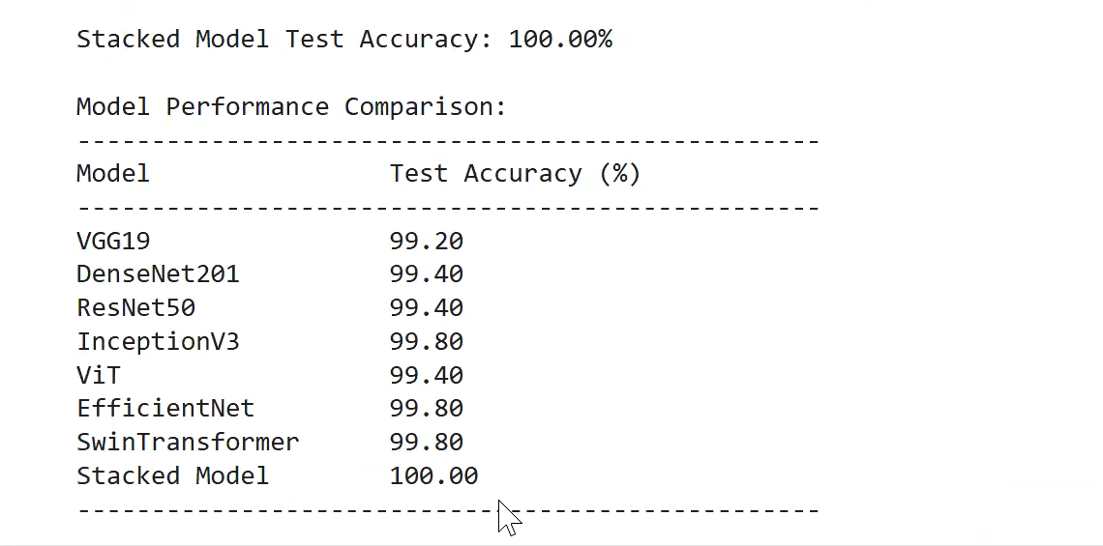
Data Visualization and Results
Comparison of various models

Slide 15
Conclusion
Our stacking ensemble approach successfully combines multiple deep learning models (VGG19, DenseNet201, ResNet50, etc.)
To achieve superior cancer cell classification performance over single-model approaches.
The two-stage training methodology significantly enhances performance through transfer learning,
with initial feature extraction followed by fine-tuning.
The meta-classifier effectively learns to weight predictions from all models, resulting in better generalization
across unseen test data.
Integration of explainability tools makes the deep learning models more interpretable
for medical professionals, addressing a key requirement for clinical adoption.
Our stacking model gives the better Accuarcy then the individual models in blood cell cancer classification

Slide 16
References
Ahad, M. T., Payel, I. J., Song, B., & Li, Y. (2024). DVS: Blood cancer detection using novel CNN-based ensemble approach. arXiv preprint arXiv:2410.05272. https://arxiv.org/abs/2410.05272
Dabeer, S., Khan, M. M., & Islam, S. (2019). Cancer diagnosis in histopathological image: CNN based approach. Informatics in Medicine Unlocked, 16, 100231. https://doi.org/10.1016/j.imu.2019.100231
Md Muttakin, G. K., Yesmin, F., Alam, S. S., Ashraf, M. S., Akuthota, V., & Abdul Quader, M. (2024). Comparative analysis of diverse architectures for accurate blood cancer cell classification. In 2024 International Conference on Computer, Electrical & Communication Engineering (ICCECE) (pp. 1–6). IEEE. https://doi.org/10.1109/ICCECE58615.2024.10476519
Zhou, T., Ye, X., Lu, H., Zheng, X., Qiu, S., & Liu, Y. (2022). Dense convolutional network and its application in medical image analysis. BioMed Research International, 2022(1), 2384830. https://doi.org/10.1155/2022/2384830
Jain, A., & Virmani, J. (2025). Deep CNN ensemble model for acute lymphoblastic leukemia detection. arXiv preprint arXiv:2502.09804. https://arxiv.org/abs/2502.09804
Hosseini, S. A., & Khosravi, A. (2025). Hybrid feature fusion and uncertainty quantification for leukemia detection using ensemble GRU-CNN models. arXiv preprint arXiv:2410.14536. https://arxiv.org/abs/2410.14536
Dutta, S., & Dutta, T. (2025). Gompertz function-based ensemble learning for microscopic leukemia classification. Applied Soft Computing, 141, 110331. https://doi.org/10.1016/j.asoc.2024.110331
Najeeb, A., Ashiq, A., & Naseer, M. (2025). Clinical-grade hybrid and ensemble deep learning models for leukemia diagnosis. In Proceedings of the 2025 ACM International Conference on Health Informatics (pp. 45–52). ACM. https://doi.org/10.1145/3578741.3578770

Slide 17
Thank You

