Slide 1

OLA JULY Overview
Summary of Ride Statistics and Insights - July 2024

Slide 2
Expected Outcomes
This project is expected to deliver the following outcomes:
Enhanced Decision-Making: Real-time visualization of metrics such as ride volumes, earnings, and customer feedback will empower teams to make informed decisions.
Operational Efficiency: By identifying performance gaps and areas for improvement, Ola can optimize resources, improve driver allocation, and enhance service quality.
Collaboration: A centralized data platform will foster better coordination across teams, promoting a data-driven culture within the organization.

Slide 3
Methodology
The methodology is structured into distinct phases:
1.Data Integration: Data will be extracted from Ola’s internal databases, including ride details, driver metrics, and customer feedback. External data sources, such as demographic trends and weather patterns, will also be integrated to enrich insights.
2.Dashboard Design: Collaboration with stakeholders will determine key performance indicators (KPIs) like total rides, average earnings, and customer satisfaction scores. An intuitive interface will be developed to facilitate easy navigation and understanding.
3.Interactivity: Advanced features will enable users to explore trends across time, compare performance across cities, and drill down into specific metrics or categories.

Slide 4

OVERALL STATS

Slide 5
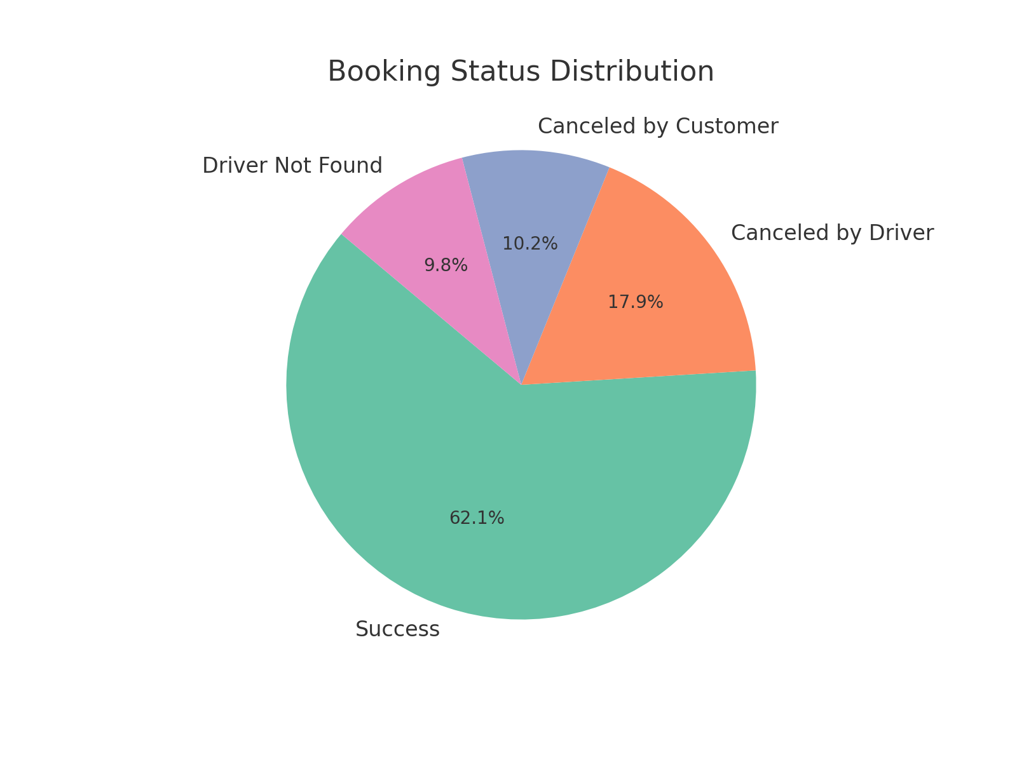
Booking Status Breakdown
- Successful Bookings: 62% (12.65K)
- Canceled by Driver: 18% (3.65K)
- Canceled by Customer: 10% (2.08K)
- Driver Not Found: 10% (2.02K)

Slide 6
TYPE OF Vehicles

Slide 7
Revenue

Slide 8
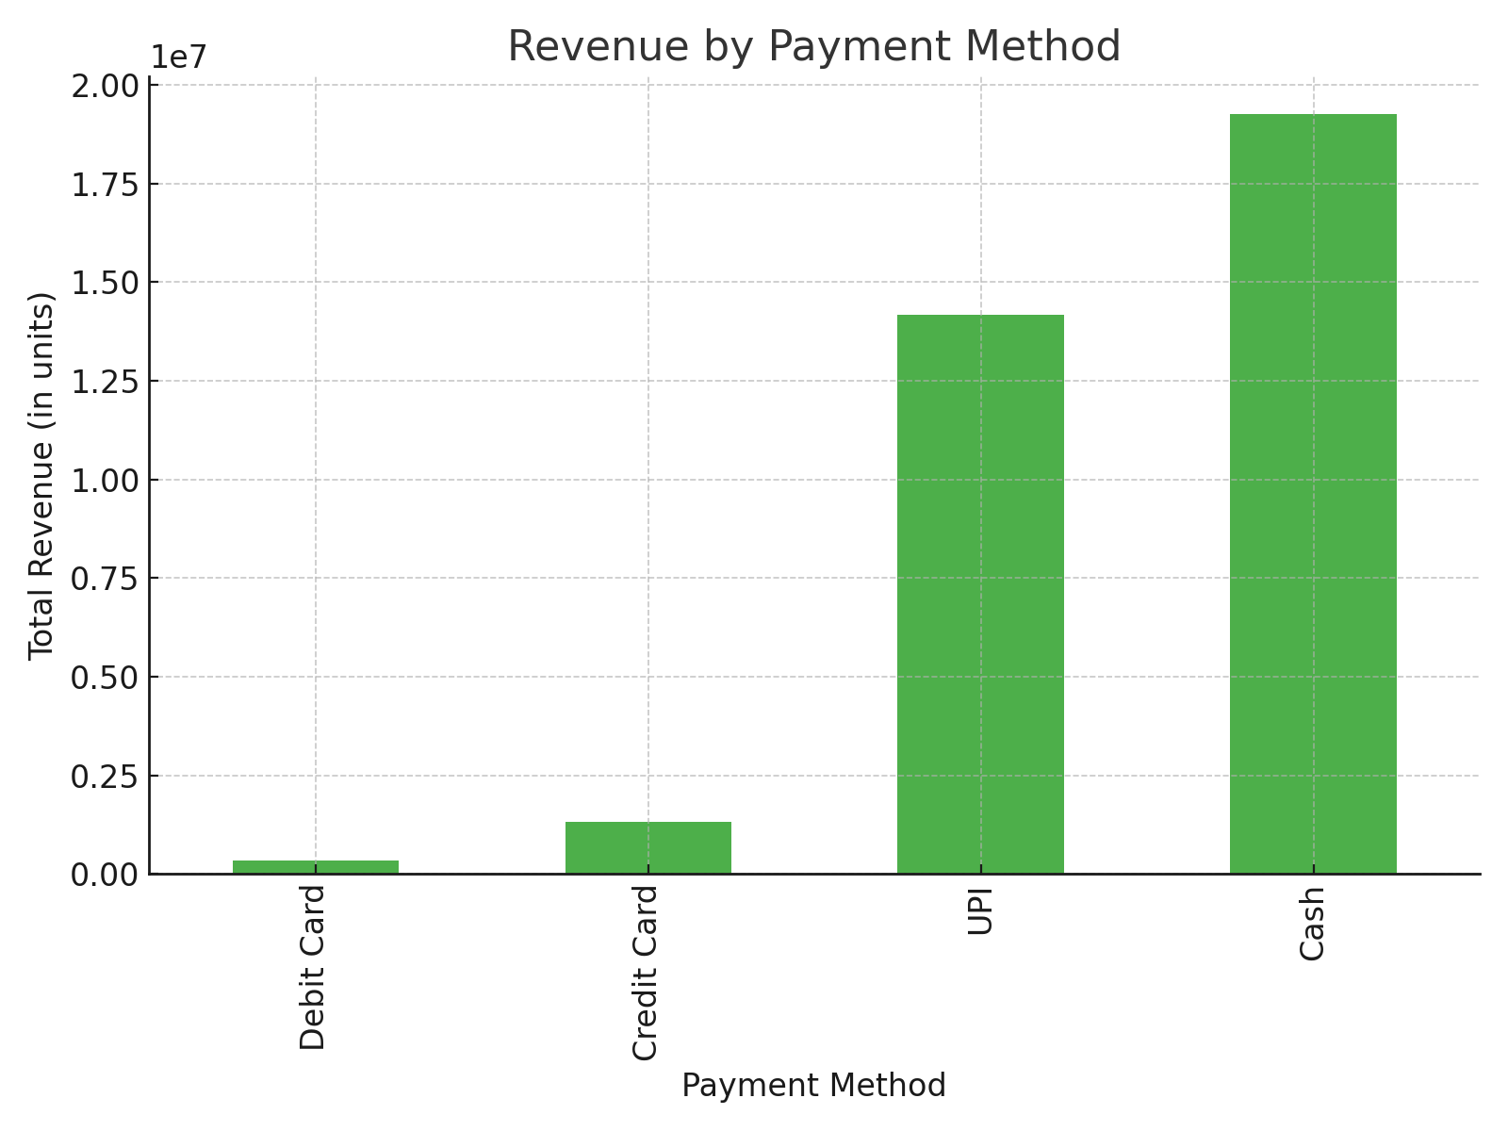
Revenue by Payment Method
- Cash and UPI are the leading payment methods.
- Total revenue from top customers amounts to 17,010 units.

Slide 9
Cancellation in Sights

Slide 10
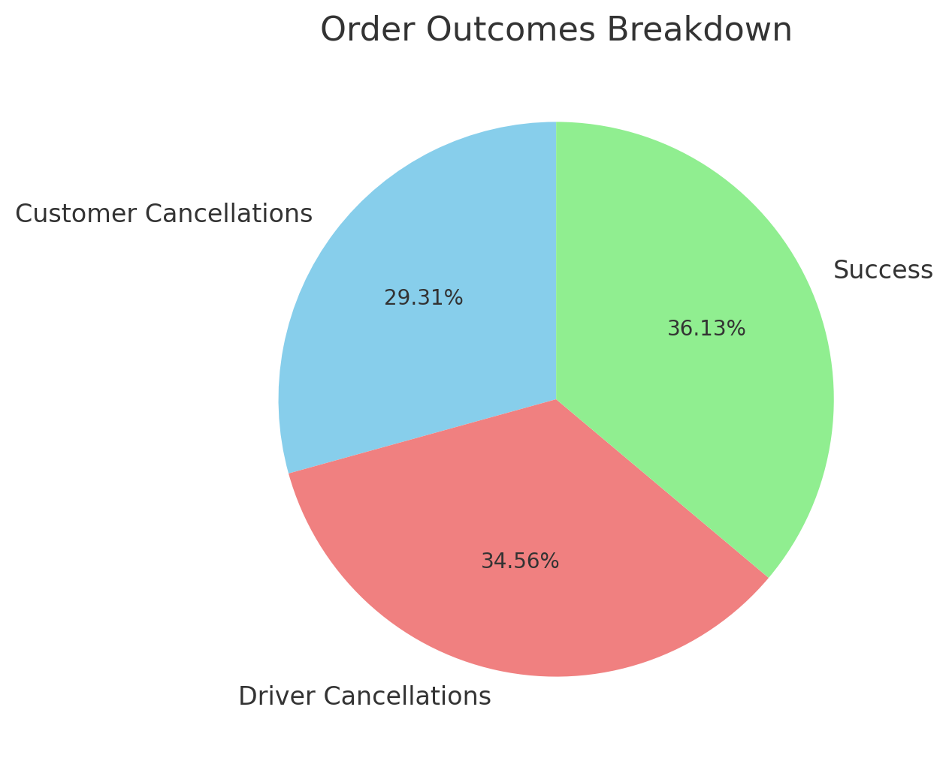
Cancellation Insights
- Customer cancellations (29.31%): Main reasons include change of plans and wrong address.
- Driver cancellations (34.56%): Predominantly due to personal or car-related issues.

Slide 11
Executive Summary
The project is centered on building an advanced dashboard leveraging Power BI, designed to provide real-time, actionable insights into Ola's operations. By focusing on key areas such as ride bookings, driver performance, and customer satisfaction, the dashboard will empower Ola to make data-driven decisions. This initiative aims to enhance service efficiency, optimize resources, and elevate the overall user experience in the competitive ride-hailing market.

Slide 12
Tools and Technologies
To achieve the project objectives, the following tools and technologies will be employed:
SQL: To extract, transform, and load data from Ola's internal systems.
Power BI: For developing dynamic dashboards with interactive visualization capabilities.

Slide 13
Risks and Challenges
Potential risks and challenges that may impact the project's success include:
Data Integration: Ensuring seamless and accurate integration of data from multiple internal and external sources.
Data Accuracy and Consistency: Verifying the uniformity of data across different regions and ensuring no discrepancies.
User Adoption: Providing comprehensive training to stakeholders unfamiliar with Power BI to encourage adoption.
Scalability: Designing the dashboard to handle growing data volumes and accommodate new markets as Ola expands.

