Slide 1

DEPARTMENT OF CSE (AI & ML)
Session: June – July 2026
PI Labs Summer Internship
Final Evaluation
ZeroTrace
Cryptographic Text Watermarking & Tamper Telemetry Engine
Students:
Sreephaneesha Kanugovi (PES1UGAM314)
Vivek Gowda S (PES1UGAM355)
Chandan S (PES1UGAM355)
Mentor: Dr Vidhya K

Slide 2
Problem Statement
AI Provenance Risk: Generative LLMs need robust mechanisms to verify text origin and ownership.
Vulnerable Steganography: Standard invisible watermarks break from 'frame shift' when text is edited.
No Graded Telemetry: Existing systems give binary (yes/no) output rather than measuring tamper severity.
Perceptibility Trade-off: Must hide watermarks visually while maintaining resilience against edits.

Slide 3
Literature Review / Background
Zero-Width Steganography: Invisible bit hiding; simple but easily scrubbed by editing.
Repetition Coding (3x/5x): Low correction capacity (1 bit/block) with very high overhead (300%+).
Cryptographic Signatures: RSA verifies authenticity but breaks entirely if a single character is modified.

Slide 4
Cryptographic Architecture
RSA-2048 Signing: Server-side private key signing guarantees non-repudiation and origin validation.
Document Binding: Embeds SHA-256 hash of clean text to block provenance transfer attacks.
Keyed Placement Engine: Spreads bits pseudo randomly using HMAC-SHA256 (secret key + hash + nonce).
ZW Unicode Channel: Invisible carriers (\u200B and \u200C) that survive standard copy-pasting.

Slide 5
Methodology & Approach
Embed Flow: Text -> RSA Sign -> RS + BCH ECC -> Keyed Placement -> Zero-Width insertion.
Concatenated ECC: Reed-Solomon outer (fixes bursts/deletes) + BCH inner (fixes single typos) provides strong error recovery.
Extract Flow: Jaccard matches history -> LCS aligns characters -> decodes ECC -> checks RSA signature.
LCS Alignment: Aligning target against original converts text deletes into erasures, avoiding frame-shifts.

Slide 6
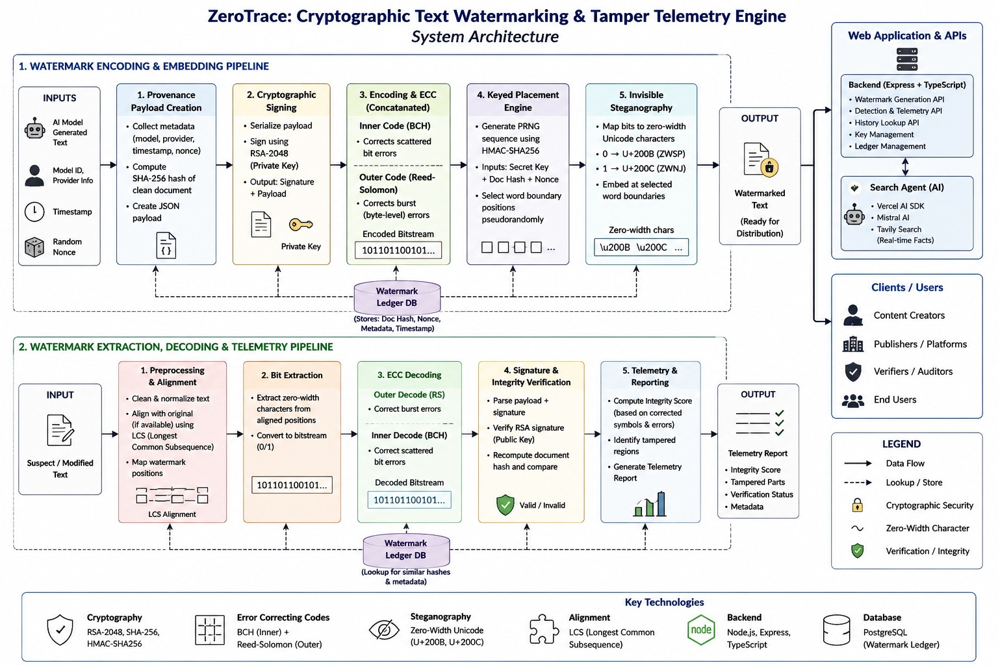
Methodology / Approach

Slide 7
Work Done / Tools technologies used
Backend Stack: Built using Node.js, Express, and TypeScript for modularity and performance.
Custom ECC Library: Custom-built Galois Field GF(2^8) math, Reed-Solomon, and BCH(255,191,8) codecs.
Autonomous Web Agent: ToolLoopAgent (Vercel AI SDK + Mistral) using Tavily Search API for live facts.
Interactive Dashboard: Frontend (HTML, CSS, JS) featuring live diff visualizers and telemetry logs.

Slide 8
Results / Observations
100% Recovery on Copy-Paste: Zero-width bits extracted and RSA signature verified successfully.
Robust to Block Deletions: LCS character alignment maps deletions, allowing RS outer code to repair blocks.
Robust to Scattered Typos: BCH inner code corrects up to 8 random bit flips in each 255-bit block.
Tamper Telemetry: Reports exact error correction logs (BCH/RS counts) to calculate a graded Integrity Score.

Slide 9
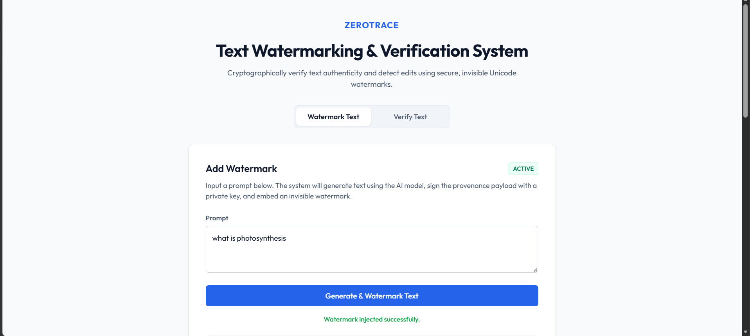
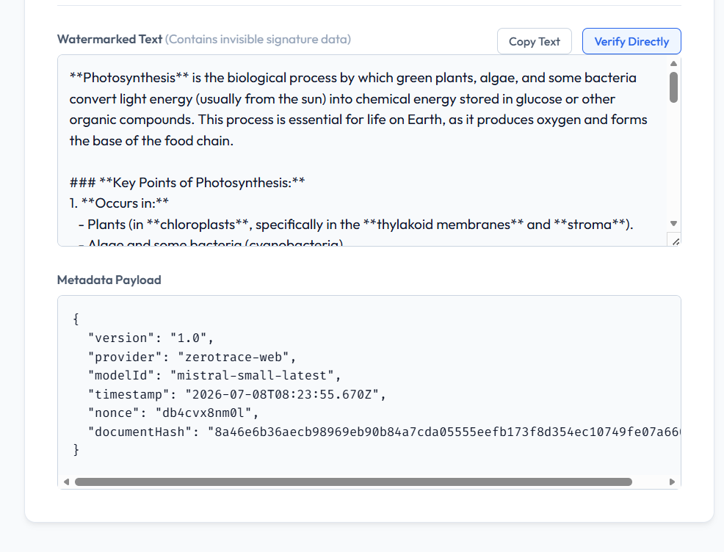
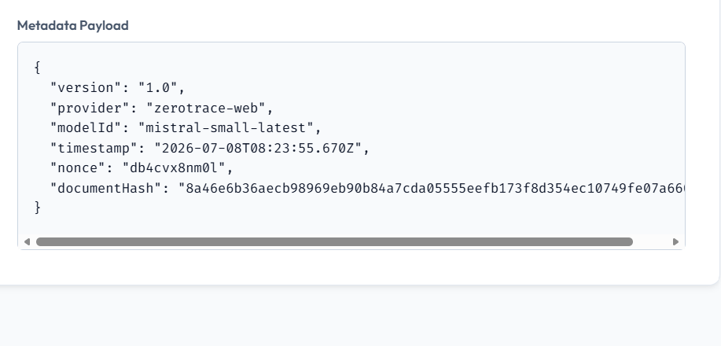
Results / Observations

Slide 10
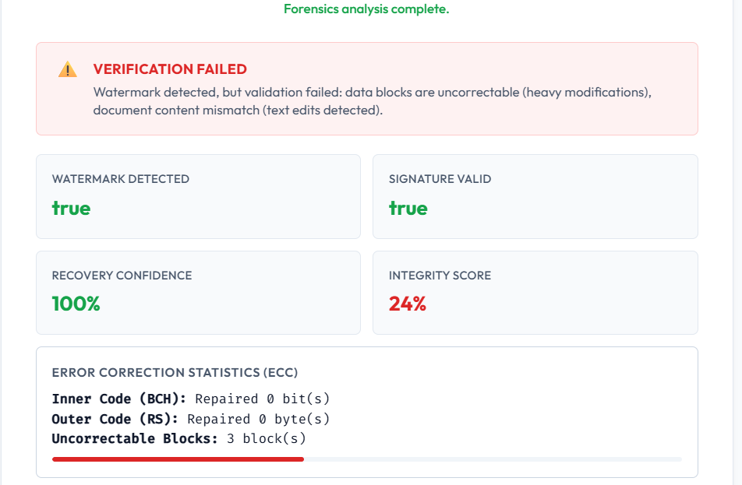
Results / Observations

Slide 11
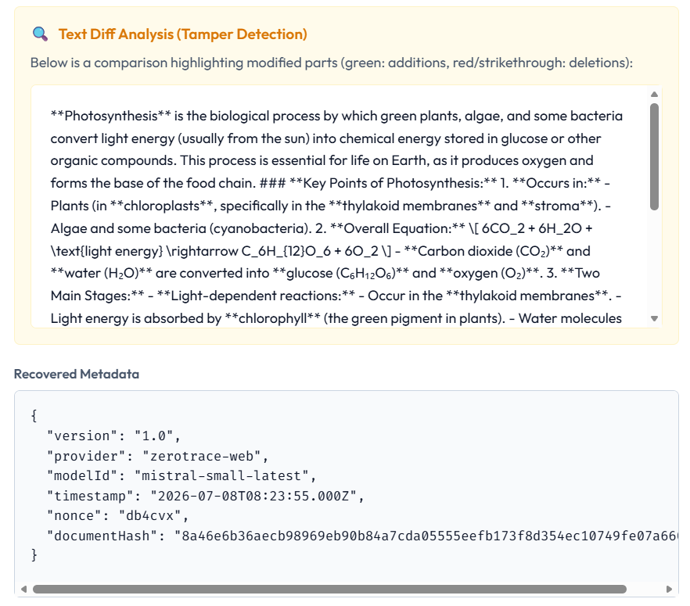
Results / Observations

Slide 12
Future Scope
Adaptive Parity Scaling: Dynamically adjust ECC parity sizes based on text length to minimize overhead.
Semantic-Aware Alignment: Integrate synonym mappings during alignment to withstand paraphrasing.
Public Signature Registries: Create decentralized registries for transparent verifications.
Multi-channel Steganography: Distribute bits across multiple invisible unicode character channels.

