Slide 1
LENDING CLUB CASE STUDY SUBMISSION
M.PHANEESHWAR
(ML & AI)

Slide 2
Problem Statement
Lending company is the largest online loan marketplace, facilitating personal loans, business loans and financial of medical procedures
Lending Company wants to identify the risky loans which have higher probability of defaults by considering the demographic variables and loan characteristics
Lending Company should make decision for approval of loans which involve two types of risks:
If the applicant is likely to repay the loan, then not approving the loan results in a loss of business to the company
If the applicant is not likely to repay the loan, i.e. he/she is likely to default, then approving the loan may lead to a financial loss for the company

Slide 3
PROCESS FLOW OF THE ANALYSIS
Data Understanding
Data Cleaning
Univariate Analysis
Segmented
Univariate Analysis
Bivariate Analysis
Recommendations
Studying the provided Data Dictionary to gain knowledge over the given columns and their importance in the domain
Cleaning the data to remove any unnecessary rows/columns. Treating the null values by either dropping or imputing them with appropriate values.
Exploring each variable in the dataset individually and looking at their range, central tendency of the values
Univariant analysis on various segments of variables to determine the default cases, grouping segments for easier analysis.
Considering two or more variables to a determine the default rates & correlation between variables if any exist.
Analysing all plots, graphs and insights from each analysis to lay down important recommendations for reducing the loss of business by detecting important columns which contribute to loan defaulters.

Slide 4
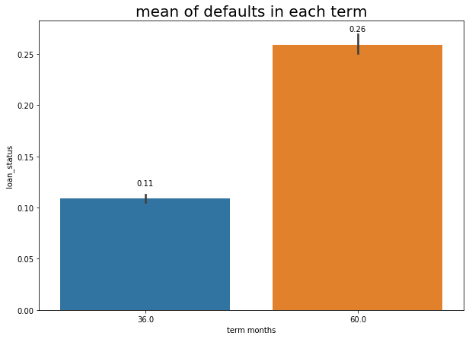
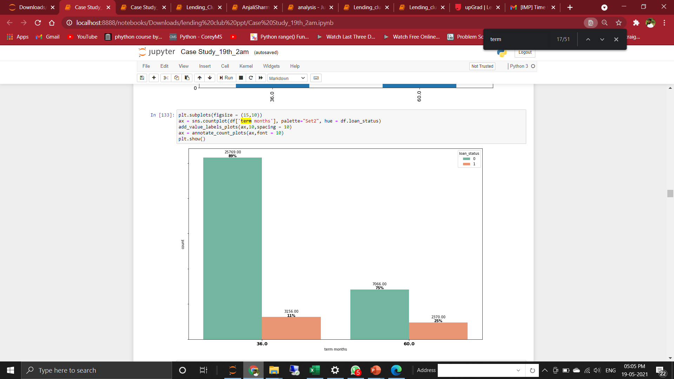
Term of loan
Driver Variables
The loans are provided with two loan repayment terms (installment terms) 36 Months & 60 Months.
Loan applicants who opted for 36 months had charged off percentage around 11 %.
Loan applicants who opted for 60 months had charged off percentage around 25 %.
It is evident that in terms of charged off percentage 60 Months loan applications are more prone to default.

Slide 5
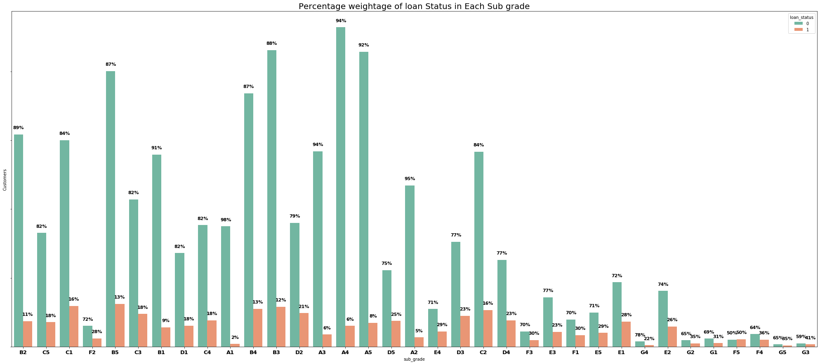
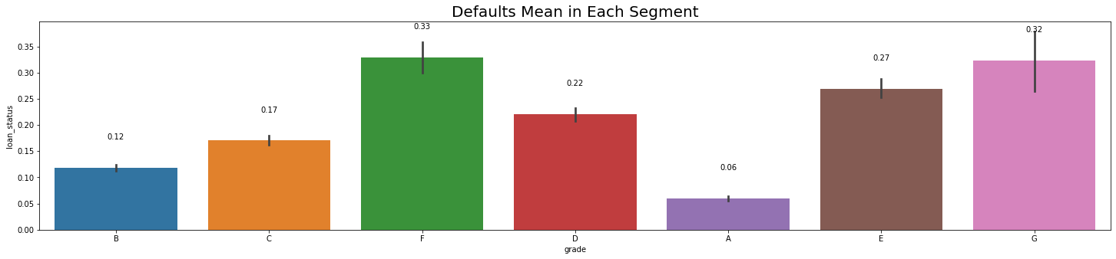
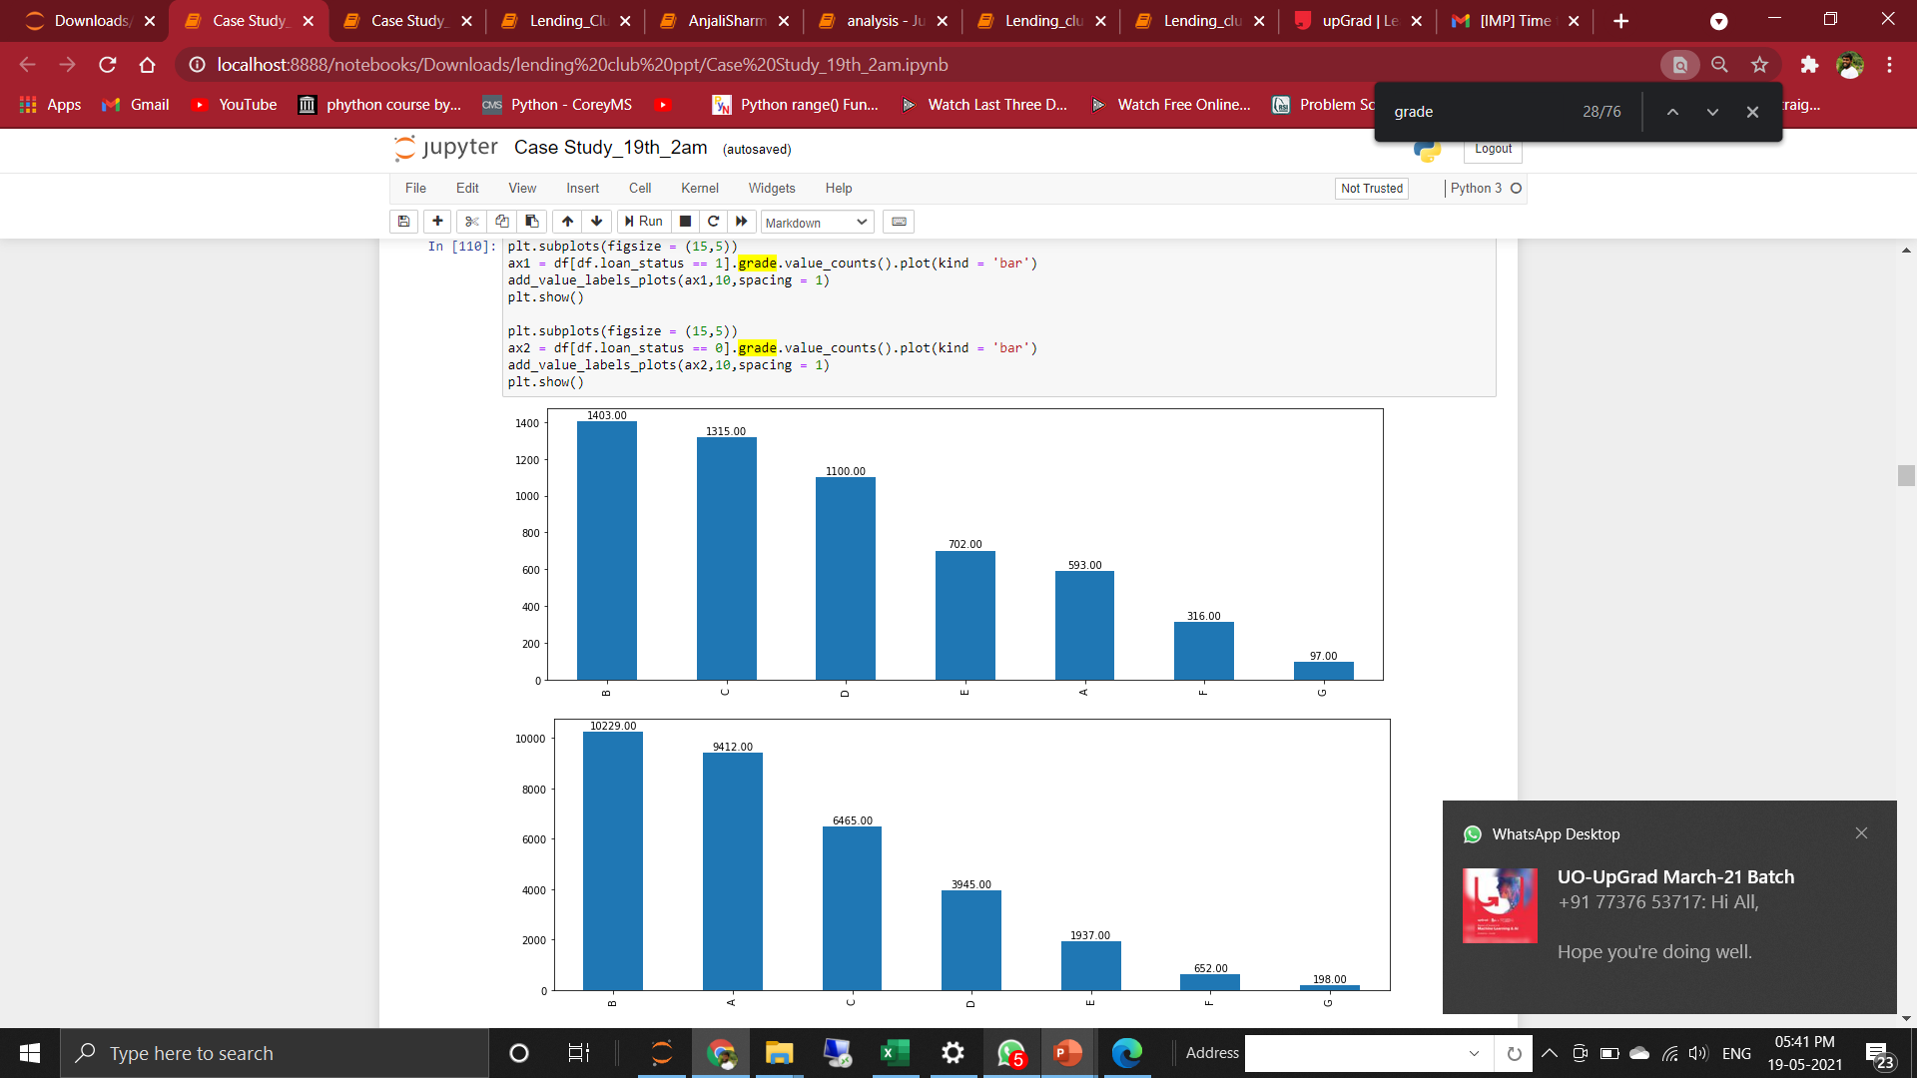
Grade
Driver Variables
The best Grade being A is very likely to reply the loan and all the latter grades being successively bad with almost incremental percentage of being Charged off.
The top 2 Grades in terms of percentage likely to default are G & F with charged off percentage 33% each.
In terms of numbers Grades B has the highest Charged off rate
with 1403 charged off applications.
It is followed by the Grade C with second highest Charged off rate
with 1315 charged off applications.

Slide 6
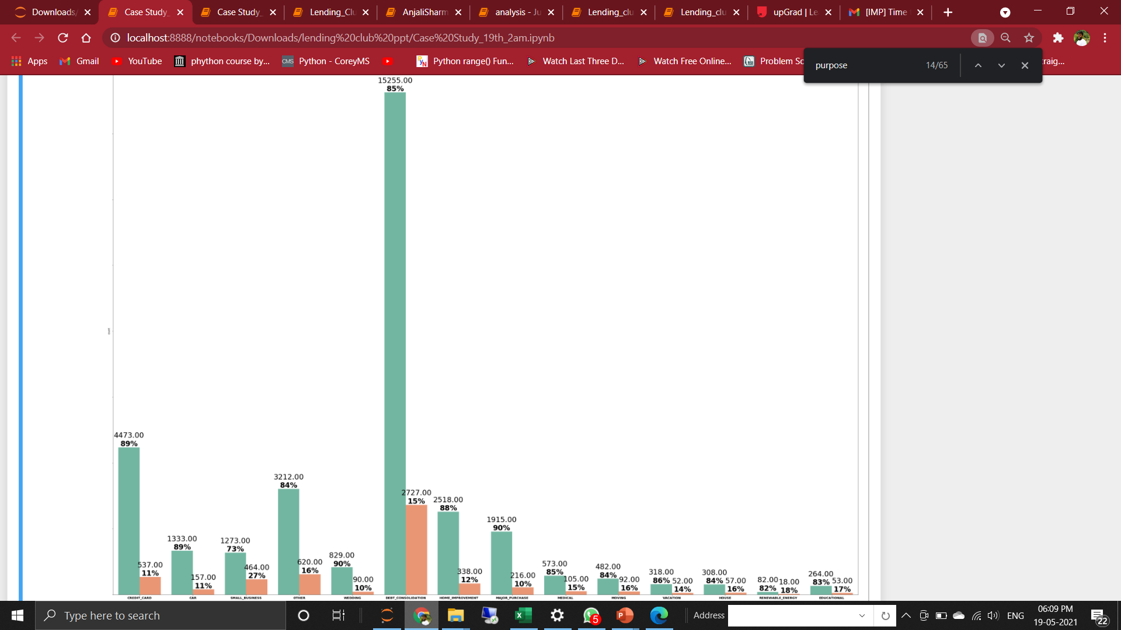
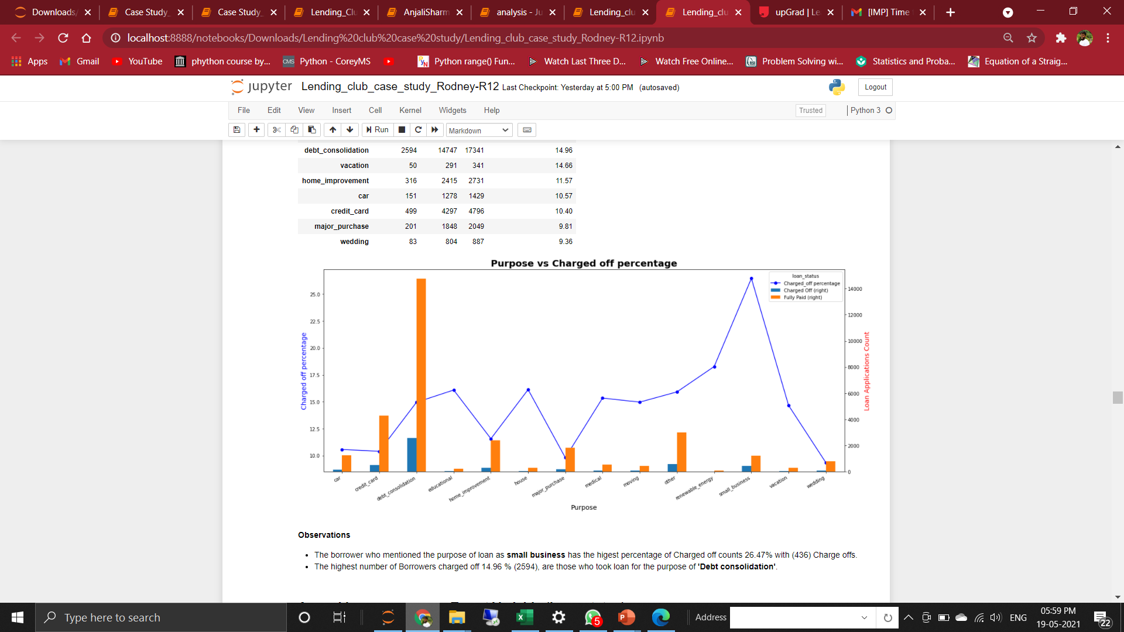
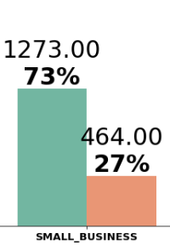
Purpose of loan
Driver Variables
15225
85 %
2727
15 %
DEBT CONSOLIDATION
The borrower who mentioned the purpose of loan as “Small Business” has the highest percentage of Charged off counts
27% with (464) Charge offS.
The highest number of charged off loan applications 2727 (15%), are those who took loan for the purpose of
“ Debt consolidation ”.

Slide 7
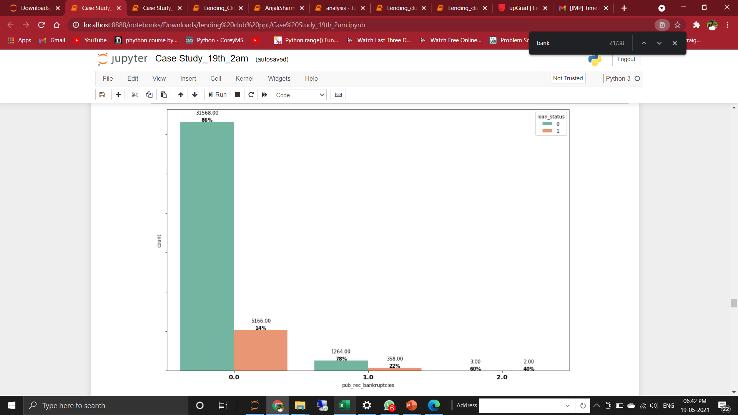
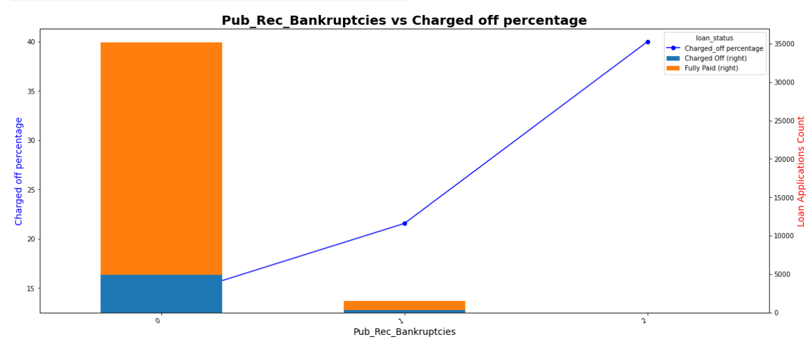
Driver Variables
Public Record Bankruptcies
Public Record Bankruptcies are the number of bankruptcies records available for public viewing.
Customers with bankruptcies equal to 1 or greater than 1 have higher chances of default rates.
The blue line in the second graph shows the increase in the percentage of charged off with increasing number of Public Record Bankruptcies (i.e) Public Record Bankruptcies and Charged off percentage are directly proportional to each other

Slide 8
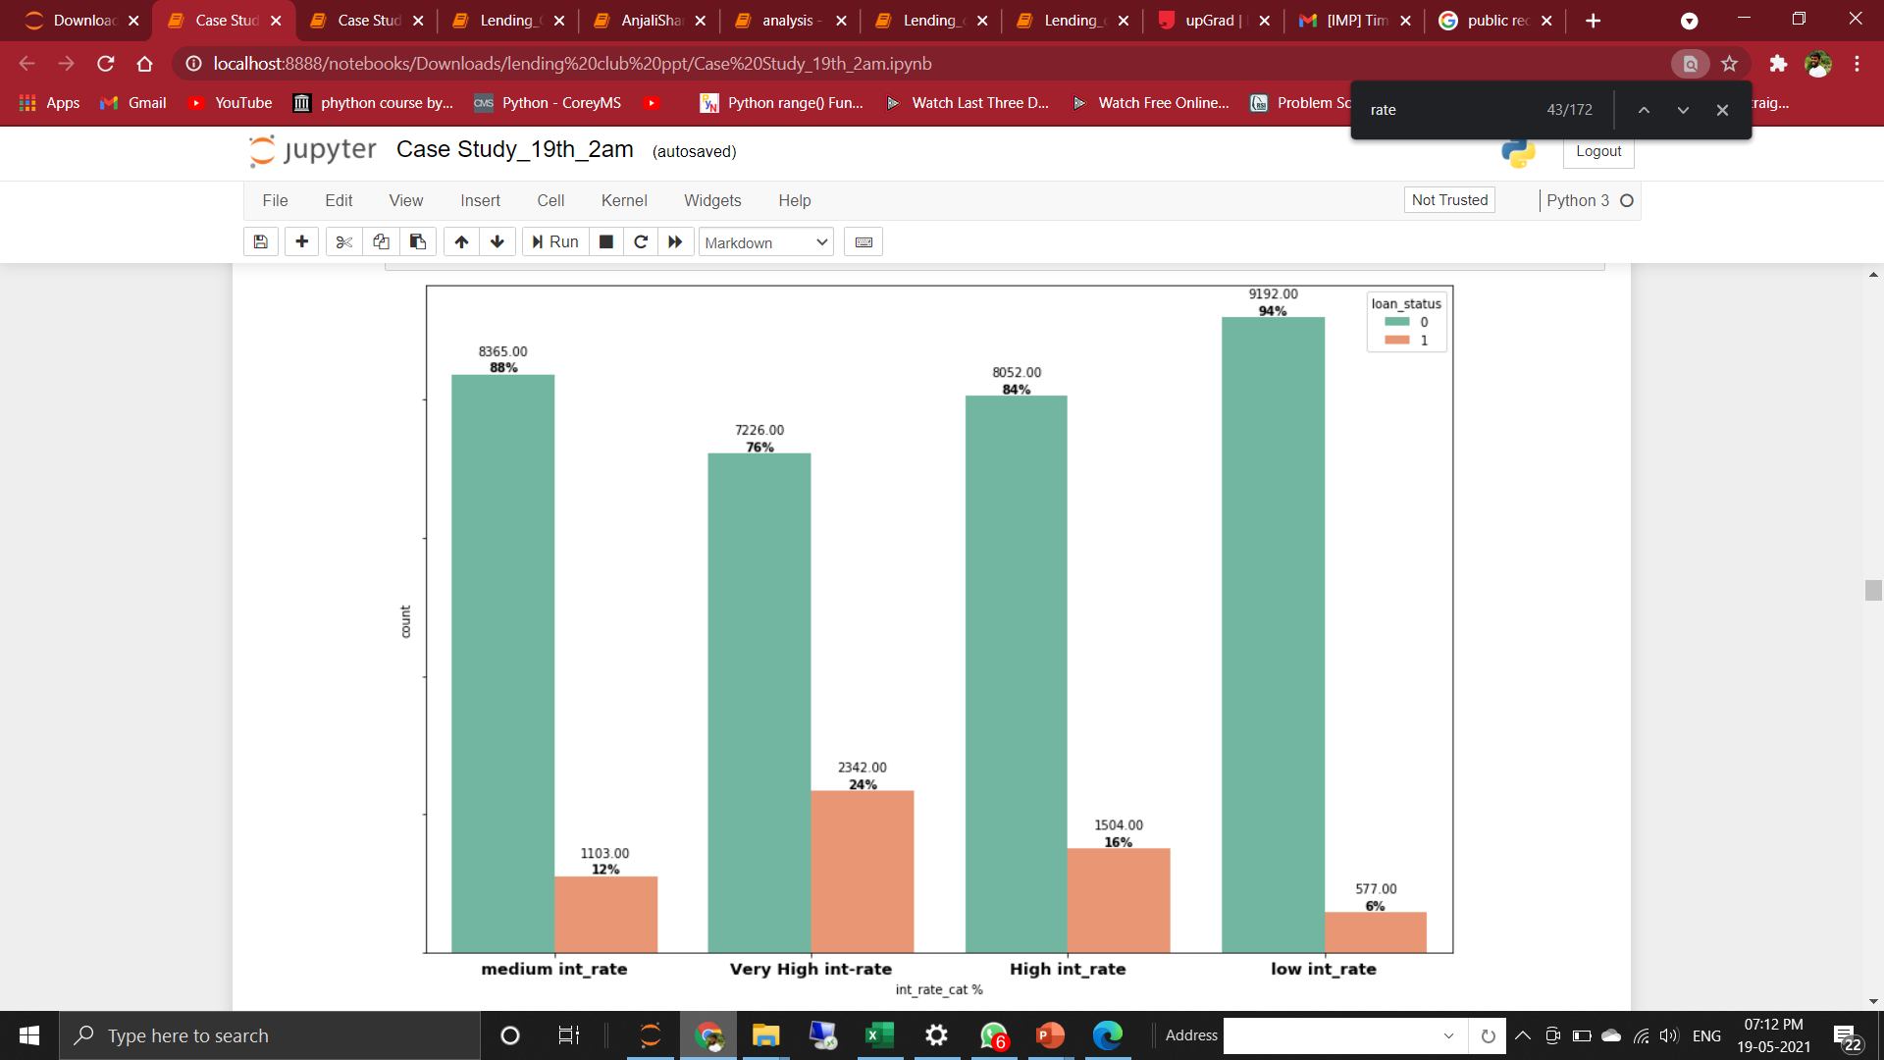
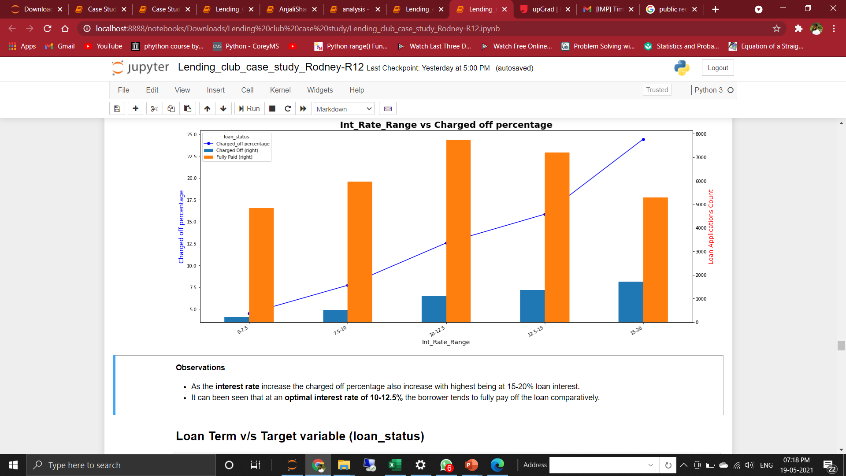
Driver Variables
Interest rate of loan
- As the interest rate increase the charged off percentage also increase with highest being at 15-20% loan interest.
- It can been seen that at an optimal interest rate of 10-12.5% the borrower tends to fully pay off the loan comparatively..

Slide 9
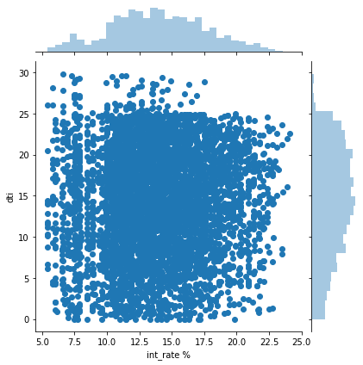
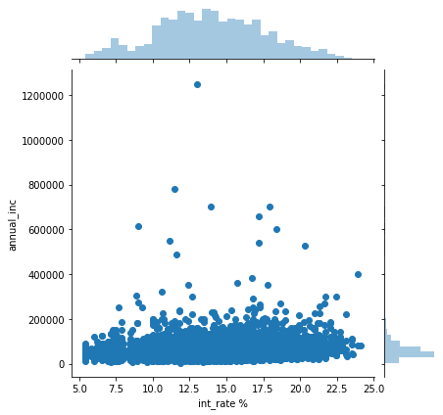
Bivariate analysis
Interest Rate & Dti
Interest Rate & annual income
It is observed from the plot that, the data points are very much denser for higher interest rates and dti rates
Lower annual income with higher interest rates have a huge amount of default cases, it is also observed from the joint plot where the data point density is higher in high interest rates and at lower income

Slide 10
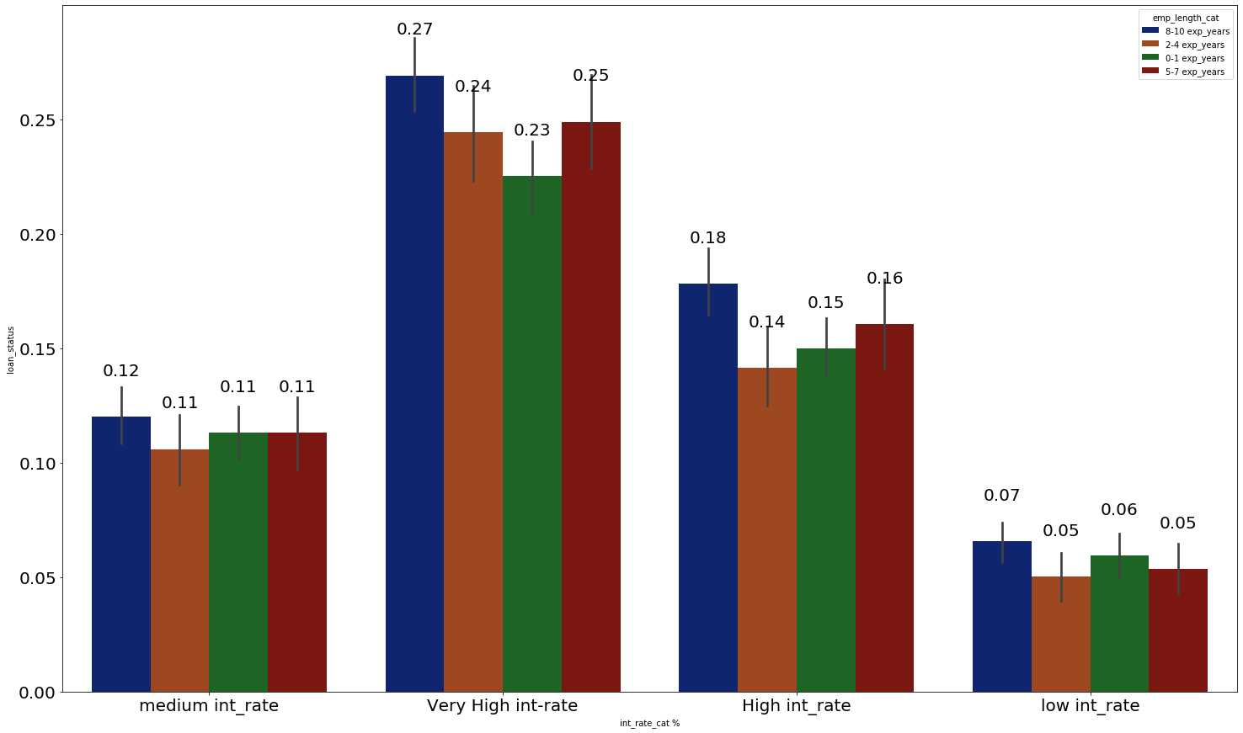
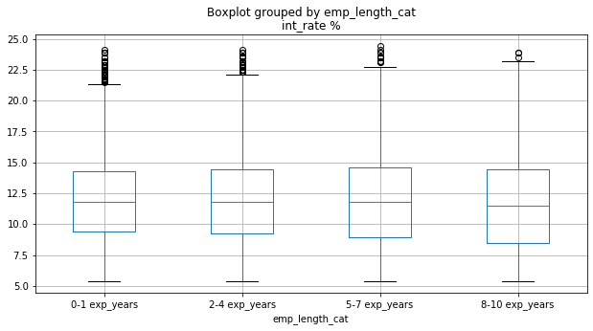
Bivariate analysis
Interest Rate & Employment Length
It was observed that as the interest rate increases the default cases are proportionally increasing.
Another important observation was made that default cases is highest for experience greater than 8 years for any interest rate
when compared to people with lesser years of employment (experience).

Slide 11
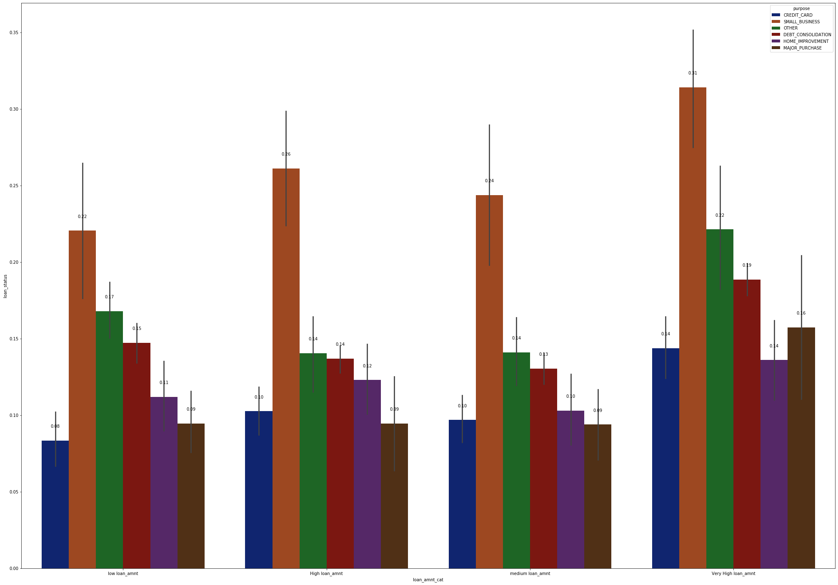
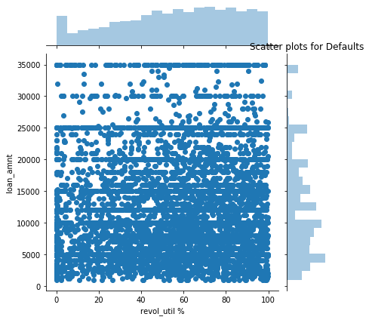
Bivariate analysis
Purpose & loan amount
Revol_util & loan amount
Small business have high default rates for any type of loan and it is also observerd in any sectors, that customers who tend to apply for huge amount of loans have high defaults
from the joint plot it is observerd that , for higher rate of revol_util the default rates is drastically high. Moreover, for higher loan amount and with lesser rate of revol_util also has high default cases. with high revol_util rate and with higher loan amount is a very risky factor

Slide 12
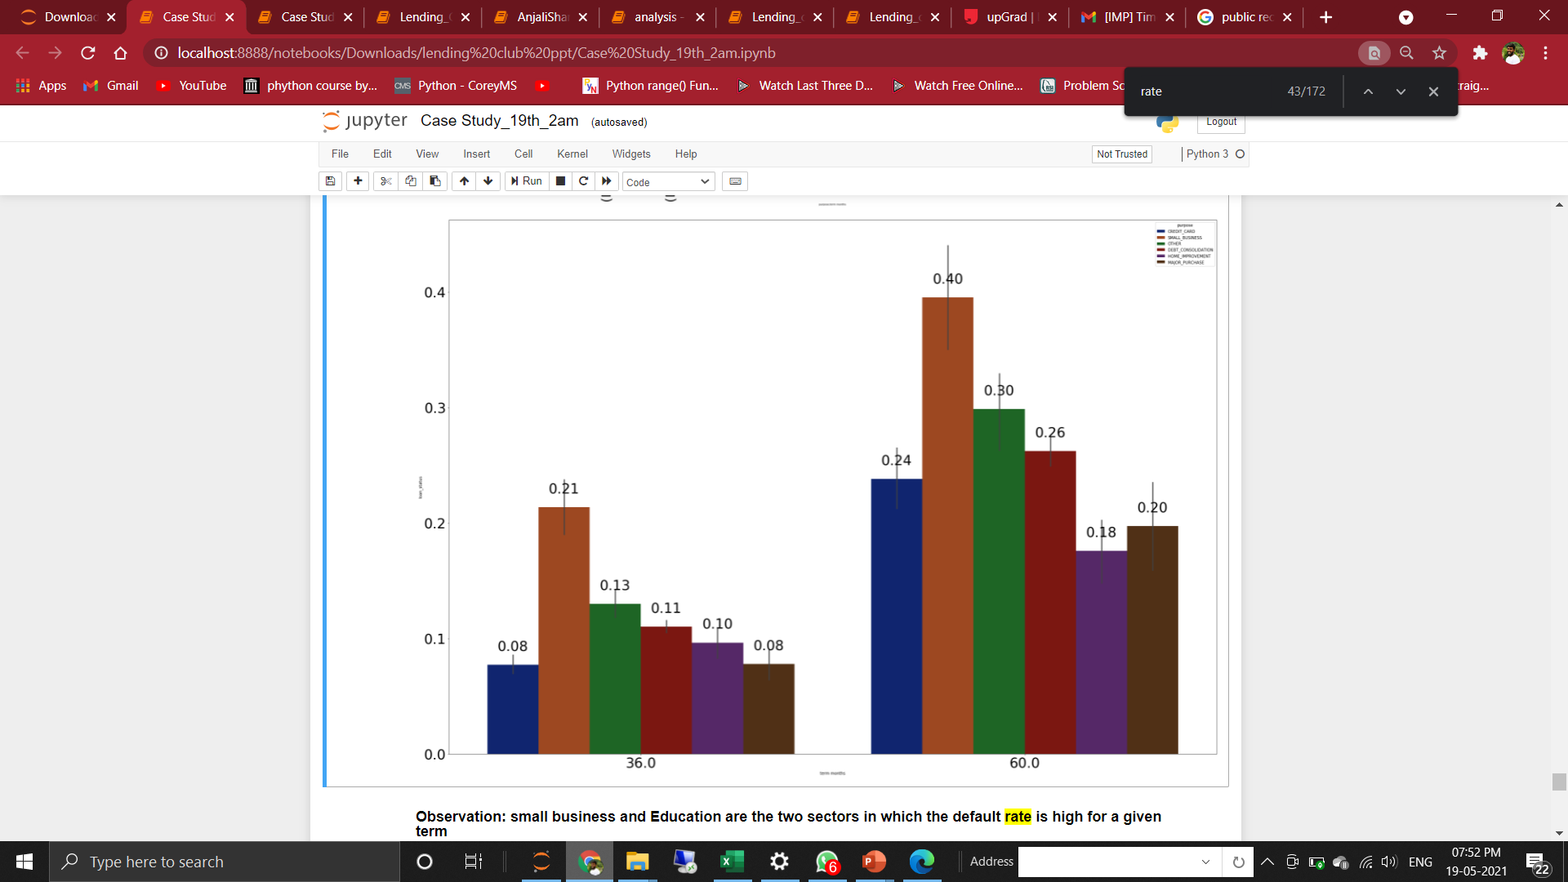
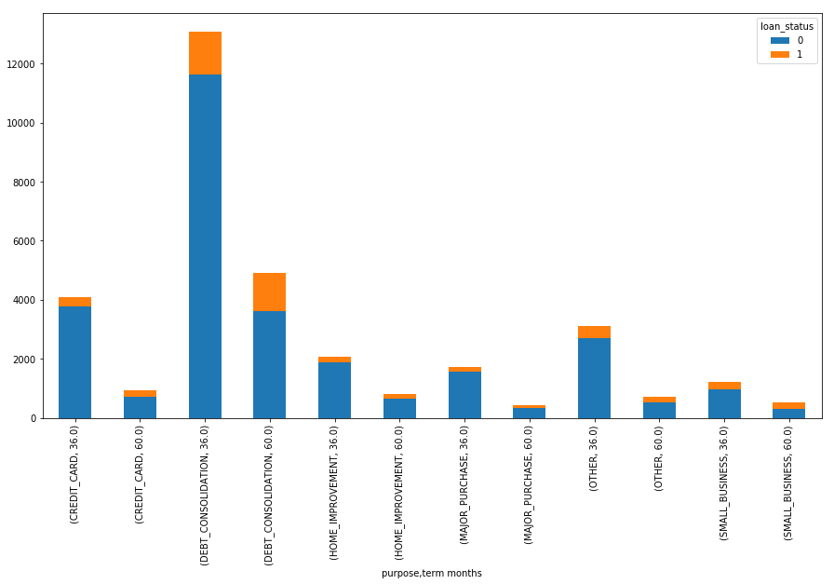
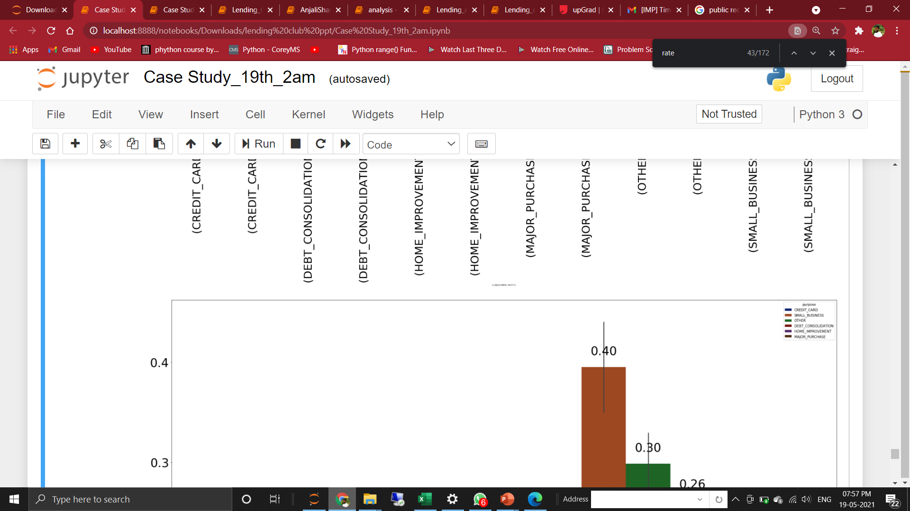
Bivariate analysis
Purpose of the loan and Term
Small business and Debt Consolidation are the two sectors in which the loan term is 60 months are prone to be Charged Off.
This can be mainly due to the high vulnerability of small businesses which is very lowly funded and highly market dependent hence very low changes of profit leads to loan default.

Slide 13
Recommendations to Lending Club
Safe Loan Applications
For Weddings, Major Purchases, Car and Credit Card purposes.
Loan amount ranging between 5,000 USD and 10,000 USD.
Annual Income of applicants more than 1,00,000 USD.
Calculated interest rate for loan less than 7.5%.
Grade A & B.
Loan applicant is owning a house.
Loans for 36 months term.
Risky Loan Applciations
Loans for purpose of Small Business.
Loans for loan amount 30,000 USD and above.
Loan applicants annual income whose annual income is less than 25000 USD.
Loans having calculated interest rate more than 15%.
Loans in grade E, F & G.
Loan applicant is either living on rent or mortgage.
Loans for 60 months term.

