Slide 1

Extension of the Lexicon Algorithm for Sarcasm Detection
Kommuri Pratap Reddy Institute Of Technology
Department Of Computer Science And Engineering
Major project
ON
Batch-18
Project Guide : Mr. M NARESH
by
RUSHALI PATANGE -18RA1A0537
CH. DIVIJA -18RA1A0510
PHANENDHAR REDDY -18RA1A0531

Slide 2
Abstract
Lexicon algorithm is used to determine the sentiment expressed by a textual content. This sentiment might be negative, neutral or positive. It is possible to be sarcastic using only positive or neutral sentiment textual contents. Hence, lexicon algorithm can be useful but yet insufficient for sarcasm detection. It is necessary to extend the lexicon algorithm in order to come out with systems that would be proven efficient for sarcasm detection on neutral and positive sentiment textual contents. In this paper, two sarcasm analysis systems both obtained from the extension of the lexicon algorithm have been proposed for that sake. The first system consists of the combination of a lexicon algorithm and a pure sarcasm analysis algorithm. The second system consists of the combination of a lexicon algorithm and a sentiment prediction algorithm.

Slide 3
Introduction
Communication is the process of exchanging information. As time goes by, many ways and platforms of communication are being developed. Since the industrial revolution, the original way of communicating; face-to-face communication has been used as a model to develop the various ways of communicating known to date.
Transposing the principles and codes of the natural face-to-face communication to today’s online communication is a major challenge for developers.
Sarcasm is the communication practice that consists of meaning the opposite of what is said in order to mock or insult someone.
Sarcasm makes use of positive lingual contents in order to convey a negative message.

Slide 4
Different types of approaches have been developed in order to implement sarcasm detection on online communication platforms.
However the levels of efficiency of these approaches have been the principal worries of developers.
In this paper, propositions are made on how the lexicon algorithm can be extended in order to come out with systems that would be proven more efficient for sarcasm detection on textual contents.

Slide 5
Literature Survey
A literature survey in a project is that,
Sarcasm is a form of irony or satire that inverts the sentiment of a post or remark, often in the form of a positive surface sentiment with a negative intended sentiment.
While common, as it is used for both humor and criticism over social media, sarcasm is often missed by the reader, or listener.
This missed sarcasm leads to confusion as the speaker’s words are seen to support the surface sentiment instead of inverting it.
For the purposes of this research, the emphasis of sarcasm detection is on detecting deliberate polarity inversion between the surface and intended sentiments.

Slide 6
While the positive surface sentiment with negative intended sentiment variant is the most common variant and some studies exclusively identify this variant, creating a unified way of detecting both of the opposing sentiment variants would be more efficient.
After all, determining the intended sentiment is the goal, regardless of polarity, as using the intended sentiment is essential to reduce error in sentiment analysis and opinion mining.
Thus, sarcasm shall be defined as a statement deliberately composed to have an opposing surface or literal sentiment to its intended sentiment used intentionally to criticize, praise or evoke humor.

Slide 7
Existing Systems
Lexicon algorithm makes use of a sentiment lexicon. A sentiment lexicon is a collection of known and precompiled sentiment terms. Lexicon algorithm computes the polarity of each term in a textual content in order to deduce the sentiment expressed through that textual content. This sentiment can either be negative, neutral or positive. However, lexicon algorithm is insufficient for sarcasm detection as it limits itself to give the polarity of a textual content without being able to specify whether that textual content is a sarcastic one or not.
Disadvantages of Existing Systems:
It is necessary to extend the lexicon algorithm in order to come out with systems that would be proven efficient for sarcasm detection on neutral and positive sentiment textual contents.

Slide 8
Proposed Systems
In this paper, the lexicon algorithm has been extended in two ways so as to generate two systems that could be more efficient for sarcasm analysis, especially on neutral and positive sentiment textual contents.
First system:
The first system is the combination of a lexicon algorithm and a pure sarcasm analysis algorithm. This system takes textual contents as input. These contents could be from various social media platforms like Twitter or Facebook.
Second system:
The second system is the combination of a lexicon algorithm and a sentiment prediction algorithm.

Slide 9
The lexicon algorithm is used here the same way as in the first system.
The sentiment prediction algorithm consists of a mechanism that can predict the sentiment of a textual content that would be made under a specific environment.
Advantages of Proposed System:
The sentiment prediction algorithm processes these details and predicts the sentiment of the textual content that would be formed under that environment.
The results from both the algorithms are compared.
In Case the results are different for a textual content, this later is classified as sarcastic else it is classified as non-sarcastic

Slide 10
System Requirements
Software Requirements
Hardware Requirements
Operating System: Windows 10.
Python 3.7.4.
Anaconda Software.
RAM: 8GB.
Hard-disk:500GB.

Slide 11
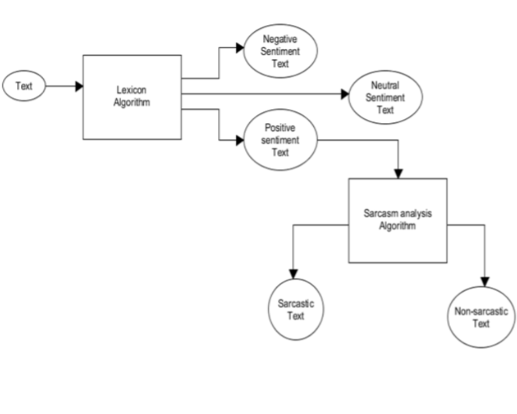
System Architecture
There are total two blocks for the project.
First Block:

Slide 12
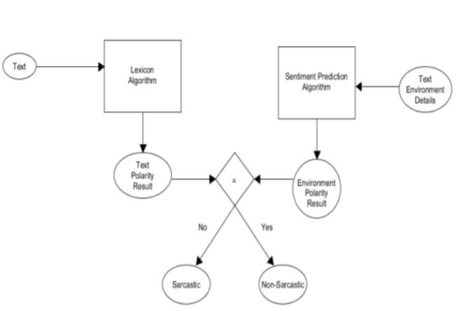
Second Block:

Slide 13
These environment details are processed based on a training data set that was formed as follow:
Each environment detail had a polarity. The polarity could be negative, neutral or positive. An AND operation was performed in between the details polarities of each textual content environment to predict the sentiment of the textual content that would be made under each environment.
The training data set of the sentiment prediction algorithm was formed of the environment details polarities and their predicted sentiment.

Slide 14
Project Structure and Implementation
Structure of Algorithm:
All the algorithms used in this paper have been derived from the classic Naïve Bayes algorithm. Naïve Bayes algorithm was named after Rev. Thomas Bayes.
This algorithm makes use of conditional probability to predict the likeness of future occurrence of events based on their historical information.

Slide 15
Project Implementation:
To implement this project we are using VADER(Valence Aware Dictionary and Sentiment Reasoner) sentiment API from python which is built on Naïve Bayes algorithm. Using this API we can calculate polarity from sentences. All tweets used in this project for testing is saved inside dataset folder.
VADER is a lexicon and rule-based sentiment analysis tool that is specifically attuned to sentiments expressed in social media, and works well on texts from other domains.
The project has been implemented with the help of two systems:
First System: In this system we calculate polarity of sentences such as positive polarity, negative polarity and neutral polarity and then calculate sarcastic by checking positive polarity.

Slide 16
If positive and neutral polarity is high and contains some negative words in messages then it will consider as sarcastic otherwise non-sarcastic.
Take below example sentence/tweet:
‘Mark Zuckerberg used to be a hero of the digital age, but now he has lived long enough to see himself become the villain’
In above sentence person saying hero to Mark Zuckerberg in one sentence and in other sentence proving him villain.
So we can see in above positive sentence user is giving some negativity or using insulting words and such tweets/messages consider as sarcastic.
Second System: In second module we will calculate sentiments from sentences and if sentence is positive or neutral and if positive sentence contains negative words then display/predict sentence as positive with sarcasm else positive without sarcasm.

Slide 17
UML Diagrams
UML stands for Unified Modeling Language.
UML is a standardized general-purpose modeling language in the field of object-oriented software engineering.
The standard is managed, and was created by, the Object Management Group.
The goal is for UML to become a common language for creating models of object oriented computer software.
In its current form UML is comprised of two major components: a Meta-model and a notation.

Slide 18
The UML represents a collection of best engineering practices that have proven successful in the modeling of large and complex systems.
The UML is a very important part of developing objects oriented software and the software development process. The UML uses mostly graphical notations to express the design of software projects.

Slide 19
USE CASE DIAGRAM:
A use case diagram in the Unified Modeling Language (UML) is a type of behavioral diagram defined by and created from a Use-case analysis.
Its purpose is to present a graphical overview of the functionality provided by a system in terms of actors, their goals (represented as use cases), and any dependencies between those use cases.
The main purpose of a use case diagram is to show what system functions are performed for which actor. Roles of the actors in the system can be depicted.

Slide 20
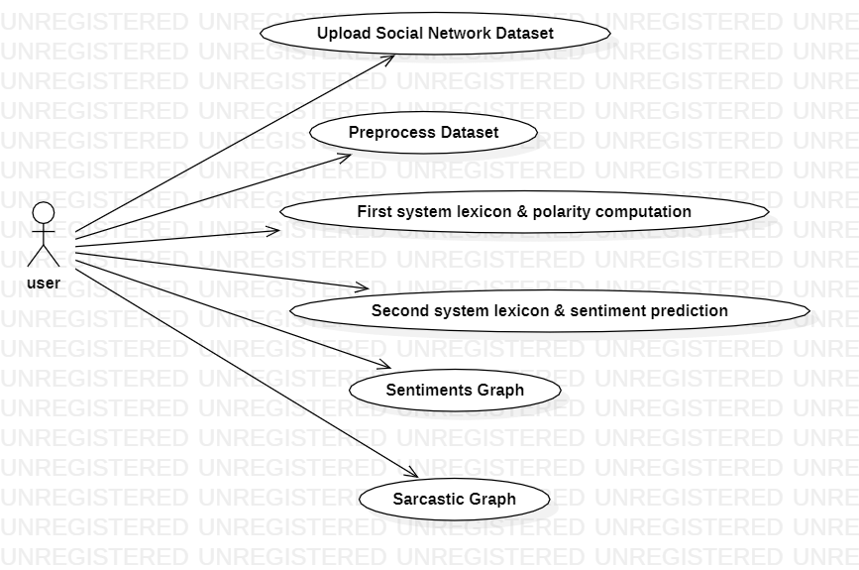

Slide 21
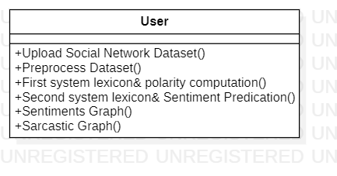
CLASS DIAGRAM:
In software engineering, a class diagram in the Unified Modeling Language (UML) is a type of static structure diagram that describes the structure of a system by showing the system's classes, their attributes, operations (or methods), and the relationships among the classes. It explains which class contains information.

Slide 22
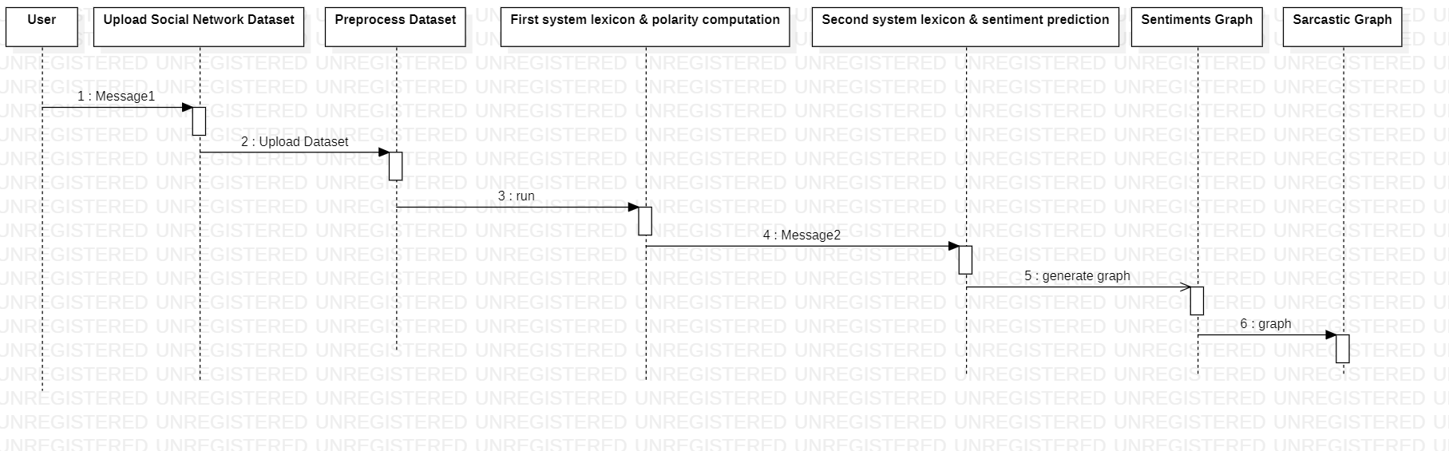
SEQUENCE DIAGRAM:
A sequence diagram in Unified Modeling Language (UML) is a kind of interaction diagram that shows how processes operate with one another and in what order. It is a construct of a Message Sequence Chart. Sequence diagrams are sometimes called event diagrams, event scenarios, and timing diagrams.

Slide 23
ACTIVITY DIAGRAM:
Activity diagrams are graphical representations of workflows of stepwise activities and actions with support for choice, iteration, and concurrency.
In the Unified Modeling Language, activity diagrams can be used to describe the business and operational step-by-step workflows of components in a system.
An activity diagram shows the overall flow of control.

Slide 24
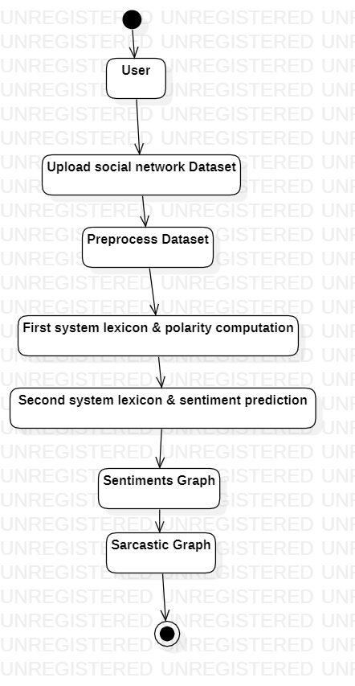

Slide 25
Pseudocode
Input: Positive Strength (P), Negative Strength (N), i =iteration
Sarc_Detector:
scorei = Pi + Ni
IF (scorei <= 0):
IF (scorei = 0):
IF (Pi != 1 AND Ni != -1):
print ("Hyperbole")
ELSE:
print ("Neutral")
ELSE:
print ("Sarcasm")
ELSE:
print ("Non-Sarcasm")

Slide 26
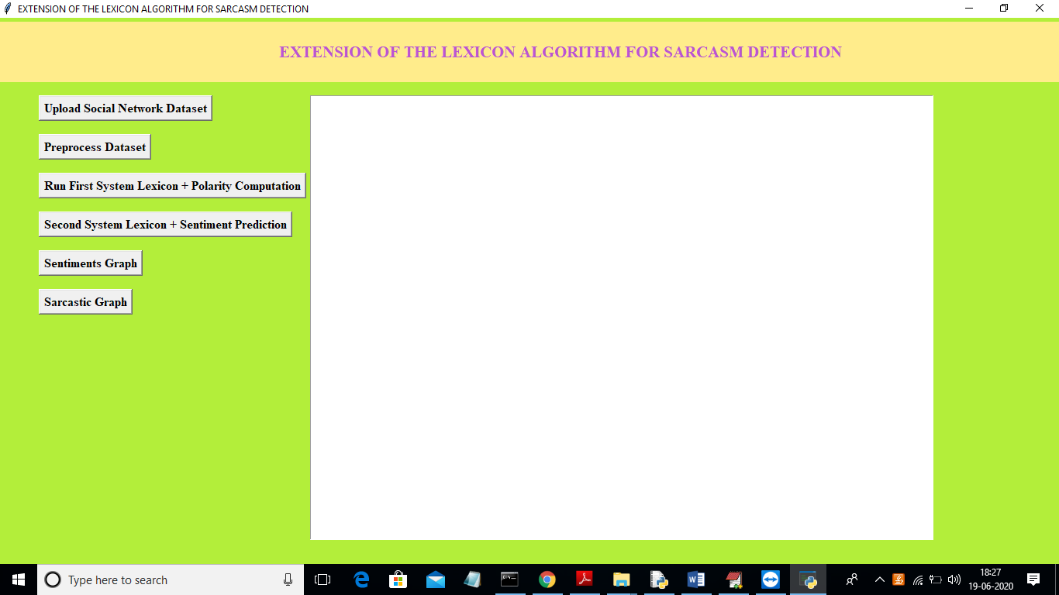
Output Screen
To run project double click on run.bat file to get below screen

Slide 27
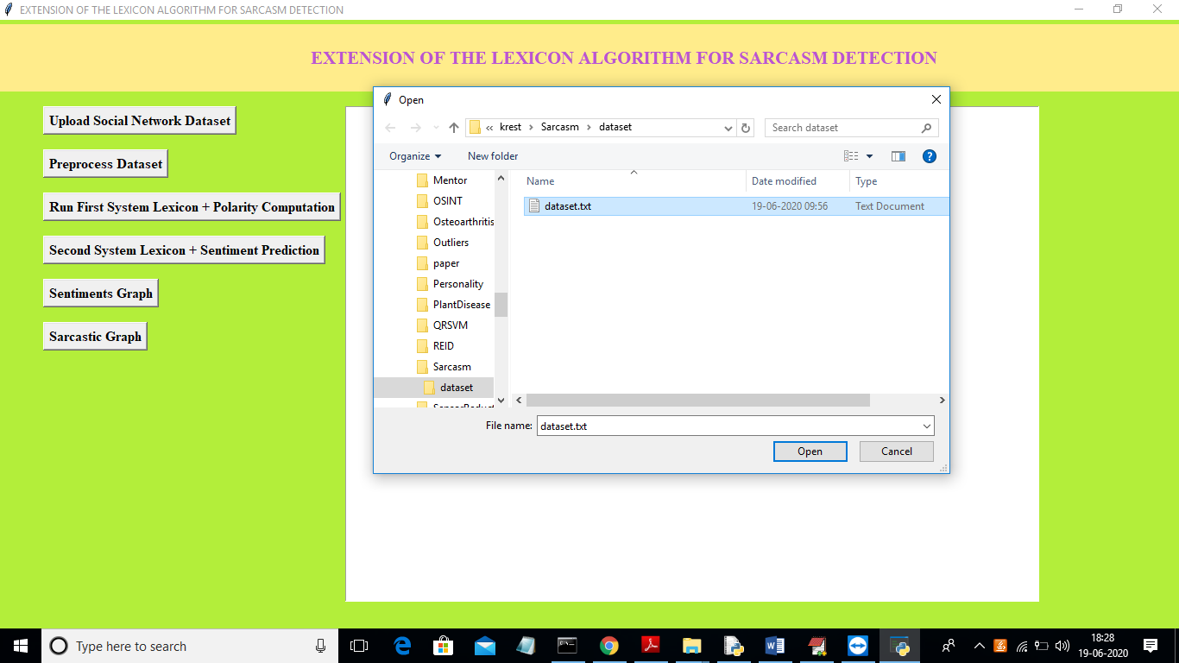
Click on ‘Upload Social Network Dataset’ button and Select the trained dataset and click on “Open” button to load dataset

Slide 28
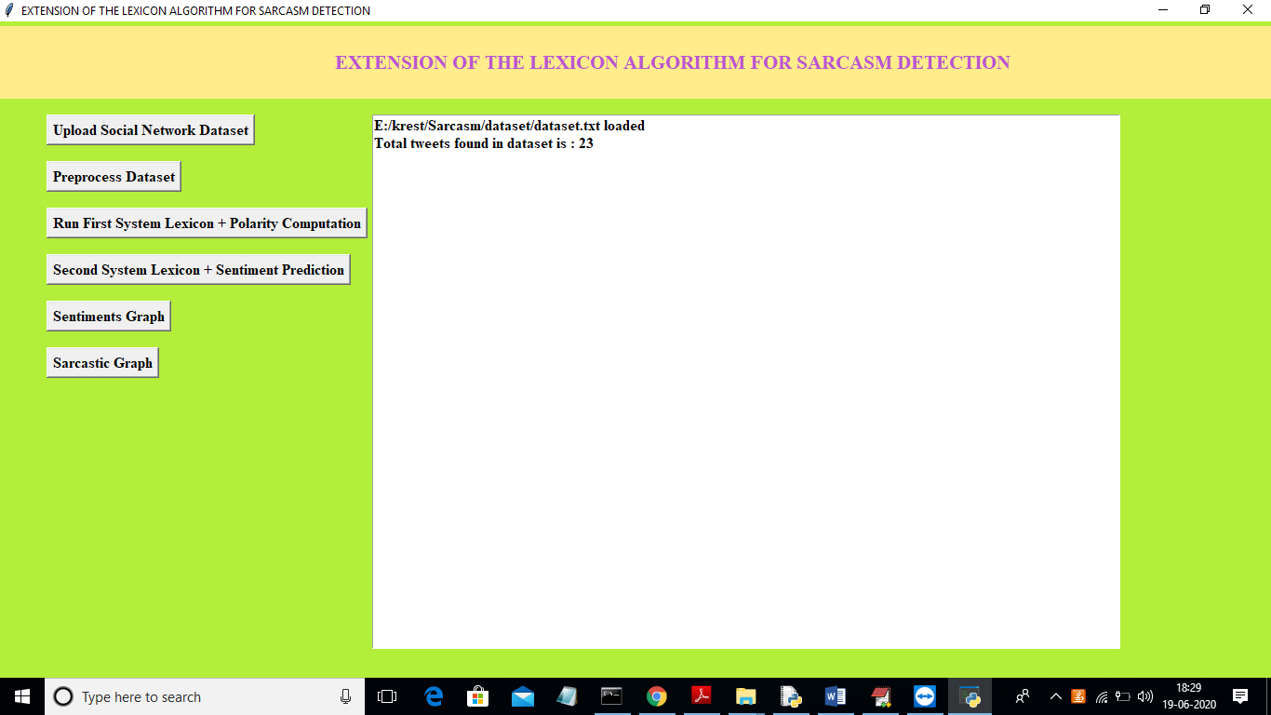
In the provided dataset 23 tweets messages found. Now click on “Preprocess Dataset” button to remove special symbols and stop words from messages.

Slide 29
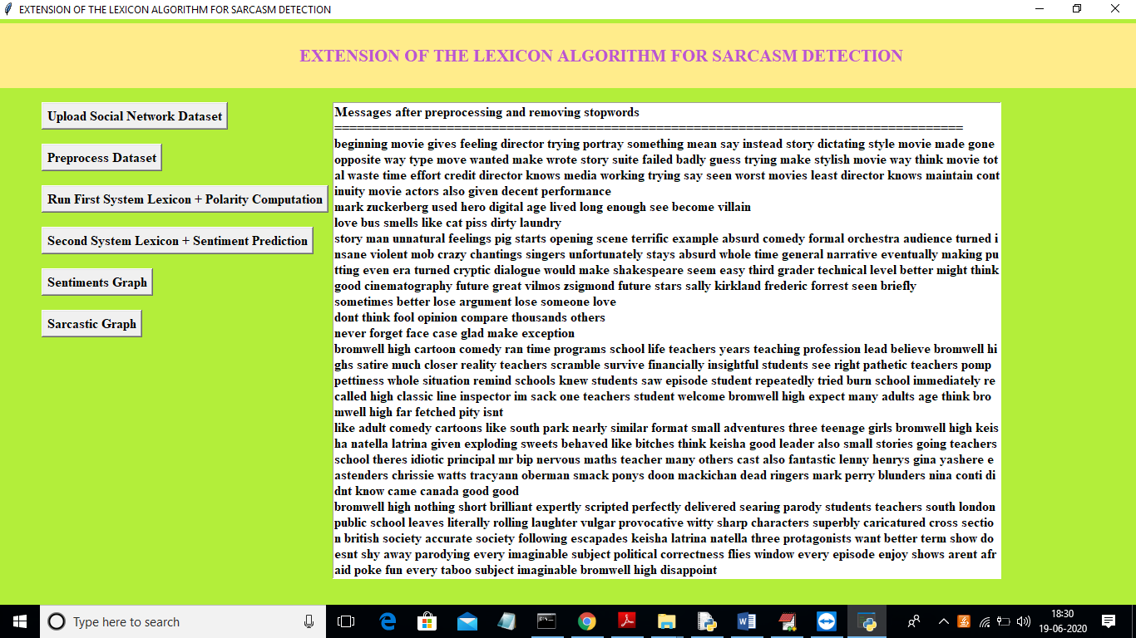
We can see all messages after removing special symbols and stop words. Now click on ‘Run First System Lexicon + Polarity Computation’ button to calculate polarity of messages

Slide 30
Here, for each message we can see tweet data and positive, negative and neutral polarity score and the message in tweets is sarcastic or non-sarcastic.
The tweets will be classified to positive, negative or neutral based on its high score for example in first tweet neutral got high score as 0.757 so tweet will consider as neutral.
If that neutral tweets contains some negative words then consider as sarcastic. You can scroll down above screen text area to see all messages details. Now click on ‘Second System Lexicon + Sentiment Prediction’ button to predict sentiments of sentences/tweets.

Slide 31
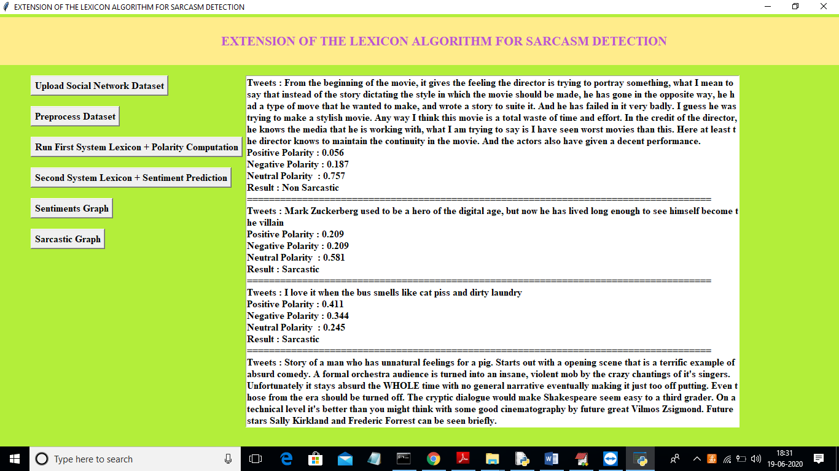

Slide 32
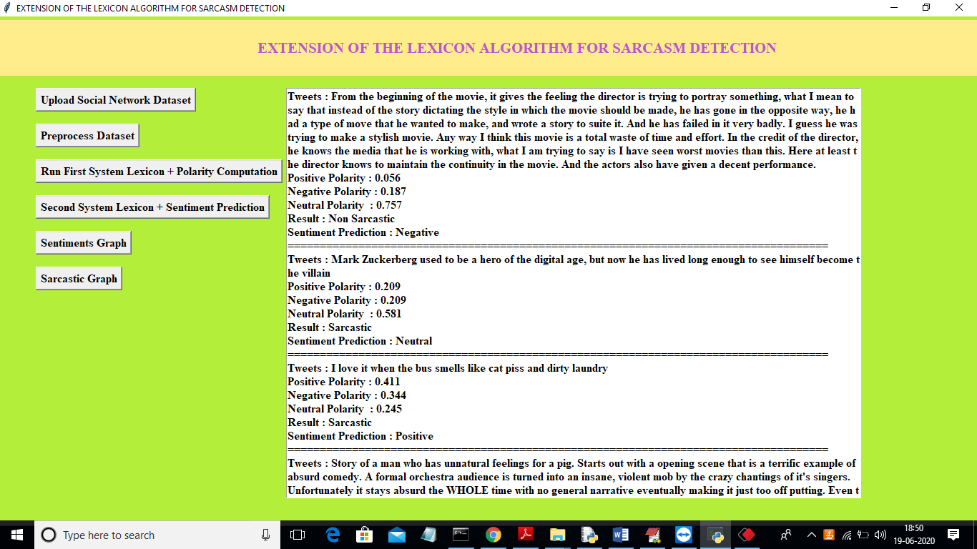
We can see same results with extra details such as whether tweet/message is positive or negtive or neutral. You can scroll down above text area to see all messages. Now click on ‘Sentiments Graph’ button to get below graph.

Slide 33
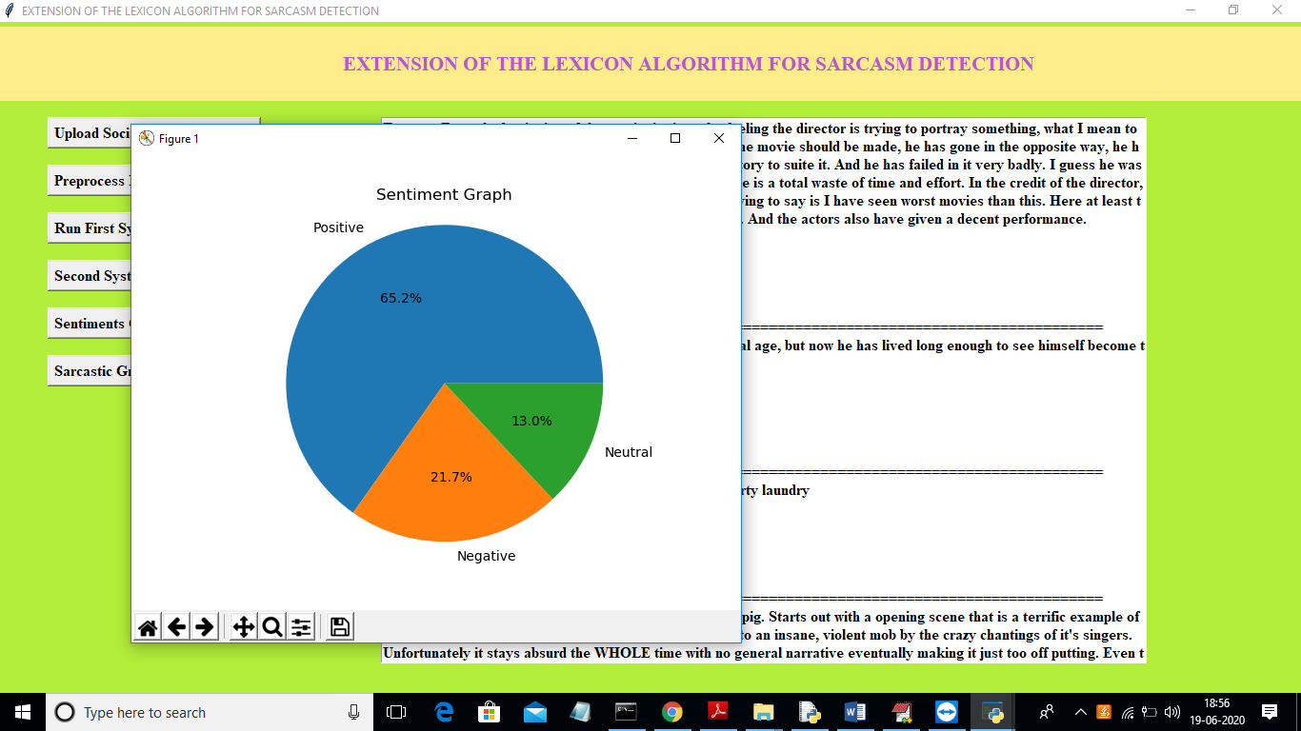
With the help of pie chart we can see percentage of positive, negative or neutral tweets. Now click on ‘Sarcastic Graph’ button to get below graph

Slide 34
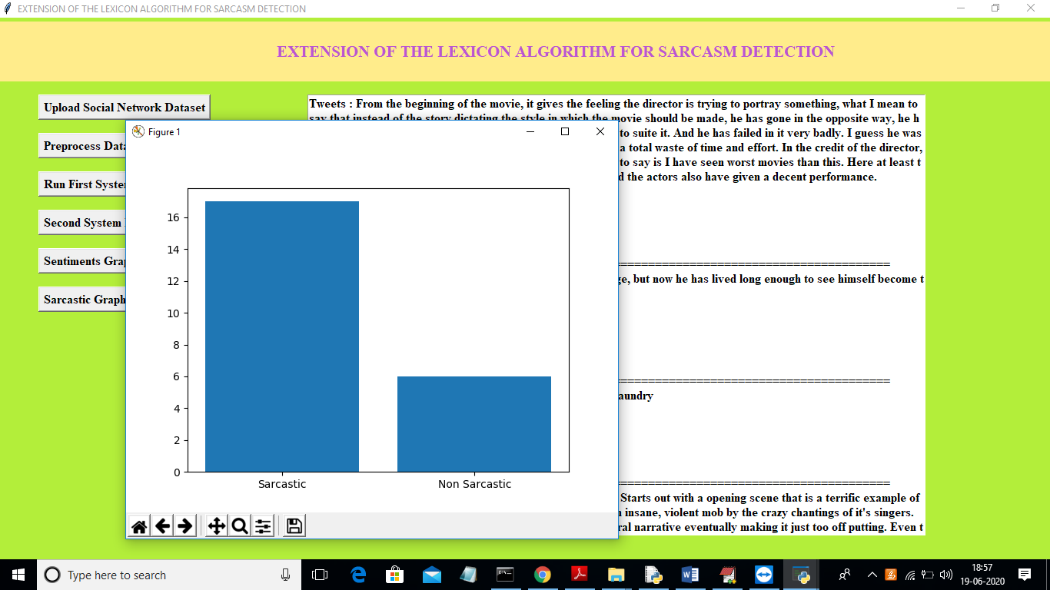
Below Graph x-axis represents type of tweets and y-axis represents count of sarcastic or non-sarcastic tweets.

Slide 35
Conclusion
Sarcasm is a very popular and common way to express negative comments or feelings about something or someone.
The Sarcasm Detection in Sentiment Analysis is still one of the most widely studied challenge in sentiment analysis.
The proposed method Lexicon based approach provides with accuracy and performance results
The different standard datasets of books or movies which may be used in experiments for recommendation systems are explored. The study reveals that a lot of improvement can still be done in content based and collaborative filtering recommendation techniques for obtaining better results

Slide 36
THANK YOU

