Slide 1

AMORY

Slide 2





LEO: longtime employees of the company. experienced. specialized in dev(mobile app)
RKO:have many years of experience in writing wed (Dev web)
BM:Long-term staff with a lot of experience and achievements. (Dew)
OIP: Fast, standard, no errors, warranty (tester)
Buffalo: Actively working to complete the job quickly, meeting the needs of customers( tester)

Slide 3
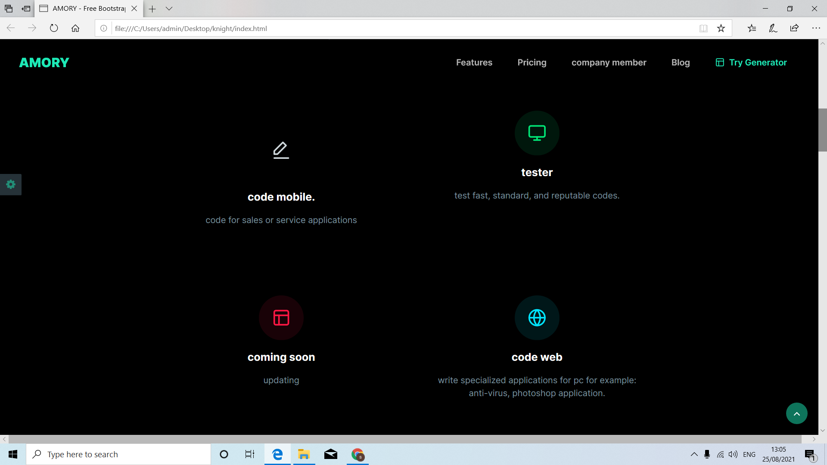
AMORY offers everything you need.

Slide 4


AMORY is more than just a page builder.
help programmers find jobs, create a large and reputable network of programmers

Slide 5
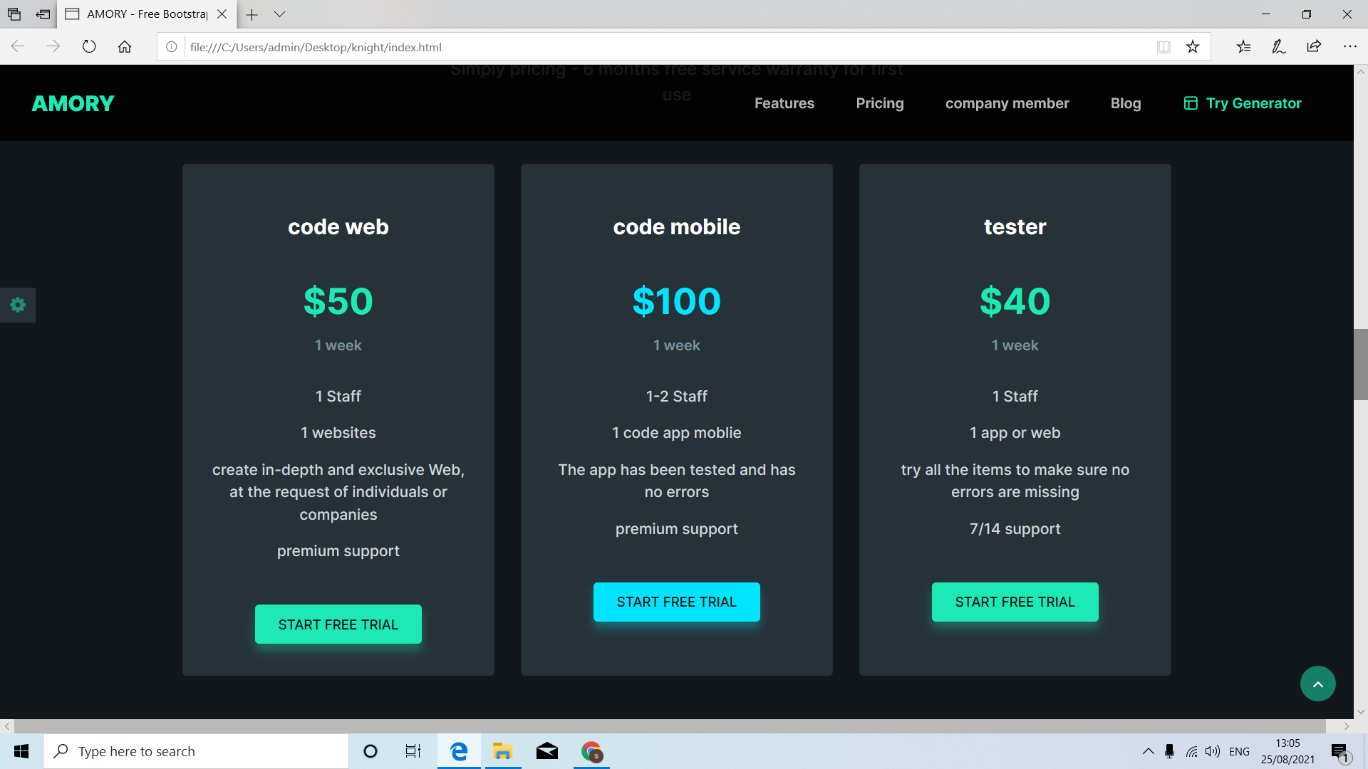
Choose service and price.
Simply pricing - 6 months free service warranty for first use

Slide 6
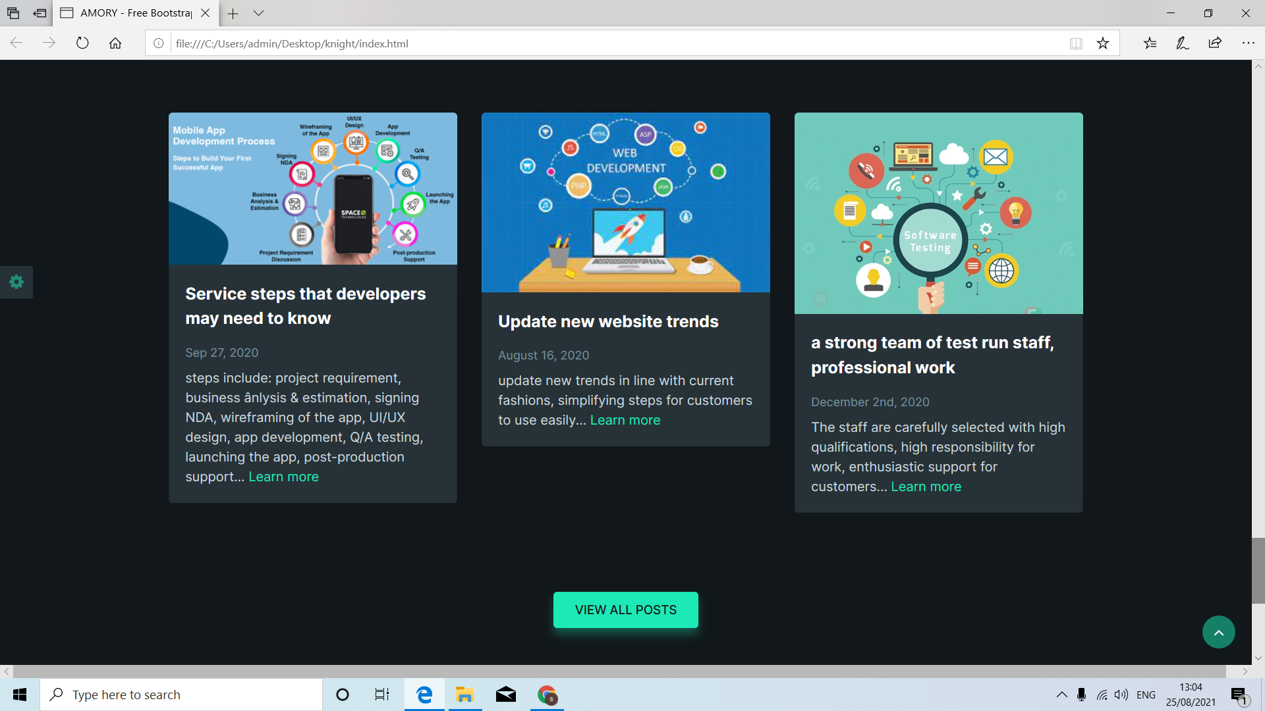
Everything is covered. warranty services of the company according to the agreement with the customer. ensure the quality of service as in the agreement
Quality service
employee performance
Mail integration
Reasonable service price
100 refund guarantee
Free unlimited support

