Slide 1
Pea Cosmestic
Cosmetics management software
Class Name: PF1118
Group Name: Group 13
Member: Đỗ Phương Anh

Slide 2

Introduction to Project
Cosmetics management software
Introduction
The sales management system will have the following basic features:
There are 2 main functions including Create Orders and Manage Products along with other functions such as viewing customer information, managing accounts, searching for products.

Slide 3

FUNTIONS OF SYSTEM
Customer Menu Sller Menu
1.Login
2. Product Management
2.1 Update Product Information
2.2 Add Product
2.3 Display Product
3. View Customer
4. Check Order
View All Order
Confirm Order
5. Log out
1. Login
2. Register
3. Search Product
4. Order
- My Order
- Create Order
5. Setting Account
6.Log Out

Slide 4
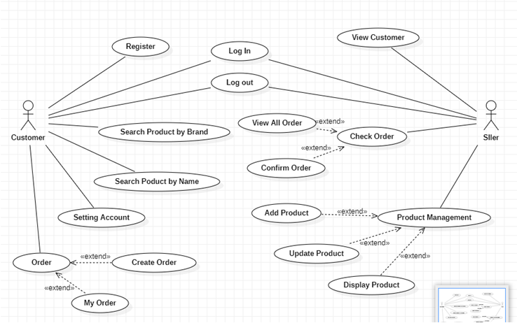
USE CASE

Slide 5
LOGIN
NAME | LOGIN
Description | Used to access the program and define the accessible features depending on the account type.
Actor | Seller and customer.
Organization Benefits | This feature was created to define the features and data that merchants and customers can access the program,.
Trigger | Login will be automatically enabled right after starting the program.
Preconditions | The correct username and password must be entered, the database must be connected, the account must exist in the database.
Postconditions | Success: the account will log into the system, the main menu of the program displays. Failed: could not login to the system.
Main course | 1. Enter UserName and Password2. Verify information3. Show main menu
Alternate Courses | AC 2.1: User entered wrong PassWord or UserName1. Display error message2. Show the login screen again3.Re-enter required
Exceptions | EX 1.1: Enter UserName and PassWord1. Display: “Your PassWord and UserName is wrong!” and ask to re-enter until correct2. Re-enter username and passwordEX 2.1:1. Step 1: Display “Error!!!Can’t connect to database”2. Check internet connections .

Slide 6
REGISTER
NAME | REGISTER
Description | Used to register an account in the system.
Actor | Customer
Organization Benefits | This feature is created so that customers can create an account in the system, from which they can use all customer functions in the system such as ordering, viewing products, changing account information, etc. account,…
Trigger | After registration, the account will immediately exist in the database.
Preconditions | It is necessary to enter the correct information required for successful account registration.
Postconditions | Success: the account will be created in the database and can be logged in immediately with that account.Failed: the account could not be added to the system.
Main course | 1. Enter FullName, UserName, PassWord, Phone, Age2. Receiving information3. Show the login screen again
Alternate Courses | AC 2.1: User enters an already existing User Name 1. Show Existing User Name 2.Re-enter request
Exceptions | EX1: Failed to connect to database 1. Request to recheck connections 2. Request to restart the program.

Slide 7
SEARCH PRODUCT
NAME | Search Product
Description | Use to search for products
Actor | Customer
Organization Benefits | Customers can search for cosmetics in the system
Trigger | Log in to the program with the customer's account and the customer can use this feature.
Preconditions | There must be at least 1 product created in the database.
Postconditions | Success: Showing the list of searched cosmeticsFailed: No valid product
Main course | 1. Enter the name of the product/cosmetic brand you want to search for2. Show list of cosmetics found
Alternate Courses | AC3: 1. The data does not exist in the database. Display: “No product you are looking for”
Exceptions | EX1: Failed to connect to database 1. Request to recheck connections 2. Request to restart the program.

Slide 8
VIEW CUSTOMER
NAME | View All Customer
Description | Use to view customer information
Actor | Seller
Organization Benefits | Seller can see all customer information
Trigger | Log in to the program with the merchant account and can use this function.
Preconditions | Must have at least one customer.
Postconditions | Success: Show all customers Failed: No display
Main course | 1.Display information of all customers
Alternate Courses
Exceptions | EX1: Failed to connect to database 1. Request to recheck connections 2. Requires a reboot

Slide 9
CREATE ORDER
NAME | Create Order
Description | Use to create orders
Actor | Customer
Organization Benefits | Customers can create orders based on the shop's products.
Trigger | Log in to the program with the customer's account and use the order function
Preconditions | There must be at least 1 product in the store
Postconditions | Success: Order has been createdFailed: Unable to create order
Main course | 1. Enter the product code, the quantity customers want to add to the order2. Valid data3. Successful order creation
Alternate Courses | AC 2.1: Invalid product number or product ID 1. Error display 2. Re-enter request
Exceptions | EX1: Failed to connect to database 1. Request to recheck connections 2. Requires a reboot

Slide 10
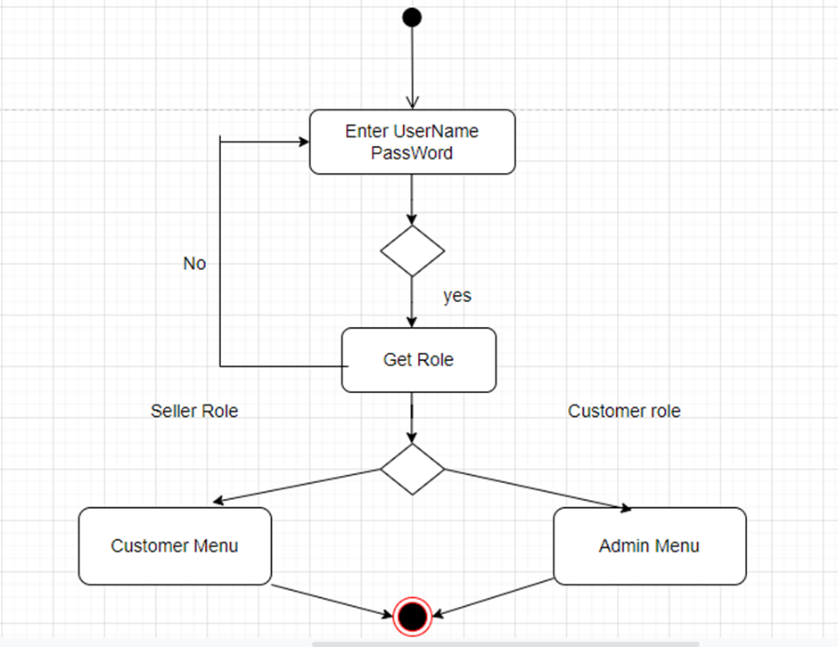
ACTIVITY DIAGRAM : LOGIN

Slide 11
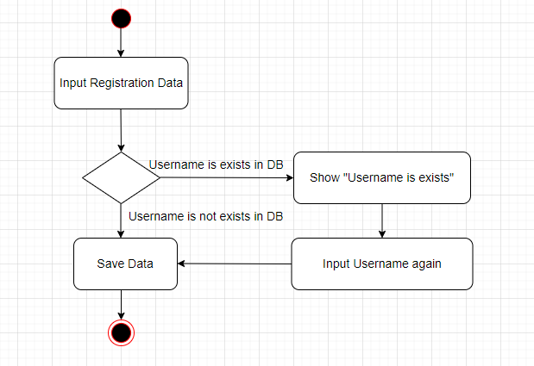
ACTIVITY DIAGRAM : REGISTER

Slide 12
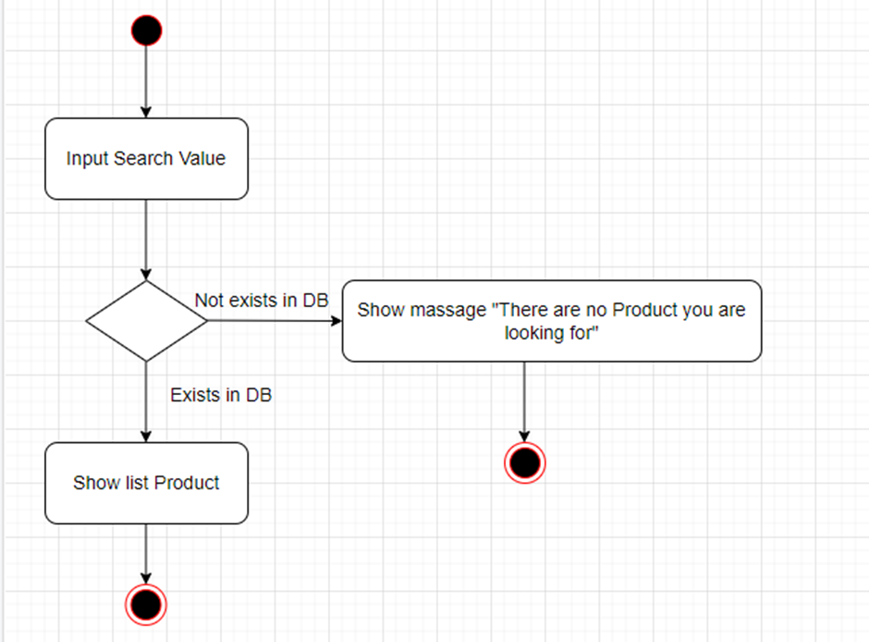
SEARCH PRODUCT

Slide 13
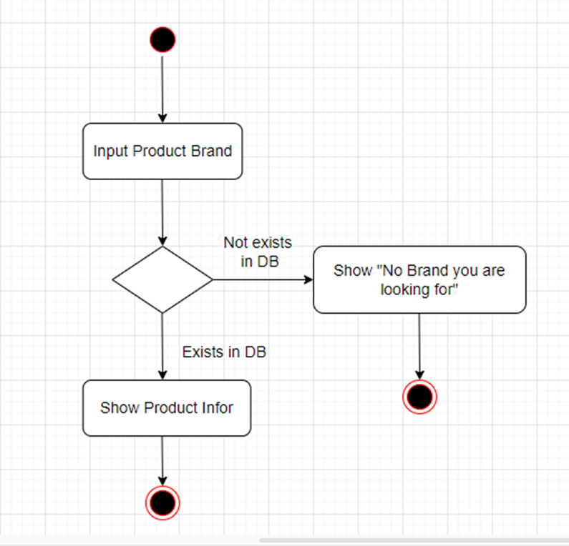
ACTIVITY DIAGRAM : SEARCH PRODUCT BY BRAND

Slide 14
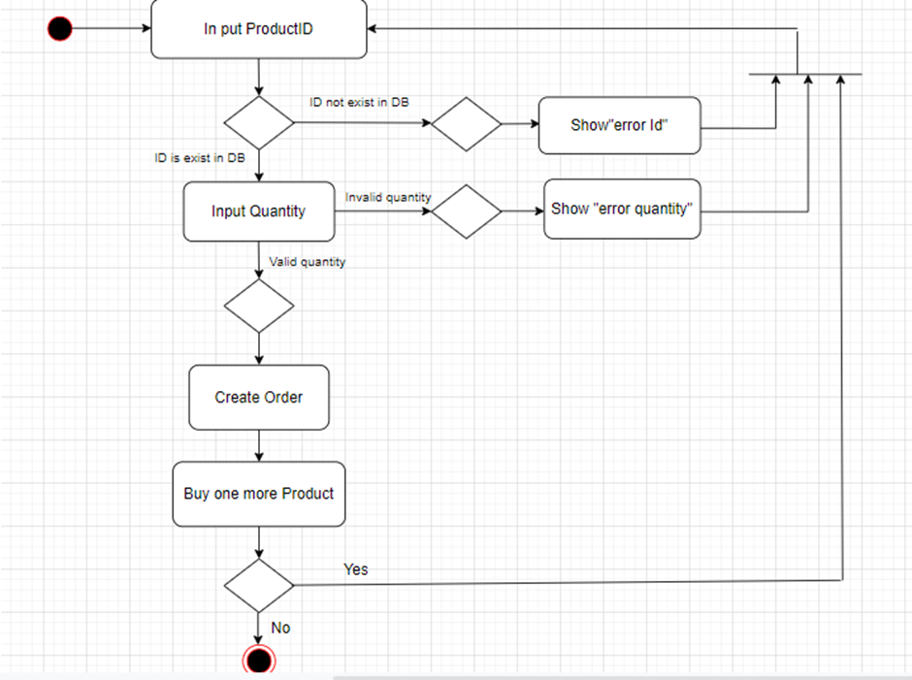
ACTIVITY DIAGRAM : LOGIN ACTIVITY DIAGRAM : ORDER

Slide 15
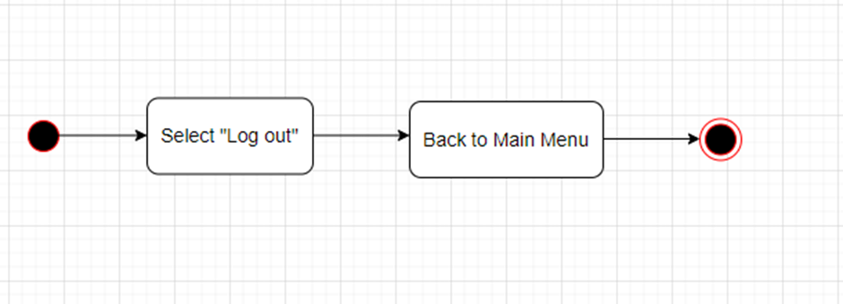
LOG OUT

Slide 16

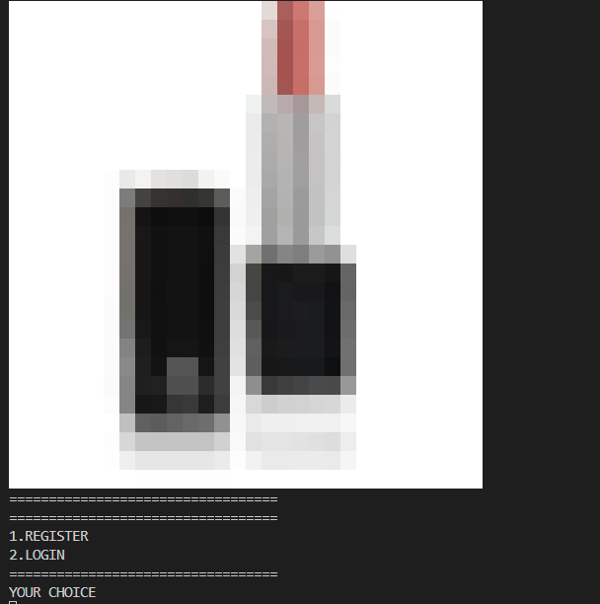
UI DESIGN:
1. MAIN MENU

Slide 17
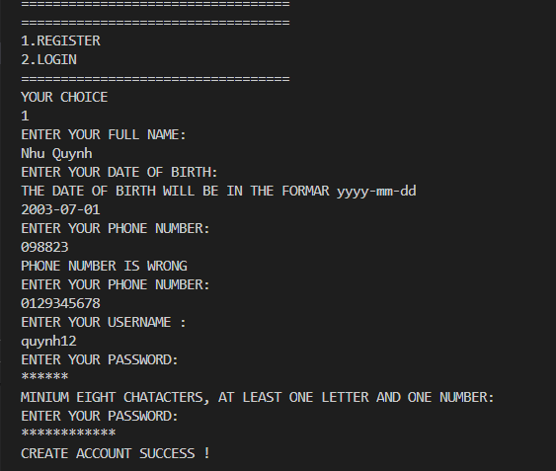
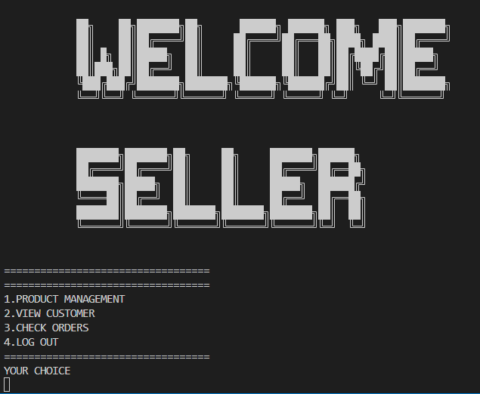
UI DESIGN
2. REGISTER
3. MENU SELLER

Slide 18
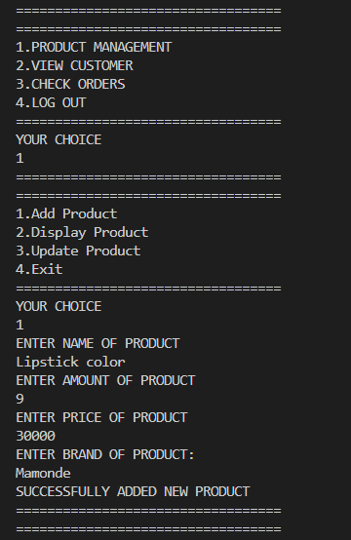
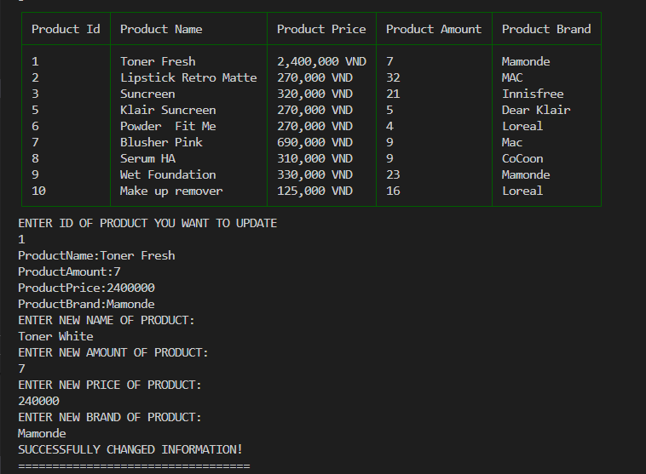
UI DESIGN
3. ADD PRODUCT
4. UPDATE PRODUCT

Slide 19
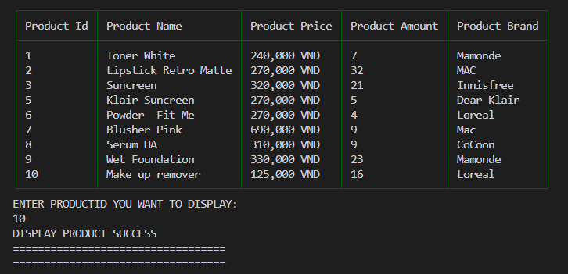
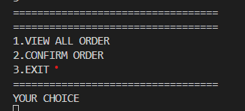
UI DESIGN
5. DISPLAY PRODUCT
6.CHECK ORDER

Slide 20
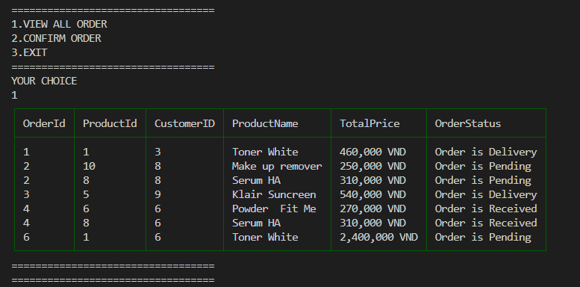
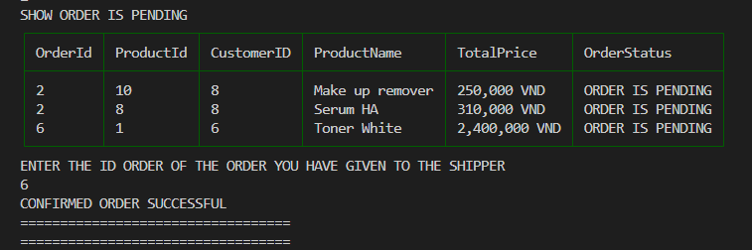
UI DESIGN
7. VIEW ALL ORDER
8. CONFIRM ORDER

Slide 21
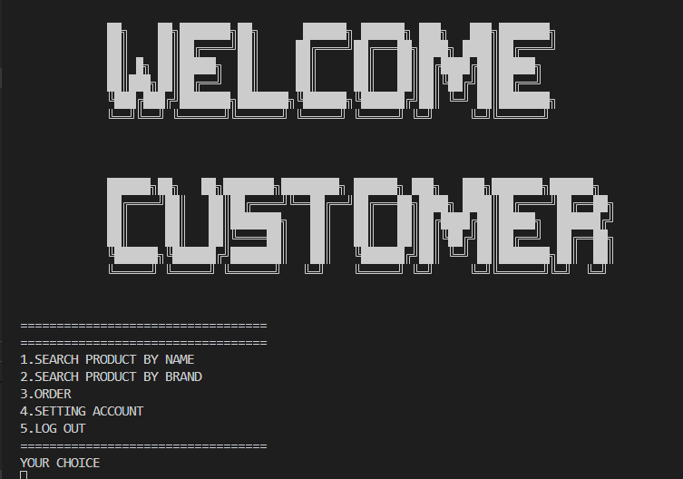
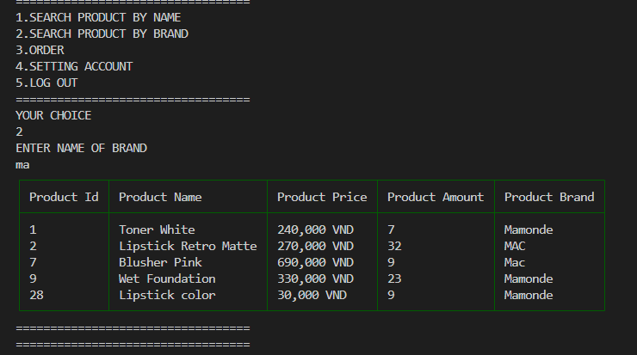
UI DESIGN
9. MENU CUSTOMER
10. SEARCH PRODUCT

Slide 22
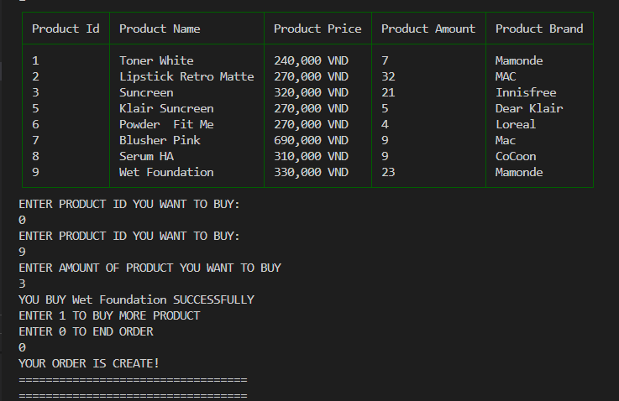
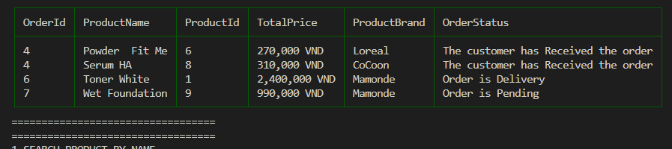
UI DESIGN
11. ORDER
12. MY ORDER

Slide 23
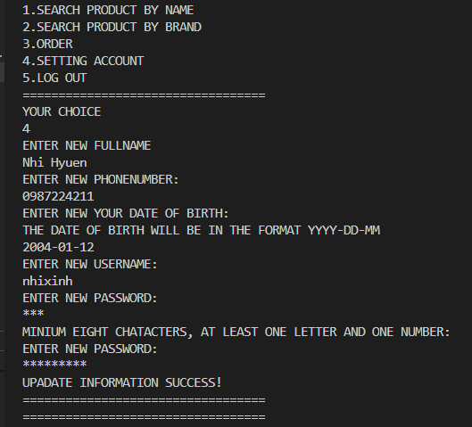
UI DESIGN
13. SETTING ACCOUNT

Slide 24
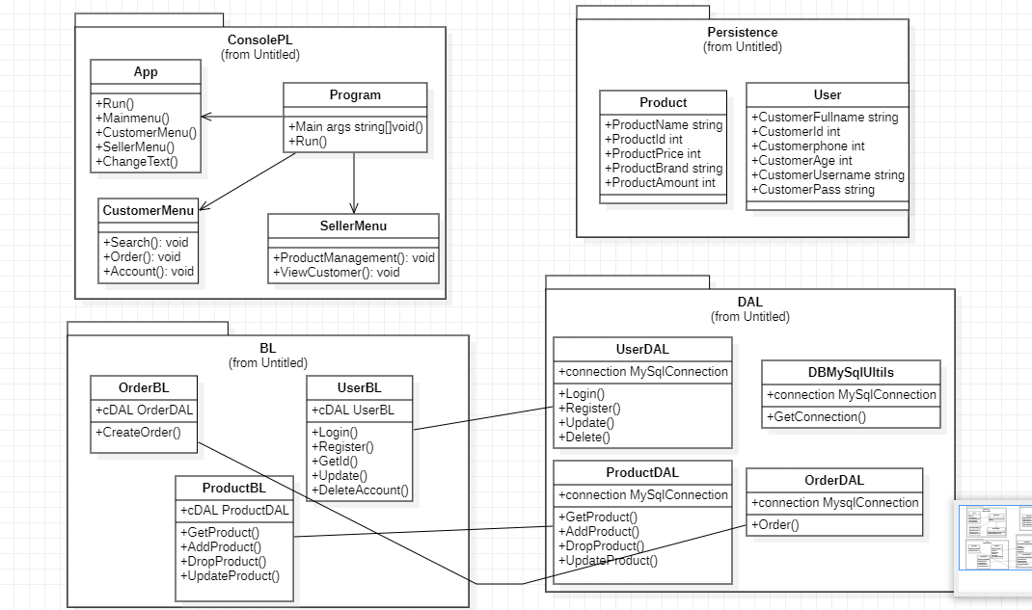
CLASS DIAGRAM

Slide 25
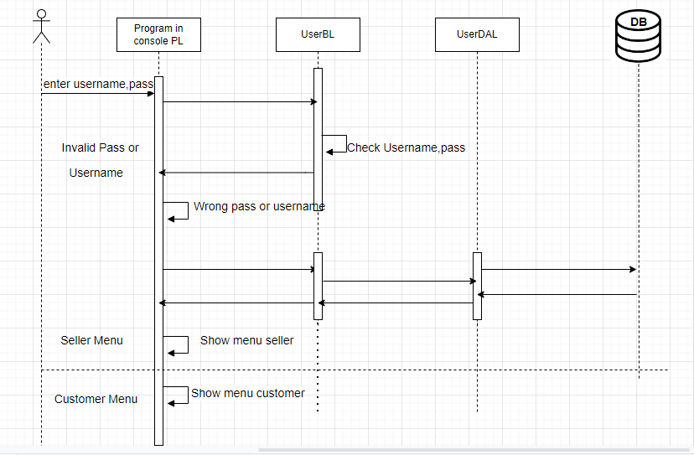
SEQUENCE DIAGRAM: LOG IN

Slide 26
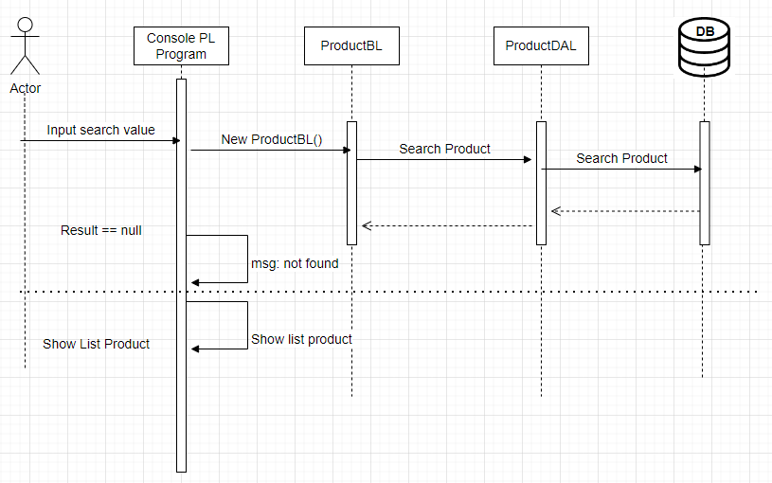
SEQUENCE DIAGRAM: SEARCH PRODUCT

Slide 27
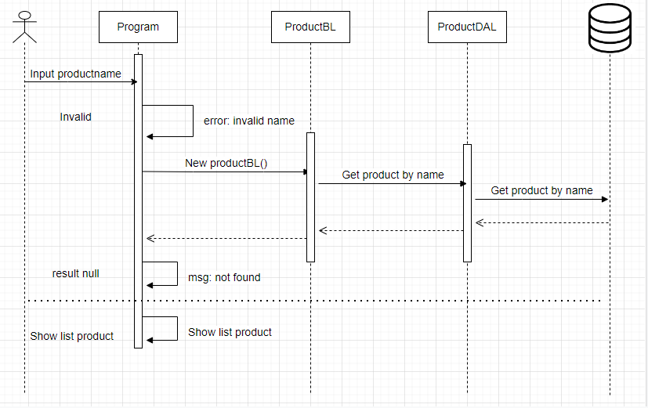
SEQUENCE DIAGRAM: SEARCH PRODUCT BY NAME

Slide 28
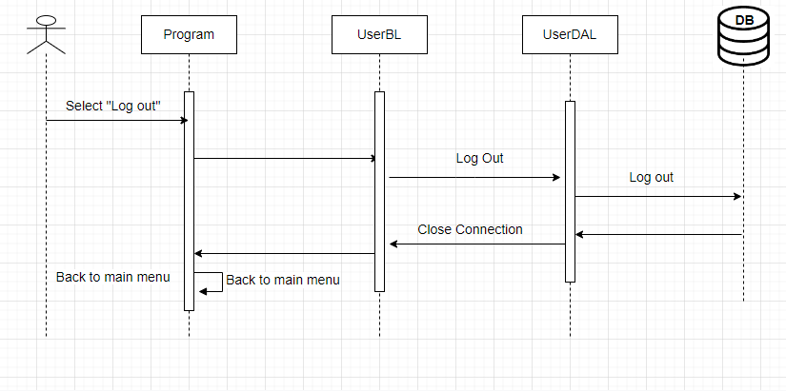
SEQUENCE DIAGRAM: LOG OUT

Slide 29
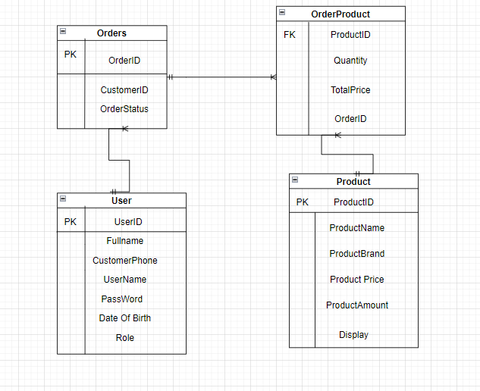
DATABASE

Slide 30
DATABASE
Users
Column Name | Data Type | Constraints | Description
CustomerId | int | Primary Key, Autoincrement
FullName | varchar(200) | NOT NULL | Customer’s name
CustomerNumber | int | NOT NULL
Password | Varchar(100) | NOT NULL
UserName | Varchar(100) | NOT NULL
Role | Varchar(100) |  | 1. Seller 2.Customer
Date of Birth | Date
Product
Column Name | Data Type | Constraints | Description
ProdudctId | int | Primary Key, Autoincrement
ProductName | varchar(200) | NOT NULL | Product’s name
ProductAmount | int | NOT NULL | Product’s amount
ProductPrice | int | NOT NULL | Product’s price
ProductBrand | Varchar(200) | NOT NULL | Product’s brand
Display | int | NOT NULL

Slide 31
DATABASE
orders
Column Name | Data Type | Constraints | Description
OrderID | int | Primary Key
ProductName | varchar(200) | NOT NULL
OrderStatus | int | NOT NULL | 1. Order is Pending 2.Order is Delivery 3.Order is received
OrderProduct
Column Name | Data Type | Constraints | Description
ProdudctId | int | NOT NULL
Quantity | int | NOT NULL
TotalPrice | int | NOT NULL
OrderID | int | NOT NULL

Slide 32
Task Assign (to each team member)
Group 13 | Pea _Cosmestic
No | Task name | Description | Start Date | End Date | Member | Self assessment
1 | Code |  | 17/08 | 22/08 | Ph.Anh
2 | Code |  | 29/08 | 06/09 | Ph.Anh
3 | Code |  | 16/09 | 18/09 | Ph.Anh
4 | Control |  | 20/09 | 21/09 | Ph.Anh
5 | Write report |  | 25/09 | 28/09 | Ph.Anh

Slide 33


Slide 34
Q & A

