Slide 1
Machine Learning Using Hadoop

Slide 2
Hadoop
Big is a collection of large datasets that cannot be processed using traditional computing techniques.
Examples:
Search Engine Data
Stock Exchange Data
Social Media Data

Slide 3
Types of Data
Structured data : Relational data.
Semi Structured data : XML data.
Unstructured data : Word, PDF, Text, Media Logs.

Slide 4
Big Data Technologies
Operational Big Data
    This include systems like MongoDB that provide operational capabilities for real-time, interactive workloads where data is primarily captured and stored.
Analytical Big Data
  This includes systems like Massively Parallel Processing (MPP) database systems and MapReduce that provide analytical capabilities.

Slide 5
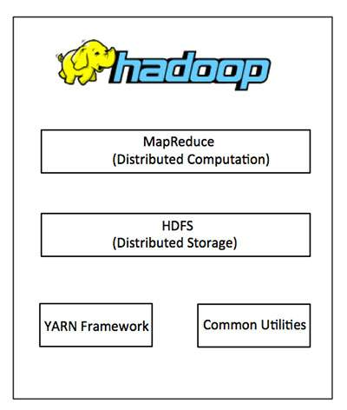
Hadoop Architecture

Slide 6
MapReduce
MapReduce is a software framework for process big amounts of data in-parallel on large clusters
Map Task: Takes input data and converts it into a set of tuples (key/value pairs)
Reduce Task: Takes the output from a map task as input and combines those data tuples into a smaller set of tuples.

Slide 7
Machine Learning - Classification
Classification is the problem of identifying to which of a set of categories , a new observation belongs on the basis of a training set of data for which category membership is known.
Examples of Algorithm:
k-nearest neighbors algorithm
  An object is classified based on the class most common among its k nearest neighbors.
Support Vector Machines
  A binary classifier that is classifies the whole n-dimensional plane using n-1 dimensional hyperplane.

Slide 8
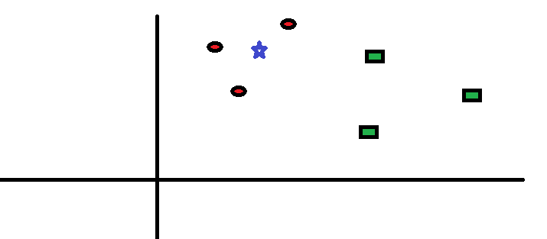
k-Nearest Neighbors

Slide 9
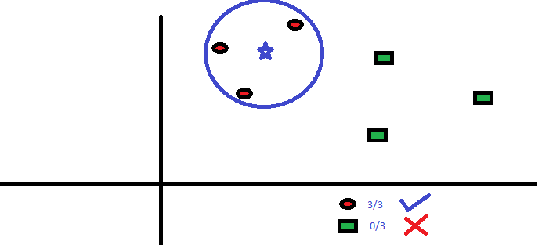

Slide 10
Implementation using Hadoop
Map Task:
In mapper we calculate the distances of the observation from all data points
Reduce Task:
    In reducer we sort the distance values calculated in the mapper and classify based on the k nearest neighbors.

Slide 11
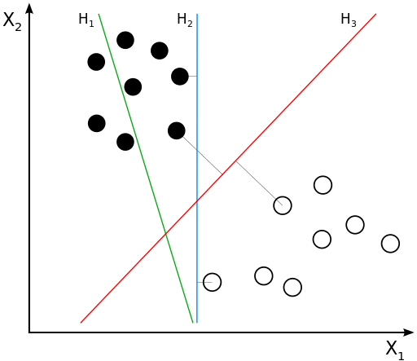
Support Vector Machines
H1 does not separate the classes.
H2 does, but only with a small margin.
H3 separates them with the maximum margin.

Slide 12
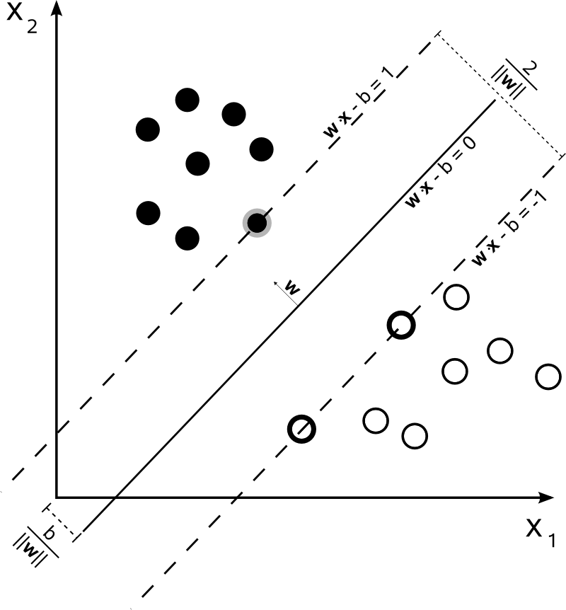
SVM Hyperplanes

Slide 13
Applications
Recommender Systems: To find similar items, you store the set of users who like each item—if a similar set of users like two different items, then the items themselves are probably similar.
Face Detection: We can use deep learning algorithms to generate feature vectors representing people’s faces and then use k-NN to identify a person.

