Slide 1
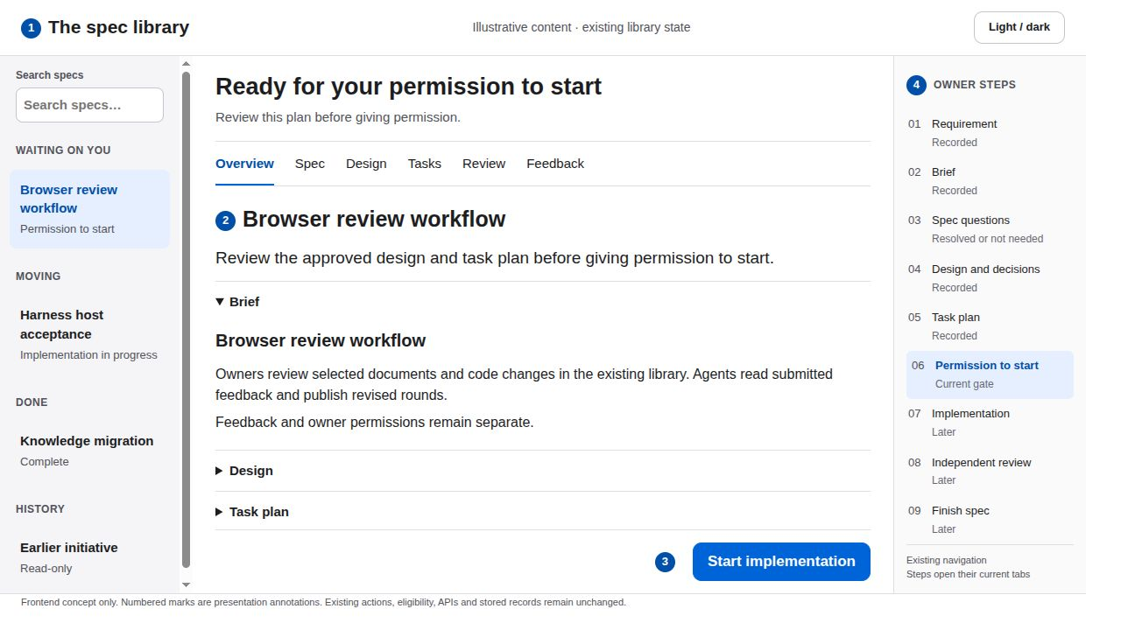
01 The approval queue
READ THE ANNOTATIONS FIRST
SCREEN CONCEPT 1 Context 2 Content 3 Action 4 Navigation
What the user sees
Existing search and spec groups lead into the selected item. The selected workflow phase supplies the current gate and next action.
Primary action
Select an item, inspect its plan, then use its eligible owner action. Keep search and the existing group order.
Why it reduces friction
A quiet sidebar and one content heading replace repeated cards and competing stage badges. Revision metadata moves into existing details.
Feedback and interaction
Selection gains a subtle gray fill. Current-gate text outranks a stale deliverable label. Keyboard focus stays visible.
List labels use existing list workflow data. No bulk approval, added inbox or new status field.
Quiet Workspace · frontend proposal · illustrative states
1 / 23
Notes:
The approval queue
Quiet Workspace: system sans serif, white content, soft gray navigation, near-black text, one blue primary action, 44 px controls, 8 px spacing rhythm and 10 px corners. Green and amber always accompany written status. Existing light/dark preference, routes and nine owner steps remain.
What the user sees: 1. Existing search and spec groups lead into the selected item. The selected workflow phase supplies the current gate and next action.
Primary action: 2. Select an item, inspect its plan, then use its eligible owner action. Keep search and the existing group order.
Why it reduces friction: 3. A quiet sidebar and one content heading replace repeated cards and competing stage badges. Revision metadata moves into existing details.
Feedback and interaction: 4. Selection gains a subtle gray fill. Current-gate text outranks a stale deliverable label. Keyboard focus stays visible.
Boundary: List labels use existing list workflow data. No bulk approval, added inbox or new status field.
Detailed behavior: Keep all existing eligibility and authority checks. Presentation is a frontend-only proposal, not shipped behavior. Do not create or mutate endpoints, fields, models, task records or owner receipts. Rearrangement, typography, status copy, native disclosures, focus and existing control placement are the only proposed changes. Existing action handlers keep their payloads and server checks. Resolve, Submit feedback, spec approval, decision acceptance, Start and Finish remain distinct acts. Preserve keyboard navigation and visible focus. Targets should remain at least 44 CSS pixels for primary actions. Use status words alongside color. Prefer short opacity changes of about 120 milliseconds, disable animation under reduced motion and restore focus on success or cancellation. Never silently submit on selection or optimistically advance an owner gate. The existing theme control keeps its preference. In dark appearance use dark neutral surfaces and readable light text, with the same hierarchy and contrast target. The deck renders the light appearance only. Any displayed counts and example wording are illustrative, not a report of the live completed pack.
Repository sources at revision 2d22941c84a1362f5572e461753e29813386aadd: treadle/packages/web/src/library.js:53, treadle/packages/web/src/library.js:76, treadle/packages/web/src/library.js:631
Design references: https://developer.apple.com/design/human-interface-guidelines
https://developer.apple.com/design/human-interface-guidelines/buttons?changes=l_8
https://developer.apple.com/design/human-interface-guidelines/color?changes=_5_2
https://developer.apple.com/design/human-interface-guidelines/dark-mode
Apple HIG informs hierarchy, descriptive actions, action feedback and status color with written labels. The exact palette, spacing and presentation layout are this proposal's design choices, not an Apple specification.

Slide 2
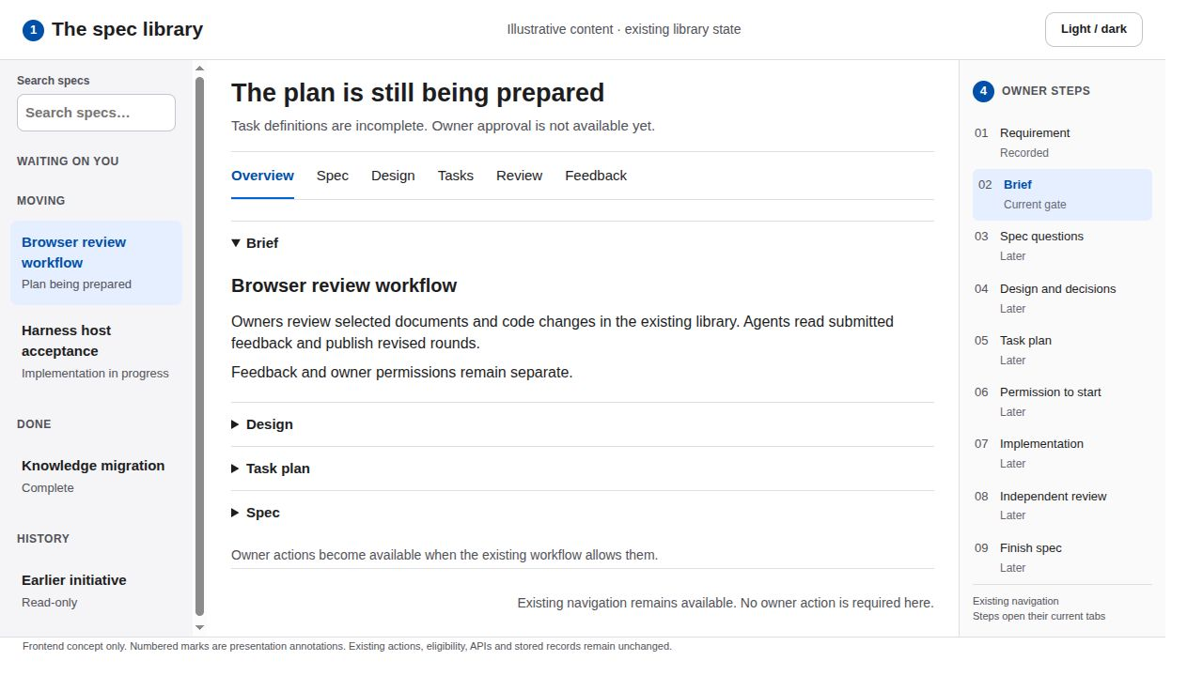
02 The brief and incomplete plan
READ THE ANNOTATIONS FIRST
SCREEN CONCEPT 1 Context 2 Content 3 Action 4 Navigation
What the user sees
The existing owner panel explains the current wait. The brief is expanded and other document disclosures remain available.
Primary action
Read the brief or open the existing plan document. Show no approval action while the workflow is in the plan phase.
Why it reduces friction
Scope appears before technical detail. Quiet document disclosures avoid multiple tall cards and nested visual frames.
Feedback and interaction
Expanding a document retains its place and focus. Missing artifacts have explicit text rather than an empty rectangle.
Display the existing workflow reasons. Do not create a request-plan action or let the owner edit task definitions here.
Quiet Workspace · frontend proposal · illustrative states
2 / 23
Notes:
The brief and incomplete plan
Quiet Workspace: system sans serif, white content, soft gray navigation, near-black text, one blue primary action, 44 px controls, 8 px spacing rhythm and 10 px corners. Green and amber always accompany written status. Existing light/dark preference, routes and nine owner steps remain.
What the user sees: 1. The existing owner panel explains the current wait. The brief is expanded and other document disclosures remain available.
Primary action: 2. Read the brief or open the existing plan document. Show no approval action while the workflow is in the plan phase.
Why it reduces friction: 3. Scope appears before technical detail. Quiet document disclosures avoid multiple tall cards and nested visual frames.
Feedback and interaction: 4. Expanding a document retains its place and focus. Missing artifacts have explicit text rather than an empty rectangle.
Boundary: Display the existing workflow reasons. Do not create a request-plan action or let the owner edit task definitions here.
Detailed behavior: Keep all existing eligibility and authority checks. Presentation is a frontend-only proposal, not shipped behavior. Do not create or mutate endpoints, fields, models, task records or owner receipts. Rearrangement, typography, status copy, native disclosures, focus and existing control placement are the only proposed changes. Existing action handlers keep their payloads and server checks. Resolve, Submit feedback, spec approval, decision acceptance, Start and Finish remain distinct acts. Preserve keyboard navigation and visible focus. Targets should remain at least 44 CSS pixels for primary actions. Use status words alongside color. Prefer short opacity changes of about 120 milliseconds, disable animation under reduced motion and restore focus on success or cancellation. Never silently submit on selection or optimistically advance an owner gate. The existing theme control keeps its preference. In dark appearance use dark neutral surfaces and readable light text, with the same hierarchy and contrast target. The deck renders the light appearance only. Any displayed counts and example wording are illustrative, not a report of the live completed pack.
Repository sources at revision 2d22941c84a1362f5572e461753e29813386aadd: treadle/packages/web/src/library.js:240, treadle/packages/web/src/library.js:403, treadle/packages/web/src/library.js:550, treadle/packages/web/src/library.js:637
Design references: https://developer.apple.com/design/human-interface-guidelines
https://developer.apple.com/design/human-interface-guidelines/buttons?changes=l_8
https://developer.apple.com/design/human-interface-guidelines/color?changes=_5_2
https://developer.apple.com/design/human-interface-guidelines/dark-mode
Apple HIG informs hierarchy, descriptive actions, action feedback and status color with written labels. The exact palette, spacing and presentation layout are this proposal's design choices, not an Apple specification.

Slide 3
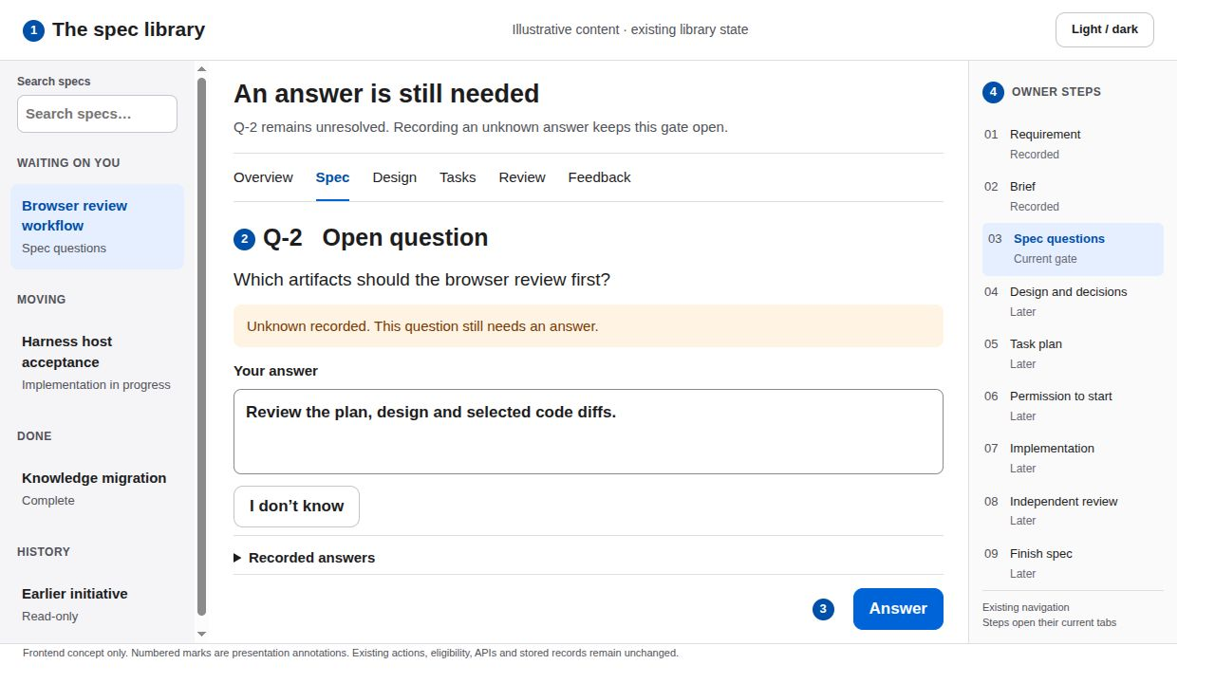
03 Spec questions and an unknown answer
READ THE ANNOTATIONS FIRST
SCREEN CONCEPT 1 Context 2 Content 3 Action 4 Navigation
What the user sees
The first unresolved question sits above supporting requirements. The saved unknown state remains explicit beside the question.
Primary action
Type an answer and choose Answer. Keep I don’t know as a quieter existing secondary action.
Why it reduces friction
The user handles one visible question before reading supporting material. Completed answers remain in existing disclosures below.
Feedback and interaction
On a successful response, announce Answer recorded and focus the next unresolved question. On failure, retain the typed answer.
The count comes from loaded clarifications. Unknown does not count as resolved. No automatic approval or hidden answer submission.
Quiet Workspace · frontend proposal · illustrative states
3 / 23
Notes:
Spec questions and an unknown answer
Quiet Workspace: system sans serif, white content, soft gray navigation, near-black text, one blue primary action, 44 px controls, 8 px spacing rhythm and 10 px corners. Green and amber always accompany written status. Existing light/dark preference, routes and nine owner steps remain.
What the user sees: 1. The first unresolved question sits above supporting requirements. The saved unknown state remains explicit beside the question.
Primary action: 2. Type an answer and choose Answer. Keep I don’t know as a quieter existing secondary action.
Why it reduces friction: 3. The user handles one visible question before reading supporting material. Completed answers remain in existing disclosures below.
Feedback and interaction: 4. On a successful response, announce Answer recorded and focus the next unresolved question. On failure, retain the typed answer.
Boundary: The count comes from loaded clarifications. Unknown does not count as resolved. No automatic approval or hidden answer submission.
Detailed behavior: Keep all existing eligibility and authority checks. Presentation is a frontend-only proposal, not shipped behavior. Do not create or mutate endpoints, fields, models, task records or owner receipts. Rearrangement, typography, status copy, native disclosures, focus and existing control placement are the only proposed changes. Existing action handlers keep their payloads and server checks. Resolve, Submit feedback, spec approval, decision acceptance, Start and Finish remain distinct acts. Preserve keyboard navigation and visible focus. Targets should remain at least 44 CSS pixels for primary actions. Use status words alongside color. Prefer short opacity changes of about 120 milliseconds, disable animation under reduced motion and restore focus on success or cancellation. Never silently submit on selection or optimistically advance an owner gate. The existing theme control keeps its preference. In dark appearance use dark neutral surfaces and readable light text, with the same hierarchy and contrast target. The deck renders the light appearance only. Any displayed counts and example wording are illustrative, not a report of the live completed pack.
Repository sources at revision 2d22941c84a1362f5572e461753e29813386aadd: treadle/packages/web/src/library.js:280, treadle/packages/web/src/library.js:435, treadle/packages/web/src/library.js:532, treadle/packages/web/src/page.js:303
Design references: https://developer.apple.com/design/human-interface-guidelines
https://developer.apple.com/design/human-interface-guidelines/buttons?changes=l_8
https://developer.apple.com/design/human-interface-guidelines/color?changes=_5_2
https://developer.apple.com/design/human-interface-guidelines/dark-mode
Apple HIG informs hierarchy, descriptive actions, action feedback and status color with written labels. The exact palette, spacing and presentation layout are this proposal's design choices, not an Apple specification.

Slide 4
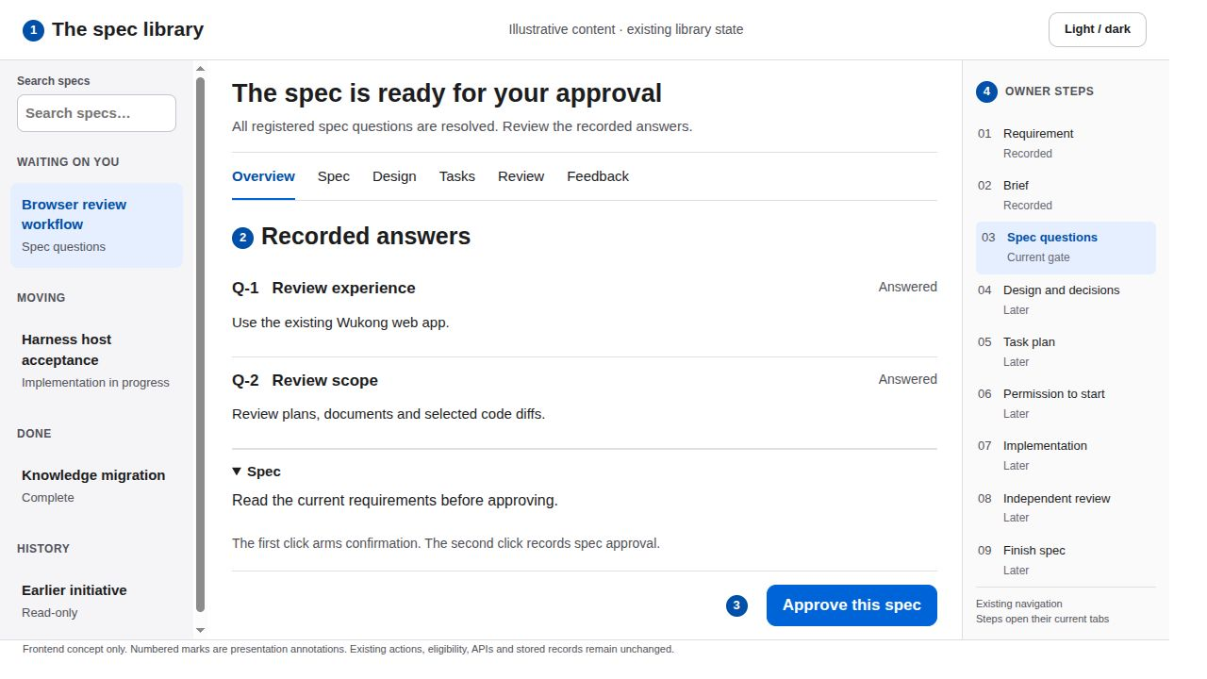
04 Spec approval after answers
READ THE ANNOTATIONS FIRST
SCREEN CONCEPT 1 Context 2 Content 3 Action 4 Navigation
What the user sees
The current gate, answer summary and existing spec disclosure share one reading column.
Primary action
Approve this spec arms the existing confirmation. A second deliberate click records the approval with the current owner claim.
Why it reduces friction
Answers stay visible near the approval action. The design removes unrelated instructions instead of asking users to infer readiness.
Feedback and interaction
First click changes the same button to Confirm spec approval and explains the recorded act inline. Busy state prevents duplicate submissions.
Keep the current two-click library approval. Empty phase-question lists skip this ceremony. Approval still grants no Start permission.
Quiet Workspace · frontend proposal · illustrative states
4 / 23
Notes:
Spec approval after answers
Quiet Workspace: system sans serif, white content, soft gray navigation, near-black text, one blue primary action, 44 px controls, 8 px spacing rhythm and 10 px corners. Green and amber always accompany written status. Existing light/dark preference, routes and nine owner steps remain.
What the user sees: 1. The current gate, answer summary and existing spec disclosure share one reading column.
Primary action: 2. Approve this spec arms the existing confirmation. A second deliberate click records the approval with the current owner claim.
Why it reduces friction: 3. Answers stay visible near the approval action. The design removes unrelated instructions instead of asking users to infer readiness.
Feedback and interaction: 4. First click changes the same button to Confirm spec approval and explains the recorded act inline. Busy state prevents duplicate submissions.
Boundary: Keep the current two-click library approval. Empty phase-question lists skip this ceremony. Approval still grants no Start permission.
Detailed behavior: Keep all existing eligibility and authority checks. Presentation is a frontend-only proposal, not shipped behavior. Do not create or mutate endpoints, fields, models, task records or owner receipts. Rearrangement, typography, status copy, native disclosures, focus and existing control placement are the only proposed changes. Existing action handlers keep their payloads and server checks. Resolve, Submit feedback, spec approval, decision acceptance, Start and Finish remain distinct acts. Preserve keyboard navigation and visible focus. Targets should remain at least 44 CSS pixels for primary actions. Use status words alongside color. Prefer short opacity changes of about 120 milliseconds, disable animation under reduced motion and restore focus on success or cancellation. Never silently submit on selection or optimistically advance an owner gate. The existing theme control keeps its preference. In dark appearance use dark neutral surfaces and readable light text, with the same hierarchy and contrast target. The deck renders the light appearance only. Any displayed counts and example wording are illustrative, not a report of the live completed pack.
Repository sources at revision 2d22941c84a1362f5572e461753e29813386aadd: treadle/packages/web/src/library.js:503, treadle/packages/web/src/library.js:517, treadle/packages/web/src/library.js:582
Design references: https://developer.apple.com/design/human-interface-guidelines
https://developer.apple.com/design/human-interface-guidelines/buttons?changes=l_8
https://developer.apple.com/design/human-interface-guidelines/color?changes=_5_2
https://developer.apple.com/design/human-interface-guidelines/dark-mode
Apple HIG informs hierarchy, descriptive actions, action feedback and status color with written labels. The exact palette, spacing and presentation layout are this proposal's design choices, not an Apple specification.

Slide 5
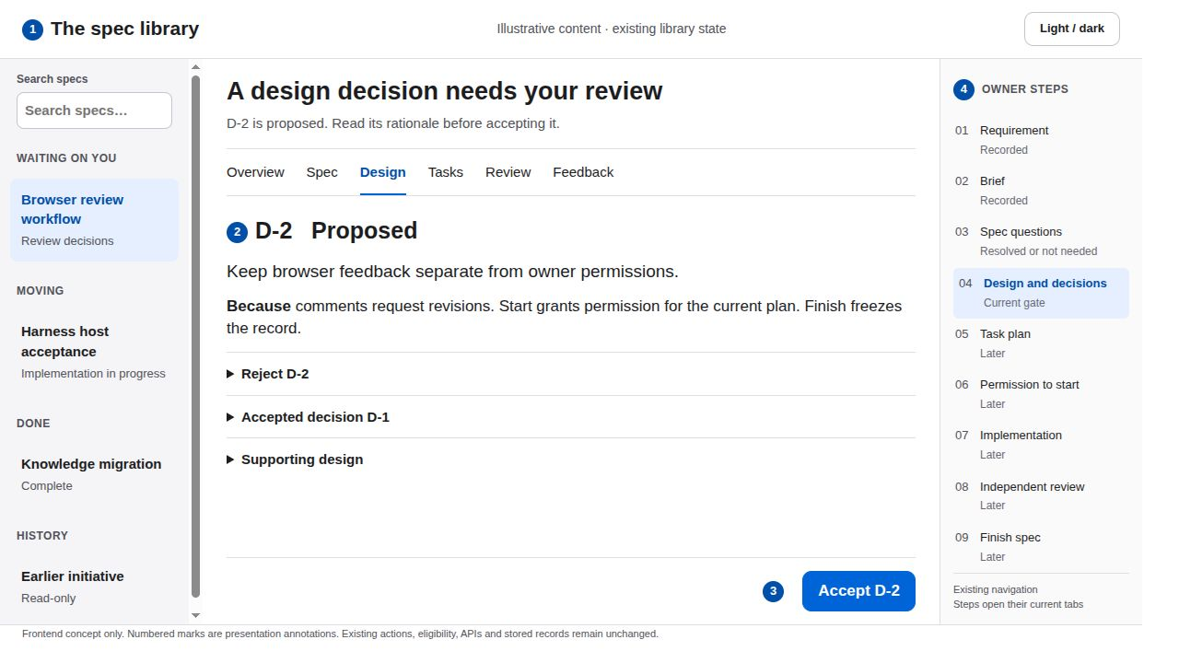
05 Design decision acceptance
READ THE ANNOTATIONS FIRST
SCREEN CONCEPT 1 Context 2 Content 3 Action 4 Navigation
What the user sees
The current proposed decision and its because text appear before supporting design parts. Accepted decisions stay available below.
Primary action
Accept D-2 records only this decision. Each remaining proposal still needs its own existing acceptance action.
Why it reduces friction
One expanded proposal has the strongest action. Secondary proposals and design diagrams use existing content disclosures.
Feedback and interaction
A saved acceptance changes the written status and moves focus to the next proposal. Success depends on the returned workflow state.
No Accept all, decision editing or automatic Start. Preserve individual decision IDs, rejection reasons and authority.
Quiet Workspace · frontend proposal · illustrative states
5 / 23
Notes:
Design decision acceptance
Quiet Workspace: system sans serif, white content, soft gray navigation, near-black text, one blue primary action, 44 px controls, 8 px spacing rhythm and 10 px corners. Green and amber always accompany written status. Existing light/dark preference, routes and nine owner steps remain.
What the user sees: 1. The current proposed decision and its because text appear before supporting design parts. Accepted decisions stay available below.
Primary action: 2. Accept D-2 records only this decision. Each remaining proposal still needs its own existing acceptance action.
Why it reduces friction: 3. One expanded proposal has the strongest action. Secondary proposals and design diagrams use existing content disclosures.
Feedback and interaction: 4. A saved acceptance changes the written status and moves focus to the next proposal. Success depends on the returned workflow state.
Boundary: No Accept all, decision editing or automatic Start. Preserve individual decision IDs, rejection reasons and authority.
Detailed behavior: Keep all existing eligibility and authority checks. Presentation is a frontend-only proposal, not shipped behavior. Do not create or mutate endpoints, fields, models, task records or owner receipts. Rearrangement, typography, status copy, native disclosures, focus and existing control placement are the only proposed changes. Existing action handlers keep their payloads and server checks. Resolve, Submit feedback, spec approval, decision acceptance, Start and Finish remain distinct acts. Preserve keyboard navigation and visible focus. Targets should remain at least 44 CSS pixels for primary actions. Use status words alongside color. Prefer short opacity changes of about 120 milliseconds, disable animation under reduced motion and restore focus on success or cancellation. Never silently submit on selection or optimistically advance an owner gate. The existing theme control keeps its preference. In dark appearance use dark neutral surfaces and readable light text, with the same hierarchy and contrast target. The deck renders the light appearance only. Any displayed counts and example wording are illustrative, not a report of the live completed pack.
Repository sources at revision 2d22941c84a1362f5572e461753e29813386aadd: treadle/packages/web/src/library.js:302, treadle/packages/web/src/library.js:313, treadle/packages/web/src/library.js:664
Design references: https://developer.apple.com/design/human-interface-guidelines
https://developer.apple.com/design/human-interface-guidelines/buttons?changes=l_8
https://developer.apple.com/design/human-interface-guidelines/color?changes=_5_2
https://developer.apple.com/design/human-interface-guidelines/dark-mode
Apple HIG informs hierarchy, descriptive actions, action feedback and status color with written labels. The exact palette, spacing and presentation layout are this proposal's design choices, not an Apple specification.

Slide 6
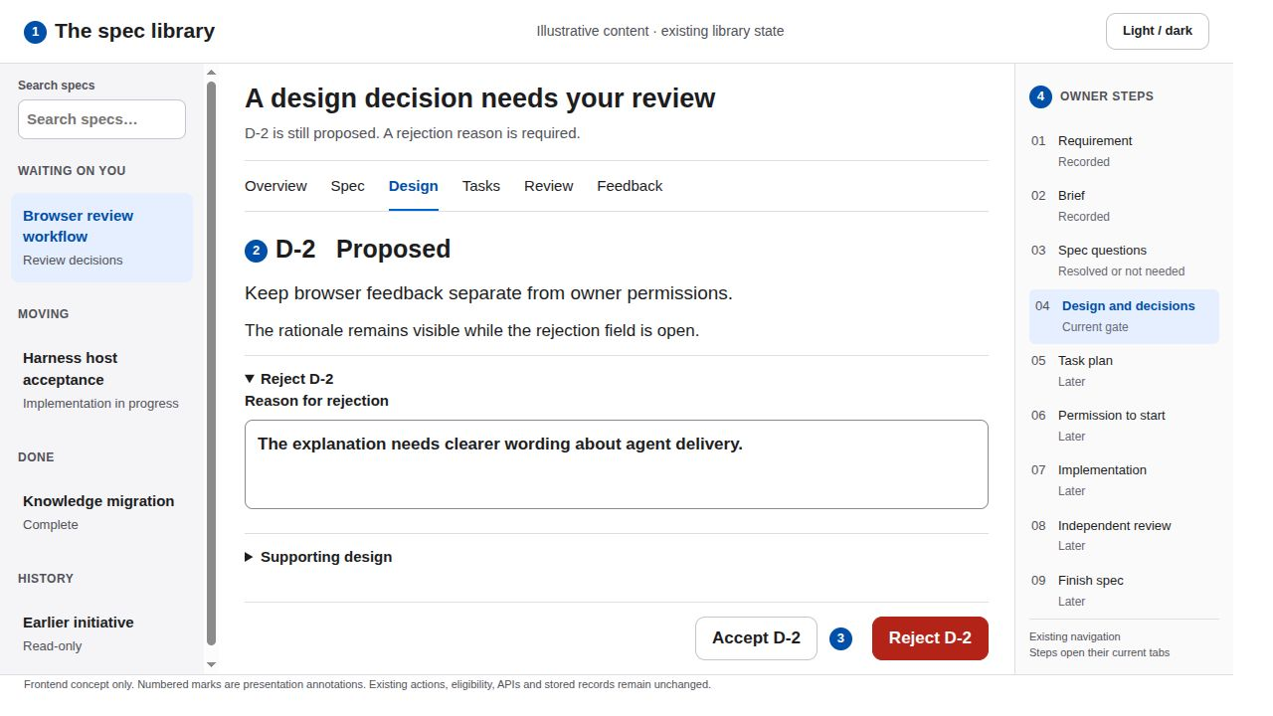
06 A decision rejection
READ THE ANNOTATIONS FIRST
SCREEN CONCEPT 1 Context 2 Content 3 Action 4 Navigation
What the user sees
The existing Reject disclosure is open beneath the same decision. The rationale remains visible above the reason field.
Primary action
Enter the reason and choose Reject D-2. Acceptance stays secondary while this disclosure has focus.
Why it reduces friction
The less common action reveals its required field only when needed. The user keeps the original decision in view.
Feedback and interaction
An empty reason produces an inline field error and focused guidance. A saved rejection displays Declined and the returned blocking reason.
Rejection uses the existing owner action. Declined required choices still block dependent work. No undo or reopen control is invented.
Quiet Workspace · frontend proposal · illustrative states
6 / 23
Notes:
A decision rejection
Quiet Workspace: system sans serif, white content, soft gray navigation, near-black text, one blue primary action, 44 px controls, 8 px spacing rhythm and 10 px corners. Green and amber always accompany written status. Existing light/dark preference, routes and nine owner steps remain.
What the user sees: 1. The existing Reject disclosure is open beneath the same decision. The rationale remains visible above the reason field.
Primary action: 2. Enter the reason and choose Reject D-2. Acceptance stays secondary while this disclosure has focus.
Why it reduces friction: 3. The less common action reveals its required field only when needed. The user keeps the original decision in view.
Feedback and interaction: 4. An empty reason produces an inline field error and focused guidance. A saved rejection displays Declined and the returned blocking reason.
Boundary: Rejection uses the existing owner action. Declined required choices still block dependent work. No undo or reopen control is invented.
Detailed behavior: Keep all existing eligibility and authority checks. Presentation is a frontend-only proposal, not shipped behavior. Do not create or mutate endpoints, fields, models, task records or owner receipts. Rearrangement, typography, status copy, native disclosures, focus and existing control placement are the only proposed changes. Existing action handlers keep their payloads and server checks. Resolve, Submit feedback, spec approval, decision acceptance, Start and Finish remain distinct acts. Preserve keyboard navigation and visible focus. Targets should remain at least 44 CSS pixels for primary actions. Use status words alongside color. Prefer short opacity changes of about 120 milliseconds, disable animation under reduced motion and restore focus on success or cancellation. Never silently submit on selection or optimistically advance an owner gate. The existing theme control keeps its preference. In dark appearance use dark neutral surfaces and readable light text, with the same hierarchy and contrast target. The deck renders the light appearance only. Any displayed counts and example wording are illustrative, not a report of the live completed pack.
Repository sources at revision 2d22941c84a1362f5572e461753e29813386aadd: treadle/packages/web/src/library.js:317, treadle/packages/web/src/library.js:667
Design references: https://developer.apple.com/design/human-interface-guidelines
https://developer.apple.com/design/human-interface-guidelines/buttons?changes=l_8
https://developer.apple.com/design/human-interface-guidelines/color?changes=_5_2
https://developer.apple.com/design/human-interface-guidelines/dark-mode
Apple HIG informs hierarchy, descriptive actions, action feedback and status color with written labels. The exact palette, spacing and presentation layout are this proposal's design choices, not an Apple specification.

Slide 7
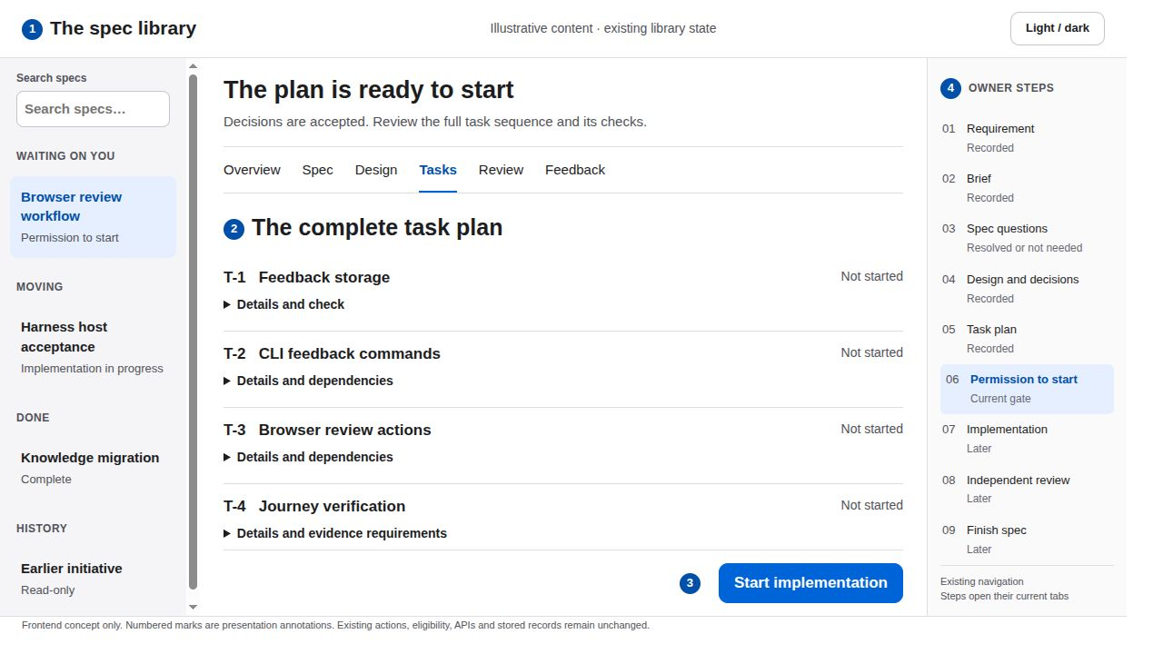
07 The task plan and permission to start
READ THE ANNOTATIONS FIRST
SCREEN CONCEPT 1 Context 2 Content 3 Action 4 Navigation
What the user sees
Task titles, dependencies and declared checks remain accessible. The existing Start button stays beside a short permission explanation.
Primary action
Start implementation grants permission for this exact plan. Keep the action in the existing owner panel, sticky within its content column.
Why it reduces friction
A stable action position avoids a long trip back to the top after reading tasks. Technical trace links expand only on demand.
Feedback and interaction
Show Saving permission while the existing request is pending. After success, display Permission recorded and the returned phase.
Use can_start and the existing revision guard. The browser records permission and does not wake an idle agent. No instant-running claim.
Quiet Workspace · frontend proposal · illustrative states
7 / 23
Notes:
The task plan and permission to start
Quiet Workspace: system sans serif, white content, soft gray navigation, near-black text, one blue primary action, 44 px controls, 8 px spacing rhythm and 10 px corners. Green and amber always accompany written status. Existing light/dark preference, routes and nine owner steps remain.
What the user sees: 1. Task titles, dependencies and declared checks remain accessible. The existing Start button stays beside a short permission explanation.
Primary action: 2. Start implementation grants permission for this exact plan. Keep the action in the existing owner panel, sticky within its content column.
Why it reduces friction: 3. A stable action position avoids a long trip back to the top after reading tasks. Technical trace links expand only on demand.
Feedback and interaction: 4. Show Saving permission while the existing request is pending. After success, display Permission recorded and the returned phase.
Boundary: Use can_start and the existing revision guard. The browser records permission and does not wake an idle agent. No instant-running claim.
Detailed behavior: Keep all existing eligibility and authority checks. Presentation is a frontend-only proposal, not shipped behavior. Do not create or mutate endpoints, fields, models, task records or owner receipts. Rearrangement, typography, status copy, native disclosures, focus and existing control placement are the only proposed changes. Existing action handlers keep their payloads and server checks. Resolve, Submit feedback, spec approval, decision acceptance, Start and Finish remain distinct acts. Preserve keyboard navigation and visible focus. Targets should remain at least 44 CSS pixels for primary actions. Use status words alongside color. Prefer short opacity changes of about 120 milliseconds, disable animation under reduced motion and restore focus on success or cancellation. Never silently submit on selection or optimistically advance an owner gate. The existing theme control keeps its preference. In dark appearance use dark neutral surfaces and readable light text, with the same hierarchy and contrast target. The deck renders the light appearance only. Any displayed counts and example wording are illustrative, not a report of the live completed pack.
Repository sources at revision 2d22941c84a1362f5572e461753e29813386aadd: treadle/packages/web/src/library.js:331, treadle/packages/web/src/library.js:643, treadle/packages/web/src/library.js:677, wiki/systems/owner-workflow.md
Design references: https://developer.apple.com/design/human-interface-guidelines
https://developer.apple.com/design/human-interface-guidelines/buttons?changes=l_8
https://developer.apple.com/design/human-interface-guidelines/color?changes=_5_2
https://developer.apple.com/design/human-interface-guidelines/dark-mode
Apple HIG informs hierarchy, descriptive actions, action feedback and status color with written labels. The exact palette, spacing and presentation layout are this proposal's design choices, not an Apple specification.

Slide 8
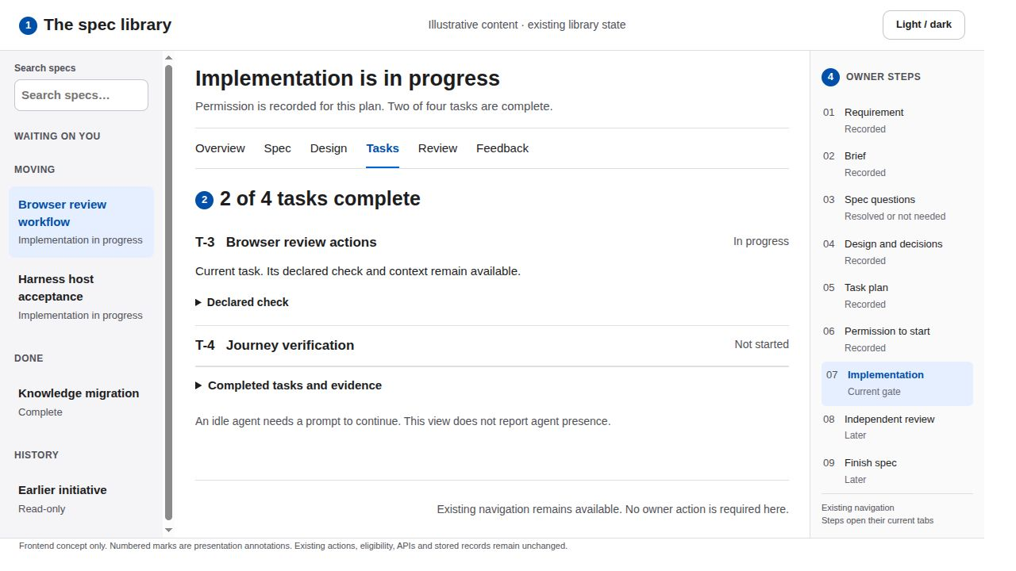
08 Implementation in progress
READ THE ANNOTATIONS FIRST
SCREEN CONCEPT 1 Context 2 Content 3 Action 4 Navigation
What the user sees
Existing task statuses lead each row. The current task stays expanded with its declared check. Completed evidence sits in a disclosure.
Primary action
Inspect the current task or use the existing refresh trigger when state may have changed. There is no owner approval to repeat here.
Why it reduces friction
Removing prior approval instructions makes progress immediately legible. Task counts come directly from the loaded tasks.
Feedback and interaction
Completed tasks show a checkmark and the word Done. State refreshes through existing interaction and focus behavior, without invented live telemetry.
Display approved execution state, not agent presence. No Run, pause, retry or new polling service. Keep independent review as the next gate.
Quiet Workspace · frontend proposal · illustrative states
8 / 23
Notes:
Implementation in progress
Quiet Workspace: system sans serif, white content, soft gray navigation, near-black text, one blue primary action, 44 px controls, 8 px spacing rhythm and 10 px corners. Green and amber always accompany written status. Existing light/dark preference, routes and nine owner steps remain.
What the user sees: 1. Existing task statuses lead each row. The current task stays expanded with its declared check. Completed evidence sits in a disclosure.
Primary action: 2. Inspect the current task or use the existing refresh trigger when state may have changed. There is no owner approval to repeat here.
Why it reduces friction: 3. Removing prior approval instructions makes progress immediately legible. Task counts come directly from the loaded tasks.
Feedback and interaction: 4. Completed tasks show a checkmark and the word Done. State refreshes through existing interaction and focus behavior, without invented live telemetry.
Boundary: Display approved execution state, not agent presence. No Run, pause, retry or new polling service. Keep independent review as the next gate.
Detailed behavior: Keep all existing eligibility and authority checks. Presentation is a frontend-only proposal, not shipped behavior. Do not create or mutate endpoints, fields, models, task records or owner receipts. Rearrangement, typography, status copy, native disclosures, focus and existing control placement are the only proposed changes. Existing action handlers keep their payloads and server checks. Resolve, Submit feedback, spec approval, decision acceptance, Start and Finish remain distinct acts. Preserve keyboard navigation and visible focus. Targets should remain at least 44 CSS pixels for primary actions. Use status words alongside color. Prefer short opacity changes of about 120 milliseconds, disable animation under reduced motion and restore focus on success or cancellation. Never silently submit on selection or optimistically advance an owner gate. The existing theme control keeps its preference. In dark appearance use dark neutral surfaces and readable light text, with the same hierarchy and contrast target. The deck renders the light appearance only. Any displayed counts and example wording are illustrative, not a report of the live completed pack.
Repository sources at revision 2d22941c84a1362f5572e461753e29813386aadd: treadle/packages/web/src/library.js:331, treadle/packages/web/src/library.js:607, treadle/packages/web/src/library.js:645, treadle/packages/web/src/library.js:985
Design references: https://developer.apple.com/design/human-interface-guidelines
https://developer.apple.com/design/human-interface-guidelines/buttons?changes=l_8
https://developer.apple.com/design/human-interface-guidelines/color?changes=_5_2
https://developer.apple.com/design/human-interface-guidelines/dark-mode
Apple HIG informs hierarchy, descriptive actions, action feedback and status color with written labels. The exact palette, spacing and presentation layout are this proposal's design choices, not an Apple specification.

Slide 9
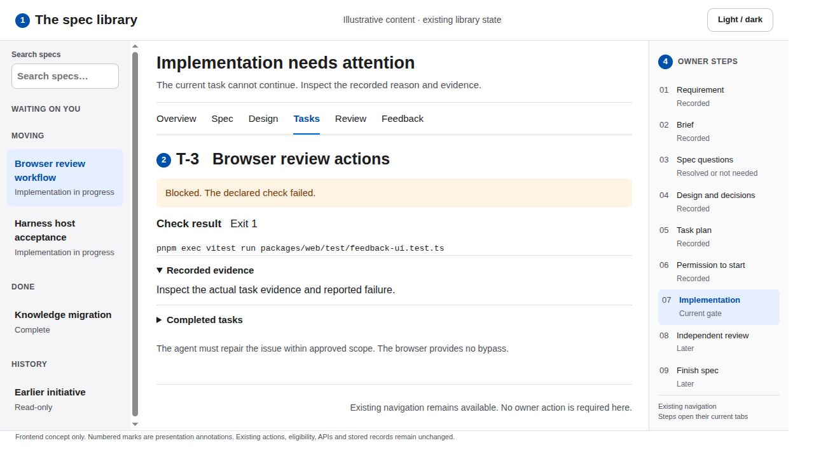
09 A blocked task
READ THE ANNOTATIONS FIRST
SCREEN CONCEPT 1 Context 2 Content 3 Action 4 Navigation
What the user sees
The blocked task moves above completed evidence. Existing reasons and any failed command result appear next to its status.
Primary action
Read the blocker, inspect its evidence and refresh when the agent has repaired the issue. Do not offer a browser bypass.
Why it reduces friction
The specific blocking reason replaces a generic warning panel. Only the affected task expands by default.
Feedback and interaction
Amber pairs with the word Blocked. A failed command retains its actual exit code. Refresh changes the display only after a new response.
Source drift and a changed plan remain distinct. A changed plan uses the existing Start gate again. No repin, retry-task or force-approve UI.
Quiet Workspace · frontend proposal · illustrative states
9 / 23
Notes:
A blocked task
Quiet Workspace: system sans serif, white content, soft gray navigation, near-black text, one blue primary action, 44 px controls, 8 px spacing rhythm and 10 px corners. Green and amber always accompany written status. Existing light/dark preference, routes and nine owner steps remain.
What the user sees: 1. The blocked task moves above completed evidence. Existing reasons and any failed command result appear next to its status.
Primary action: 2. Read the blocker, inspect its evidence and refresh when the agent has repaired the issue. Do not offer a browser bypass.
Why it reduces friction: 3. The specific blocking reason replaces a generic warning panel. Only the affected task expands by default.
Feedback and interaction: 4. Amber pairs with the word Blocked. A failed command retains its actual exit code. Refresh changes the display only after a new response.
Boundary: Source drift and a changed plan remain distinct. A changed plan uses the existing Start gate again. No repin, retry-task or force-approve UI.
Detailed behavior: Keep all existing eligibility and authority checks. Presentation is a frontend-only proposal, not shipped behavior. Do not create or mutate endpoints, fields, models, task records or owner receipts. Rearrangement, typography, status copy, native disclosures, focus and existing control placement are the only proposed changes. Existing action handlers keep their payloads and server checks. Resolve, Submit feedback, spec approval, decision acceptance, Start and Finish remain distinct acts. Preserve keyboard navigation and visible focus. Targets should remain at least 44 CSS pixels for primary actions. Use status words alongside color. Prefer short opacity changes of about 120 milliseconds, disable animation under reduced motion and restore focus on success or cancellation. Never silently submit on selection or optimistically advance an owner gate. The existing theme control keeps its preference. In dark appearance use dark neutral surfaces and readable light text, with the same hierarchy and contrast target. The deck renders the light appearance only. Any displayed counts and example wording are illustrative, not a report of the live completed pack.
Repository sources at revision 2d22941c84a1362f5572e461753e29813386aadd: treadle/packages/web/src/library.js:331, treadle/packages/web/src/library.js:637, wiki/systems/owner-workflow.md
Design references: https://developer.apple.com/design/human-interface-guidelines
https://developer.apple.com/design/human-interface-guidelines/buttons?changes=l_8
https://developer.apple.com/design/human-interface-guidelines/color?changes=_5_2
https://developer.apple.com/design/human-interface-guidelines/dark-mode
Apple HIG informs hierarchy, descriptive actions, action feedback and status color with written labels. The exact palette, spacing and presentation layout are this proposal's design choices, not an Apple specification.

Slide 10
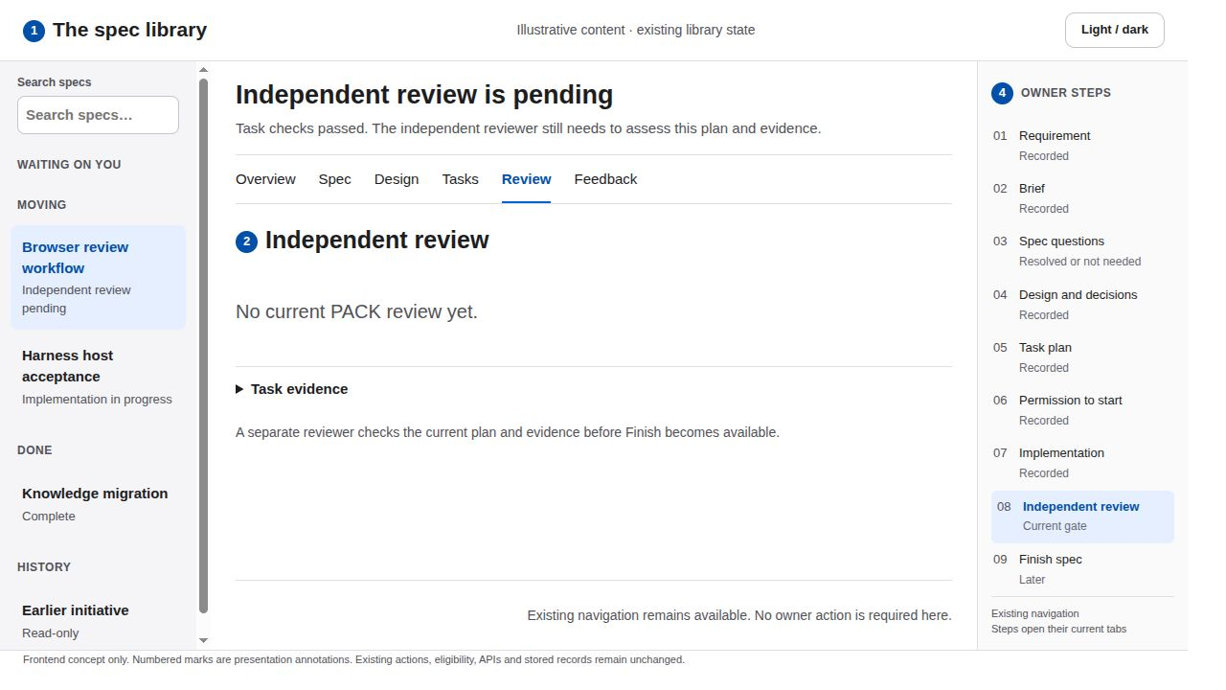
10 Independent review pending
READ THE ANNOTATIONS FIRST
SCREEN CONCEPT 1 Context 2 Content 3 Action 4 Navigation
What the user sees
The existing review empty state sits below the current gate. The phase inspector shows Finish as a later step.
Primary action
Inspect available evidence. No Finish control appears until the existing workflow declares the pack eligible.
Why it reduces friction
The screen explains exactly who must act next. Completion and owner attention no longer compete with review waiting.
Feedback and interaction
Existing refresh behavior reveals the returned review result. A passing task check never animates into a passing PACK review.
No Request review button, reviewer assignment or live activity indicator. Keep can_close authoritative.
Quiet Workspace · frontend proposal · illustrative states
10 / 23
Notes:
Independent review pending
Quiet Workspace: system sans serif, white content, soft gray navigation, near-black text, one blue primary action, 44 px controls, 8 px spacing rhythm and 10 px corners. Green and amber always accompany written status. Existing light/dark preference, routes and nine owner steps remain.
What the user sees: 1. The existing review empty state sits below the current gate. The phase inspector shows Finish as a later step.
Primary action: 2. Inspect available evidence. No Finish control appears until the existing workflow declares the pack eligible.
Why it reduces friction: 3. The screen explains exactly who must act next. Completion and owner attention no longer compete with review waiting.
Feedback and interaction: 4. Existing refresh behavior reveals the returned review result. A passing task check never animates into a passing PACK review.
Boundary: No Request review button, reviewer assignment or live activity indicator. Keep can_close authoritative.
Detailed behavior: Keep all existing eligibility and authority checks. Presentation is a frontend-only proposal, not shipped behavior. Do not create or mutate endpoints, fields, models, task records or owner receipts. Rearrangement, typography, status copy, native disclosures, focus and existing control placement are the only proposed changes. Existing action handlers keep their payloads and server checks. Resolve, Submit feedback, spec approval, decision acceptance, Start and Finish remain distinct acts. Preserve keyboard navigation and visible focus. Targets should remain at least 44 CSS pixels for primary actions. Use status words alongside color. Prefer short opacity changes of about 120 milliseconds, disable animation under reduced motion and restore focus on success or cancellation. Never silently submit on selection or optimistically advance an owner gate. The existing theme control keeps its preference. In dark appearance use dark neutral surfaces and readable light text, with the same hierarchy and contrast target. The deck renders the light appearance only. Any displayed counts and example wording are illustrative, not a report of the live completed pack.
Repository sources at revision 2d22941c84a1362f5572e461753e29813386aadd: treadle/packages/web/src/library.js:347, treadle/packages/web/src/library.js:617, treadle/packages/web/src/library.js:646
Design references: https://developer.apple.com/design/human-interface-guidelines
https://developer.apple.com/design/human-interface-guidelines/buttons?changes=l_8
https://developer.apple.com/design/human-interface-guidelines/color?changes=_5_2
https://developer.apple.com/design/human-interface-guidelines/dark-mode
Apple HIG informs hierarchy, descriptive actions, action feedback and status color with written labels. The exact palette, spacing and presentation layout are this proposal's design choices, not an Apple specification.

Slide 11
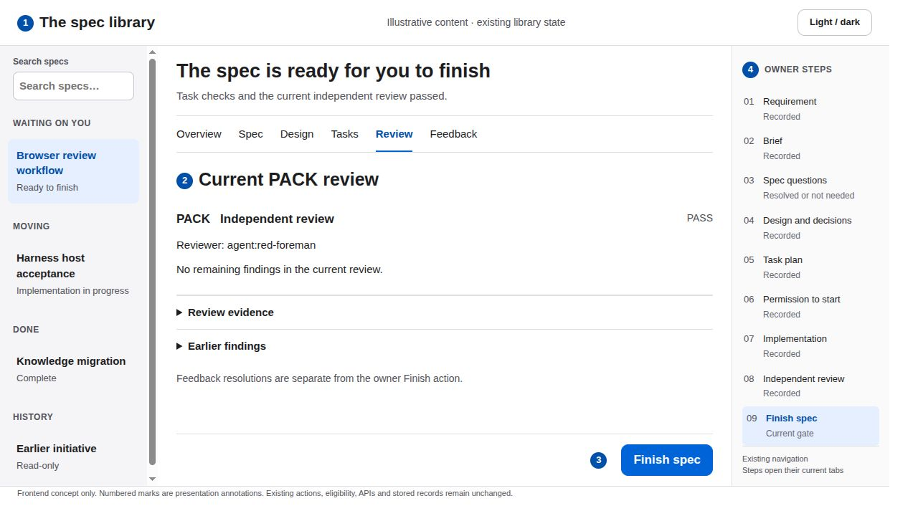
11 The reviewed pack is ready to finish
READ THE ANNOTATIONS FIRST
SCREEN CONCEPT 1 Context 2 Content 3 Action 4 Navigation
What the user sees
The current PACK verdict leads the review list. Reviewer identity and recorded evidence remain available beneath it.
Primary action
Inspect the verdict, then choose Finish spec. This reveals the existing confirmation in place.
Why it reduces friction
A short readiness statement and one primary action replace scattered success badges. The review remains adjacent to the final decision.
Feedback and interaction
Show the Finish action only when can_close is true. Review filters retain access to earlier findings without obscuring the current verdict.
Earlier PASS records are not current eligibility. The workflow response remains authoritative. Unresolved feedback does not become a new finish gate.
Quiet Workspace · frontend proposal · illustrative states
11 / 23
Notes:
The reviewed pack is ready to finish
Quiet Workspace: system sans serif, white content, soft gray navigation, near-black text, one blue primary action, 44 px controls, 8 px spacing rhythm and 10 px corners. Green and amber always accompany written status. Existing light/dark preference, routes and nine owner steps remain.
What the user sees: 1. The current PACK verdict leads the review list. Reviewer identity and recorded evidence remain available beneath it.
Primary action: 2. Inspect the verdict, then choose Finish spec. This reveals the existing confirmation in place.
Why it reduces friction: 3. A short readiness statement and one primary action replace scattered success badges. The review remains adjacent to the final decision.
Feedback and interaction: 4. Show the Finish action only when can_close is true. Review filters retain access to earlier findings without obscuring the current verdict.
Boundary: Earlier PASS records are not current eligibility. The workflow response remains authoritative. Unresolved feedback does not become a new finish gate.
Detailed behavior: Keep all existing eligibility and authority checks. Presentation is a frontend-only proposal, not shipped behavior. Do not create or mutate endpoints, fields, models, task records or owner receipts. Rearrangement, typography, status copy, native disclosures, focus and existing control placement are the only proposed changes. Existing action handlers keep their payloads and server checks. Resolve, Submit feedback, spec approval, decision acceptance, Start and Finish remain distinct acts. Preserve keyboard navigation and visible focus. Targets should remain at least 44 CSS pixels for primary actions. Use status words alongside color. Prefer short opacity changes of about 120 milliseconds, disable animation under reduced motion and restore focus on success or cancellation. Never silently submit on selection or optimistically advance an owner gate. The existing theme control keeps its preference. In dark appearance use dark neutral surfaces and readable light text, with the same hierarchy and contrast target. The deck renders the light appearance only. Any displayed counts and example wording are illustrative, not a report of the live completed pack.
Repository sources at revision 2d22941c84a1362f5572e461753e29813386aadd: treadle/packages/web/src/library.js:347, treadle/packages/web/src/library.js:644, treadle/packages/web/src/library.js:808
Design references: https://developer.apple.com/design/human-interface-guidelines
https://developer.apple.com/design/human-interface-guidelines/buttons?changes=l_8
https://developer.apple.com/design/human-interface-guidelines/color?changes=_5_2
https://developer.apple.com/design/human-interface-guidelines/dark-mode
Apple HIG informs hierarchy, descriptive actions, action feedback and status color with written labels. The exact palette, spacing and presentation layout are this proposal's design choices, not an Apple specification.

Slide 12
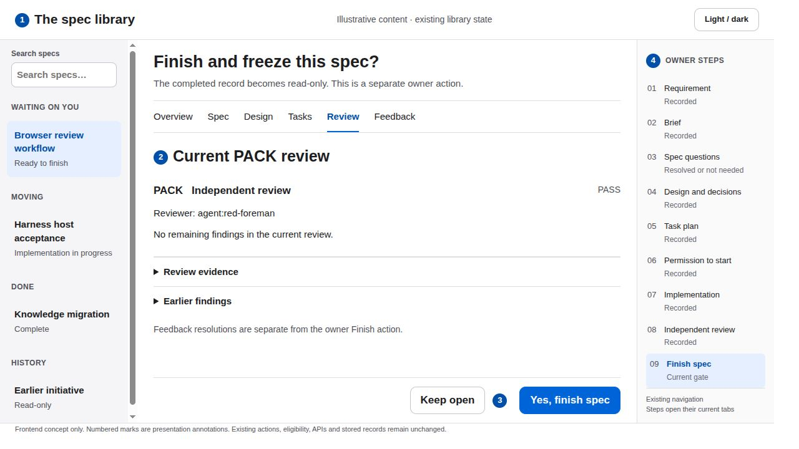
12 Finish confirmation
READ THE ANNOTATIONS FIRST
SCREEN CONCEPT 1 Context 2 Content 3 Action 4 Navigation
What the user sees
The existing confirmation replaces the Finish button inside the owner panel. The pack title and current review remain visible.
Primary action
Yes, finish spec records completion. Keep open cancels the confirmation and restores the original action.
Why it reduces friction
The consequence is plain and close to the control. No extra dialog, screen, typing challenge or approval ceremony is added.
Feedback and interaction
Focus enters the existing confirmation. Cancellation returns focus to Finish spec. While saving, disable duplicate controls and announce progress.
Keep both existing confirmation choices and the distinct close action. Never auto-finish after a PASS or a Resolve event.
Quiet Workspace · frontend proposal · illustrative states
12 / 23
Notes:
Finish confirmation
Quiet Workspace: system sans serif, white content, soft gray navigation, near-black text, one blue primary action, 44 px controls, 8 px spacing rhythm and 10 px corners. Green and amber always accompany written status. Existing light/dark preference, routes and nine owner steps remain.
What the user sees: 1. The existing confirmation replaces the Finish button inside the owner panel. The pack title and current review remain visible.
Primary action: 2. Yes, finish spec records completion. Keep open cancels the confirmation and restores the original action.
Why it reduces friction: 3. The consequence is plain and close to the control. No extra dialog, screen, typing challenge or approval ceremony is added.
Feedback and interaction: 4. Focus enters the existing confirmation. Cancellation returns focus to Finish spec. While saving, disable duplicate controls and announce progress.
Boundary: Keep both existing confirmation choices and the distinct close action. Never auto-finish after a PASS or a Resolve event.
Detailed behavior: Keep all existing eligibility and authority checks. Presentation is a frontend-only proposal, not shipped behavior. Do not create or mutate endpoints, fields, models, task records or owner receipts. Rearrangement, typography, status copy, native disclosures, focus and existing control placement are the only proposed changes. Existing action handlers keep their payloads and server checks. Resolve, Submit feedback, spec approval, decision acceptance, Start and Finish remain distinct acts. Preserve keyboard navigation and visible focus. Targets should remain at least 44 CSS pixels for primary actions. Use status words alongside color. Prefer short opacity changes of about 120 milliseconds, disable animation under reduced motion and restore focus on success or cancellation. Never silently submit on selection or optimistically advance an owner gate. The existing theme control keeps its preference. In dark appearance use dark neutral surfaces and readable light text, with the same hierarchy and contrast target. The deck renders the light appearance only. Any displayed counts and example wording are illustrative, not a report of the live completed pack.
Repository sources at revision 2d22941c84a1362f5572e461753e29813386aadd: treadle/packages/web/src/library.js:644, treadle/packages/web/src/library.js:650
Design references: https://developer.apple.com/design/human-interface-guidelines
https://developer.apple.com/design/human-interface-guidelines/buttons?changes=l_8
https://developer.apple.com/design/human-interface-guidelines/color?changes=_5_2
https://developer.apple.com/design/human-interface-guidelines/dark-mode
Apple HIG informs hierarchy, descriptive actions, action feedback and status color with written labels. The exact palette, spacing and presentation layout are this proposal's design choices, not an Apple specification.

Slide 13
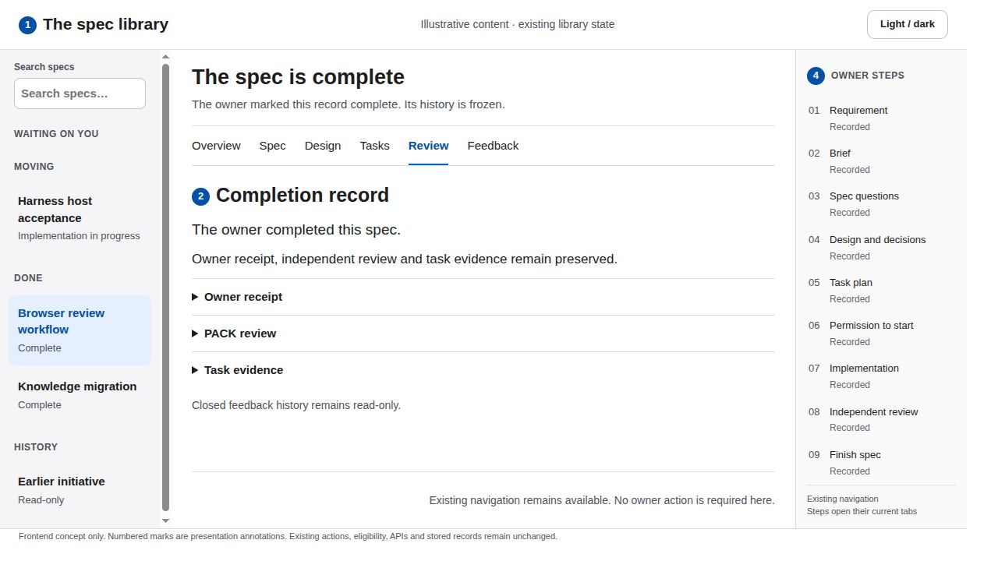
13 The completed spec
READ THE ANNOTATIONS FIRST
SCREEN CONCEPT 1 Context 2 Content 3 Action 4 Navigation
What the user sees
Completion replaces the action area with a concise recorded state. The same tabs and phase inspector remain available for inspection.
Primary action
Read the review, task evidence or feedback history. Existing navigation provides the route back to other library items.
Why it reduces friction
One completion heading communicates the outcome. Repeated green badges and inactive approval buttons add no useful information.
Feedback and interaction
Focus lands on the completion heading after a successful response. Read-only history retains text selection and document navigation.
No Reopen, duplicate item or new summary screen. Closed feedback controls stay disabled under existing rules.
Quiet Workspace · frontend proposal · illustrative states
13 / 23
Notes:
The completed spec
Quiet Workspace: system sans serif, white content, soft gray navigation, near-black text, one blue primary action, 44 px controls, 8 px spacing rhythm and 10 px corners. Green and amber always accompany written status. Existing light/dark preference, routes and nine owner steps remain.
What the user sees: 1. Completion replaces the action area with a concise recorded state. The same tabs and phase inspector remain available for inspection.
Primary action: 2. Read the review, task evidence or feedback history. Existing navigation provides the route back to other library items.
Why it reduces friction: 3. One completion heading communicates the outcome. Repeated green badges and inactive approval buttons add no useful information.
Feedback and interaction: 4. Focus lands on the completion heading after a successful response. Read-only history retains text selection and document navigation.
Boundary: No Reopen, duplicate item or new summary screen. Closed feedback controls stay disabled under existing rules.
Detailed behavior: Keep all existing eligibility and authority checks. Presentation is a frontend-only proposal, not shipped behavior. Do not create or mutate endpoints, fields, models, task records or owner receipts. Rearrangement, typography, status copy, native disclosures, focus and existing control placement are the only proposed changes. Existing action handlers keep their payloads and server checks. Resolve, Submit feedback, spec approval, decision acceptance, Start and Finish remain distinct acts. Preserve keyboard navigation and visible focus. Targets should remain at least 44 CSS pixels for primary actions. Use status words alongside color. Prefer short opacity changes of about 120 milliseconds, disable animation under reduced motion and restore focus on success or cancellation. Never silently submit on selection or optimistically advance an owner gate. The existing theme control keeps its preference. In dark appearance use dark neutral surfaces and readable light text, with the same hierarchy and contrast target. The deck renders the light appearance only. Any displayed counts and example wording are illustrative, not a report of the live completed pack.
Repository sources at revision 2d22941c84a1362f5572e461753e29813386aadd: treadle/packages/web/src/library.js:647, treadle/packages/web/src/feedback.js:225, treadle/packages/web/src/feedback.js:505
Design references: https://developer.apple.com/design/human-interface-guidelines
https://developer.apple.com/design/human-interface-guidelines/buttons?changes=l_8
https://developer.apple.com/design/human-interface-guidelines/color?changes=_5_2
https://developer.apple.com/design/human-interface-guidelines/dark-mode
Apple HIG informs hierarchy, descriptive actions, action feedback and status color with written labels. The exact palette, spacing and presentation layout are this proposal's design choices, not an Apple specification.

Slide 14
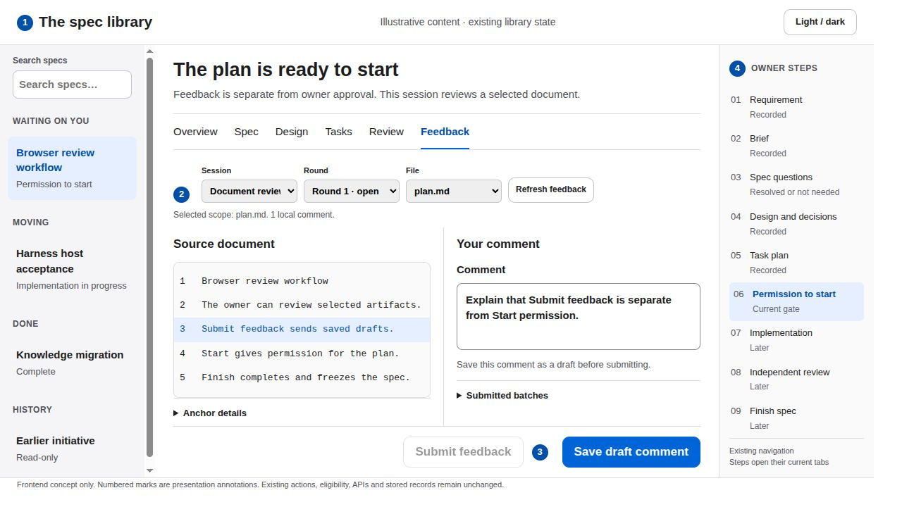
14 Document feedback as a draft
READ THE ANNOTATIONS FIRST
SCREEN CONCEPT 1 Context 2 Content 3 Action 4 Navigation
What the user sees
Existing session, round and file controls form a compact toolbar. The selected source line appears beside the comment field.
Primary action
Select the existing anchor, write the comment and Save draft comment. Submit feedback stays a separate action after the comment is saved.
Why it reduces friction
A two-column source and discussion arrangement shortens eye movement. Scope and draft state stay visible near the action.
Feedback and interaction
Selection gains a blue line highlight. The save response says Draft saved, then the same Submit feedback control gains visual priority.
Keep comment and submit as separate existing requests. Local input is not a submitted batch. No combined Save and send action.
Quiet Workspace · frontend proposal · illustrative states
14 / 23
Notes:
Document feedback as a draft
Quiet Workspace: system sans serif, white content, soft gray navigation, near-black text, one blue primary action, 44 px controls, 8 px spacing rhythm and 10 px corners. Green and amber always accompany written status. Existing light/dark preference, routes and nine owner steps remain.
What the user sees: 1. Existing session, round and file controls form a compact toolbar. The selected source line appears beside the comment field.
Primary action: 2. Select the existing anchor, write the comment and Save draft comment. Submit feedback stays a separate action after the comment is saved.
Why it reduces friction: 3. A two-column source and discussion arrangement shortens eye movement. Scope and draft state stay visible near the action.
Feedback and interaction: 4. Selection gains a blue line highlight. The save response says Draft saved, then the same Submit feedback control gains visual priority.
Boundary: Keep comment and submit as separate existing requests. Local input is not a submitted batch. No combined Save and send action.
Detailed behavior: Keep all existing eligibility and authority checks. Presentation is a frontend-only proposal, not shipped behavior. Do not create or mutate endpoints, fields, models, task records or owner receipts. Rearrangement, typography, status copy, native disclosures, focus and existing control placement are the only proposed changes. Existing action handlers keep their payloads and server checks. Resolve, Submit feedback, spec approval, decision acceptance, Start and Finish remain distinct acts. Preserve keyboard navigation and visible focus. Targets should remain at least 44 CSS pixels for primary actions. Use status words alongside color. Prefer short opacity changes of about 120 milliseconds, disable animation under reduced motion and restore focus on success or cancellation. Never silently submit on selection or optimistically advance an owner gate. The existing theme control keeps its preference. In dark appearance use dark neutral surfaces and readable light text, with the same hierarchy and contrast target. The deck renders the light appearance only. Any displayed counts and example wording are illustrative, not a report of the live completed pack.
Repository sources at revision 2d22941c84a1362f5572e461753e29813386aadd: treadle/packages/web/src/feedback.js:239, treadle/packages/web/src/feedback.js:386, treadle/packages/web/src/feedback.js:465, treadle/packages/web/src/feedback.js:486
Design references: https://developer.apple.com/design/human-interface-guidelines
https://developer.apple.com/design/human-interface-guidelines/buttons?changes=l_8
https://developer.apple.com/design/human-interface-guidelines/color?changes=_5_2
https://developer.apple.com/design/human-interface-guidelines/dark-mode
Apple HIG informs hierarchy, descriptive actions, action feedback and status color with written labels. The exact palette, spacing and presentation layout are this proposal's design choices, not an Apple specification.

Slide 15
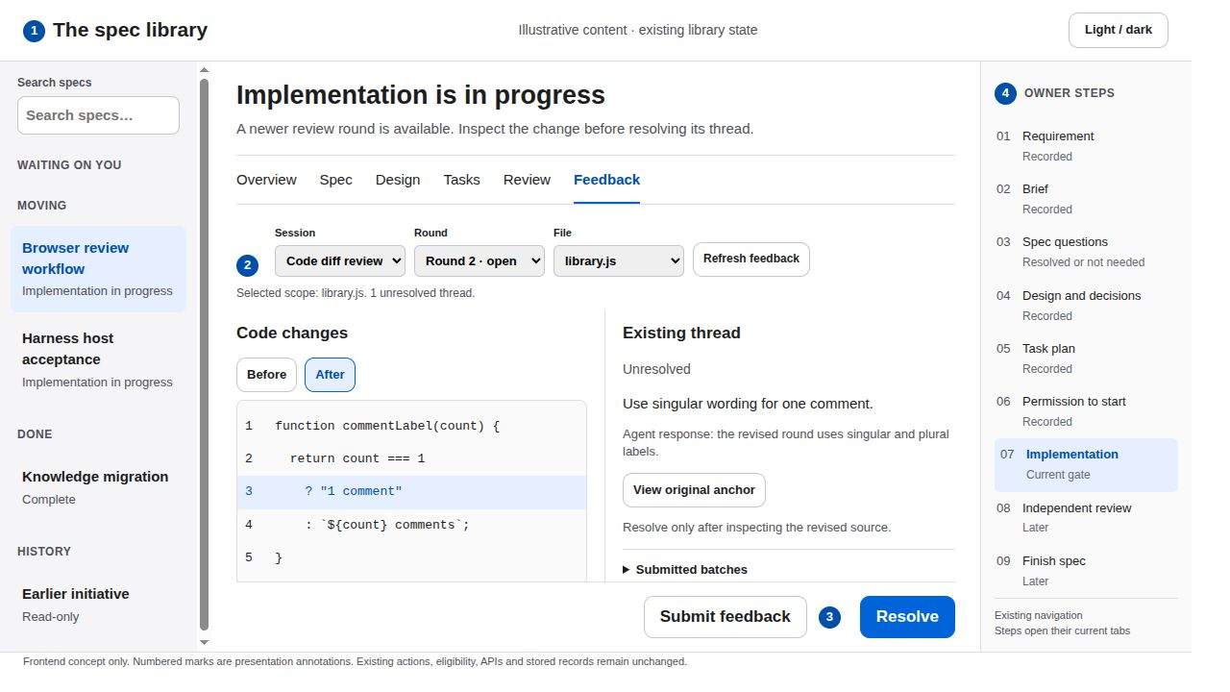
15 A revised code diff and thread resolution
READ THE ANNOTATIONS FIRST
SCREEN CONCEPT 1 Context 2 Content 3 Action 4 Navigation
What the user sees
The existing round selector points to the newest round. Before and After remain available. The thread and agent response sit beside the source.
Primary action
Inspect the revised lines, then use that thread’s Resolve button. Resolve each remaining thread independently.
Why it reduces friction
The source and discussion share a visual baseline. The user sees what changed and why without moving across several stacked panels.
Feedback and interaction
A successful response changes Unresolved to Resolved and disables its action. Original anchors and submitted batches remain accessible.
Do not claim auto-delivery or agent presence. An idle agent needs a prompt. Resolve grants no approval, Start or Finish permission.
Quiet Workspace · frontend proposal · illustrative states
15 / 23
Notes:
A revised code diff and thread resolution
Quiet Workspace: system sans serif, white content, soft gray navigation, near-black text, one blue primary action, 44 px controls, 8 px spacing rhythm and 10 px corners. Green and amber always accompany written status. Existing light/dark preference, routes and nine owner steps remain.
What the user sees: 1. The existing round selector points to the newest round. Before and After remain available. The thread and agent response sit beside the source.
Primary action: 2. Inspect the revised lines, then use that thread’s Resolve button. Resolve each remaining thread independently.
Why it reduces friction: 3. The source and discussion share a visual baseline. The user sees what changed and why without moving across several stacked panels.
Feedback and interaction: 4. A successful response changes Unresolved to Resolved and disables its action. Original anchors and submitted batches remain accessible.
Boundary: Do not claim auto-delivery or agent presence. An idle agent needs a prompt. Resolve grants no approval, Start or Finish permission.
Detailed behavior: Keep all existing eligibility and authority checks. Presentation is a frontend-only proposal, not shipped behavior. Do not create or mutate endpoints, fields, models, task records or owner receipts. Rearrangement, typography, status copy, native disclosures, focus and existing control placement are the only proposed changes. Existing action handlers keep their payloads and server checks. Resolve, Submit feedback, spec approval, decision acceptance, Start and Finish remain distinct acts. Preserve keyboard navigation and visible focus. Targets should remain at least 44 CSS pixels for primary actions. Use status words alongside color. Prefer short opacity changes of about 120 milliseconds, disable animation under reduced motion and restore focus on success or cancellation. Never silently submit on selection or optimistically advance an owner gate. The existing theme control keeps its preference. In dark appearance use dark neutral surfaces and readable light text, with the same hierarchy and contrast target. The deck renders the light appearance only. Any displayed counts and example wording are illustrative, not a report of the live completed pack.
Repository sources at revision 2d22941c84a1362f5572e461753e29813386aadd: treadle/packages/web/src/feedback.js:267, treadle/packages/web/src/feedback.js:547, treadle/packages/web/src/feedback.js:560, treadle/packages/web/src/feedback.js:493
Design references: https://developer.apple.com/design/human-interface-guidelines
https://developer.apple.com/design/human-interface-guidelines/buttons?changes=l_8
https://developer.apple.com/design/human-interface-guidelines/color?changes=_5_2
https://developer.apple.com/design/human-interface-guidelines/dark-mode
Apple HIG informs hierarchy, descriptive actions, action feedback and status color with written labels. The exact palette, spacing and presentation layout are this proposal's design choices, not an Apple specification.

Slide 16
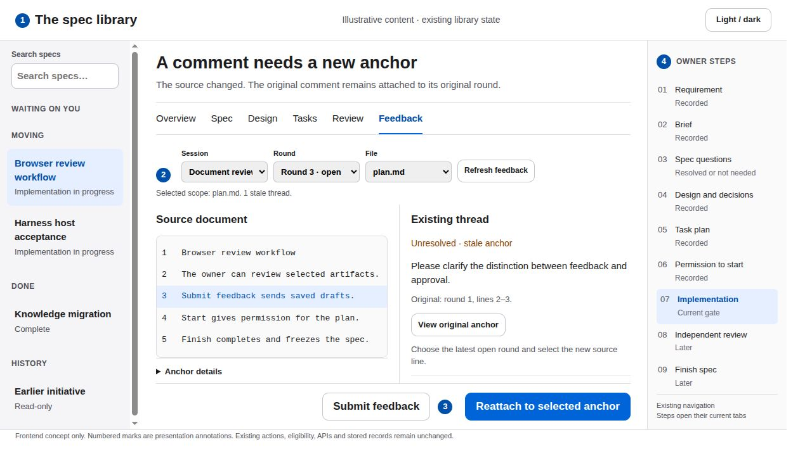
16 A stale feedback anchor
READ THE ANNOTATIONS FIRST
SCREEN CONCEPT 1 Context 2 Content 3 Action 4 Navigation
What the user sees
The existing stale status labels the thread. The latest open round and new selected source line remain visible beside it.
Primary action
Select the new anchor, choose Reattach to selected anchor, then Submit feedback. These remain two separate recorded actions.
Why it reduces friction
Context, selection and the recovery action stay together. A stale comment does not disappear into a generic error message.
Feedback and interaction
Announce Reattachment saved as a draft. Visual priority then moves to the existing Submit feedback control, after a successful response.
Never infer or silently move an anchor. A sealed round requires an agent-published new round. Preserve View original anchor.
Quiet Workspace · frontend proposal · illustrative states
16 / 23
Notes:
A stale feedback anchor
Quiet Workspace: system sans serif, white content, soft gray navigation, near-black text, one blue primary action, 44 px controls, 8 px spacing rhythm and 10 px corners. Green and amber always accompany written status. Existing light/dark preference, routes and nine owner steps remain.
What the user sees: 1. The existing stale status labels the thread. The latest open round and new selected source line remain visible beside it.
Primary action: 2. Select the new anchor, choose Reattach to selected anchor, then Submit feedback. These remain two separate recorded actions.
Why it reduces friction: 3. Context, selection and the recovery action stay together. A stale comment does not disappear into a generic error message.
Feedback and interaction: 4. Announce Reattachment saved as a draft. Visual priority then moves to the existing Submit feedback control, after a successful response.
Boundary: Never infer or silently move an anchor. A sealed round requires an agent-published new round. Preserve View original anchor.
Detailed behavior: Keep all existing eligibility and authority checks. Presentation is a frontend-only proposal, not shipped behavior. Do not create or mutate endpoints, fields, models, task records or owner receipts. Rearrangement, typography, status copy, native disclosures, focus and existing control placement are the only proposed changes. Existing action handlers keep their payloads and server checks. Resolve, Submit feedback, spec approval, decision acceptance, Start and Finish remain distinct acts. Preserve keyboard navigation and visible focus. Targets should remain at least 44 CSS pixels for primary actions. Use status words alongside color. Prefer short opacity changes of about 120 milliseconds, disable animation under reduced motion and restore focus on success or cancellation. Never silently submit on selection or optimistically advance an owner gate. The existing theme control keeps its preference. In dark appearance use dark neutral surfaces and readable light text, with the same hierarchy and contrast target. The deck renders the light appearance only. Any displayed counts and example wording are illustrative, not a report of the live completed pack.
Repository sources at revision 2d22941c84a1362f5572e461753e29813386aadd: treadle/packages/web/src/feedback.js:567, treadle/packages/web/src/feedback.js:578
Design references: https://developer.apple.com/design/human-interface-guidelines
https://developer.apple.com/design/human-interface-guidelines/buttons?changes=l_8
https://developer.apple.com/design/human-interface-guidelines/color?changes=_5_2
https://developer.apple.com/design/human-interface-guidelines/dark-mode
Apple HIG informs hierarchy, descriptive actions, action feedback and status color with written labels. The exact palette, spacing and presentation layout are this proposal's design choices, not an Apple specification.

Slide 17
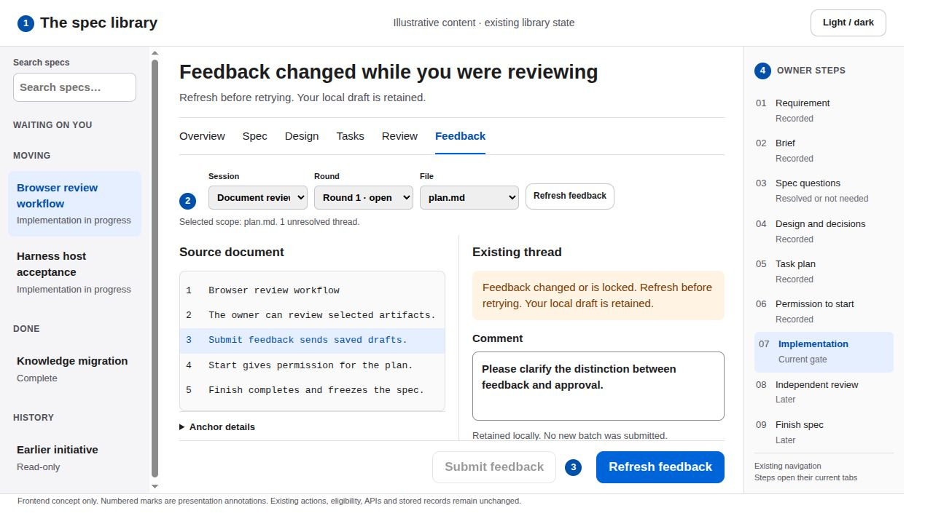
17 A feedback revision conflict
READ THE ANNOTATIONS FIRST
SCREEN CONCEPT 1 Context 2 Content 3 Action 4 Navigation
What the user sees
The existing feedback error sits next to the comment field. The selected source and retained text stay visible.
Primary action
Refresh feedback, inspect the current round and retry the intended existing action. Keep the draft and the spec owner controls separate.
Why it reduces friction
A specific recovery instruction replaces a broad red banner. Draft retention avoids retyping and makes the interrupted work recoverable.
Feedback and interaction
Focus the error announcement without erasing the draft. Show a busy refresh state and update source selection deliberately.
Retain the existing operation identity and revision checks. Do not automatically resend, submit a new batch or reattach after conflict.
Quiet Workspace · frontend proposal · illustrative states
17 / 23
Notes:
A feedback revision conflict
Quiet Workspace: system sans serif, white content, soft gray navigation, near-black text, one blue primary action, 44 px controls, 8 px spacing rhythm and 10 px corners. Green and amber always accompany written status. Existing light/dark preference, routes and nine owner steps remain.
What the user sees: 1. The existing feedback error sits next to the comment field. The selected source and retained text stay visible.
Primary action: 2. Refresh feedback, inspect the current round and retry the intended existing action. Keep the draft and the spec owner controls separate.
Why it reduces friction: 3. A specific recovery instruction replaces a broad red banner. Draft retention avoids retyping and makes the interrupted work recoverable.
Feedback and interaction: 4. Focus the error announcement without erasing the draft. Show a busy refresh state and update source selection deliberately.
Boundary: Retain the existing operation identity and revision checks. Do not automatically resend, submit a new batch or reattach after conflict.
Detailed behavior: Keep all existing eligibility and authority checks. Presentation is a frontend-only proposal, not shipped behavior. Do not create or mutate endpoints, fields, models, task records or owner receipts. Rearrangement, typography, status copy, native disclosures, focus and existing control placement are the only proposed changes. Existing action handlers keep their payloads and server checks. Resolve, Submit feedback, spec approval, decision acceptance, Start and Finish remain distinct acts. Preserve keyboard navigation and visible focus. Targets should remain at least 44 CSS pixels for primary actions. Use status words alongside color. Prefer short opacity changes of about 120 milliseconds, disable animation under reduced motion and restore focus on success or cancellation. Never silently submit on selection or optimistically advance an owner gate. The existing theme control keeps its preference. In dark appearance use dark neutral surfaces and readable light text, with the same hierarchy and contrast target. The deck renders the light appearance only. Any displayed counts and example wording are illustrative, not a report of the live completed pack.
Repository sources at revision 2d22941c84a1362f5572e461753e29813386aadd: treadle/packages/web/src/feedback.js:124, treadle/packages/web/src/feedback.js:135, treadle/packages/web/src/feedback.js:164
Design references: https://developer.apple.com/design/human-interface-guidelines
https://developer.apple.com/design/human-interface-guidelines/buttons?changes=l_8
https://developer.apple.com/design/human-interface-guidelines/color?changes=_5_2
https://developer.apple.com/design/human-interface-guidelines/dark-mode
Apple HIG informs hierarchy, descriptive actions, action feedback and status color with written labels. The exact palette, spacing and presentation layout are this proposal's design choices, not an Apple specification.

Slide 18
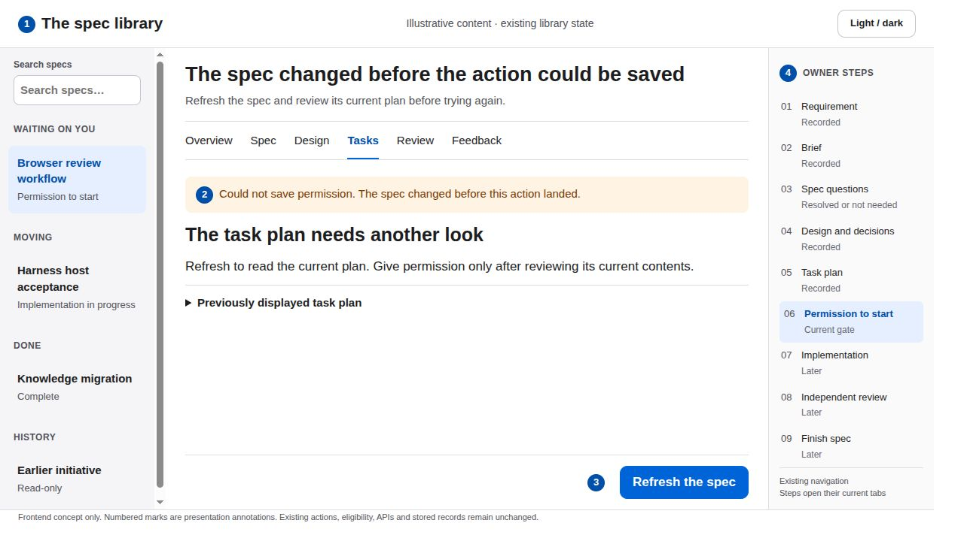
18 An owner action revision conflict
READ THE ANNOTATIONS FIRST
SCREEN CONCEPT 1 Context 2 Content 3 Action 4 Navigation
What the user sees
The existing owner error and Refresh control sit directly beside the owner action area. The attempted action remains understandable.
Primary action
Refresh the spec, reread changed content, then deliberately repeat the eligible action if it is still appropriate.
Why it reduces friction
Recovery lives at the point of interruption. The UI makes no claim that permission exists when the server refused the write.
Feedback and interaction
Focus the error. Disable duplicate requests while refreshing. Restore an action only from the new workflow response.
Never advance optimistically or auto-retry approval. Keep expected_revision, plan identity and all server eligibility rules unchanged.
Quiet Workspace · frontend proposal · illustrative states
18 / 23
Notes:
An owner action revision conflict
Quiet Workspace: system sans serif, white content, soft gray navigation, near-black text, one blue primary action, 44 px controls, 8 px spacing rhythm and 10 px corners. Green and amber always accompany written status. Existing light/dark preference, routes and nine owner steps remain.
What the user sees: 1. The existing owner error and Refresh control sit directly beside the owner action area. The attempted action remains understandable.
Primary action: 2. Refresh the spec, reread changed content, then deliberately repeat the eligible action if it is still appropriate.
Why it reduces friction: 3. Recovery lives at the point of interruption. The UI makes no claim that permission exists when the server refused the write.
Feedback and interaction: 4. Focus the error. Disable duplicate requests while refreshing. Restore an action only from the new workflow response.
Boundary: Never advance optimistically or auto-retry approval. Keep expected_revision, plan identity and all server eligibility rules unchanged.
Detailed behavior: Keep all existing eligibility and authority checks. Presentation is a frontend-only proposal, not shipped behavior. Do not create or mutate endpoints, fields, models, task records or owner receipts. Rearrangement, typography, status copy, native disclosures, focus and existing control placement are the only proposed changes. Existing action handlers keep their payloads and server checks. Resolve, Submit feedback, spec approval, decision acceptance, Start and Finish remain distinct acts. Preserve keyboard navigation and visible focus. Targets should remain at least 44 CSS pixels for primary actions. Use status words alongside color. Prefer short opacity changes of about 120 milliseconds, disable animation under reduced motion and restore focus on success or cancellation. Never silently submit on selection or optimistically advance an owner gate. The existing theme control keeps its preference. In dark appearance use dark neutral surfaces and readable light text, with the same hierarchy and contrast target. The deck renders the light appearance only. Any displayed counts and example wording are illustrative, not a report of the live completed pack.
Repository sources at revision 2d22941c84a1362f5572e461753e29813386aadd: treadle/packages/web/src/library.js:572, treadle/packages/web/src/library.js:677, treadle/packages/web/src/library.js:689, treadle/packages/web/src/library.js:986
Design references: https://developer.apple.com/design/human-interface-guidelines
https://developer.apple.com/design/human-interface-guidelines/buttons?changes=l_8
https://developer.apple.com/design/human-interface-guidelines/color?changes=_5_2
https://developer.apple.com/design/human-interface-guidelines/dark-mode
Apple HIG informs hierarchy, descriptive actions, action feedback and status color with written labels. The exact palette, spacing and presentation layout are this proposal's design choices, not an Apple specification.

Slide 19
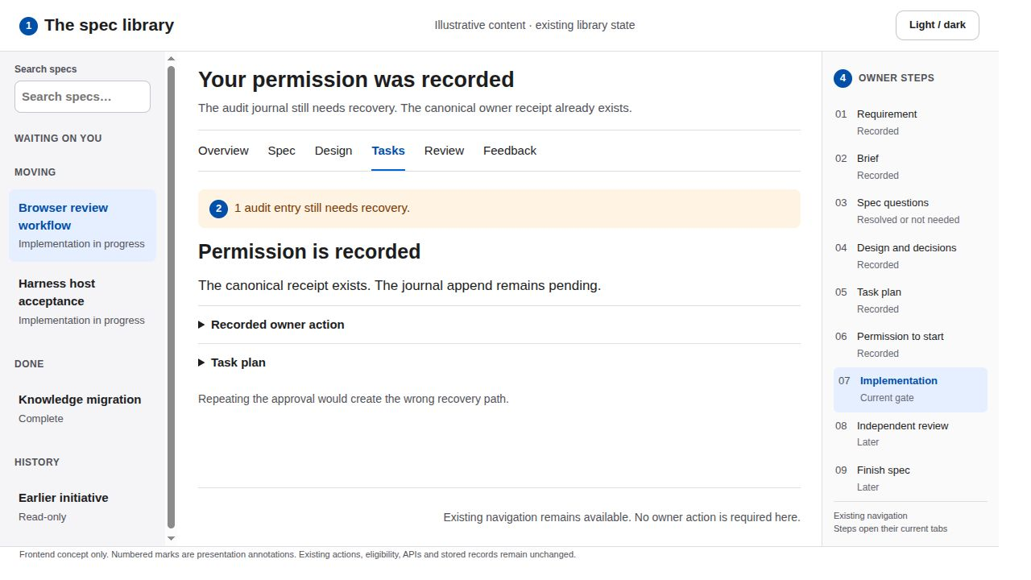
19 A recorded action with pending audit recovery
READ THE ANNOTATIONS FIRST
SCREEN CONCEPT 1 Context 2 Content 3 Action 4 Navigation
What the user sees
The existing audit_pending message appears beneath the recorded permission state. Task content remains available.
Primary action
Read the state and refresh after recovery. The owner does not repeat an action that already landed.
Why it reduces friction
The UI distinguishes a durable receipt from a journal problem. A quiet amber message prevents a second approval prompted by uncertainty.
Feedback and interaction
Present the actual pending-entry count only when returned. Announce the recorded action, then the outstanding recovery status.
No Recover audit button or backend repair. No invented journal completion. Avoid showing Start again because an append failed.
Quiet Workspace · frontend proposal · illustrative states
19 / 23
Notes:
A recorded action with pending audit recovery
Quiet Workspace: system sans serif, white content, soft gray navigation, near-black text, one blue primary action, 44 px controls, 8 px spacing rhythm and 10 px corners. Green and amber always accompany written status. Existing light/dark preference, routes and nine owner steps remain.
What the user sees: 1. The existing audit_pending message appears beneath the recorded permission state. Task content remains available.
Primary action: 2. Read the state and refresh after recovery. The owner does not repeat an action that already landed.
Why it reduces friction: 3. The UI distinguishes a durable receipt from a journal problem. A quiet amber message prevents a second approval prompted by uncertainty.
Feedback and interaction: 4. Present the actual pending-entry count only when returned. Announce the recorded action, then the outstanding recovery status.
Boundary: No Recover audit button or backend repair. No invented journal completion. Avoid showing Start again because an append failed.
Detailed behavior: Keep all existing eligibility and authority checks. Presentation is a frontend-only proposal, not shipped behavior. Do not create or mutate endpoints, fields, models, task records or owner receipts. Rearrangement, typography, status copy, native disclosures, focus and existing control placement are the only proposed changes. Existing action handlers keep their payloads and server checks. Resolve, Submit feedback, spec approval, decision acceptance, Start and Finish remain distinct acts. Preserve keyboard navigation and visible focus. Targets should remain at least 44 CSS pixels for primary actions. Use status words alongside color. Prefer short opacity changes of about 120 milliseconds, disable animation under reduced motion and restore focus on success or cancellation. Never silently submit on selection or optimistically advance an owner gate. The existing theme control keeps its preference. In dark appearance use dark neutral surfaces and readable light text, with the same hierarchy and contrast target. The deck renders the light appearance only. Any displayed counts and example wording are illustrative, not a report of the live completed pack.
Repository sources at revision 2d22941c84a1362f5572e461753e29813386aadd: treadle/packages/web/src/library.js:642, treadle/packages/web/src/library.js:697, wiki/systems/owner-workflow.md
Design references: https://developer.apple.com/design/human-interface-guidelines
https://developer.apple.com/design/human-interface-guidelines/buttons?changes=l_8
https://developer.apple.com/design/human-interface-guidelines/color?changes=_5_2
https://developer.apple.com/design/human-interface-guidelines/dark-mode
Apple HIG informs hierarchy, descriptive actions, action feedback and status color with written labels. The exact palette, spacing and presentation layout are this proposal's design choices, not an Apple specification.

Slide 20
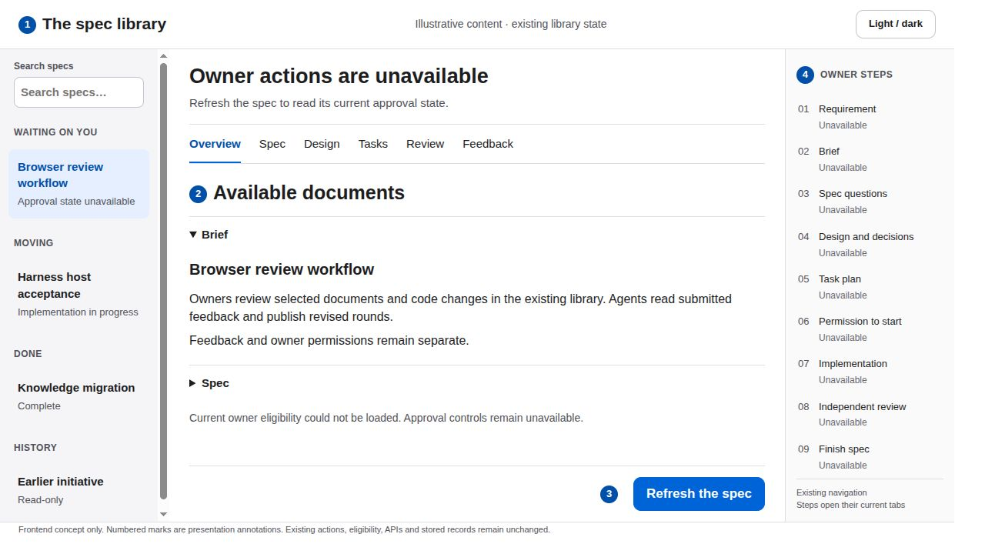
20 Approval state unavailable
READ THE ANNOTATIONS FIRST
SCREEN CONCEPT 1 Context 2 Content 3 Action 4 Navigation
What the user sees
The existing unavailable state occupies the owner panel. Already available document content stays readable.
Primary action
Use the existing Refresh control. Approval actions stay hidden until the workflow response has loaded consistently.
Why it reduces friction
The message explains the interruption and offers the supported recovery path. The screen does not collapse into an empty error page.
Feedback and interaction
Announce unavailable and refreshing states. Restore focus to the current-gate heading after a successful refresh.
Do not infer can_start or can_close from cached content, task counts or an old PASS. No new error screen or endpoint.
Quiet Workspace · frontend proposal · illustrative states
20 / 23
Notes:
Approval state unavailable
Quiet Workspace: system sans serif, white content, soft gray navigation, near-black text, one blue primary action, 44 px controls, 8 px spacing rhythm and 10 px corners. Green and amber always accompany written status. Existing light/dark preference, routes and nine owner steps remain.
What the user sees: 1. The existing unavailable state occupies the owner panel. Already available document content stays readable.
Primary action: 2. Use the existing Refresh control. Approval actions stay hidden until the workflow response has loaded consistently.
Why it reduces friction: 3. The message explains the interruption and offers the supported recovery path. The screen does not collapse into an empty error page.
Feedback and interaction: 4. Announce unavailable and refreshing states. Restore focus to the current-gate heading after a successful refresh.
Boundary: Do not infer can_start or can_close from cached content, task counts or an old PASS. No new error screen or endpoint.
Detailed behavior: Keep all existing eligibility and authority checks. Presentation is a frontend-only proposal, not shipped behavior. Do not create or mutate endpoints, fields, models, task records or owner receipts. Rearrangement, typography, status copy, native disclosures, focus and existing control placement are the only proposed changes. Existing action handlers keep their payloads and server checks. Resolve, Submit feedback, spec approval, decision acceptance, Start and Finish remain distinct acts. Preserve keyboard navigation and visible focus. Targets should remain at least 44 CSS pixels for primary actions. Use status words alongside color. Prefer short opacity changes of about 120 milliseconds, disable animation under reduced motion and restore focus on success or cancellation. Never silently submit on selection or optimistically advance an owner gate. The existing theme control keeps its preference. In dark appearance use dark neutral surfaces and readable light text, with the same hierarchy and contrast target. The deck renders the light appearance only. Any displayed counts and example wording are illustrative, not a report of the live completed pack.
Repository sources at revision 2d22941c84a1362f5572e461753e29813386aadd: treadle/packages/web/src/library.js:631, treadle/packages/web/src/library.js:916, treadle/packages/web/src/library.js:986
Design references: https://developer.apple.com/design/human-interface-guidelines
https://developer.apple.com/design/human-interface-guidelines/buttons?changes=l_8
https://developer.apple.com/design/human-interface-guidelines/color?changes=_5_2
https://developer.apple.com/design/human-interface-guidelines/dark-mode
Apple HIG informs hierarchy, descriptive actions, action feedback and status color with written labels. The exact palette, spacing and presentation layout are this proposal's design choices, not an Apple specification.

Slide 21
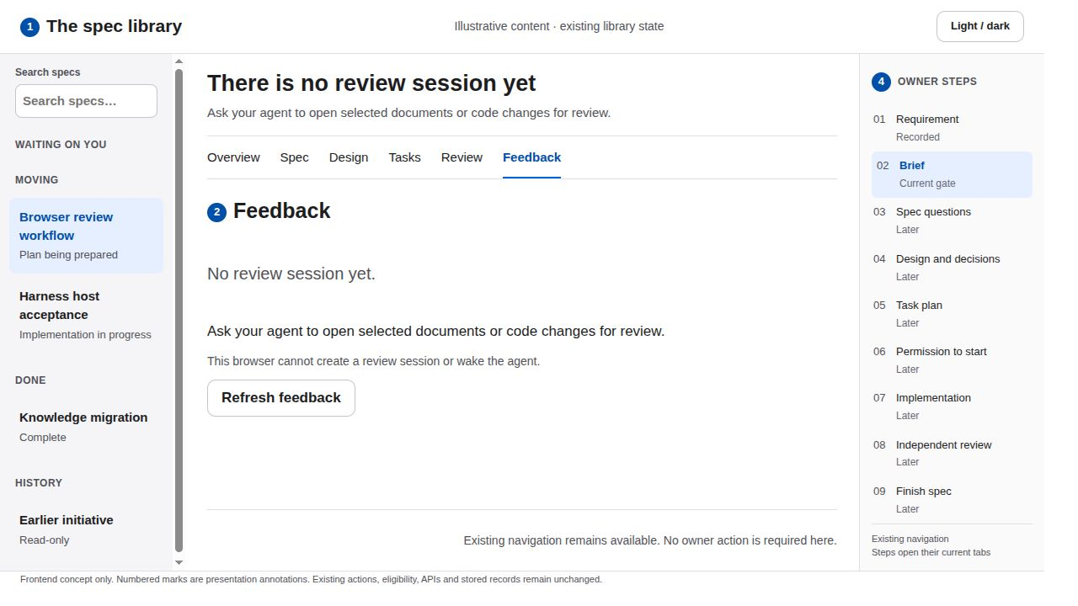
21 Feedback before a session exists
READ THE ANNOTATIONS FIRST
SCREEN CONCEPT 1 Context 2 Content 3 Action 4 Navigation
What the user sees
The existing feedback empty state explains why no source or thread is available. Spec navigation remains visible.
Primary action
The next step is the existing agent workflow outside this browser. Refresh feedback after the agent opens the session.
Why it reduces friction
Clear scope avoids offering a dead comment box. The user knows that a review session must exist before leaving feedback.
Feedback and interaction
Keep the empty message stable while a refresh is pending. Show a session only when the existing state response supplies one.
No Create session, agent chat composer or wake-agent action. The browser’s current feedback endpoints retain their existing scope.
Quiet Workspace · frontend proposal · illustrative states
21 / 23
Notes:
Feedback before a session exists
Quiet Workspace: system sans serif, white content, soft gray navigation, near-black text, one blue primary action, 44 px controls, 8 px spacing rhythm and 10 px corners. Green and amber always accompany written status. Existing light/dark preference, routes and nine owner steps remain.
What the user sees: 1. The existing feedback empty state explains why no source or thread is available. Spec navigation remains visible.
Primary action: 2. The next step is the existing agent workflow outside this browser. Refresh feedback after the agent opens the session.
Why it reduces friction: 3. Clear scope avoids offering a dead comment box. The user knows that a review session must exist before leaving feedback.
Feedback and interaction: 4. Keep the empty message stable while a refresh is pending. Show a session only when the existing state response supplies one.
Boundary: No Create session, agent chat composer or wake-agent action. The browser’s current feedback endpoints retain their existing scope.
Detailed behavior: Keep all existing eligibility and authority checks. Presentation is a frontend-only proposal, not shipped behavior. Do not create or mutate endpoints, fields, models, task records or owner receipts. Rearrangement, typography, status copy, native disclosures, focus and existing control placement are the only proposed changes. Existing action handlers keep their payloads and server checks. Resolve, Submit feedback, spec approval, decision acceptance, Start and Finish remain distinct acts. Preserve keyboard navigation and visible focus. Targets should remain at least 44 CSS pixels for primary actions. Use status words alongside color. Prefer short opacity changes of about 120 milliseconds, disable animation under reduced motion and restore focus on success or cancellation. Never silently submit on selection or optimistically advance an owner gate. The existing theme control keeps its preference. In dark appearance use dark neutral surfaces and readable light text, with the same hierarchy and contrast target. The deck renders the light appearance only. Any displayed counts and example wording are illustrative, not a report of the live completed pack.
Repository sources at revision 2d22941c84a1362f5572e461753e29813386aadd: treadle/packages/web/src/feedback.js:51, treadle/packages/web/src/feedback.js:218
Design references: https://developer.apple.com/design/human-interface-guidelines
https://developer.apple.com/design/human-interface-guidelines/buttons?changes=l_8
https://developer.apple.com/design/human-interface-guidelines/color?changes=_5_2
https://developer.apple.com/design/human-interface-guidelines/dark-mode
Apple HIG informs hierarchy, descriptive actions, action feedback and status color with written labels. The exact palette, spacing and presentation layout are this proposal's design choices, not an Apple specification.

Slide 22
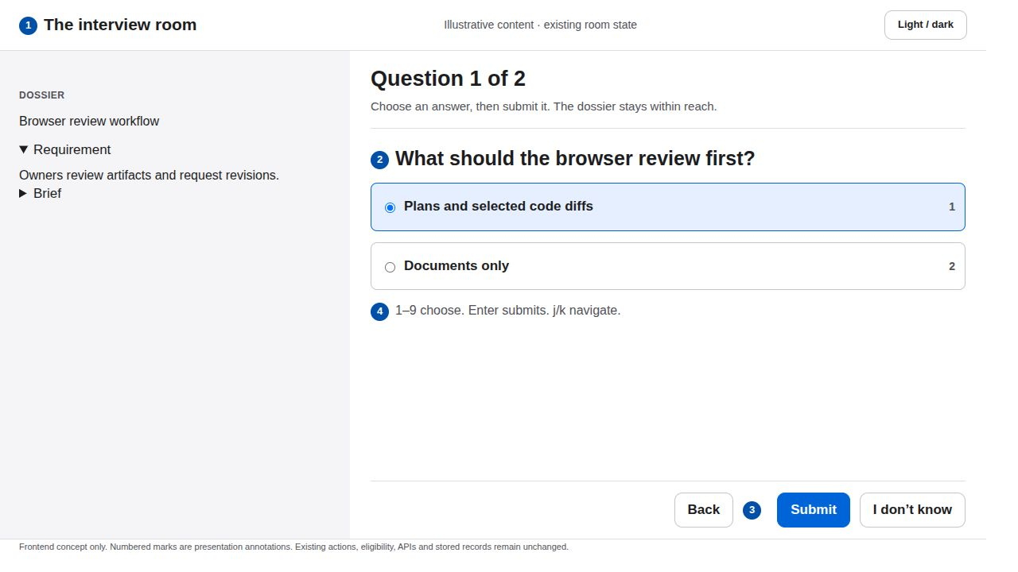
22 The existing interview room
READ THE ANNOTATIONS FIRST
SCREEN CONCEPT 1 Context 2 Content 3 Action 4 Navigation
What the user sees
The existing dossier, focused interview and question count retain their layout roles. Choice labels use full rows with visible selection.
Primary action
Choose an existing option and Submit. Back and I don’t know remain secondary. Preserve the current keyboard behavior.
Why it reduces friction
One question fills the center rather than competing with the entire spec. The selected option and submit action form one clear reading path.
Feedback and interaction
Keep 1–9 choice hints and j/k navigation. Enter submits, Shift+Enter adds a line in free text. Successful answers advance through the existing room.
This is the existing page.html room, not a new wizard. Room approval remains separate from library Start and Finish actions.
Quiet Workspace · frontend proposal · illustrative states
22 / 23
Notes:
The existing interview room
Quiet Workspace: system sans serif, white content, soft gray navigation, near-black text, one blue primary action, 44 px controls, 8 px spacing rhythm and 10 px corners. Green and amber always accompany written status. Existing light/dark preference, routes and nine owner steps remain.
What the user sees: 1. The existing dossier, focused interview and question count retain their layout roles. Choice labels use full rows with visible selection.
Primary action: 2. Choose an existing option and Submit. Back and I don’t know remain secondary. Preserve the current keyboard behavior.
Why it reduces friction: 3. One question fills the center rather than competing with the entire spec. The selected option and submit action form one clear reading path.
Feedback and interaction: 4. Keep 1–9 choice hints and j/k navigation. Enter submits, Shift+Enter adds a line in free text. Successful answers advance through the existing room.
Boundary: This is the existing page.html room, not a new wizard. Room approval remains separate from library Start and Finish actions.
Detailed behavior: Keep all existing eligibility and authority checks. Presentation is a frontend-only proposal, not shipped behavior. Do not create or mutate endpoints, fields, models, task records or owner receipts. Rearrangement, typography, status copy, native disclosures, focus and existing control placement are the only proposed changes. Existing action handlers keep their payloads and server checks. Resolve, Submit feedback, spec approval, decision acceptance, Start and Finish remain distinct acts. Preserve keyboard navigation and visible focus. Targets should remain at least 44 CSS pixels for primary actions. Use status words alongside color. Prefer short opacity changes of about 120 milliseconds, disable animation under reduced motion and restore focus on success or cancellation. Never silently submit on selection or optimistically advance an owner gate. The existing theme control keeps its preference. In dark appearance use dark neutral surfaces and readable light text, with the same hierarchy and contrast target. The deck renders the light appearance only. Any displayed counts and example wording are illustrative, not a report of the live completed pack.
Repository sources at revision 2d22941c84a1362f5572e461753e29813386aadd: treadle/packages/web/src/page.js:268, treadle/packages/web/src/page.js:294, treadle/packages/web/src/page.js:321, treadle/packages/web/src/page.js:379
Design references: https://developer.apple.com/design/human-interface-guidelines
https://developer.apple.com/design/human-interface-guidelines/buttons?changes=l_8
https://developer.apple.com/design/human-interface-guidelines/color?changes=_5_2
https://developer.apple.com/design/human-interface-guidelines/dark-mode
Apple HIG informs hierarchy, descriptive actions, action feedback and status color with written labels. The exact palette, spacing and presentation layout are this proposal's design choices, not an Apple specification.

Slide 23
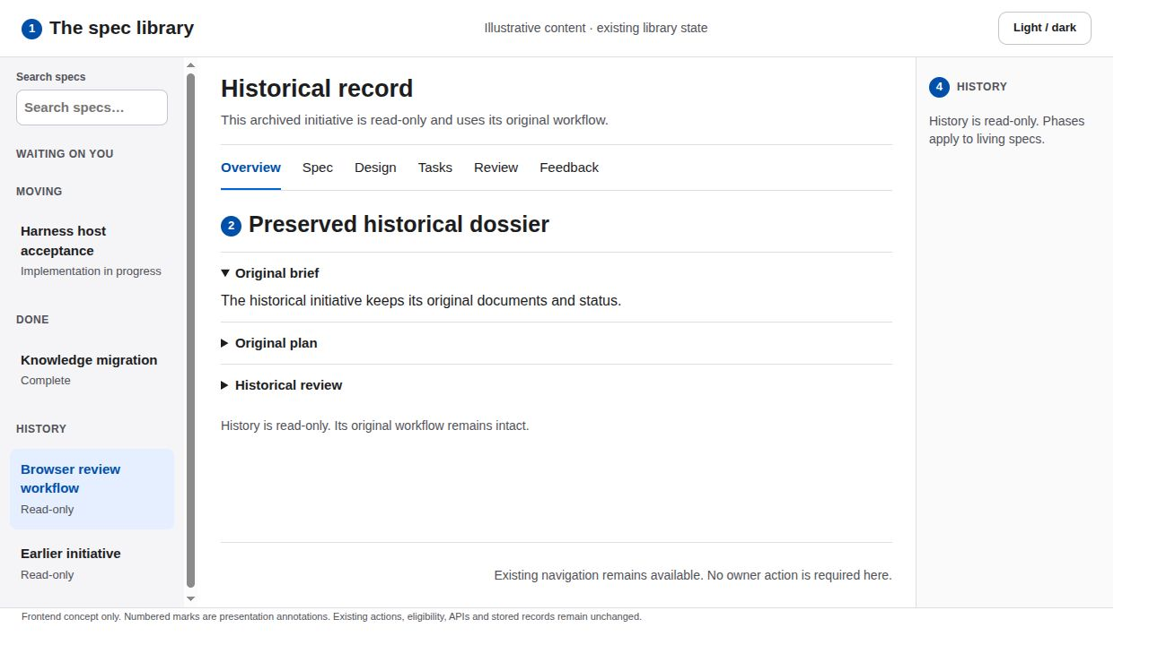
23 Legacy history remains read-only
READ THE ANNOTATIONS FIRST
SCREEN CONCEPT 1 Context 2 Content 3 Action 4 Navigation
What the user sees
The existing History group opens the preserved dossier. Historical labels and documents remain available without owner controls.
Primary action
Inspect the record or choose another existing item in the library. Do not show gated actions for a historical entry.
Why it reduces friction
A persistent read-only heading avoids disabled-button clutter and separates current workflow readiness from historical evidence.
Feedback and interaction
Preserve search, focus and disclosure behavior. Show the source’s actual historic state without converting it into a current gate.
No browser migration, adoption, editing or reopen action. Legacy active records retain their own rules and are distinct from archived history.
Quiet Workspace · frontend proposal · illustrative states
23 / 23
Notes:
Legacy history remains read-only
Quiet Workspace: system sans serif, white content, soft gray navigation, near-black text, one blue primary action, 44 px controls, 8 px spacing rhythm and 10 px corners. Green and amber always accompany written status. Existing light/dark preference, routes and nine owner steps remain.
What the user sees: 1. The existing History group opens the preserved dossier. Historical labels and documents remain available without owner controls.
Primary action: 2. Inspect the record or choose another existing item in the library. Do not show gated actions for a historical entry.
Why it reduces friction: 3. A persistent read-only heading avoids disabled-button clutter and separates current workflow readiness from historical evidence.
Feedback and interaction: 4. Preserve search, focus and disclosure behavior. Show the source’s actual historic state without converting it into a current gate.
Boundary: No browser migration, adoption, editing or reopen action. Legacy active records retain their own rules and are distinct from archived history.
Detailed behavior: Keep all existing eligibility and authority checks. Presentation is a frontend-only proposal, not shipped behavior. Do not create or mutate endpoints, fields, models, task records or owner receipts. Rearrangement, typography, status copy, native disclosures, focus and existing control placement are the only proposed changes. Existing action handlers keep their payloads and server checks. Resolve, Submit feedback, spec approval, decision acceptance, Start and Finish remain distinct acts. Preserve keyboard navigation and visible focus. Targets should remain at least 44 CSS pixels for primary actions. Use status words alongside color. Prefer short opacity changes of about 120 milliseconds, disable animation under reduced motion and restore focus on success or cancellation. Never silently submit on selection or optimistically advance an owner gate. The existing theme control keeps its preference. In dark appearance use dark neutral surfaces and readable light text, with the same hierarchy and contrast target. The deck renders the light appearance only. Any displayed counts and example wording are illustrative, not a report of the live completed pack.
Repository sources at revision 2d22941c84a1362f5572e461753e29813386aadd: treadle/packages/web/src/library.js:98, treadle/packages/web/src/library.js:239, treadle/packages/web/src/library.js:779
Design references: https://developer.apple.com/design/human-interface-guidelines
https://developer.apple.com/design/human-interface-guidelines/buttons?changes=l_8
https://developer.apple.com/design/human-interface-guidelines/color?changes=_5_2
https://developer.apple.com/design/human-interface-guidelines/dark-mode
Apple HIG informs hierarchy, descriptive actions, action feedback and status color with written labels. The exact palette, spacing and presentation layout are this proposal's design choices, not an Apple specification.

