Slide 1



Space
Accelerate your journey
Space
Feb 2022

Slide 2





OVERVIEW
Space Overview
Space is low-code framework enabled for scaling, standardizing and driving efficiency in AI/ML engagements for our clients. The framework brings together the “leading practices” and “human experience” in all aspects of implementation and management.
KEY CAPABILITIES
KEY VALUE PROPOSITIONS
r
Self Service User Experience with an intuitive UI enabling non-experts to train and build them in few clicks
Improved cost effectiveness by leveraging open-source tool kits and libraries and pre-built ELT constructs
Reduction in effort by automating repeatable tasks with built in libraries to perform your tasks.
Accelerate “Go to Production” for AI/ML implementations at scale
Significant reduction in time to ingest, curate and process data. 30+ Prebuilt configurable components for data and ML model build
Simplified DevOps with model as service for real Time Predictions, batch predictions , One-Click Statistics.
Automated MLOps with Model Control Tower for comprehensive monitoring & management of data & machine learning pipelines enabling governance, quality and reproducibility of your data and management.
Configurable Orientation for any of the hyper scalers - AWS, AZURE, GCP and other platforms
Notes:
Adam

Slide 3

SCOPE
Space – Overall Scope
Corporate Login
Team Management
Individual Login
Statistics
Robust Security
Monitoring
Common Data Services
MVP Scope
To be covered in future releases

Slide 4



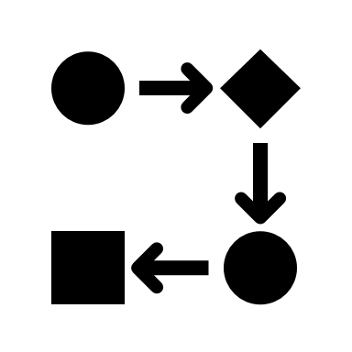








Space User Journey
User journey
1
2
3
4
5
6
Portal Login
Data Set Import
Exploratory Data Analysis
Data Preparation
Model Design
Model Registry & deploy
vv
v
v
v
v
v
Select or bid the required set from the content library and import it to workspace.
User can perform EDA by choosing the required set.
Visualization of Data Distribution , Outliers etc.
User creates a model workflow and chooses the Bid or Buy.
Save & Buy or sell the model in the workflow
Select Model to do the future analysis
Evaluate the Test & Train Summary to identify the best model
Package the best performing Model
Model Registry holds the list of models
User can enter the model benchmark definition and buy or the model.
Model is Ready for Execution in the hosted end point.
Launch the Space portal and create a project and enter the project workspace.
User can see the default presentation Tab .
Retraining
7
Monitoring Dashboard
Model Drift
(Response Time)
Technical KPI’s
Model Deployed to Production
Model Decay/Performance Alert
Data Drift

Slide 5




ARCHITECTURE
ModelX Solution Architecture
Data Sources
Space platform
Consumption
1
2
4
Users
ML Ops
Structured Data
Files
Data Preparation
Model cart or Bid
Model Predictions
Administrator
Preprocessing
Train
Deploy
Scoring
Hyper tune
Real Time
Inferences
RDBMS
Feature Engineering
Evaluate
Batch
Data Drifts
Model Repository
Data Drift Monitoring
Teams
Model Buy or Sell
Reports/Dashboards
3
Workflow and Orchestration
Audit, Balance and Control Framework. Logging, Error/Exception Handling
CI/CD Pipeline (Code Management and Deployment)
1. Data SOURCES
2. Space Lifecycle
3. Core Services & Orchestration
4. Touch points & Delivery
Authoritative source of data in the form of Tables, Flat Files, APIs with structured and unstructured format
ML Ops models built on machine learning platform can be deployed, tested, and seamlessly updated in production without interrupting service to downstream applications and retrain based on the data drift
Dashboards and Reporting solution for end users. Delivery of information to downstream apps and portal.
ABC framework, orchestration framework and ci/cd are the list of core services used.

Slide 6








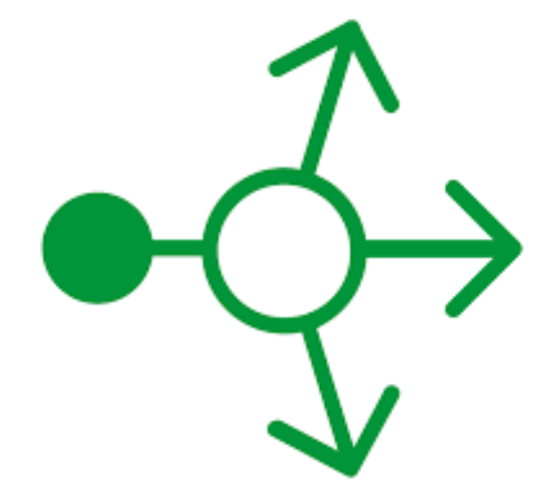




Space Application Architecture
SPACE APPLICATION ARCHITECTURE
Front end
Backend services
Backend services
Load Balancing
Nginx
RESTful Service/API
Web Application
ML API
Kubernetes Monitoring Services
ABC services
Grafana Visualization
RESTful Service/API
Metrics

Slide 7















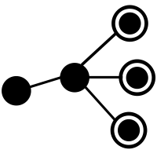

Integration of ABC Services with Space
Audit BALANCE & CONTROL FRAMEWORK
Space
Governance
Operational Statistics
Model Monitoring & Drift
Organization
Groups
User
Project
Data Source
ETL Pipelines
Run Time Statistics & Log Collection
Data Storage
Model Prediction
Actual Vs Predicted Data
KPI Monitor
Drift Detection
Audit ,Balance & Control Framework
v
Features
Governance
Audit Logging
Notification/Alerts
Dashboard
Run Time Statistics– Start End time, Job Status
Model Metrics –Stability & performance metrics
Data Drift & Performance Threshold Validation
Trigger events/emails on threshold breach of Data Drift /Performance Drift benchmarks
Model Monitoring Dashboard
- Performance Metrics& Stability Metrics
-Prediction Service Health Summary
Operational Dashboard
- ETL & ML Pipeline execution summary
- ETL & ML pipeline run time statistics
-Computational Summary
Project Management
User Management
Access Policies
User compliance standards

Slide 8







Automated CI/CD Pipeline for Space Deployment
Ci/CD PIPELINE
SpaceX UI
Model Library
Model Registry
Monitoring Dashboard
Finalize Model
Select the Model to Cart or Bid
Enter Benchmarks
Buy or Sell Model
Select the Model to view the Model Inferencing Charts
Data Scientists
Pickle File is generated and stored on s3
Jenkins Pipeline is Triggered on Publish & model deployed to production.
Automated CI/CD Pipeline
Stage 1
Stage 2
Stage 3
Build Docker Images
Push Docker Images to ECR Repo
Kubernetes Pod Deployment
Space Artifactory
Use a docker file template with the requirements for Space service.
Copy Space Pickle File to Jenkins Server
Embed Space Pickle File to Docker and build docker image.
Use a Helm Chart Templates for dynamic Kubernetes deployment for Models with Ingress routing
Install/Upgrade new Helm charts with Space name and end points are generated.
Create ECR Repository to store the Docker Image
Push Docker Image to ECR Repository
Use a Helm Chart Templates for dynamic Kubernetes deployment for Models
Space Pickle File
POD
Space Service
Prediction Service is accessible at endpoint:
<Ingress Static IP: Port 80/Model Name>

Slide 9
TECHNOLOGY
Technology Stack
Software/Tool | Version | License
Deployment pre-requisites
Python | 3.9
Nginx | 1.20.0 | Free Commercial License
Java | 8 | Free Commercial License
MySQL | 8.0 | Free Commercial GPL License
Docker | 19.03.8 | Free Commercial License
Kubernetes Cluster
For development, testing & building:
NPM | 6.14.8 | Artistic License 2.0
Angular CLI or React JS | 9.1.0 | MIT License
Maven | 3.6.3 | Apache 2.0
Spring Tool Suite (IDE) or Eclipse | 4.5.1 | EPL
Visual Studio Code (IDE) | 1.54.3 | MIT
Postman | 8.3.0 | Free Commercial License

Slide 10

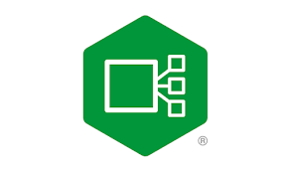

SPACE –Kubernetes Deployment Architecture
Application PACKAGING
Draft
Space follows the docker container approach to leverage distributed microservice architecture . Docker Images will be built for all the services and will be deployed to Kubernetes Cluster using Helm Charts.
Layer 4 load Balancer-This load balancer will route traffic to Ingress Service in Kubernetes cluster that will perform service-specific routing
Kubernetes Cluster to orchestrate the containerized Space application components.
The Ingress Controller that routes HTTP/HTTPS traffic to endpoints within the Kubernetes cluster as per routing rules defined
ModelX namespace that contains the application components for the front end , middleware api, ml api ,database and ABC services.
Code Deployment Pipeline to build and deploy the code to Kubernetes using Docker & Helm Client.
2
4
http traffic from internet
Client UI
Back End API
Public IP
Load balancer
3
Database
ML Service
ABC Service
1
Code Deployment
Deploy
5
Docker Registry
Docker Image
Code Build
Space Source Code
Helm Charts(Package manager)

Slide 11

SPACE Application Packaging
Application PACKAGING
Draft
Space follows the docker container approach to leverage distributed microservice architecture . Docker Images will be built for all the services and will be deployed to Kubernetes Cluster using Helm Charts.
1
Front End
4
Source Code
Docker File
3
Back End
Build Docker Images
Push Docker Images to Docker Repository
Kubernetes Pod Deployment
Source Code
Docker File
Client UI
Back End API
Build Docker Images for Front End, Back End , Database ,Python ML & ABC Services
Push Docker Images to Container Repository
Install Helm Chart to deploy all the services and pods to Kubernetes
Database
Source Code
Docker File
Database
ML Service
ABC Service
Python ML
Source Code
Docker File
2
Application File Resides in Artifact Repository along with Docker Files for each component
Create Chart to package all the Kubernetes deployment packages.
All the manifest files –deployment, service ,ingress ,secrets and config map Build Docker Images ,Push the image to Docker Repository and Use helm charts to deploy the services to Kubernetes .Build step can be automated using a shell/python script
All components of Space application are deployed to Kubernetes.
ABC
Charts
Source Code
Docker File
Chart.yaml
templates
deployment.yaml
service.yaml
ingress.yaml
Chart.yaml

Slide 12
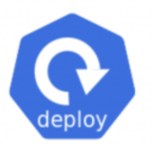

Space – Interaction between Services
Application PACKAGING
Draft
Space follows the docker container approach to leverage distributed microservice architecture . Docker Images will be built for all the services and will be deployed to Kubernetes Cluster using Helm Charts.
AWS EKS
4
Kubernetes Cluster
modelX-ns
mySql DB
ML API(Python)
ABC Service
Type:ClusterIP
api traffic
Type:ClusterIP
Type:ClusterIP
Space-db.modelx-ns
ml-api.modelx-ns
abc-api.modelx-ns
api traffic
3
http traffic from internet
ingress-ns
Front End
Type:ClusterIP
Back-end API(Springboot)
api traffic
backend-api.modelx-ns
Public IP
Load balancer
Nginx –ingress controller
Type:ClusterIP
client-ui.modelx-ns
Configurations to enable communication between pods
Create the pods using deployment object and assign a label in its yaml file. app:api
Create a service and associate it with pod to match the label by specifying a selector in the Service definition . Service name :backend-api .It selects pod with label app=api
Other services communicates with the backend pod using the service name using CoreDNS set up for Kubernetes
http://backend-api.space-ns:8080

