Slide 1
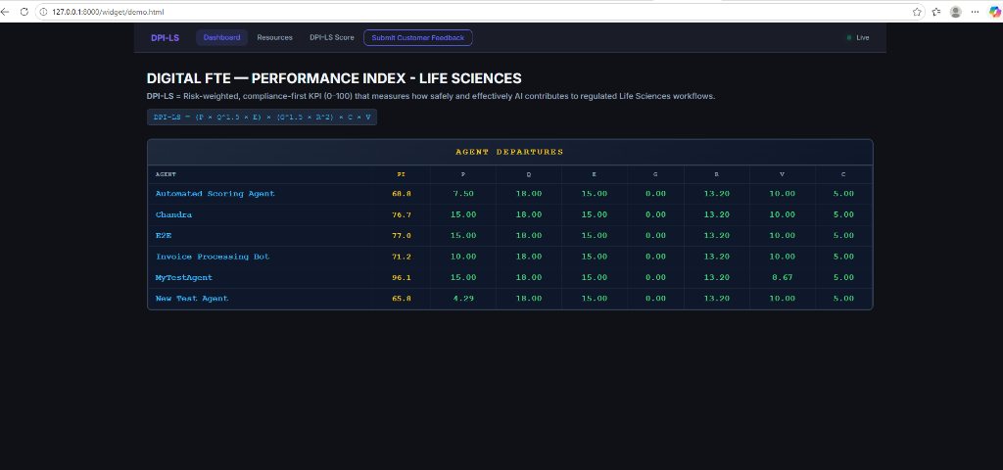
01
What is DPI-LS?
Digital Performance Index for Life Sciences
Workflow: The system measures your AI's health — just like an airport departure board, you can instantly see if your digital workers are delayed, failing, or operating smoothly.
When companies deploy AI to do important work, they need to know if the AI is doing a good job, working safely, and saving money.
DPI-LS automatically measures 7 critical areas — Productivity, Quality, Execution, Governance, Risk, Validation, and Cost — and gives you a single, easy-to-understand score out of 100.

Slide 2
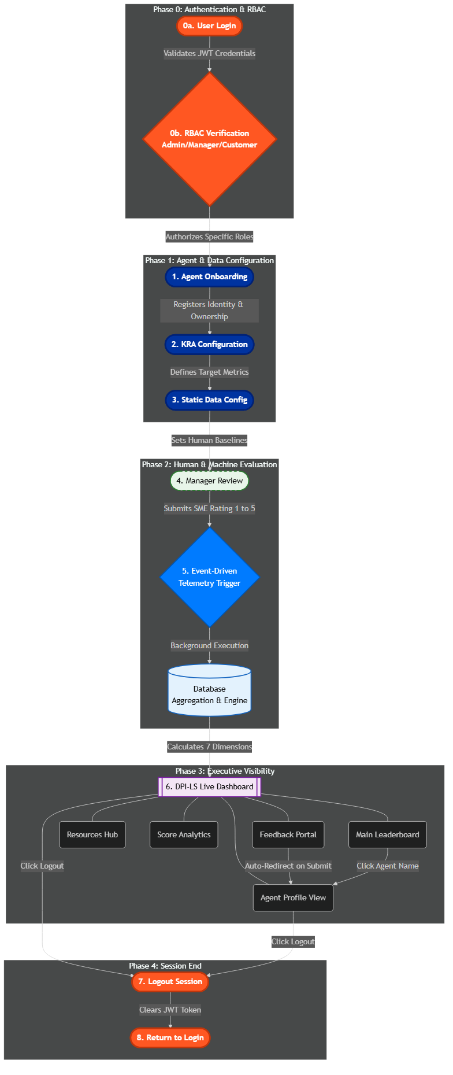
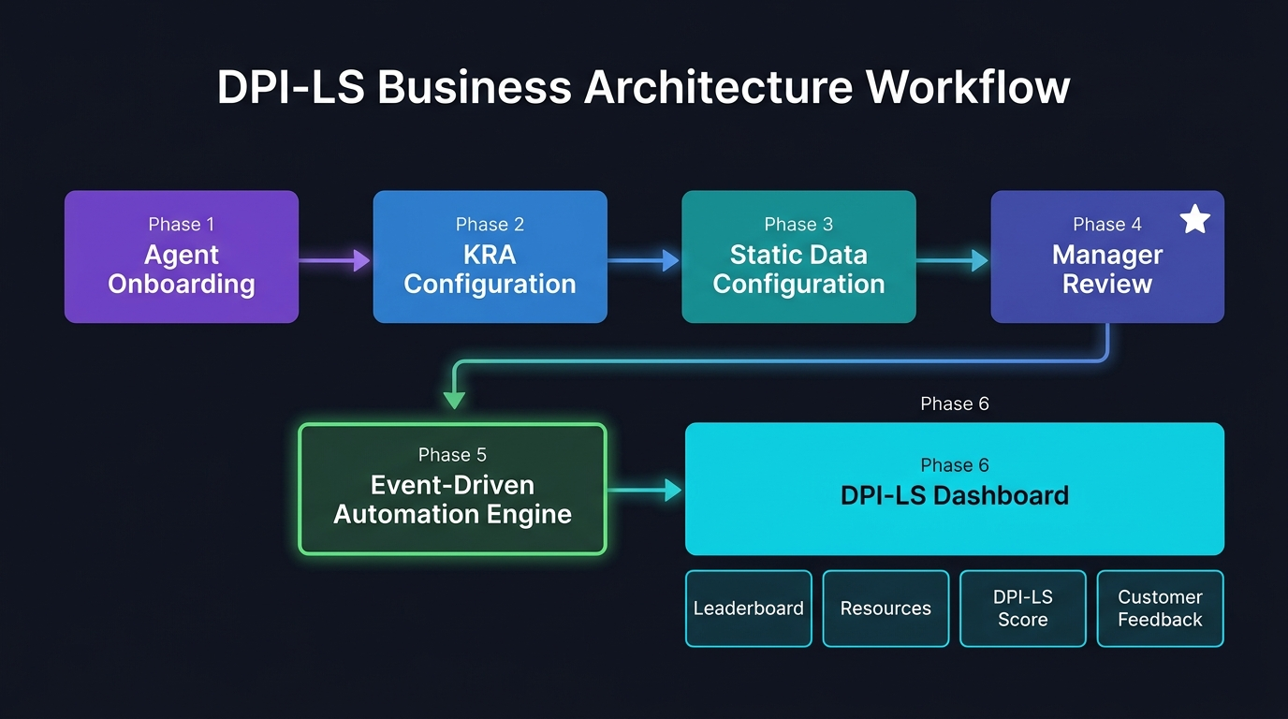
02
DPI-LS Business Architecture Workflow
End-to-End Event-Driven Automation — From Onboarding to Live Dashboard

Slide 3
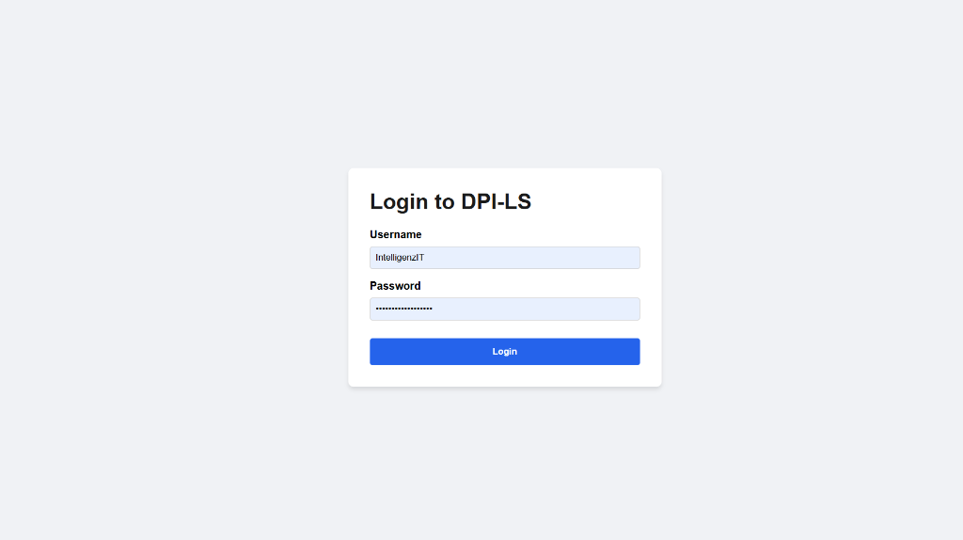
03
First, users log into the system securely. The platform checks their role to see if they are an Admin, Manager, or Customer. This ensures that only authorized people can add new agents, rate their own agents, or submit feedback, keeping the entire system safe and accountable.

Slide 4
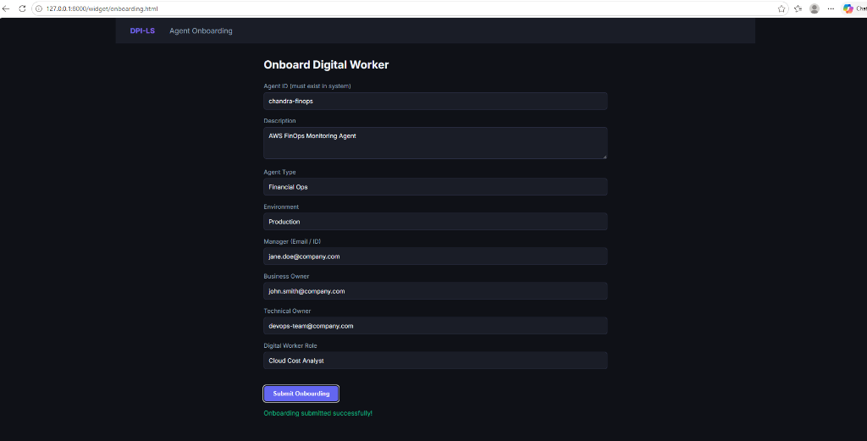
04
Agent Onboarding
Registering Your AI Worker in the System
Workflow: First, you register the AI in the system by giving it an identity and assigning human managers so it is never running without supervision.
Before we can track an AI's performance, we introduce it to the system.
• Give the AI a unique ID and description
• Define its business role (e.g. Finance, Accounts Payable)
• Assign a Manager, Business Owner, and Technical Owner
This ensures clear human accountability for the AI's actions.

Slide 5
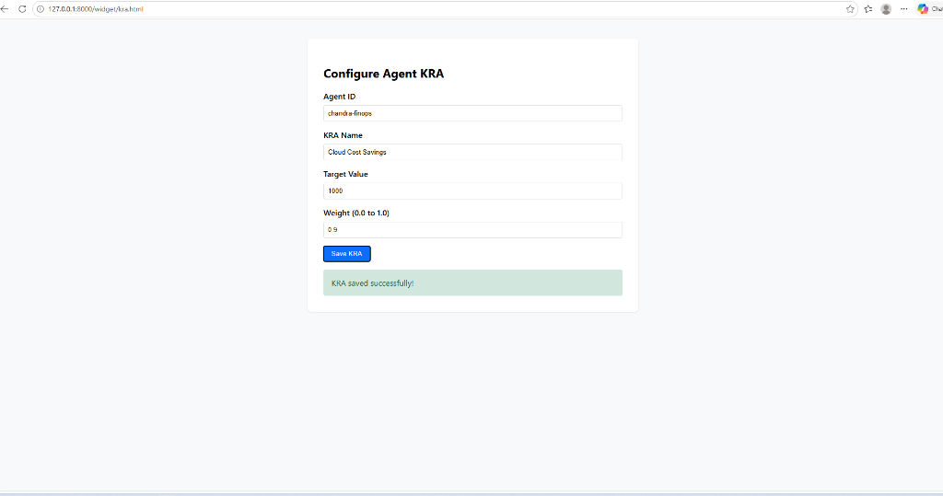
05
KRA Configuration
Defining What Success Looks Like
Workflow: Next, you tell the system exactly what goals this AI needs to achieve and how important those goals are to your business.
KRA stands for Key Result Area. Not all AI agents have the same goals.
• Set a Target Value (e.g. 99.5% accuracy)
• Set a Weight (e.g. 85%)
This tells the scoring engine that accuracy is critical for this agent. If the AI makes a mistake, its overall score will be heavily penalized.

Slide 6
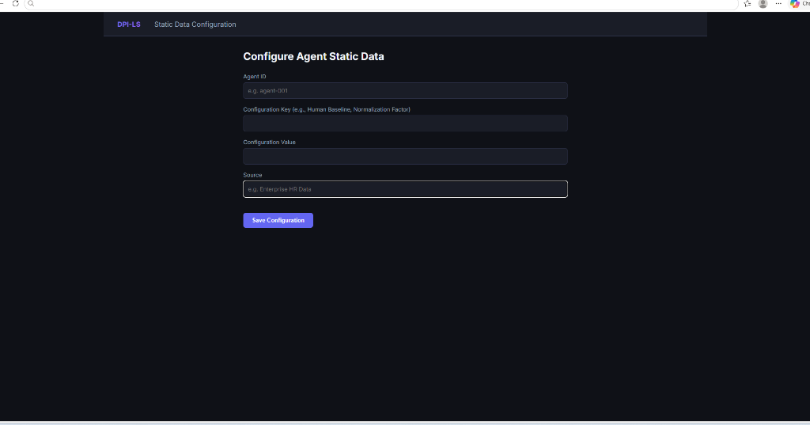
06
Static Data Configuration
Setting the Human Baseline
Workflow: Then, you input the Human Baseline — how fast or cheap a human would do the job — so the system can prove if the AI is actually saving you time and money.
To know if an AI is truly efficient, we compare it against how a human would do the same job.
• If a human processes 10 invoices per hour, set baseline to 10
• If the AI processes 20 invoices, the system calculates it is 2x more productive
This directly feeds into the Productivity and Cost dimensions.

Slide 7
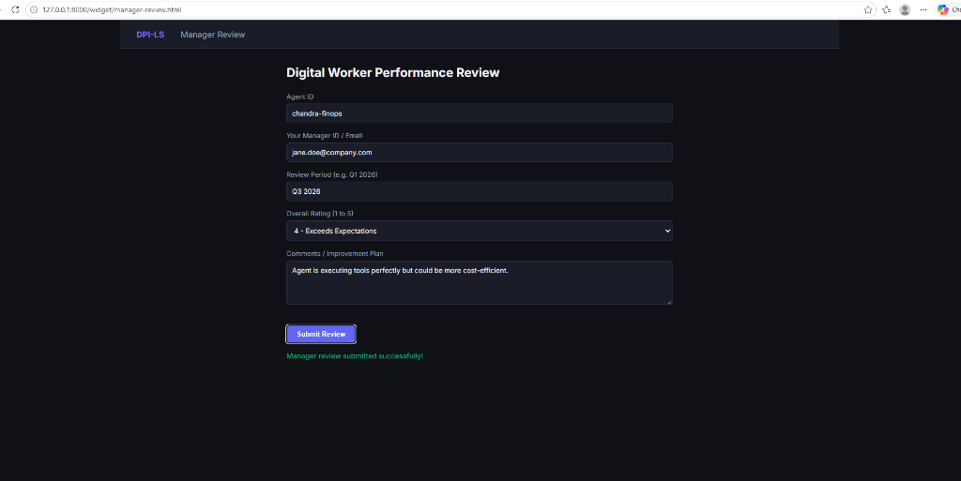
07
Manager Review
Human Feedback Meets AI Automation
Workflow: A human supervisor leaves a 1 to 5 star rating. Clicking Submit automatically triggers the backend to calculate the AI's final score.
Numbers don't tell the whole story. The Manager Review blends subjective human feedback with objective data.
• The manager selects a rating from 1 to 5
• Leaves written comments or improvement plans
• Clicking Submit triggers the automated evaluation
The system gathers the baseline, KRA weights, and feedback, then runs a full telemetry evaluation in the background.

Slide 8
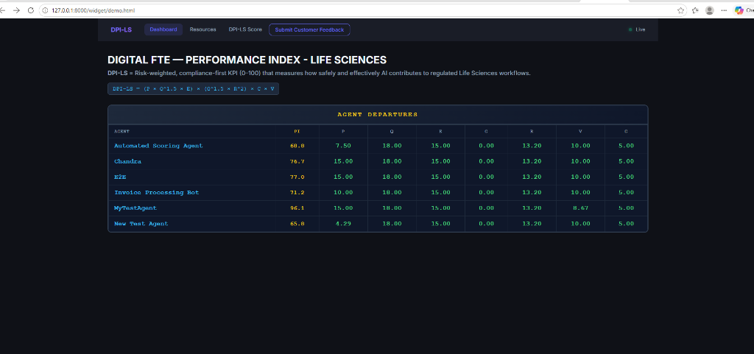
08
The DPI-LS Dashboard
Your Central Command Center
Workflow: All the automation finishes and the results flow into this live command center, where executives can monitor all agents at a glance.
The Dashboard has four main sections:
• Dashboard — The main leaderboard with scores across 7 dimensions
• Resources — Documentation and AI operations manuals
• DPI-LS Score — Detailed scoring methodology breakdown
• Submit Customer Feedback — End-user portal that feeds into Quality scores

Slide 9
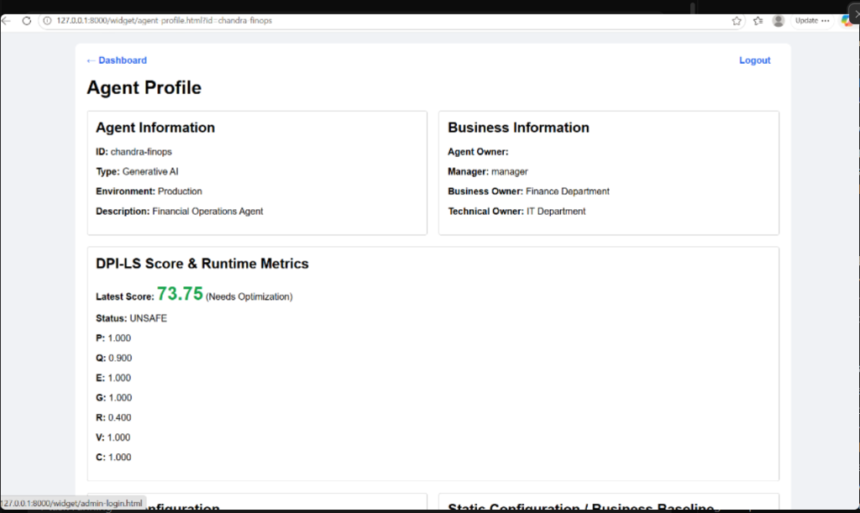
09
Agent Profile View
Deep Dive into Digital Worker Configurations
Workflow: After an end-user submits Customer Feedback, the system automatically redirects them here to the Agent Profile page.
What is the Agent Profile?
Provides complete transparency into a specific AI worker.
Displays the assigned Business, Technical, and Manager owners.
Shows the exact KRA weights and static human baselines used for scoring.
Can be accessed instantly by clicking an agents name on the Dashboard.

